Slide 1


Cerner LIS Training
Requisition Order Entry (ROE)

Slide 2

ROE – Registration Order Entry
ROE is a portion of the Cerner PathNet Outreach Services Management (OSM) application. It is used to place laboratory orders on Pathology clients.
ROE is most often used in Microbiology to place orders for surveillance cultures requested by the Infection Prevention Department (IP), a Pathology client.
All test requests will arrive with a manual requisition. There is no electronic ordering. Orders placed in ROE do not post the Epic electronic medical record (EMR).

Slide 3

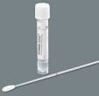
ROE – Registration Order Entry
There are 2 screens for this application:
  Registration Screen - to register the patient
  Order Screen – to place orders

Slide 4
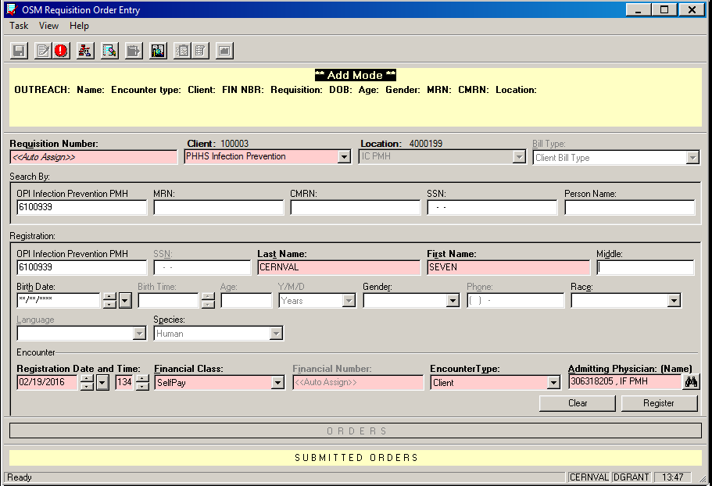
ROE – Registration
Registration screen

Slide 5
ROE - Registration
To register a patient:
1. Enter the Requisition Number.
a. Scan or hand key the barcoded requisition number into the
Requisition Number field.
b. The client number is embedded in the requisition number, so the
remaining fields in this section will automatically populate with the
correct information.

Slide 6
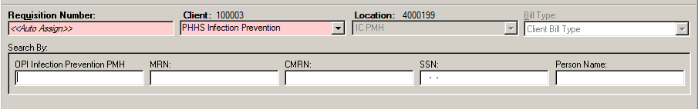
ROE - Registration
2. Search for the Patient
A. Query for prior registrations in the Search by section.
Enter the Out Patient Identifier (OPI). The OPI is the client’s medical record number for their patient. If the patient is a Parkland patient, then enter the Parkland MRN in the OPI field. Likewise for CMC, CUH, etc.
Do Not use MRN, CMRN, SSN or Person Name fields as a search criteria.
If the OPI is recognized, Cerner will retrieve and display the patient demographics in the Registration section of the ROE screen.
Ensure that the displayed patient demographics match those on the client requisition.
If a match, click Add Encounter. A new encounter will be created for the requisition.

Slide 7
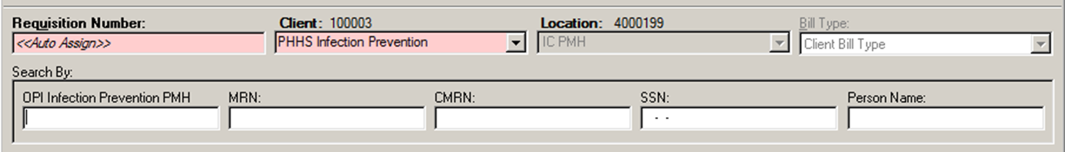
ROE - Registration
B. WARNING
If a Parkland MRN is entered here, then Cerner will connect the ROE registration to the hospital registration system (Epic) by linking the medical record numbers:
Linked MRN
2061624, 10286
Epic ROE
The linked MRN will display in ORV, transmit to MediCopia, and print on IP reports, resulting in IT system and reporting errors.
Do Not use MRN, CMRN, SSN or Person Name fields as a search criteria.

Slide 8
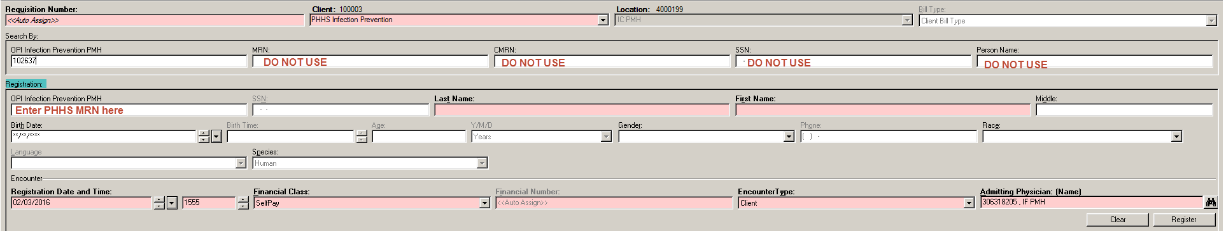
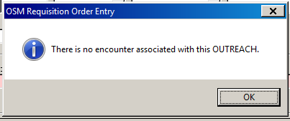
ROE - Registration
3. If the patient has no prior registration, a pop up
message will display.
Click OK

Slide 9
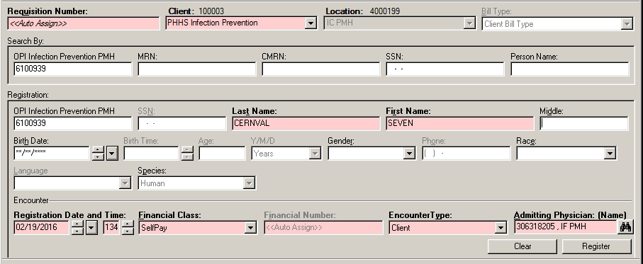
ROE - Registration
  4. Enter patient demographic data in the Registration section of the ROE screen.
  a. Re-enter OPI. The OPI must be re-keyed in the Registration section in order to be stored with
  the new patient registration.
  b. The required fields for data entry are highlighted (pink). DOB, age, gender, etc. are optional
  but useful information.
  c. The Encounter fields auto-populate; DO NOT change any information in this section.
  d. Click Register to save the new patient registration.

Slide 10
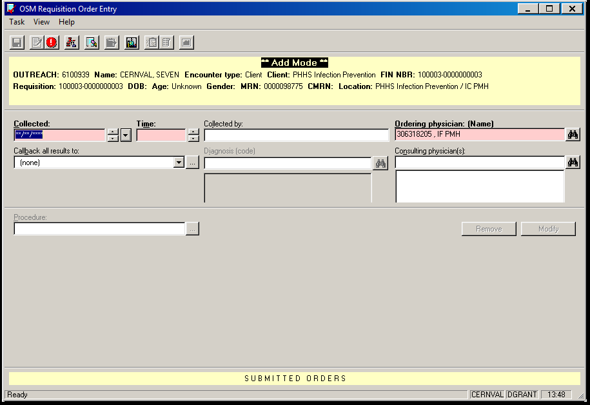
ROE – Order Entry
1. Order entry screen:

Slide 11
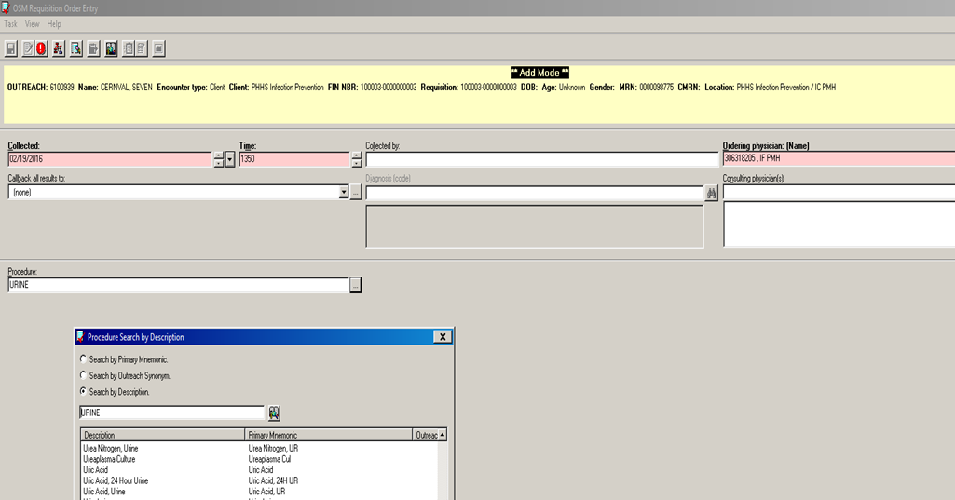
ROE – Order Entry
2. Enter order info:
Enter collection date and time
Enter procedure (test). Select from menu.

Slide 12
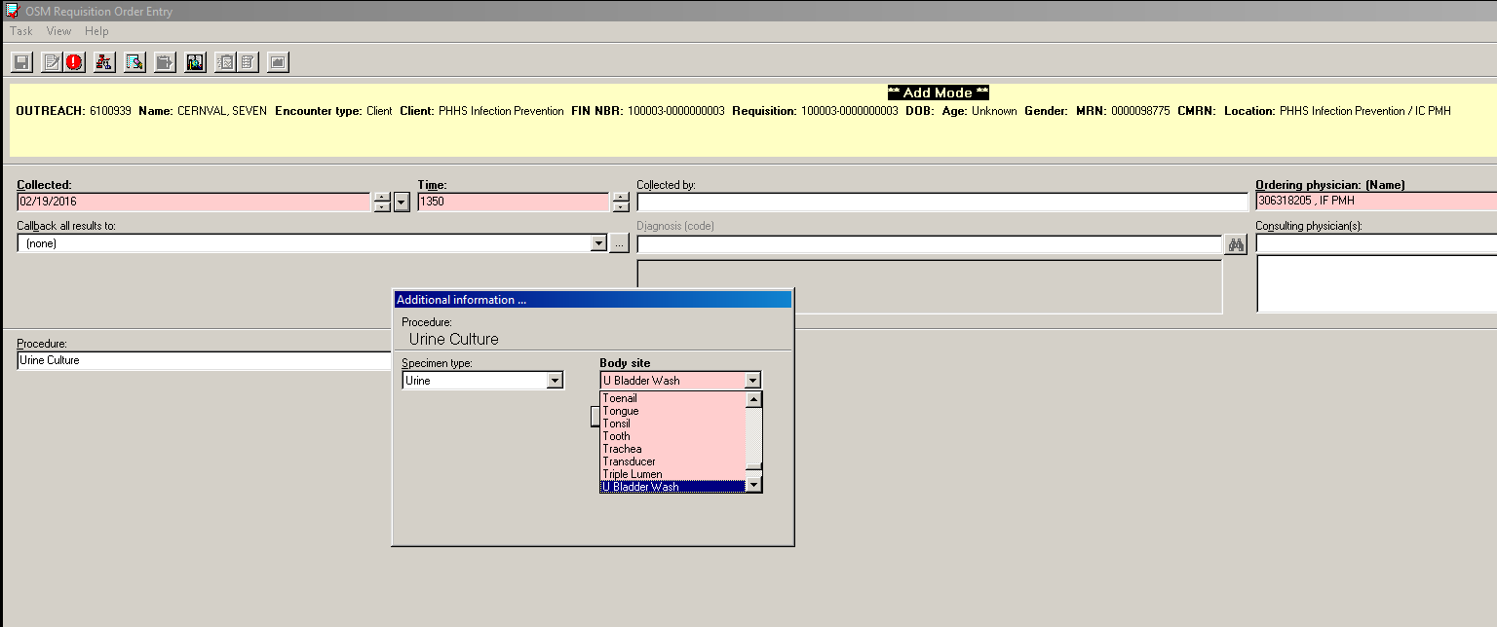
ROE – Order Entry
3. Additional information pop up will display.
Add body site if applicable.

Slide 13
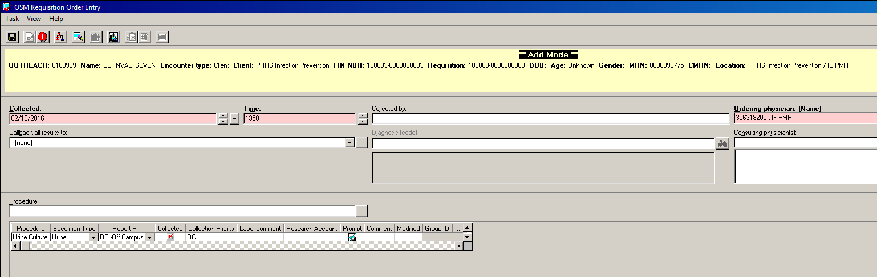
ROE – Order Entry
5. Order summary display.
Order additional procedures or
Click Save icon if order entry is complete.

Slide 14
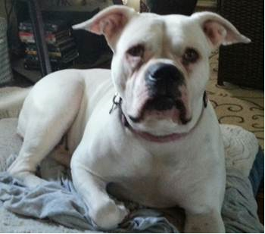
ROE: Registration Order Entry
The END
Complete the competency exam. Minimum passing score is 80%.
Woof-woof. Take the test.

