Slide 1
Biohazard Management
Laboratory Services

Slide 2
Objectives
Compare physical and health hazards
Identify how bloodborne pathogens are transmitted
Explain the importance of personal hygiene, handwashing, and PPE in avoiding exposure to biohazard
Discuss the different components of PPE
Discuss the purpose of engineering controls
Identify the safety measures available in the laboratory
Describe the proper response to an injury on duty
Summarize the safe use of centrifuges

Slide 3
Laboratory Environment
The laboratory work environment poses special infectious disease risks.
Laboratory Leadership has identified these risks and has adopted procedures to protect its employees.
It is the employee’s responsibility to ensure that the proper Personal Protective Equipment (PPE) is used and safe practices are followed.
Laboratory safety is the key to reducing injury and illness.

Slide 4
Know Your Surroundings
Many laboratories contain hazardous substances.
A hazardous substance is defined as a material/substance that poses a physical or health hazard. This includes both chemicals and biological agents.
A biological agent has the ability to adversely affect human health in a variety of ways, ranging from relatively mild, allergic reactions to serious medical conditions, even death.

Slide 5
Laboratory Hazards
Each lab is faced with different hazards. There could be exposure to biological, chemical, or radioactive material, which may pose a variety of physical and/or health hazards.
There are differences between a physical hazard and a health hazard. Let’s take a look.

Slide 6
Physical Hazard
A physical hazard has the following characteristics:
Explosive
Flammable
Oxidizer
Pyrophoric
Organic peroxide
Compressed gas
Combustible liquid
Unstable (Reactive)
Water-reactive

Slide 7
Health Hazard
A health hazard has the following characteristics:
Chemical: Biological:
Carcinogen • Bacteria
Toxic or highly toxic • Viruses
Reproductive Toxins • Fungi
Irritants • Toxins
Corrosives • Hepatotoxins
Sensitizers
Nephrotoxins
Neurotoxins

Slide 8
Biohazards
Physical and chemical health hazards are covered in another module; so, let’s focus on biological health hazards (or biohazards).
Biohazards pose a threat because these substances are capable of producing infection or disease in living organisms, particularly humans.

Slide 9
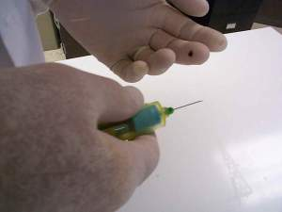
Bloodborne Pathogens
Some of the biohazards in the clinical laboratory are classified as Bloodborne Pathogens
Transmitted by blood/body fluid exposure

Slide 10
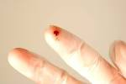
Blood/Body Fluid Exposure
Blood/Body fluid exposures can be caused by:
Percutaneous injuries (punctures by needles, scalpels, or other sharp objects)
Splashes to the mucous membranes of the mouth, nose, or eyes
Contact with open wounds (fresh open abrasions, incisions, lacerations)
Human bites
Any blood/body fluid exposure warrants immediate attention.

Slide 11
Avoiding Exposure

Slide 12
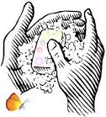
Avoiding Exposure
In order to avoid exposure to biohazards, there are four key practices:
Follow standard precaution measures
Pay attention to your personal hygiene
Wash your hands often and properly
Adhere to Personal Protection Equipment guidelines

Slide 13
Standard Precautions
Standard Precautions is the system that considers all blood, body fluids, and fresh tissue as potentially infectious.
These precautions were introduced to decrease the occupational risks of bloodborne diseases such as
Human Immunodeficiency Virus (HIV)
Hepatitis B (HBV)

Slide 14
Personal Hygiene
Do not eat, drink, smoke, chew gum, apply cosmetics, or remove/insert contact lenses while in the laboratory
Do not store food or beverages in the lab or in chemical refrigerators
Restrain hair when working with hazardous materials
Remove protective clothing (PPE) before leaving the lab
Adhere to laboratory clothing guidelines

Slide 15
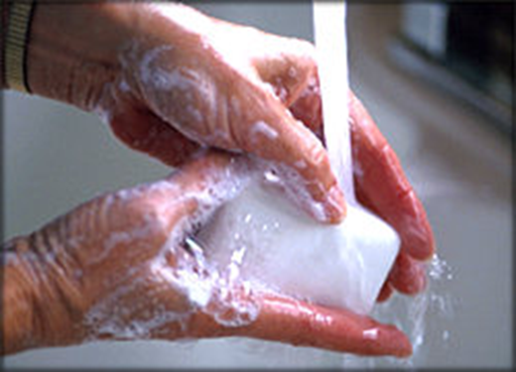
Handwashing
Wash hands :
After removal of gloves or other protection equipment
When visibly contaminated with blood, body fluids, or bodily tissue
Before leaving the work area.
Before donning personal protective equipment (PPE)
Handwashing is the single-most effective means of preventing the spread of infectious disease.

Slide 16
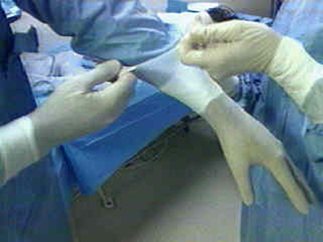
Personal Protective Equipment (PPE)
PPE includes:
Gloves
Lab coats
Safety glasses
Face shields
Other items worn on the body as barrier protection
PPE creates a ‘barrier’ to protect skin, respiratory, and mucous membranes from contamination.
Let’s look at some of the different types of PPE!

Slide 17
PPE: Gloves
Laboratory professionals are required to wear gloves anytime contamination of the hands can occur.
Gloves must be:
Comfortably fitted without restricting motion
Replaced immediately when torn or contaminated
For single-use only (may not be washed and reused)

Slide 18
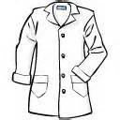
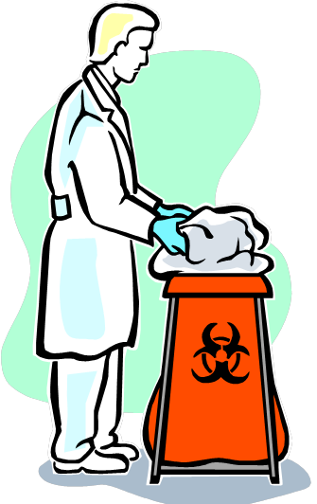
PPE: Lab Coats
Wearing a fluid-resistant lab coat is required whenever working near:
Blood
Body fluids
Fresh tissue
Lab coats are disposable, but may be reused for several days if not soiled.
Dispose of lab coat immediately if soiled with biohazardous material.

Slide 19
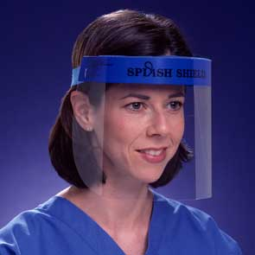
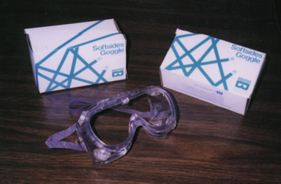
PPE: Safety Glasses & Face Shields
Face protection is used during procedures that are likely to generate droplets of blood or other body fluids.
Used to prevent exposure to the mouth, nose, and eyes

Slide 20
Engineering Controls
The good news is - PPE is NOT the only protective barrier!
Engineering controls are also used as barrier protection and include:
Sharps containers
Safety needles
Biological safety cabinets (BSC)
Mechanical pipettes
Many other items.
Let’s look at each engineering control in depth!

Slide 21
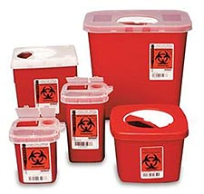
Sharps Container
All used sharps must be placed into a rigid, puncture and leak-resistant container that is also impervious to moisture. The sharps container must be labeled either with “Biohazard” or “Infectious Waste”.
Do not over fill the sharps container.
Seal when ¾ full.
Examples of sharps are:
Needles/syringes
Scalpels
Blades

Slide 22
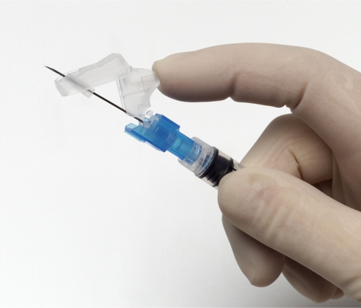
Safety Needles
In 2010, the Needlestick Safety and Prevention Act improved protection against injuries that expose laboratory workers to potentially deadly blood borne pathogens.
Safety needles have a safety mechanism built into the device which protects workers from accidental needlestick injuries.

Slide 23
Biological Safety Cabinets (BSC)
The biological safety cabinet (BSC) is used as a containment for infectious agents. The BSC has a HEPA filter in the exhaust system to protect the environment and yourself.
Considered the single most useful safety device in the microbiology laboratory
The (HEPA) filter is a high efficiency particulate air filter. It is able to remove particles at a size of 0.3 µm with an efficiency of 99.97%. It is also able to remove both smaller and larger particles.

Slide 24
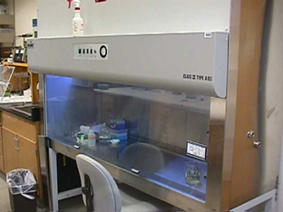
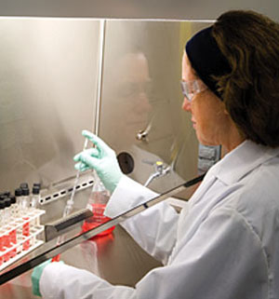
Biological Safety Cabinets (BSC)
There are 3 classes of BSC that are used. The higher the risk group and biosafety level, the higher the class of cabinet that is used.
Each lab has a BSC appropriate for their biosafety needs
When using this containment device, remember to also use the proper personal protective equipment.

Slide 25
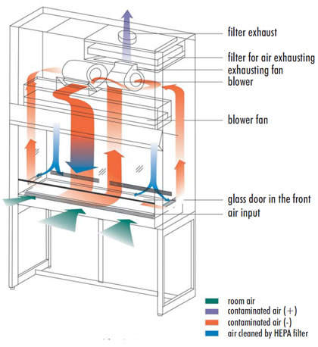
Diagram of Class II BSCs

Slide 26
BSC Guidelines
Not to be used with toxic materials or carcinogens
Make sure that your head remains above sash opening
Don’t block front grill
Keep area organized
Work in a unidirectional flow (don’t hold dirty objects over clean supplies)
Minimize the air disruption in the room
Move slowly to avoid air disruption
No fans allowed in room
BSCs are remotely exhausted – meaning that an alarm will sound if exhaust is not working properly
If alarm is sounding, do not use even if the BSC is running!

Slide 27
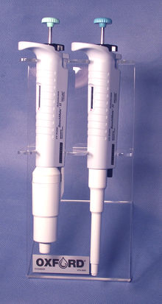
Mechanical Pipettes
Mechanical pipettes shall be used for manipulating all liquids including:
blood
body fluids
chemicals
reagents in the laboratory

Slide 28
Safety Measures

Slide 29
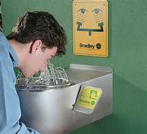
Safety Measures
When physical hazards and health hazards exist, it is very important to know where the safety measures are located.
Eye wash/safety shower
First aid kit
Incident report protocol
Emergency spill kit
MSDS
Unexpected accidents do occur and knowing where to go at the time of an emergency can reduce injury/illness.

Slide 30
Injury on Duty Response
If a blood/body fluid exposure occurs, follow these steps:
Flush the site with large amounts of water to remove the body fluids
Report the incident to the supervisor on the same shift the accident occurred.
The supervisor will complete an Injury on Duty (IOD) Report. The lab will keep a copy, a copy is sent to the Laboratory Safety Office, and a copy is retained by the employee. The IOD is sent to Worker’s Compensation within twenty-four hours of the injury.
The exposed/injured employee shall report to Occupational Health with their IOD as soon as possible for treatment and follow-up.
Injury on Duty Report

Slide 31
Aerosol Prevention
Fill evacuation tubes, vials, and bottles by using their internal vacuum only.
Never force fluid into an evacuation tube by exerting pressure on the syringe plunger.
Perform all aerosol-producing activities (de-capping tubes, transferring high-risk samples from one container to another, etc.) according to the protocols described in your lab area.
Use all engineering controls indicated for your area

Slide 32
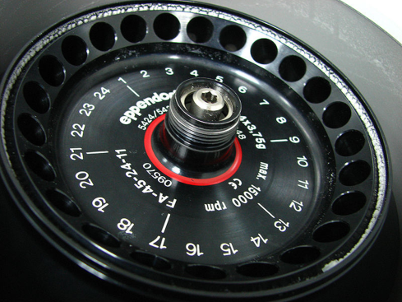
Safe Use of Centrifuges
Before use, check to see if:
Balanced – equal volumes in opposing positions.
May need a “placeholder tube”
Tightly cap all tubes & check for damage before spinning
Use sealable buckets (safety cups) or sealed rotors, when available.
Close & lock lid before starting centrifuge. Leave lid closed and locked until centrifuge stops.

Slide 33
After Centrifugation
After run, check to see if:
Centrifuge completely stopped
A tube has broken or a spill (leak) has occurred, or if an open tube has been spun. If so,
Leave lid closed and allow potential aerosols to settle for 30 minutes or open in a Biosafety Cabinet
Wearing appropriate PPE (includes mask), clean spill thoroughly with appropriate disinfectant according to procedure

Slide 34
Safe Practices
These safe practices should be followed to ensure safe working conditions:
Use proper PPE
Do not use chipped or cracked glassware
When working with hazardous materials, have a second person nearby
Know emergency procedures
Keep the laboratory neat and clean
Use hazardous chemicals under a fume hood and biohazardous materials under a biosafety cabinet (BSC)
All procedures should be performed to minimize aerosol

Slide 35
A Final Word about PPE
Knowing how to properly use PPE can be the key to adequate protection. Not only do you want to make sure it is the proper size for you, but also make sure you are wearing it properly. If it is too big or too small, it is not right for you! Let your supervisor know if you need a different size.
Rev. 6/28/16
Rev. 6/28/16

