Slide 1
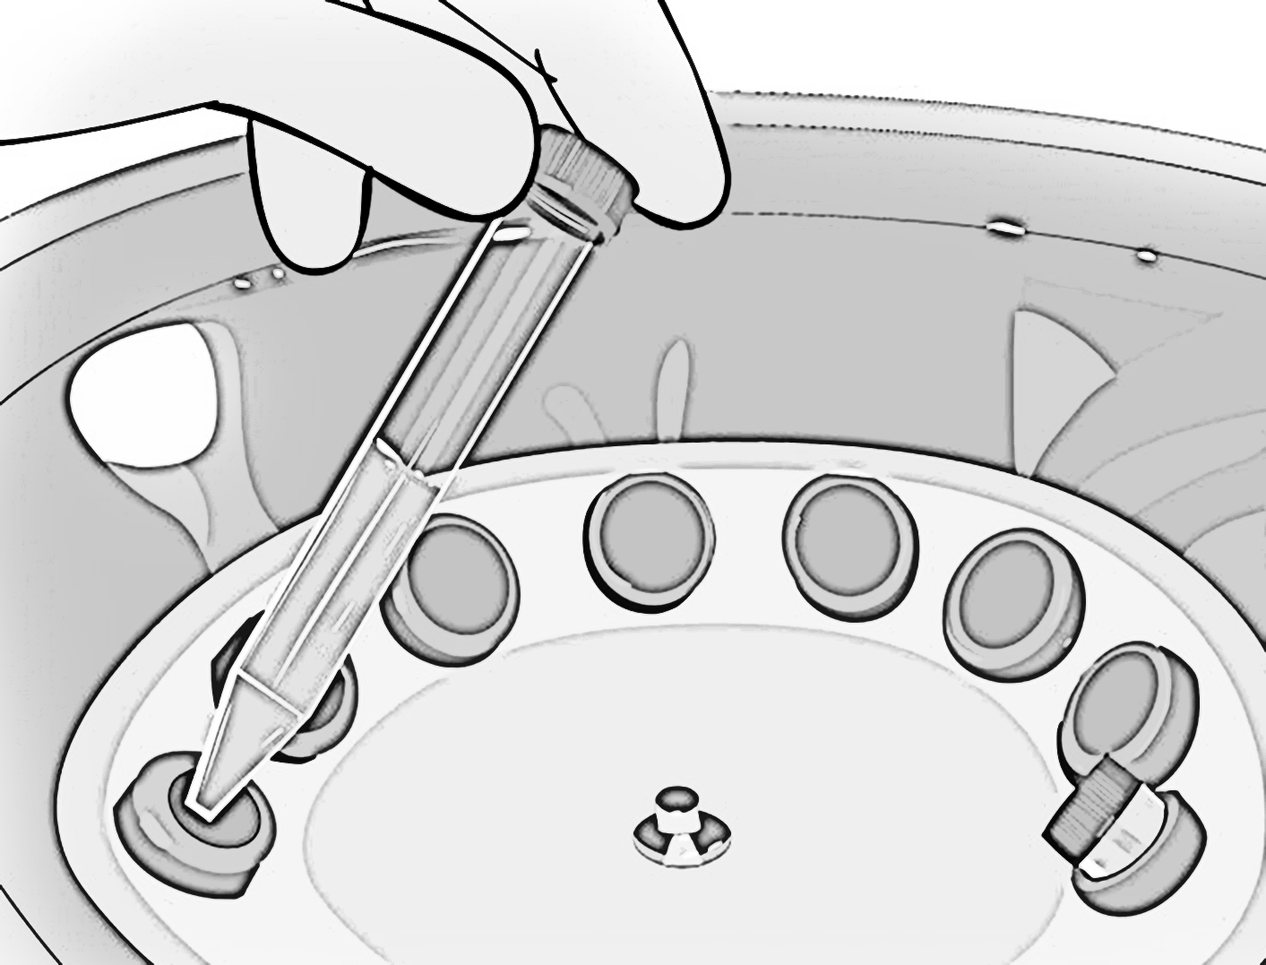
Centrifuge Safety
Laboratory Services

Slide 2
Objectives
At the completion of this module, the participant should be able to correctly:
Describe the physical and exposure hazards for a centrifuge
Discuss the guidelines for before, during, and after centrifugation
Identify how to balance a rotor with different number of tubes
Explain how to decontaminate a centrifuge

Slide 3
Centrifuges
A centrifuge is a common tool in the laboratory.
It uses centrifugal force to separate substances according to particle size and density differences.
Has great potential for injuring users if not operated properly!

Slide 4
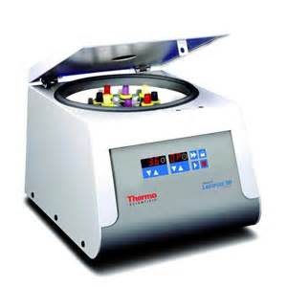
Centrifuge Hazards
Hazards by centrifuges include:
Physical hazards
Mechanical failure or stress
Sample imbalance causing machine movement
Metal fatigue
Corrosion of rotor
Exposure hazards
Sample container breakage causing aerosols that are harmful if inhaled
Aerosolization of biological, chemical, or radioactive materials

Slide 5
Centrifuge Safety
90% of all centrifuge accidents are the result of user error!
Each user should be properly trained on operating procedures

Slide 6
Before Centrifugation Guidelines
Wear appropriate PPE
Inspect centrifuge
Ensure centrifuge bowls & tubes are dry
Ensure spindle is clean
Use matching sets of tubes & buckets
Ensure O-ring is not cracked or worn
Inspect tubes before use
Check for cracks/defects
Follow manufacturer’s filling limits
Inspect environment
Ensure that work surface is level and firm enough to support equipment

Slide 7
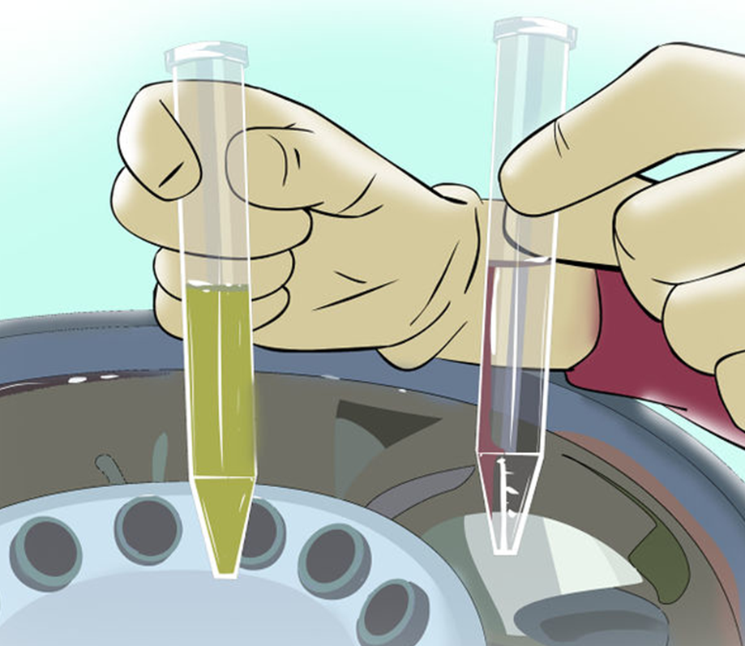
Before Centrifugation Guidelines
Balance tubes in rotor!
Ensure that the rotor is balanced with equal and opposing tubes
Cap each tube &/or bucket before centrifugation
Close & lock lid before starting centrifuge

Slide 8
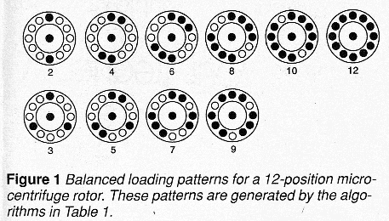
Rotor Balancing
Frothingham, R. (1999, February). Centrifugation without a balance tube. American Biotechnology Laboratory, 17, 84/
NOTE: These images represent tubes with equal volume!

Slide 9
During Centrifugation Guidelines
Keep lid closed at all times during operation
Don’t exceed safe rotor speed according to manufacturer
Don’t leave centrifuge until full operating speed is reached, and appears to be running safely without incident
Stop centrifuge immediately if an unusual condition (noises or shaking) begins and check load balances

Slide 10
After Centrifugation Guidelines
Allow centrifuge to come to a complete stop before opening cover
Wear appropriate PPE
Check inside centrifuge for possible tube breakage or spills (leak), or if an open tube has been spun. If found,
Leave lid closed and allow potential aerosols to settle for 30 minutes or open in a Biosafety Cabinet
Wearing appropriate PPE (includes mask), clean spill thoroughly with appropriate disinfectant according to procedure
If spill occurs, use appropriate decontamination and cleanup procedures
Report all accidents to your supervisor immediately!
Rev. 7/6/16

