Slide 1
Chemical Hazard Management
Laboratory Services

Slide 2
Objectives
At the completion of this module, the participant should be able to correctly:
Recognize how work procedures/practices, engineering controls, and PPE act as protection against chemicals
Understand the importance of SDS sheets and labeling
Identify engineering controls in the laboratory and the role of PPE components
Discuss chemical waste disposal and spill management

Slide 3
Chemical Hazard Management
Laboratory Services is one of the largest users of hazardous chemicals in the hospital. The goal of this module is to inform Laboratory employees of specific risks and ways to protect themselves.

Slide 4
Chemical Hazards in your Lab
Chemicals can pose a significant hazard. They should be limited to the use under a properly working fume hood. Chemicals can release hazardous fumes which not only harm the environment, but they can be a major health threat. They must be handled carefully and disposed of properly.
Protection against chemicals is a combination of work procedures/practices, engineering controls, and PPE. Let’s look at each of these!

Slide 5
Chemical Work Procedures/Practices

Slide 6
Types of Hazards
Chemicals have both physical and health hazards
Physical Hazards:
Flammables and combustibles (formaldehyde, xylene)
Corrosives and oxidizers (strong acids and bases)
Compressed gasses (helium, CO2)
Health Hazards:
Irritants
Toxins
Carcinogens
Corrosives
Neurotoxins
Nephrotoxins
Hepatotoxins

Slide 7
Protecting yourself
Protecting oneself includes:
Understanding the risks
Use of appropriate engineering controls and personal protective equipment (PPE)
Adherence to approved safety practices
Proper storage and transport of chemicals
Emergency preparedness

Slide 8
Employee Responsibilities
Each employee is responsible for:
planning and executing each procedure according to approved protocol
completing mandatory training activities
being attentive to all labels and warning signs
seeking clarification when unsure of proper safety practice
reporting unsafe conditions to supervisor/safety officer.
Lab management is responsible for:
selection of least-hazardous alternatives
risk assessment and mitigation
education of staff using hazardous chemicals.

Slide 9
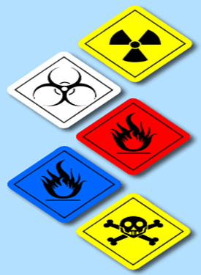
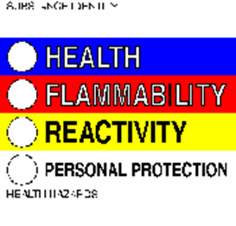
Labeling
It is important to know as much about a chemical as possible. The most dangerous substance is the one that has no label. Communicating information is essential in the science field.

Slide 10
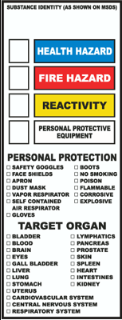
Labeling
Labeling is also required for chemicals that are in a secondary container. When labeling the secondary container the following information must be included:
Identity of the hazardous chemical
Appropriate hazard warnings
The necessary PPE required when handling the chemical

Slide 11
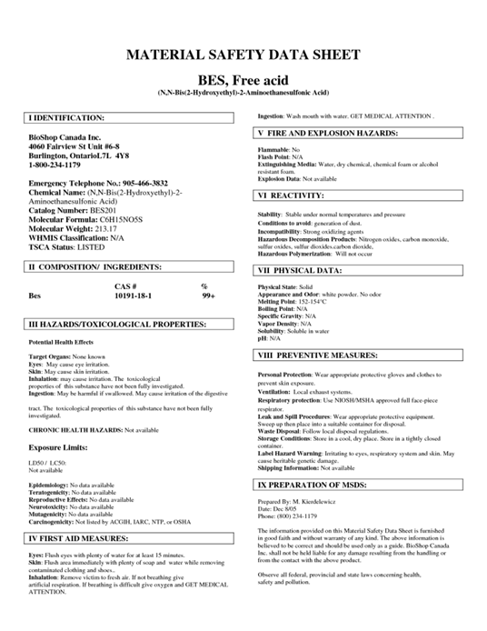
SDS
In addition to labeling, the next most important type of communication regarding hazards is the Safety Data Sheet (SDS). SDS have replaced MSDS.
SDSs are located in every laboratory and intranet at SDS/MSDS-Hazsoft.
SDSs have vital information about specific hazards, proper handling precautions, disposal instructions, and what to do if a spill occurs.

Slide 12
Importance of SDS
Why is a SDS important? When you know characteristics of a substance, it can aid in the precautionary measures taken when using the substance. Also, if there is a spill either on a surface or on your skin, the SDS can supply you with the information needed for first aid.
The SDS to every chemical in your lab must be available to you. It may be in a notebook in your lab. Make sure you find the location of the SDSs in your lab.

Slide 13
Chemical Hazard Safety
Follow approved safety procedures:
Lab procedures will specify safe handling instructions for any hazardous chemical. Read procedures and safety precautions thoroughly before beginning any new procedure and follow all instructions.
When new chemicals are introduced, lab management is responsible for assessing the risk, providing all appropriate protective measure, and employee training prior to implementation.

Slide 14
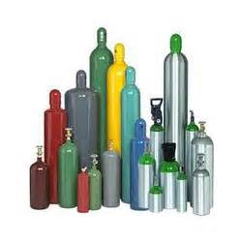
Cylinder Storage & Transportation
All Plastic Mesh should be removed from all medical gas cylinders.
Store cylinders in a well-ventilated area away from heat or ignition sources.
Fasten cylinders to a wall or cylinder stand during use, transit, or storage.
Valve-protector caps should always be left in place unless the cylinder is in use.
The number of cylinders of flammable gas at each workstation shall not exceed one extra cylinder for each cylinder actually connected for use.
If possible, keep empty and full cylinders separated. Empty cylinders must always be labeled “Empty”.

Slide 15
Chemical Engineering Controls and PPE

Slide 16
Engineering Controls for Chemicals
Chemical usage poses a variety of hazards. They can be flammable, corrosive, even toxic just to name a few. Taking all precautions to avoid physical and/or health problems is the number one goal. You can never be too cautious!
Some examples of Engineering Controls are:
Fume hoods
Pipettes
Storage cabinets

Slide 17
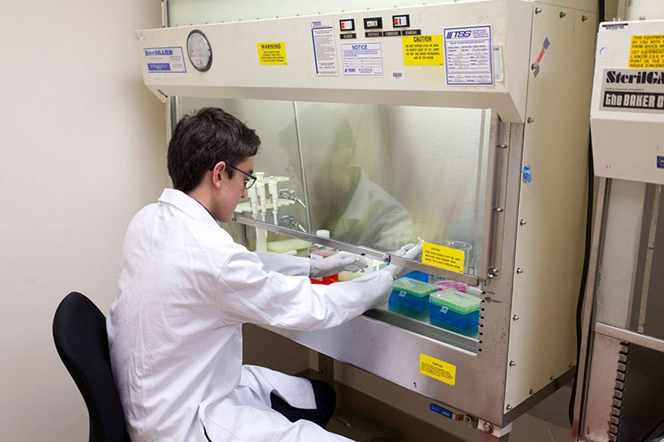
Fume Hoods
The fume hood is used with chemicals.
The main function is to exhaust the vapors and gases that are generated in the hood to the outside.
The hood is designed to minimize your exposure to airborne contaminants.
It is not to be used with biohazardous materials.
Your safety officer/supervisor will orient you to the locations and use of these safety devices

Slide 18
Fume Hood Use
When using the fume hood you first need to make sure the exhaust blower is operating and air is entering the hood.
Remember, do not put your face inside the hood!
Minimize storage of chemicals in the hood
Clean spills immediately
Work with the sash at the proper operating level as indicated by the arrows

Slide 19
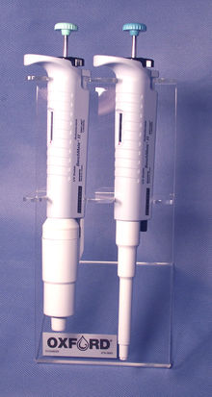
Mechanical Pipettes
Mechanical pipettes shall be used for manipulating all liquids including:
blood
body fluids
chemicals
reagents in the laboratory

Slide 20
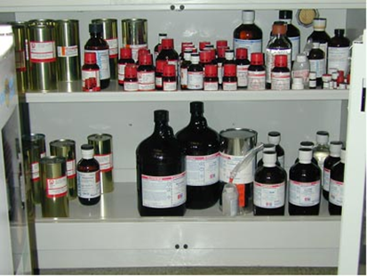
Chemical Storage Cabinets
Store chemicals according to type and compatibility. Check SDS for incompatibilities with other chemicals.
Do not store chemicals in a fume hood.
The total volume of flammable or combustible liquids outside of an approved safety cabinet may not exceed 10 gallons per 5,000 square feet.
Store flammable liquids > 1 quart in an
approved flammable container.

Slide 21
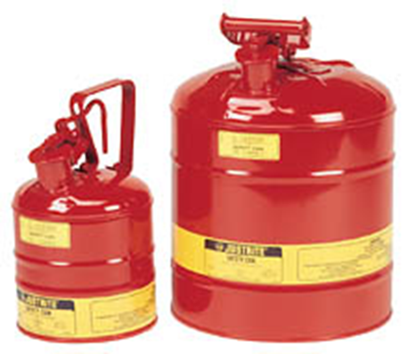
Chemical Storing and Transporting
Store acids, bases, and flammables separately.
Bottle carriers are used for transporting glass bottles of hazardous chemicals > 500 mL
Plastic bottles are preferred to glass, whenever compatible with the chemical contents.

Slide 22
Chemicals & PPE
When chemicals are being used, there is always the possibility of splashing. The proper PPE is available and must be used when the SDS or lab protocol specifies.
Proper PPE may include:
Safety glasses
Face shield
Gloves
Lab coat or apron
Respirator (Depending on the agent and whether or not an aerosol is created)

Slide 23
Chemical Disposal & Spill Management

Slide 24
Chemical Disposal
Waste can be classified as either hazardous or biohazardous.
Hazardous Waste - any waste which contains the characteristics of being any of the following:
Toxic
Corrosive
Ignitable
Flammable
Oxidizer
Biohazardous Waste - any waste that is considered infectious and/or because of its biological nature it can cause physical or health hazards in humans, animals, plants or the environment.

Slide 25
Waste Disposal
Hazardous and biohazardous waste have special guidelines for proper disposal. It is important to properly dispose of waste to ensure human and environmental health.
Waste containers must be labeled with contents and hazard designations
Obtain a copy of the SDS and attach to chemical being discarded
Transport waste chemicals to designated storage location pending removal.
Refer to Laboratory Safety Manual for procedures dealing with chemical waste disposal.

Slide 26
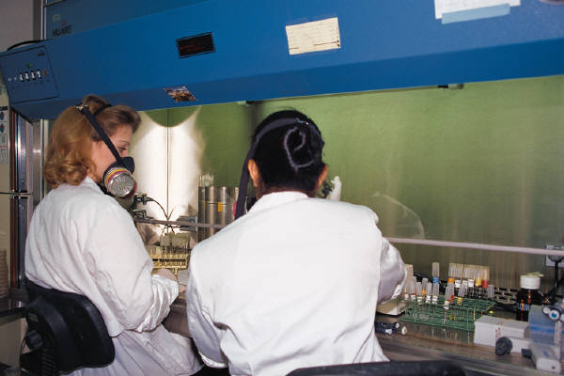
Emergency Preparedness
Think ahead, assemble all safety supplies and equipment items before handling hazardous chemicals.
Test fume hoods for proper function before use.
Be prepared with fire safety strategies when working with flammable, combustible and reactive hazards.

Slide 27
Chemical Spill or Exposure
The first priority is to help the injured:
Remove victim to a safe place
Notify a supervisor immediately
Seek medical attention if needed
First aid charts are posted in all lab areas
The second priority is containing and cleaning up the spill:
Spill kits area available wherever hazardous chemicals are used
New employees are trained on containment of chemical spills
Vermiculite should be used for containing larger spills

Slide 28
Chemical Spills or Exposure
If spill or exposure occurs:
Know who to call for help with a chemical spill
Call 9-1-1 from any hospital phone or 214-590-8104 from a non-hospital phone
Report all chemical spills to a supvr.
Rev. 6/30/16

