Slide 1
Biohazard Decontamination
Laboratory Services

Slide 2
Objectives
At the completion of this module, the participant should be able to correctly:
Explain proper procedure in the decontamination of laboratory surfaces/equipment, including centrifuges and the pneumatic tube system
Follow the 8 steps for disinfecting a blood/fluid spill
Discuss which activities require shipping certification

Slide 3
Decontamination
Decontamination is the removal or neutralization of toxic agents or the use of physical or chemical means to remove, inactivate, or destroy living organisms.
Decontamination is the responsibility of all laboratory workers.
Failure to decontaminate can result in exposure to infectious agents which can cause great illness.
Most decontamination can be done by chemicals - disinfection.

Slide 4
Decontamination of Surfaces/Equipment
Decontaminate all laboratory work areas with an appropriate disinfectant after a spill of blood or body fluids and when work activities are completed.
Lab countertops should be disinfected once per shift and always after a spill.
The Hospital Infection Control Committee selects and approves all disinfectants used anywhere in the Parkland Health System.

Slide 5
Decontamination of Centrifuge
If spill occurs, report to your supervisor and use appropriate decontamination and cleanup procedures
For general purposes, when tube breakage occurs:
Remove broken glass with tongs or forceps
Absorb spilled sample with gauze
Clean equipment with hospital disinfectant and allow to air dry before reuse

Slide 6
Decontamination of Pneumatic Tube System
When specimen leakage occurs:
Absorb spilled specimen with gauze
Clean inside and outside carrier with 10% bleach
Allow to air-dry before reuse
If broken glass is present, remove with tongs or forceps
If spill was sufficient to contaminate the tube system, call Engineering at ext #71000

Slide 7
Blood/Body Fluid Spills
Follow these steps to clean up and disinfect contaminated surfaces after a spill:
1. Don PPE – gloves, gown, safety glasses, etc.
2. Do not remove any glass or other sharp objects with your hands. Rigid cardboard or dustpans may be used to handle such objects.
3. Absorb spills with disposable, absorbent materials such as paper towels or gauze pads.
4. Clean all visibly spilled material using a detergent or disinfectant. 10% bleach is used in the laboratories to disinfect non-metallic surfaces.

Slide 8
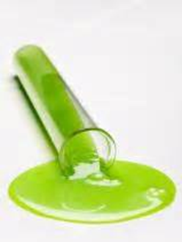
Blood/Body Fluid Spills
5. Flood the spill site or wipe down the spill site with disposable towels soaked in disinfectant.
6. Wipe off the spill site with a clean dry paper towel or gauze pad and allow to air dry. Follow manufacturer's recommendations.
7. Place contaminated gloves and paper towels in a plastic biohazard bag and dispose according to laboratory protocol.
8. Remove gloves and wash hands when cleanup is completed.
Remember to report the incident to your supervisor.

Slide 9
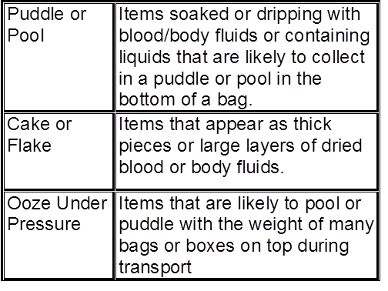
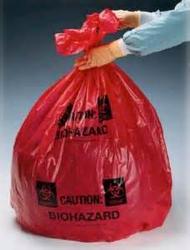
Biohazardous Waste Disposal
Body fluids and contaminated items shall be discarded into red biohazard bags if they:

Slide 10
Shipping Biohazardous Materials
Shipping lab samples by ground or air transport requires additional training and certification.
What activities require shipping certification?
Mailing newborn screening cards to Tx Dept of Health
Preparing samples to be collected by reference lab courier
Packaging lab samples for shipment by FedEx or Airborne Express
Shipment of packages containing dry ice

Slide 11
Shipping Biohazardous Materials
Certified Shipper training is:
Specific to the assigned task
Valid for 2 years
Assigned by your supervisor if your job requires you to ship regulated materials
Certified shippers will know how to:
Classify
Identify
Package
Label and Mark
Document

Slide 12
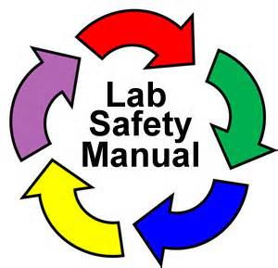
Laboratory Safety Manual
A comprehensive Laboratory Safety Manual is available on the hospital on-line document management system (ie, Policy Manager) and in each laboratory. This manual contains current information on all aspects of lab safety.
All Laboratory employees are required to read and sign the Laboratory Safety Manual annually. Contact your lab’s Safety Officer or Manager for more information.
Rev. 6/30/16

