Slide 1
Ergonomics
Laboratory Services

Slide 2
Objectives
Upon completion of this module, the participant should be able to correctly:
Evaluate high-risk injury factors:
Awkward or prolonged postures
Repetitive motions
Using excessive force or pressure
Determine the proper procedure of lifting heavy objects

Slide 3
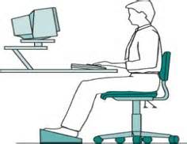
Seating
Body position and posture:
Feet should rest on the floor or a footrest
Chair should provide adequate low back and thigh support
Front edge of chair should not press up against back of knees

Slide 4
Tips for Good Seating Practices
Sit all the way back into the seat to provide back support
If back support is not adequate or if the seat pan is too long, try a rolled up towel or a back support cushion to provide support
Before starting work, make sure chair is adjusted properly
Use a footrest if feet do not reach floor
Get out of chair every 15-20 minutes to help relieve stress on the back

Slide 5
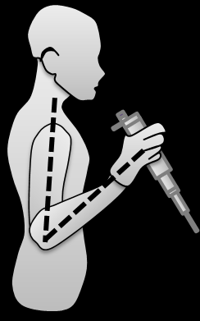
Pipetting
While pipetting, maintain good seating posture and…
Keep wrists straight – don’t twist or rotate wrists
Keep elbows close to body
Try to sit with your work slightly below your elbows
For every 15 minutes, take a 2 minutes break
Rotate pipetting tasks with other activities

Slide 6
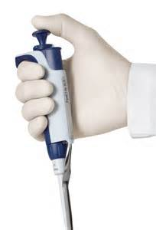
Tips for Good Pipetting Practices
Use proper seating techniques discussed earlier.
Keep waste bins, beakers, etc., as close as possible
Choose pipettes that require minimal hand and finger effort
For highly repetitive jobs, utilize automated processes or mulit-channel pipettes where feasible
Take frequent “micro-breaks” away from pipetting (at least every 15-20 minutes)
Share workload between right and left hands
Avoid pipetting for long periods – alternate activities and/or rotate tasks with other employees

Slide 7
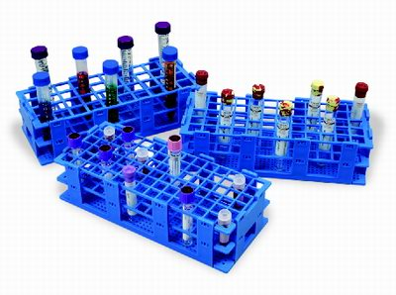
Test Tube Handling
Maintain straight wrists
Work with elbows close to the body
Avoid reaching upward or stooping low
If seated, maintain good seating posture

Slide 8
Tips for Good Test Tube Handling
Arrange tubes to minimize reaching and/or twisting
Share workload between right and left hands
Take adequate breaks away from handling activity (even short several second “micro-breaks” help
Use both hands to open tubes, or use a cap remover
To avoid forearms resting on sharp edges, pad edges or use a cushion to pad forearm

Slide 9
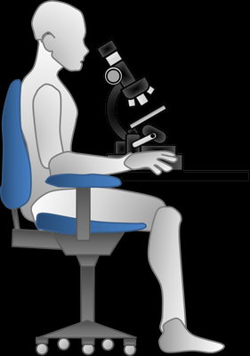
Microscope Use
Make sure that you have enough legroom
Set the chair or table height so that your shoulders can be relaxed close to your side, eyes aligned with the microscope eyepiece
Adjust the eye piece to avoid a forward head position.
Use a chair that provides good back and thigh support. Sit with your back against the back rest and your feet flat on floor or supported on footrest.

Slide 10
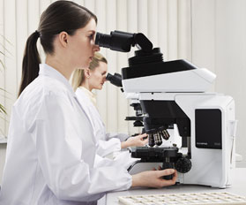
Tips for Good Microscope Posture
Move microscope close to edge of counter to avoid bending the neck
Keep elbows close to sides
To avoid forearm resting on sharp edges, pad edges or use a cushion to pad forearm
Keep scopes clean and in good condition
Take frequent “micro-breaks” to rest eyes
Spread microscope work throughout the day or rotate microscope work among several employees as feasible
Use proper seating techniques discussed earlier

Slide 11
Excessive Force or Pressure
Use a tool designed to open screw caps in order to loosen containers that are too tight to open by force alone
Use a dolly or cart to push heavy objects across the floor

Slide 12
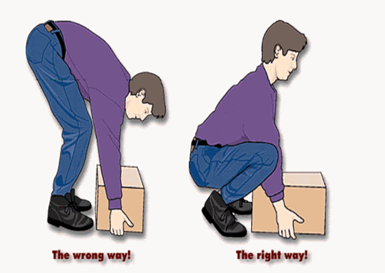
Lifting Heavy Objects
Place feet about 10 -15 in. apart, one foot alongside the object being lifted and the other behind it.
Grasp the object using the palmer grip – fingers and hand should be extended around the object to be lifted using the full palm.
Use the bent knee or squatting
position, keep the back straight,
tuck in the chin so the neck and
head continue the straight back
line.

Slide 13
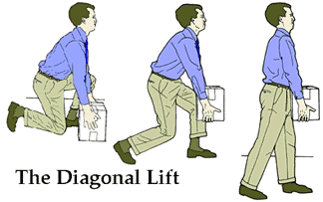
Lifting Heavy Objects
Tuck arms and elbows into the side of the body and position the body so that your weight is centered.
Start lifting with a thrust of the rear foot, keeping the object close to the body as you lift with your legs, not with your back.
Carry the load close to your body, not on extended arms, shift your feet. Do not twist your back.
Use the same technique when you set the object down.

Slide 14
General Work Tips
Work Practices and Process:
For any continuous or repetitive task, take frequent “micro-breaks” away from the primary activity
Arrange work scheduling to allow occasional alternating of tasks
Rotate intermittently between left and right hands to avoid over use of any one side
For highly continuous or repetitive tasks, consider a rotation of employees to help safely distribute workload

Slide 15
General Work Tips
Proper equipment:
When purchasing equipment, models that adjust in size are preferable
Use the proper equipment for the task
Know how to properly use the equipment
Where feasible, use automated processes to reduce or eliminate high repetition or forces
Use a step ladder when reaching overhead to remove objects from a high shelf so you aren’t reaching over your head

Slide 16
By using proper techniques and processes, we can make the laboratory a safer place.
Rev. 6/30/16

