Slide 1
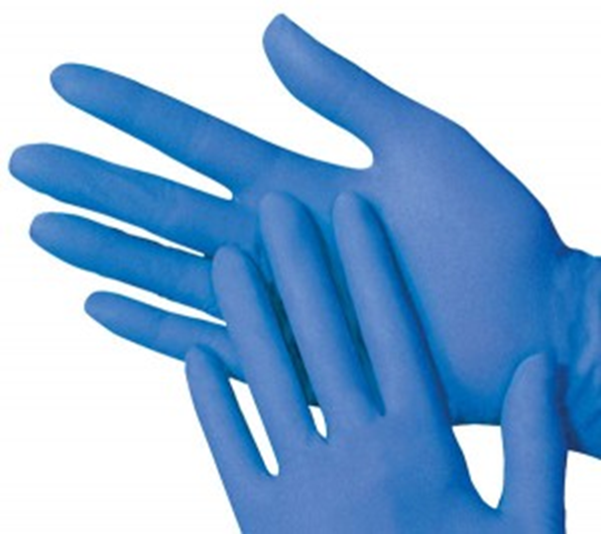
LATEX MINIMINIZATION
Laboratory Services

Slide 2
Objectives
At the end of this module, the participant should be able to correctly:
Identify potential latex components of the work environment
Describe the signs of a latex allergy
Discuss the two groups of high-risk individuals for latex allergy
Communicate ways to avoid increasing latex sensitivity
Utilize non-latex supplies when working with a patient with a latex allergy
Understand their responsibility in the laboratory team to guard against latex allergies

Slide 3
PHHS Latex Policy
Environment of Care #30-15 Latex Minimization Safety Plan focuses on the reduction of latex exposure among staff, students, patients, and visitors.
This is to reduce latex exposure to the maximum extent possible, thus minimizing sensitization and development of new latex allergy cases.
Laboratory Services uses non-latex gloves to comply with Environment of Care Policy #30-15.

Slide 4
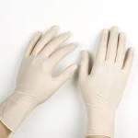
What is Latex?
Latex is produced through a manufacturing process from natural rubber.
Common latex products include:
Medical gloves
Anesthesia masks
Electrode pads
Crutch pads
Bandages
Wheelchair tires
Drug vial stoppers
And much, much more

Slide 5
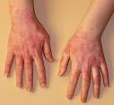
Allergy to Latex
Allergic reactions occur when an individual has a predisposition to natural latex.
The degree to which a sensitivity/reaction exists depends upon the sensitivity of the patient.
Responses range from mild irritation to respiratory distress.
Latex allergic reactions are often mistaken for skin irritation.
Most people are not automatically sensitive to most substances, but they develop an allergic reaction after being exposed to the substance.
There is no way to predict the severity of a reaction.

Slide 6
High Risk for Latex?
There are two (2) main ways to identify high-risk people.
1. Individuals with frequent exposure:
Healthcare workers
Rubber industry workers
Patients who have undergone multiple procedures
2. Individuals who are allergic to:
Banana
Tomato
Kiwi
Avocado
Potato
And many other foods

Slide 7
Why should you care?
Simply put, allergic reactions to latex can be very serious and may cause death!

Slide 8
How to tell if you’re allergic to latex?
First, ask yourself if you’re in either of the high-risk groups
Secondly, ask yourself if you’ve had a reaction to latex
Hives or rash on skin after exposure to latex
Itchy, watery or swollen eyes
Runny nose and sneezing
Asthmatic reactions (coughing, wheezing, shortness of breath,
chest tightness, and respiratory
distress)

Slide 9
How to tell if you’re allergic to latex?
Signs that you may have an allergy to latex
Swollen lips after visiting the dentist or blowing up a balloon
Rashes after using latex gloves, band-aids, or other medical tapes
Remember…
Any employee who is exposed to latex is at risk for developing latex allergies
The longer you are exposed to latex, the more serious your reactions will become
All reactions to latex can increase your sensitivity.
You must report them all!

Slide 10
Anaphylaxis Reactions
Anaphylactic reactions are serious, and all employees should recognize their symptoms:
Skin eruptions or burning sensations
Light-headedness or loss of consciousness due to blood pressure drop
Swelling which may obstruct the nose, mouth and throat
Asthma-like symptoms
Notify a supervisor
Take the affected employee to the ER or call 911
React Immediately! Anaphylactic shock is a medical emergency. Seek medical help immediately!

Slide 11
Avoiding Latex
If you are allergic, you can decrease your chances of developing sensitivity by:
Wearing non-latex gloves
Avoid oil-based creams
Oils dissolve latex and allow allergens to penetrate skin
Change gloves often
If you have a rash, wear a cotton liner under gloves
Inform doctors/dentists about your allergy before your treatment.
Notify Employee Health & your physician of allergy symptoms for treatment.
Wear a Medic Alert bracelet.
Carry an epinephrine (adrenaline) kit.

Slide 12
Avoiding Latex
Remember that your patients may also be allergic to latex. If a patient reports latex sensitivity, avoid using latex tourniquets, bandages, and gloves.

Slide 13
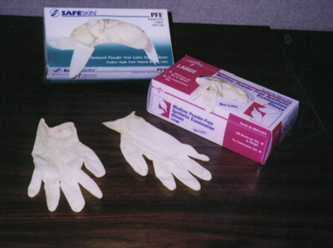
How do I know if something has latex?
As of 1998, all medical products containing natural rubber latex or dry natural rubber must be properly labeled as such.
Furthermore, all medical products packed in these forms of latex must also be labeled.
If you cannot discover whether or not a product contains latex, you should probably not use it in the presence of someone sensitive to latex.

Slide 14
Who is responsible in guarding against latex allergies?
Answer: We all are!!
Everyone is responsible to watch out for the symptoms of latex allergies.
Your employer, once they know of any threat, should inform the employees of actions to prevent occupational injury in the face of that threat.
Your employer should help prevent your injury by…
Training you about the nature of the threat
Instituting policies and procedures to prevent your injury from that threat.
Providing non-latex alternatives wherever possible

Slide 15
The Laboratory Team
Finally, remember that latex allergies can be very serious.
When the Laboratory Team (you, your colleagues, and leadership) works together, we can effectively address the issue of latex allergy.
Communication is key!
Communicate with the team if there are supplies which do not offer a non-latex option.
Keep everyone up-to-date and well-informed as to the latex status of equipment and supplies.
Rev. 6/30/16

