Slide 1
Point of Care
Nova StatStrip Glucose Testing
Overview and Objectives
At the conclusion of the module the learner will be able to: Perform patient testing using the Nova StatStrip meter Perform quality control State acceptable specimen types for patient testing Use Universal Precautions Follow patient identification procedures Clean and Disinfect meter Locate Point of Care Website

Slide 2
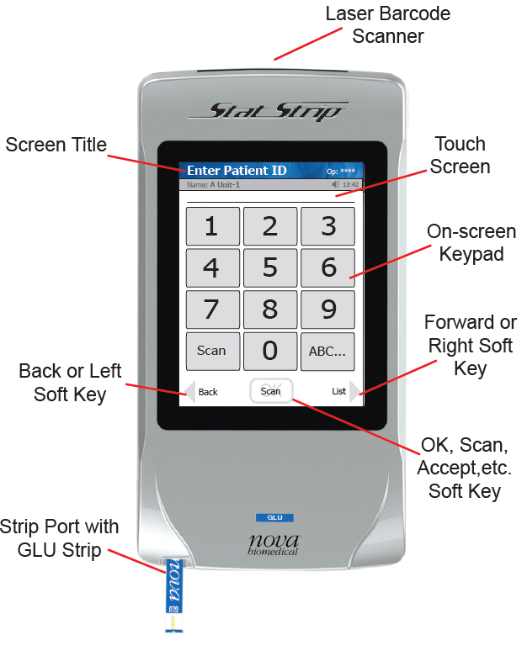
Operation Overview
Meter uses a touch screen for menu navigation and data entry On-screen keypad allows manual data entry of alphanumeric characters Meter provides audible feedback of user inputs such as key presses and barcode scans and audible and/or visual feedback for prompts and user alerts. A built-in barcode scanner provides automated data entry. **WARNING: Do not stare into the Laser light or point it toward

Slide 3
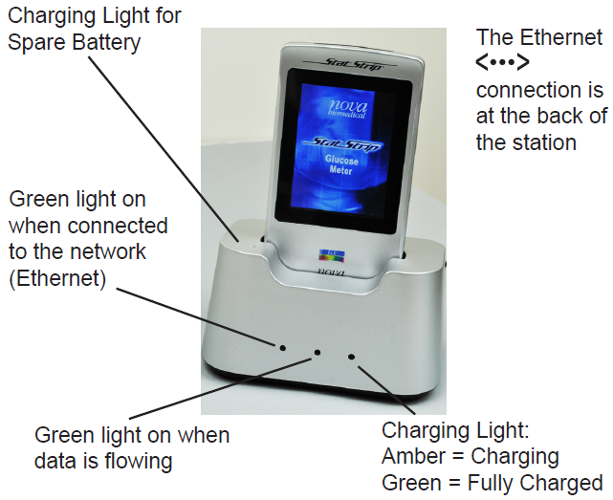
Operation Overview
Battery powered: 3.7 V Li Polymer battery (rechargeable/replaceable)
Desk-mount charging station
An LED indicator light to show the battery is charging: yellow indicates charging and green indicates fully charged.
Extra battery slot recharges and stores spare battery. An LED indicates the spare battery is charging or charged: amber indicates charging and green indicates fully charged.
When the meter is not in use, place it in the docking/ charging station. This will enable the meter to stay fully charged.

Slide 4
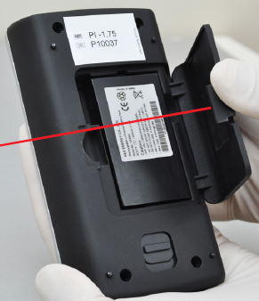
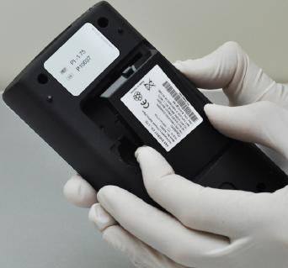
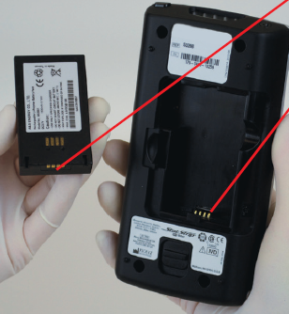
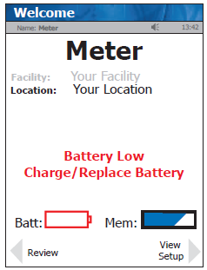
Operation Overview
When the Battery LOW symbol displays on the screen, place the meter into the Charging Station. If you have a spare battery that is fully charged, change the battery. Recharge dead battery in the docking station.
Cover Latch
Contact Pins
Changing the Battery
Switch to a spare fully charged battery to allow for continuous operation.
Press the Power button to enter the Sleep Mode. This will allow the operator approximately 20 seconds to change the battery and not lose date/time settings.
Pull back on the cover latch to release the cover. Take the battery cover off the back of the meter.
Push up on the battery latch. Remove the drained battery.
Replace with a fully charged battery by matching contact pins.
Close cover latch

Slide 5
Quality Control (QC) Testing
QC must be performed: Every 24 hours prior to patient testing (Two levels of controls – Level 1 & Level 3) **Note: Meters have a QC lockout function that prevents patient testing unless QC is performed successfully by a qualified operator. With each new operator The meter is dropped Results are questionable based on clinical signs & symptoms Issues (storage, operator, or instrument ) are identified or anytime there is a concern that the accuracy of the meter may have been affected by rough handling.

Slide 6
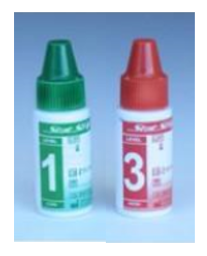
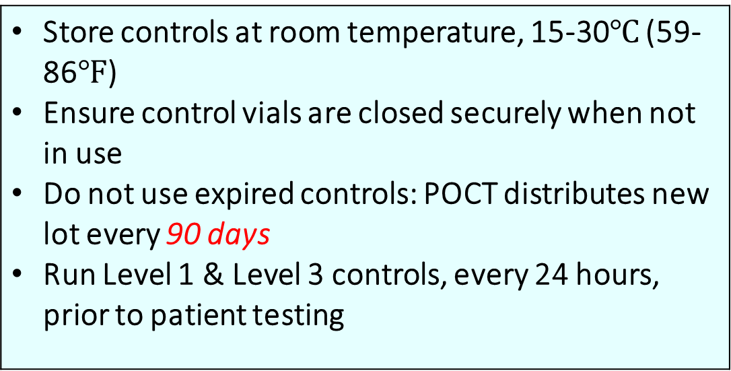
QC Solutions and Testing
Store controls at room temperature, 15-30$℃$ (59-86$℉$) Ensure control vials are closed securely when not in use Do not use expired controls: POCT distributes new lot every 90 days Run Level 1 & Level 3 controls, every 24 hours, prior to patient testing

Slide 7
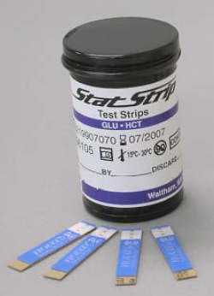
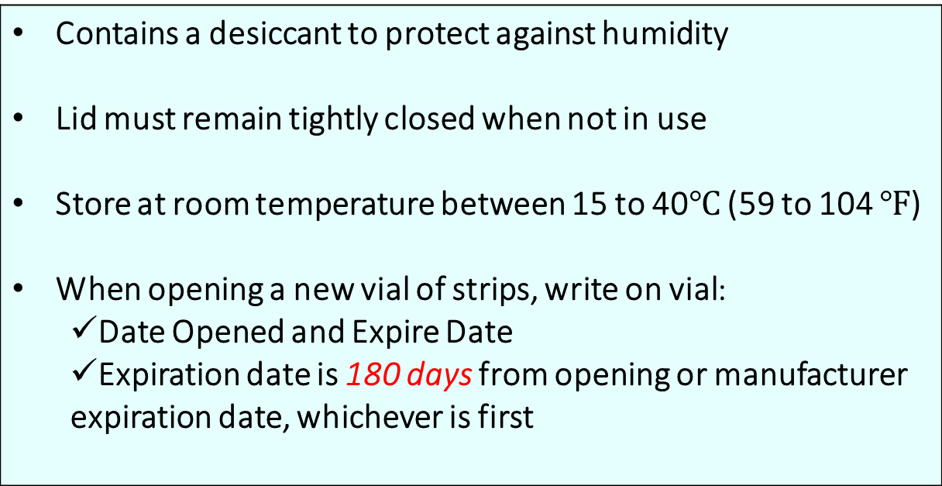
Nova StatStrip Test Vials
Contains a desiccant to protect against humidity Lid must remain tightly closed when not in use Store at room temperature between 15 to 40$℃$ (59 to 104 $℉$) When opening a new vial of strips, write on vial: Date Opened and Expire Date Expiration date is 180 days from opening or manufacturer expiration date, whichever is first

Slide 8
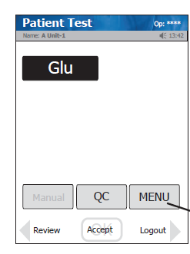
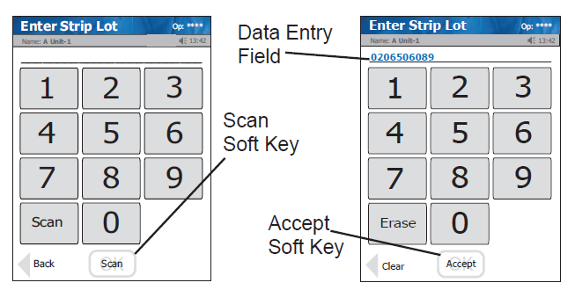
Performing Quality Control Testing
1. From the Patient Test Screen, Press the QC.
2. Scan strip lot number and press “Accept.”
*Note: If Strip lot number is invalid, the screen will display “ Not a valid strip lot # Try again.”

Slide 9
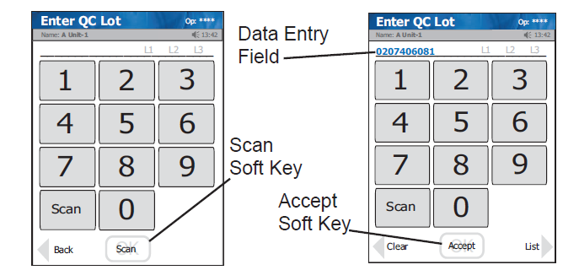
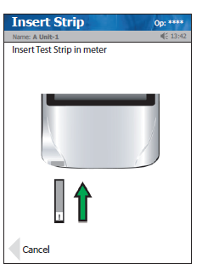
Performing Quality Control Testing
3. Scan QC lot number then press “Accept.”
*Note: If QC lot number is invalid, meter will display “Not valid QC lot. Try again.”
4. Insert test strip as shown on the screen.

Slide 10
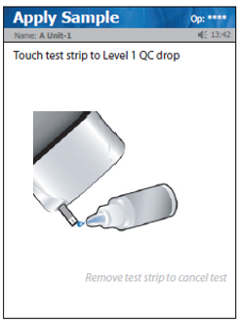
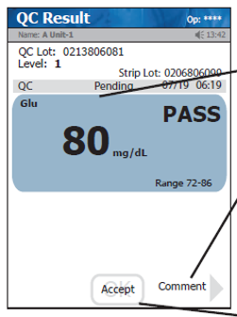
Performing Quality Control Testing
Test
Glu
PASS
Comment
7. Apply Sample screen displays
Accept
8. Gently mix control solution and discard the first drop to avoid contamination.
9. Place a drop of control solution at the end of the test strip. An audible beep is sounded when adequate sample has been applied.
10. Test completes and QC results are displayed as a PASS/FAIL. Remove strip manually or use ejector button.
11. If applicable, add a comment using the “comment key” or select “Accept” complete test.

Slide 11
Quality Control Troubleshooting
If a control level test is out of range: REPEAT Control level test
If control level test results are AGAIN out of range: OPEN a New Control vial and run test
If control test results CONTINUE to be out of range: Open a New Strip vial and run test
If control test results are STILL out of range: Notify POCT @ Pager 1-8012

Slide 12
Specimen Collection
Approved Testing for: Capillary Fingerstick Arterial Whole Blood Venous Whole Blood Neonatal Heel stick Neonatal Arterial Whole Blood Sample size 1.2 μL Remember to use Standard Precautions, including PPE, when obtaining blood samples and performing patient testing.

Slide 13
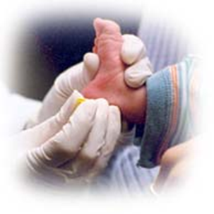
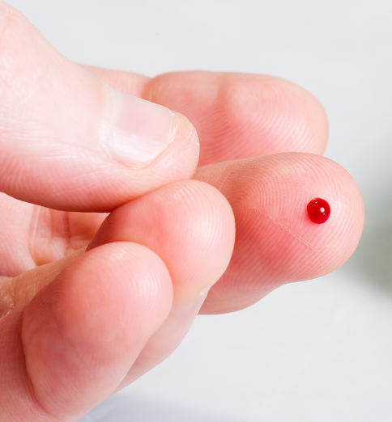
Capillary Specimen Precautions
Caution should be exercised when testing capillary whole blood due to potential pre-analytical variability in capillary specimen collection.
A capillary whole blood specimen relies on adequate, non-compromised capillary blood flow. The healthcare provider must be aware that a capillary whole blood specimen glucose result may not always be the same as an arterial or a venous whole blood glucose result, especially when the patient’s condition is rapidly changing.
If a capillary whole blood glucose result is not consistent with a patient’s clinical signs and symptoms, glucose testing should be repeated with either an arterial or venous specimen on the StatStrip Glucose Meter.

Slide 14
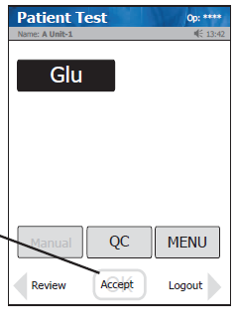
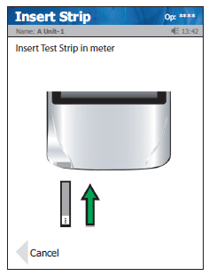
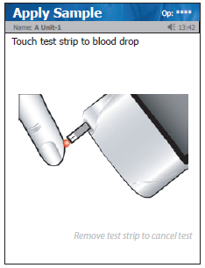
Patient Testing Procedure
Prior to patient testing, follow proper procedures to verify patient ID using two approved, and unique patient identifiers.
Scan Operator ID → select “Accept”
Scan Strip lot barcode → select “Accept”
Scan Patient ID: 10 digit CSN number from patient admission armband or chart label (Inpatient) or visit sticker (Ambulatory) → select “Accept”
Select Sample Type → select “Accept”
Insert test strip as shown in Figure 2, then the “Apply Sample” screen should be displayed.
Collect specimen, i.e Capillary Fingerstick, Arterial Whole Blood, Venous Whole Blood, Neonatal Heel stick, Neonatal Arterial Whole Blood according to protocol
When the blood drop appears, touch the end of the test strip to the blood until the well of the test strip is full. Meter will beep (Figure 3)
Results appear in 6 seconds
Remove the strip manually or use the ejector button on the back of the meter to eject the strip directly into a biohazard container.
Select “Accept” to complete test then clean & disinfect meter immediately.
1
2
3

Slide 15
Patient Testing- Result Alerts
Results within the normal range are displayed in Blue.
Results outside the normal range are displayed in Red.
Results outside the technical range of the meter (10-600 mg/dL), will display as < (low) or > (high)
A Single up arrow (↑) is displayed for a result if the value is higher than the upper end of the normal range
Single down arrow (↓) is displayed for a result if the value is lower than the lower end of the normal range
If results are outside specific action range:
• Select Comment “Repeat test” and repeat testing to confirm results.
• After confirmed repeat, select applicable comment(s) such as:
  Cleaned/Disinfected
  Initiate Hypoglycemia Protocol
  Caregiver Notified
  Sent to lab
  Followed appropriate protocol

Slide 16
Patient Testing- Result Alerts
If results are outside specific action range:
• Select Comment “Repeat test” and repeat testing to confirm results.
• After confirmed repeat, select applicable comment(s) such as:
  Cleaned/Disinfected
  Initiate Hypoglycemia Protocol
  Caregiver notified
  Sent to lab
  Followed appropriate protocol

Slide 17
Action Ranges
Age | Critical Low | Critical High
<1 month old | <40 mg/dL | >200 mg/dL
>1 month old | <50 mg/dL | >450 mg/dL
Hypoglycemia Protocol
Re-check POC BG within 30 minutes of the first POC BG test: <70mg/dL (non-pregnant) <60mg/dL (pregnant).

Slide 18
Cleaning & Disinfecting Meter
Clean & Disinfect meter with hospital approved disinfectant after each patient test
Clean Meter | Disinfect Meter
Wear protective gloves Make sure test strip is removed from meter Lay meter on a flat surface Obtain a fresh, hospital approved, germicidal wipe Wipe external surface of meter thoroughly with fresh wipe Discard used wipe and gloves appropriately | Wear protective gloves Use fresh Clorox bleach germicidal wipe to thoroughly wipe surface of the meter (top, bottom, left & right sides) Avoid the barcode scanner and electrical connector when wiping Ensure meter surfaces stay wet for 1 minute and allow to air dry for an additional minute Discard used wipe and gloves appropriately

Slide 19
Troubleshooting
Problem | Recommended Solution
Reviewing Results | From Patient Test screen, press “Review” and retrieved desired result from list
Low Battery | Place meter on docking station to charge battery
Analysis Canceled | Test has been canceled. Repeat test with new strip.
Temperature Out of Range Error | Meter will only work within the temperature range of 59- 104°F (15-40°C)
Bad Sample Error | Insert a new strip and rerun test. If error persists, open a new vial of strips
Replace Strip Error | Occurs after insertion of strip or occurs during analysis. Insert another strip and retest.
Flow Error | Specimen was incorrectly drawn into the test strip due to insufficient or incorrect sample application. Repeat test with new strip.
Transfer Failed | Check network connectivity, un-plug & re-plug network cable from dock. If problem persists, contact POCT @ Pager1-8012 OR- Meter was removed from dock before transfer was complete. Re-dock meter

Slide 20
Transmission of Results
The Nova Stat Strip glucometer utilizes wireless technology for the transmission of glucose results.
Eliminates the need to return the meter to the docking station for uploading patient results between each patient
However, the meter must be returned to the docking station for battery recharging and to receive full communication with device manager for operator & reagent updates.

Slide 21
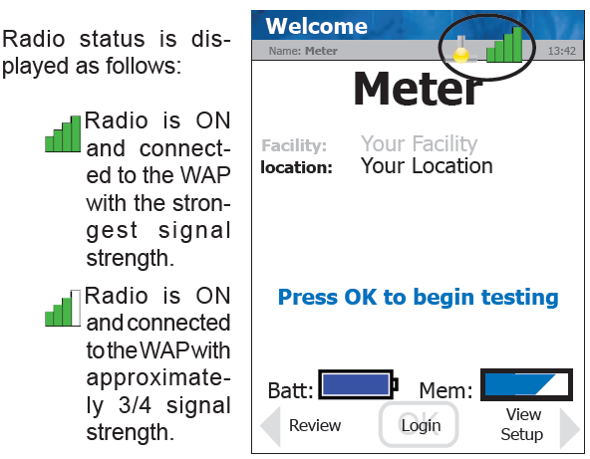
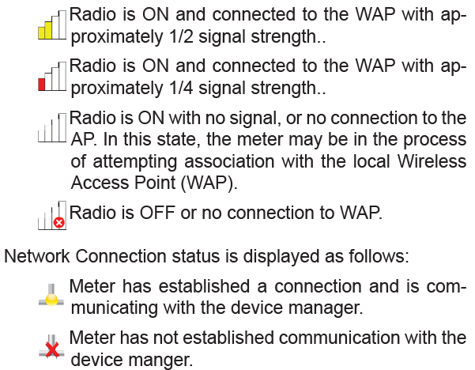
Radio and Network Connection Status
Radio and Network Connection status on meters equipped with the wireless option is displayed via icons on the Screen Title Bar.

Slide 22
Resources
Point-of-Care Testing
On-site hours: Monday – Friday
6am-6pm
24/7 Availability for Emergent Needs: Pager: 1-8012
Non-emergencies: Email poct-communication@musc.edu
POCT Website:
https://horseshoe.musc.edu/clinical/clinservices/lab-poc

