Slide 1
AmniSure Ruptured Membranes Assessment Module

Slide 2
AmniSure
AmniSure ROM is a point of care test that can aid in the detection of ROM in pregnant women reporting signs, symptoms, or complaints suggestive of ROM.

Slide 3
Patient Criteria for AmniSure Testing
<37weeks 0 days gestation, not in active labor with possible ruptured membranes
≥37 weeks 0 days gestation, not in active labor with equivocal testing (negative pooling, negative amniostat, negative ferning)
The AmniSure may be used on additional patients at the discretion of the attending or resident

Slide 4
How AmniSure Works
Uses the principles of immunochromatograpahy to detect human PAMG-1 (placental α1-microglobulin) protein present in amniotic fluid of pregnant women
High levels of PAMG1 are found in amniotic fluid, conversely, extremely low levels are found in blood and cervicovaginal discharge when the fetal membranes are intact

Slide 5
Precautions
Storage
Kits are stored in a dry place at (4-24ºC)
Do not use expired kits
Do not reuse swabs
Do not bend or fold the test strip or the aluminum foil pouch

Slide 6
Quality Control
(QC)
Reagents
Negative-Saline
Positive-reconstituted freeze dried PAMG-1 protein
Frequency
New shipment/lot, monthly thereafter
Clinical symptoms do not match results
Suspicion that product performance is compromised or when kits have not been stored according to manufacturer instructions

Slide 7
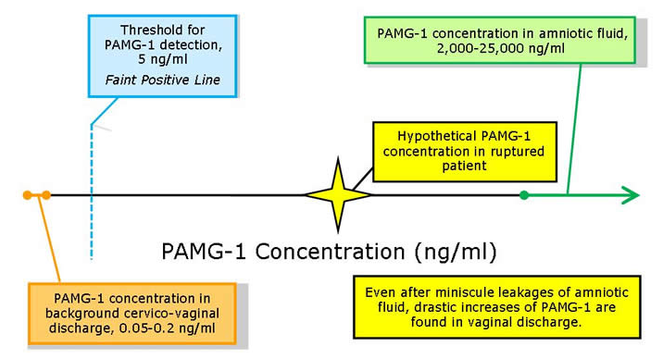
AmniSure: Procedure Detection of PAMG-1

Slide 8
AmniSure: Procedure Step 1 – Specimen Collection
Insert 2-3 inches deep (no speculum needed)
Hold in place for 1 minute to ensure saturation
Ensure that provided sterile swab touches nothing prior to insertion

Slide 9
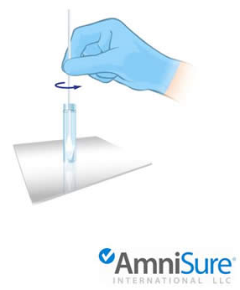
AmniSure: Procedure Step 2 - Extraction
Shake solvent vial to ensure all liquid in the vial has dropped on the bottom
Insert swab into vial
Rotate specimen in vial for 1 minute
Dispose of swab. DO NOT break off swab and leave in vial

Slide 10
AmniSure: Procedure Step 3 – Testing Sample
Insert test strip with arrows facing down into vial within 30 minutes of sample collection
Remove test strip from the vial if two lines are visible or after 10 minutes sharp
Place on dry, flat surface to read. DO NOT read after 15 minutes

Slide 11
AmniSure: Procedure Timing
Collecting sample – 1 minute for saturation of swab
Diluting sample – 1 minute rotation in vial
Testing sample – within 30 minutes of dilution
Running test – remove test strip from vial if 2 lines are visible or after 10 minutes sharp
Reading test – DO NOT read after 15 minutes

Slide 13
Test Limitations
Significant presence of blood
Rupture occurred more than 12 hours (false negative)
Earlier than 6 hours after removal of any disinfectant solutions or medicines from the vagina
If any of the following contaminants are found: meconium, anti-fungal creams/suppositories, KY jelly, Monistat, baby powder, Replens, baby oil
Results should be used in conjunction with other clinical information
Any patient result that is inconsistent with patient’s
clinical condition should be repeated.

Slide 14
Remember to Check the Following:
There are no cleansing agents or medicines applied that could destroy the sample
Procedural timing was strictly followed
The provided sterile swab touched nothing prior to insertion
The test strip was not bent or damaged
There are no significant blood admixture
The test kit was stored according to manufacturer instructions between 4-24ºC or 40-75ºF

Slide 15
Frequently Asked Questions:
Is a faint line a positive result?
Yes, even faint and broken lines are a positive result.
What is the maximum time between the sample collection and insertion of the strip into the vial?
Up to 30 minutes. If the sample is not run within 30 minutes, refrigerate up to 6 hours.
What is the maximum time between opening the test strip and using it?
You can leave a test strip open for up to 6 hours.
What do I do if liquid doesn’t flow up the strip?
Flick the vial lightly with your finger and/or shake the vial a little bit to help the lateral flow.

Slide 16
REMINDER: Patient Criteria for Routine AmniSure Testing
<37weeks 0 days gestation, not in active labor with possible ruptured membranes
≥37 weeks 0 days gestation, not in active labor with equivocal testing (negative pooling, negative amniostat, negative ferning)
The AmniSure may be used on additional patients at the discretion of the attending or resident

Slide 17
Please watch the AmniSure Training Video. To view the video, click on the Exit Course button at the top right of this screen. Then click on AmniSure Training Video link in the course activities and view.
After viewing the video, you may proceed to the Post Exam.
The videos may take 1-2 minutes to load. If you encounter technical difficulties, please contact the IT Service Desk at 535-7010.
Reminder: All course learning activities must be completed in order to receive credit for completion of this course.

