Slide 1
Ruptured Membranes Assessment Module
© Copyright 2020 Clinical Innovations, LLC. ART-0194-Rev 02
Notes:
The aim of this presentation is to provide you with an introduction to the ROM Plus Rupture of Membranes Test.

Slide 2
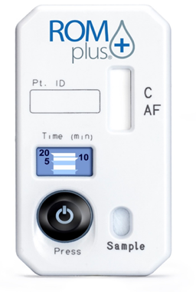
ROM plus
ROM plus is a point of care test that can aid in the detection of ROM in pregnant women reporting signs, symptoms, or complaints suggestive of ROM.

Slide 3
Diagnosing Rupture of Membranes
Sterile Speculum Exam (SSE)
Pooling
Nitrazine
Ferning
*Diagnosis requires at least 2 of 3 to be confirmed positive
Sensitivity: 51-98%
Specificity: 16-88%
Caughey, et al. Rev. Obstet. Gynecol. 2008, 1:11-22
Notes:
Now let’s discuss the different methods used to diagnose the rupture of membranes
A sterile speculum exam or SSE can consist of three different types of testing, pooling, nitrazine and ferning.
In order to diagnosis the rupture of membranes using the sterile speculum exam 2 out of 3 of the tests need to result in a positive result.
The accurate diagnosis of ROM is crucial, especially in cases of P-PROM, as you can see in the published sensitivity and specificity data, SSE has a very wide range of accuracy for diagnosis.
While SSE is still common, especially with residency programs, it’s somewhat antiquated and its performance is not always ideal

Slide 4
ROM Plus Rupture of Membranes
Rapid, qualitative immunoassay test for rupture of fetal membranes
No gestational age limitations
Detects amniotic fluid proteins in cervicovaginal secretions of pregnant women
Insulin-like Growth Factor Binding Protein-1 (IGFBP-1)
Alpha-Fetoprotein (AFP)
Uses unique monoclonal and polyclonal antibody approach
Notes:
Now let’s discuss the ROM Plus and some of the key features and benefits.
ROM Plus is a Rapid, qualitative immunoassay test for the rupture of fetal membranes
ROM Plus has no gestational age limitations
The test detects two amniotic fluid proteins in vaginal secretions of pregnant women
Insulin-like Growth Factor Binding Protein-1 or (IGFBP-1)
and Alpha-Fetoprotein or (AFP)
ROM Plus uses unique a monoclonal and polyclonal antibody approach

Slide 5
Why IGFBP-1 & AFP?
IGFBP-1 has been recognized in the literature as an excellent marker for amniotic fluid
Present in high levels during all 3 trimesters
100-1,000X higher concentrations in AF than other bodily fluids
AFP peaks during the 2nd trimester and then declines
Increases ROM Plus’ accuracy in preterm patients
100-1,000X higher concentrations in AF than other bodily fluids
Notes:
Why does ROM plus detect two proteins?
IGFBP-1 has been recognized in the literature as an excellent marker for amniotic fluid
It is shown to be present in high levels during all 3 trimesters
IGFBP-1 has 100-1,000 times higher concentrations in amniotic fluid than other bodily fluids
AFP peaks during the 2nd trimester and then declines
This increases ROM Plus’ accuracy in preterm patients
It also has100 to 1,000 times higher concentrations in amniotic fluid than other bodily fluids

Slide 6
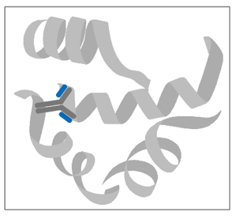
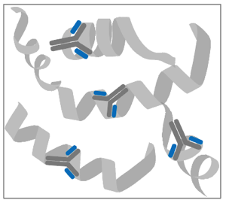
How ROM Plus works
Uses the principles of immunochromatograpahy to proteins present in amniotic fluid of pregnant women.
Detects two proteins-AFP and IGFBP-1
Uses both monoclonal and polyclonal antibodies to detect proteins
May reduce potential effects of protein degradation
Decreases potential false negatives
Reducing chance of discharging a patient who is ruptured
Monoclonal Antibody
Polyclonal Antibodies
Notes:
In addition to the detection of two proteins ROM Plus uses monoclonal and polyclonal antibodies to detect proteins.
this may reduce potential effects of protein degradation and decreases potential false negatives, reducing the chance of discharging a patient who is ruptured

Slide 7
Patient Criteria for ROM plus Testing
No gestational age limit.

Slide 8
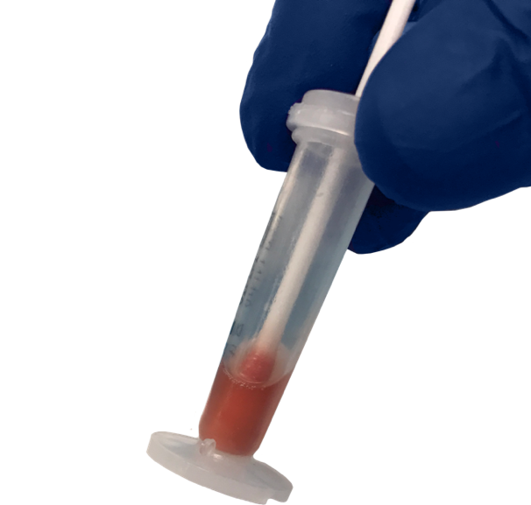
ROM plus
Tested to work with up to 10% concentration of whole blood
Ease of Use
15 second vaginal swab
15 second mix buffer solution
Spill resistant vial
Notes:
In addition, ROM plus has been tested to work with up to 10% concentration of whole blood.
ROM Plus is very user friendly and simple to use. It only requires a 15 second vaginal swab, followed by 15 seconds in a mixed buffer solution. The mixed buffer solution is housed in a easy to use spill resistant vial.
Lastly, we offer a money back guarantee for the product.

Slide 9
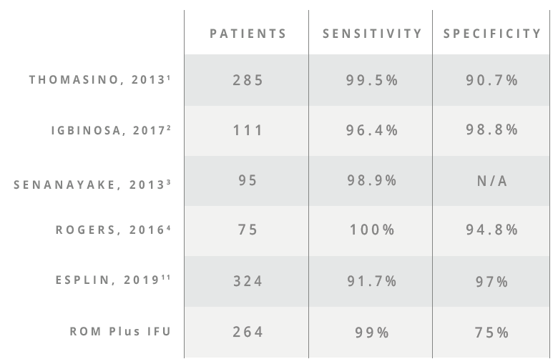
ROM Plus Performance Metrics
Thomasino T, Levi C, Draper M, Neubert AG. Diagnosing rupture of membranes using combination monoclonal/polyclonal immunologic protein detection. J Reprod Med. 2013;58(5–6):187–194.
Igbinosa, Irogue & A. Moore, Ferney & Johnson, Cheri & Block, Jon. (2017). Comparison of rapid immunoassays for rupture of fetal membranes. BMC Pregnancy and Childbirth. 17. . 10.1186/s12884-017-1311-y.
Senanayake HM. Actim™ PROM, ROM plus®, and ROM+plus®: Rupture of membrane kits tested on amniotic fluid from women at C-section: a comparative study. Sri Lanka Journal of Obstetrics and Gynaecology. 2013; 116-121.
Rogers LC, Scott L, Block JE. Accurate point-of-care detection of ruptured fetal membranes: improved diagnostic performance characteristics with a monoclonal/polyclonal immunoassay. Clin Med Insights Reprod Health. 2016;10:15–8.
11. Esplin, et. al. Prospective evaluation of the efficacy of immunoassays in the diagnosis of rupture of the membranes. J Matern Fetal Neonatal Med. 2019 Jan 13:1-7. doi: 10.1080/14767058.2018.1555809. [Epub ahead of print]
Notes:
ROM Plus has been show to provide reliable sensitivity in all gestational ages.
There are several different papers and studies that show the ROM Plus performance metrics. These metrics are cited in our collateral and on our website along with our packing and Instruction for Use.
We invite you to visit Clinical Innovations.com/ROM Plus to view these difference clinical studies.

Slide 10
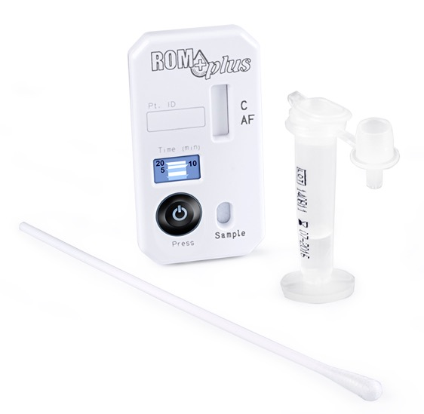
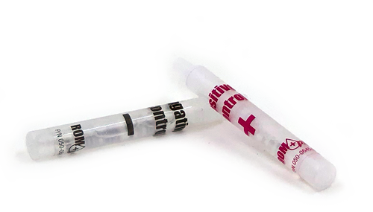
ROM Plus Test Components
Cassette
Buffer
Control Vials
Sterile Swab
Notes:
ROM Plus is offered in two convenient packaging configurations depending on how your facility prefers to read the test.
The ROM-5025 is designed for Point of care testing with the collection and test result items packaged together
While the ROM-6025 is designed for labor and delivery collection with lab testing.
We also offer the ROM-QC, a quality control package that is easy to use and cost effective.

Slide 11
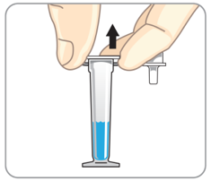
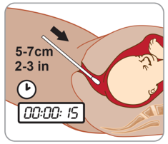
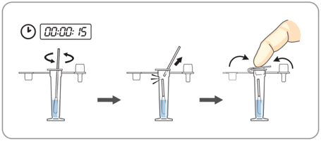
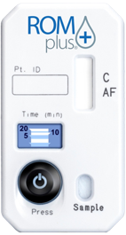
Test Procedure
See Package Insert for Full Instructions, Warnings, Precautions & Contraindications
1
2
3
4
Remove ROM Plus contents from packaging. Holding buffer vial upright, remove shipping cap and set vial aside.
Remove sterile swab to collect sample. Swab tip should not touch anything prior to its insertion. Insert swab tip into vagina 2-3 inches (5-7 cm) deep. Withdraw swab after a minimum of 15 seconds.
Place swab tip into vial and mix in buffer solution for at least 15 seconds. Break off swab tip at the scored mark and leave swab tip in the vial. Replace dropper cap on vial and dispose swab stick.
Tear open foil pouch and remove ROM Plus® cassette.
Notes:
I will now walk through the test procedure with you. We also provide these instructions in a easy to use quick reference guide that you can find on our website.
First, Remove ROM Plus contents from packaging. Holding the buffer vial upright and remove the shipping cap and set the vial aside.
Second, Remove the sterile swab to collect a sample. The swab tip should not touch anything prior to its insertion. Insert the swab tip into the vagina 2 to 3 inches or (5 to 7 cm) deep. Withdraw the swab after a minimum of 15 seconds.
Third, Place the swab tip into the vial and mix in buffer solution for at least 15 seconds. Break off the swab tip at the scored mark and leave the swab tip in the vial. Replace the dropper or shipping cap on vial and dispose swab stick.
Fourth, tear open the foil pouch and remove the ROM Plus Cassette.

Slide 12
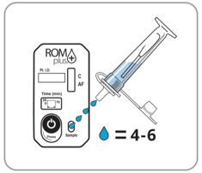
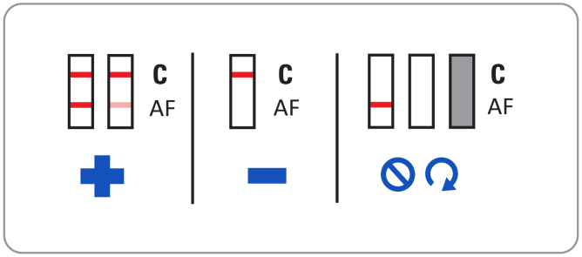
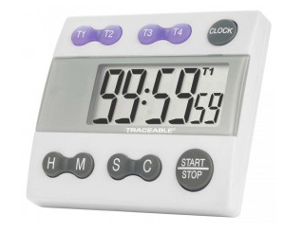
Test Procedure Cont.
See Package Insert for Full Instructions, Warnings, Precautions & Contraindications
5
6
7
Add 4-6 drops to the sample well in cassette.
Set external timer to 20 minutes. Wait 5-20 minutes for test results to manifest in test window (C/AF). A positive test result may be visible within 1-3 minutes or may take the full 20 minutes. Darkness of the stripes may vary, however test is valid even if stripes are faint. Do not interpret test results based on darkness of stripes.
Read test result. If only a control line (C) is visible, the test result is negative. If both the control line (C) and test result line (AF) are visible, the test result is positive. If no lines are visible, or just the test line (AF) is visible, the test result is invalid. A light visible line located in the test (AF) region should be considered a positive. In addition, very high concentrations of proteins may result in a light test (AF) line. It is recommended to read the strip by 20 minutes.
Notes:
Fifth, add 4 to 6 drops to the sample well in the cassette.
Sixth, Start the timer by firmly pressing and rolling your thumb over the timer button from bottom to top. Wait 5 to 20 minutes for test results to manifest in test window. A positive test result may be visible within 1-3 minutes or may take the full 20 minutes. Darkness of the stripes may vary, however test is valid even if stripes are faint. Do not interpret test results based on darkness of stripes.
Seventh, Read the test result. If only a control line, the C, is visible, the test result is negative. If both the control line and test result line, the AF, are visible, the test result is positive. If no lines are visible, or just the test line is visible, the test result is invalid. A light visible line located in the test region should be considered a positive. In addition, very high concentrations of proteins may result in a light test line. It is recommended to read the strip by 20 minutes.

Slide 13
Quality Control (QC)
Reagents
Negative-Saline (self-contained glass ampoule of buffer)
Positive-lyophilized human amniotic fluid (self-contained glass ampoule of buffer)
Frequency
New shipment/lot
Clinical symptoms do not match results
Suspicion that product performance is compromised or when kits have not been stored according to manufacturer instructions

Slide 14
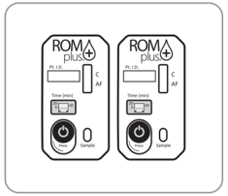
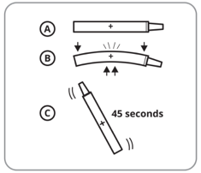
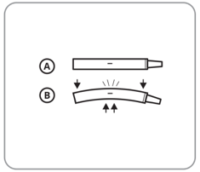
Quality Control Procedure
See Package Insert for Full Instructions, Warnings, Precautions & Contraindications
1
2
3
Prepare Test Cassettes
Prepare two ROM Plus test cassettes, one for the Positive Control and one for the Negative Control. Since this is a quality control test and no human sample is required, the polyester vaginal swab and standard dropper vial should not be used.
Prepare Positive Control
Tear open the Positive Control Vial foil pouch and remove the vial. Place the vial in the safety sleeve, gently squeeze and bend to break the Positive control glass vial inside. Mix the buffer with the lyophilized positive sample for at least 45 seconds. Be careful not to let the sample drip out of the vial.
Prepare Negative Control
Gently bend or squeeze the Negative Control Vial, breaking the glass ampoule inside. Be careful not to let the sample drip out of the vial.
Notes:
Now, I will walk you through the quality control procedure.
First, prepare two ROM Plus test cassettes, one for the Positive Control and one for the Negative Control. Since this is a quality control test and no human sample is required, the polyester vaginal swab and standard dropper vial should not be used.
Second, tear open the Positive Control Vial foil pouch and remove the vial. Place the vial in the safety sleeve, gently squeeze and bend to break the Positive control glass vial inside. Mix the buffer with the lyophilized positive sample for at least 45 seconds. Be careful not to let the sample drip out of the vial.
Third, gently bend or squeeze the Negative Control Vial, breaking the glass ampoule inside. Be careful not to let the sample drip out of the vial.

Slide 15
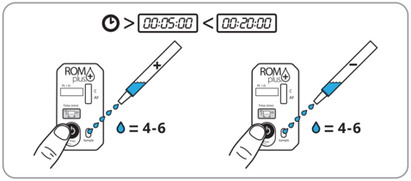
Quality Control Procedure Cont.
See Package Insert for Full Instructions, Warnings, Precautions & Contraindications
4
5
Run Tests
• Add 4-6, or more, drops of the Positive Control solution to one ROM Plus test cassette.
• Add 4-6, or more, drops of the Negative Control solution to the other ROM Plus test cassette.
Start the external timers. Wait 5-20 minutes for test results to manifest in test window (C/AF).
Read Test Results
Read the test results from 5 to 20 minutes. Only a control line (C) should be visible for the negative control. Both the control line (C) and test line (AF) should be visible for the positive control. The test is positive even if the stripes are faint.
The external positive control is four times the threshold cutoff concentration prior to dilution of the patient sample with extraction buffer, and will appear at approximately 5 minutes; however, the full 20 minutes should be used before interpreting final results. Do not interpret test results based on the darkness of the stripes. It is recommended to read the strip by 20 minutes.
Notes:
Fourth, Add 4-6, or more, drops of the Positive Control solution to one ROM Plus test cassette. Then Add 4-6, or more, drops of the Negative Control solution to the other ROM Plus test cassette. Start the timers on each cassette by firmly pressing and rolling thumb over the timer button from left to right. Wait 5-20 minutes for test results to manifest in test window (C/AF).
Fifth, Read the test results from 5 to 20 minutes. Only a control line (C) should be visible for the negative control. Both the control line (C) and test line (AF) should be visible for the positive control. The test is positive even if the stripes are faint. The external positive control is four times the threshold cutoff concentration prior to dilution of the patient sample with extraction buffer, and will appear at approximately 5 minutes; however, the full 20 minutes should be used before interpreting final results. Do not interpret test results based on the darkness of the stripes. It is recommended to read the strip by 20 minutes.

Slide 16
ROM Plus Summary
Reliable sensitivity delivered conveniently and cost effectively
Detects “2 Proteins 2 Ways”
AFP & IGFBP-1
Monoclonal and Polyclonal antibodies
No gestational age limitations
Tested with blood
No loss of activity in samples containing up to 10% blood concentration
Configured for either Lab or L&D interpretation
15 second vaginal swab, 15 second mix in the buffer solution
Specimen stable for 6 hours after collection
Test cassette & spill resistant vial
External QC stays at room temperature with no reconstitution or special storage needed
Notes:
In summary, ROM Plus delivers Reliable sensitivity conveniently and cost effectively
Rom Plus Detects “2 Proteins 2 Ways” by detecting AFP & IGFBP-1 and using Monoclonal and Polyclonal antibodies
There are no gestational age limitations
With No loss of activity in samples containing up to 10% blood concentration
While also being Configured for either Lab or L&D interpretation
The ease of use with the 15 second vaginal swab, 15 second mix in the buffer solution and the Specimen being stable for 6 hours after collection
Includes a Test cassette with built in timer & spill resistant vial
The convenient offering of an External QC which stays at room temperature with no reconstitution or special storage needed
And lastly we offer Turn Key Installation: including IQCP, correlation, validation, competency materials, on-site training and customer service

Slide 17
Precautions
Store the kit in a dry place at 4° to 37°C (40° to 99°F). Do not freeze.
When stored in the foil pouch at the recommended temperature, the test is stable until the “Expiration” date on the pouch.
Use ROM Plus within six (6) hours after opening foil pouch.
Use ROM Plus within six (6) hours of collecting the vaginal swab sample and placing it into the buffer vial
Do not use expired kits
Do not reuse swabs

Slide 18
Test Limitations
ROM diagnoses should not be based on any single test.
ROM Plus is for in vitro diagnostic use only.
ROM Plus is for healthcare professional use only.
Allow pouch containing ROM Plus to reach room temperature prior to utilizing the test.
All instructions should be followed carefully for accurate results.
Each ROM Plus test kit is single use and disposable and should not be reused.
ROM Plus results are qualitative. No quantitative interpretations should be made.
ROM Plus test kits will function properly with trace amounts of blood in the sample. Significant amounts of blood discharge may cause the test to malfunction and is not recommended.
Safety precautions should be observed when collecting, handling, and disposing of test samples. Used test kits are biohazardous.
Elevated fetal serum, urine, cord blood, and amniotic fluid as well as maternal serum levels of AFP have been reported in the literature in various developmental disorders such as neural-tube defects, hypothyroidism, autoimmune states, congenital heart defects, cystic fibrosis, etc. ROM Plus has not been evaluated for potential interference in these conditions.
Warning: The test may report positive results in patients with intact membranes (see specificity in the performance section) and therefore decisions to induce labor should not be based solely on the ROM Plus test results.
Any patient result that is inconsistent with patient’s
clinical condition should be repeated.

Slide 19
Potential Causes of False Negatives
Insufficient protein from the patient (high and/or minimal fluid leak)
Too much protein from patient which typically appears in patients with grossly rupture membranes (High Dose Hook effect)
Over-active vaginal proteases in the vaginal flora that break down the protein
User error-did not follow IFU

Slide 20
Potential Causes of False Positives
Proper IFU procedure not followed
Microtransudation of protein across the membranes as the membranes are stressed near term-causing a leakage of protein without a gross membrane rupture
Small, high leak
Potential for resealing of the membranes

Slide 21
Remember to Check the Following:
Procedural timing was strictly followed.
The provided sterile swab touched nothing prior to insertion.
Sample collected within 6 hours
There are no significant blood admixture.
The test kit was stored according to manufacturer instructions between 4-37ºC or 40-99ºF.

Slide 22
Frequently Asked Questions
Is a faint line a positive result?
Yes, even faint and broken lines are a positive result.
What is the maximum time between the sample collection and application of drops to cassette?
Up to 6 hours when swab is in buffer solution.
What is the maximum time between opening the test cassette and using it?
You can leave a test cassette open for up to 6 hours.
Does blood contamination affect the test result?
ROM Plus test kits have been tested up to 10% blood concentration. In other words, it will function properly with trace amounts of blood in the sample, however, significant amounts of bloody discharge may cause the test to malfunction. ROM Plus is not recommended for use in these situations and it should be determined what is causing the bleeding.
Will semen, urine or disinfectants interfere with test?
Tylenol, aspirin, Lever Soap, Noxema cream, Pert Shampoo, human semen, urine and blood were tested as possible interference’s and were shown to be negative. For additional information please see the ROM Plus IFU
Is there a time limit for reading the test?
Yes. The ROM Plus test is an immunoassay test and as with all immunoassay tests the results will diminish over time. Do not read the test results after 30 minutes have passed.

Slide 23
Frequently Asked Questions
Does blood contamination affect the test result?
ROM Plus test kits have been tested up to 10% blood concentration. In other words, it will function properly with trace amounts of blood in the sample, however, significant amounts of bloody discharge may cause the test to malfunction. ROM Plus is not recommended for use in these situations and it should be determined what is causing the bleeding.
What is sensitivity/specificity?
Sensitivity is the percentage probability that a positive test will occur in a patient who is really experiencing rupture of membranes, or the proportion of actual positives which are correctly identified as such. In a multi-site hospital study involving 285 patients, ROM Plus resulted in an overall sensitivity of 99% (see IFU for details). Specificity is the percentage probability that a negative test will occur in a patient who is not experiencing rupture of membranes, or the proportion of actual negatives which are correctly identified as such. Specificity also refers to the ability of the test to detect the correct result in the presence of interfering components that may be present in a sample matrix (i.e., blood, urine, semen, etc.). ROM Plus resulted in an overall specificity of 85%.
Are there gestational age limitations for using ROM Plus?
ROM Plus does not have any gestational age limits.

Slide 24
ROM plus Training Video
To view the ROM plus Training video, click on the “Exit Course” button at the top right of this screen then click on ROM plus Training Video and view.
The videos may take 1-2 minutes to load. If you encounter technical difficulties, please contact the IT Service Desk at 535-7010.
After viewing the video, proceed to the Post Exam so you may receive credit for completing this course.
Reminder: After you complete an exam for a course, you may access the course again at any time from the “Completed” tab in the HPH Learning Center.

