Slide 2
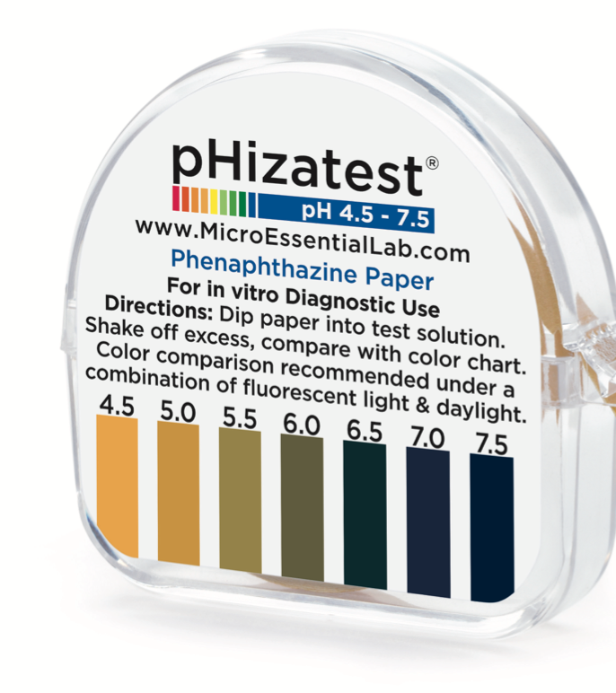
Product Description
pHizatest paper is a nitrazine indicator paper intended for in-vitro, semi quantitative determination of pH in the 4.5 – 7.5 range

Slide 3
Results
Visual comparison of colors between the test paper and the color chart will yield results in clinically meaningful units
BV detection
Amniotic fluid detection

Slide 4
Storage and Shelf Life
Store at room temperature, out of direct sunlight
Shelf life is 6 months

Slide 5
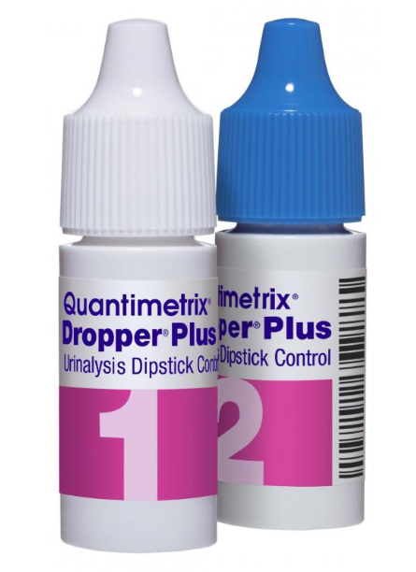
Quality Control
Complete with each new roll and every 30 days.
1. Dispense a drop from level 1 Quantimetrix dropper onto pH strip.
2. Read immediately.
3. Repeat with level 2 Quantimetrix dropper.
4. Log results on QC Log

Slide 6
Procedure
Remove 1 – 2 inches of pH paper
pHizatest may be applied directly to pooled vaginal fluid or vaginal fluid on a cotton swab
Observe for immediate color change

Slide 7
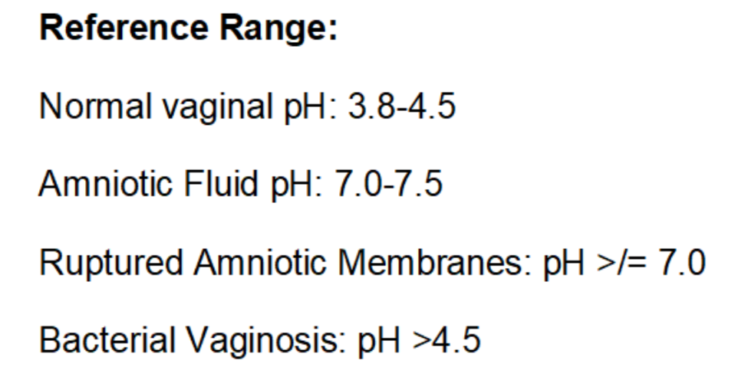
Interpretation

Slide 8
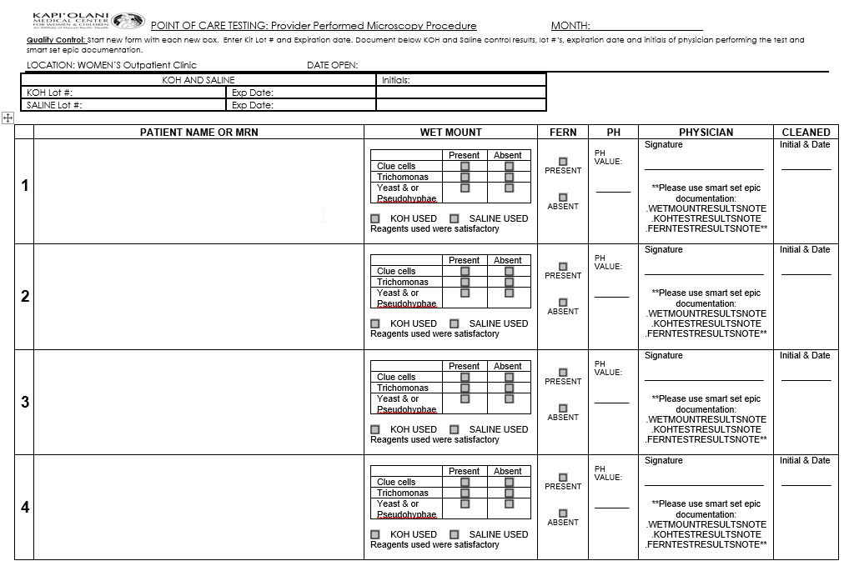
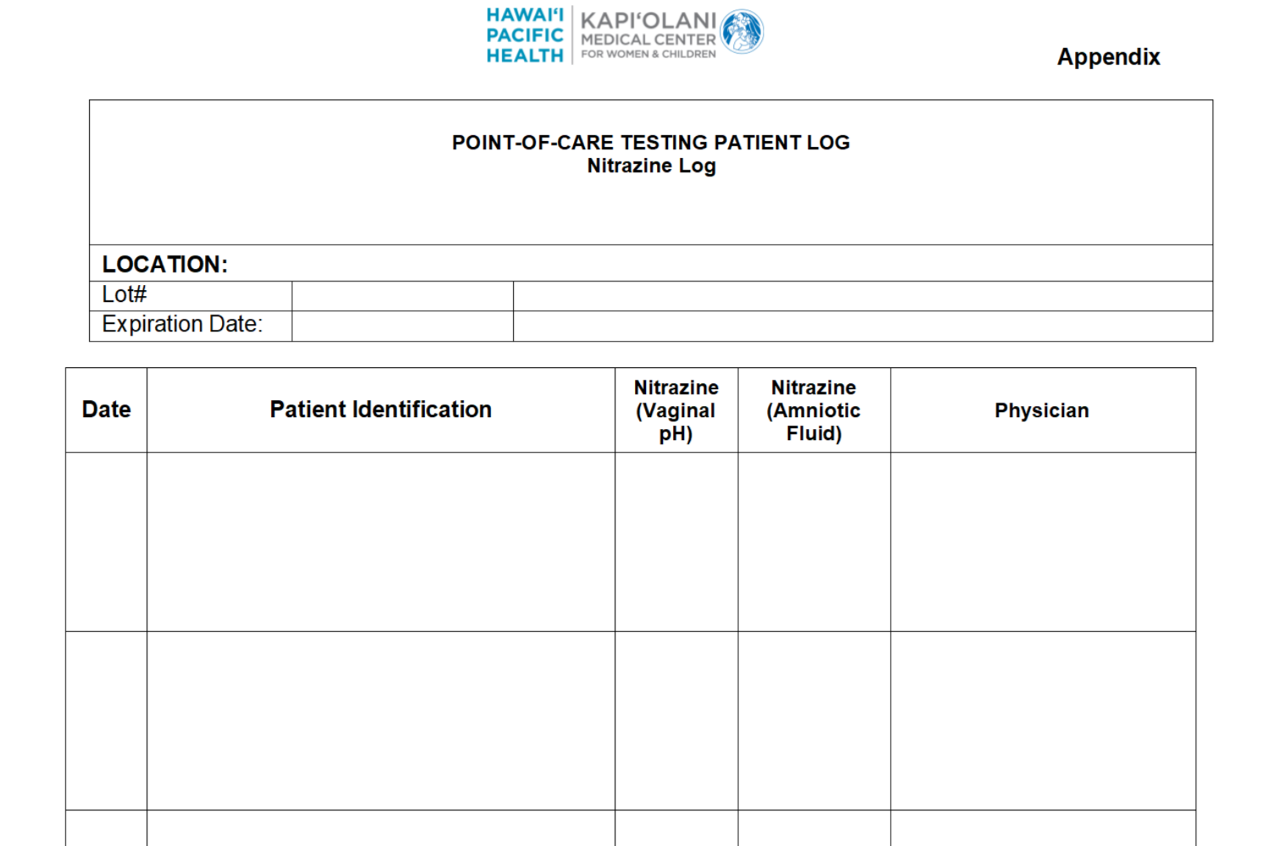
Result Reporting
Document in epic and appropriate patient log

Slide 9
Documentation in EPIC

Slide 10
Documentation in EPIC cont’d

Slide 11
Mahalo!

