Slide 1
i-STAT hs-TnI Cartridge
PERFORMING A PATIENT TEST | i-STAT 1 SYSTEM

Slide 2
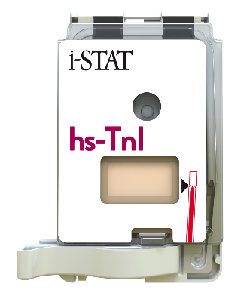

Learning Objectives
PERFORMING A PATIENT TEST | i-STAT hs-TnI CARTRIDGE
UNDERSTAND THE FOLLOWING:
CARTRIDGE OVERVIEW
RUNNING
A TEST
ERRORS
Cartridge Overview
Running a Test
Troubleshooting Errors

Slide 3
PERFORMING A PATIENT TEST
i-STAT hs-TnI Cartridge

Slide 4
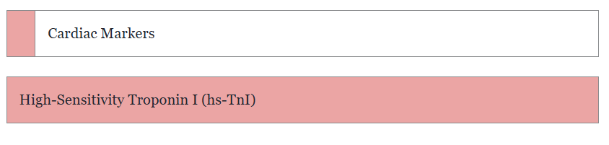
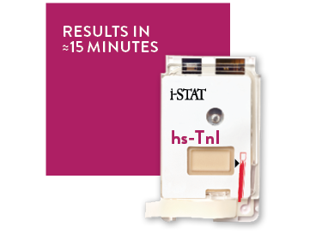
Cartridge Overview
CARTRIDGE
OVERVIEW
RUNNING
A TEST
ERRORS

Slide 5
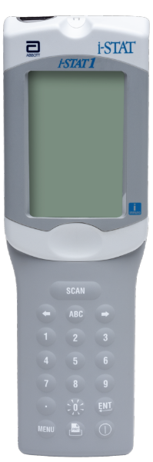
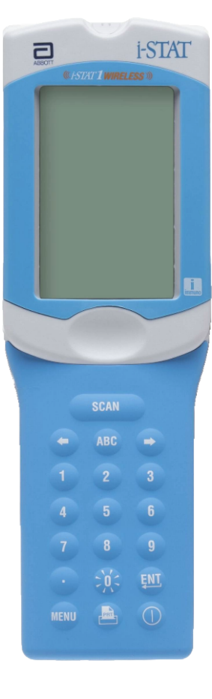

Cartridge Overview
CARTRIDGE
OVERVIEW
RUNNING
A TEST
ERRORS
INTENDED USE
The i-STAT hs-TnI cartridge with the i-STAT 1 System is intended for use in the in vitro quantification of cardiac troponin I (cTnI) in whole blood or plasma samples in point of care or clinical laboratory settings.
The i-STAT hs-TnI cartridge with the i-STAT 1 System is intended to be used as an aid in the diagnosis of myocardial infarction (MI).
SYSTEM COMPATIBILITY
The i-STAT hs-Tnl cartridge is compatible with the
i-STAT 1 Analyzer with the immuno symbol "i"

Slide 6
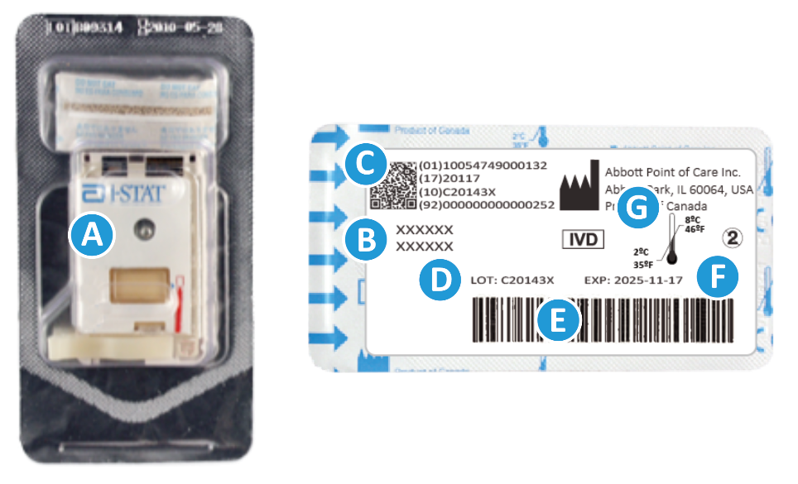
Cartridge Overview – cont’d
CARTRIDGE INFORMATION ON PORTION PACK
  On each cartridge packaging, there is important information to locate
  A Cartridge name
  B Analytes – measured and calculated, if applicable
  C 2D barcode for manufacturing quality control,
  not scannable
  D Cartridge LOT number
  E Cartridge portion pack barcode
  F Refrigerated storage expiration date
  G Refrigerated Temperature storage range

Slide 7

Cartridge Overview – cont’d
ANATOMY OF A CARTRIDGE
On each cartridge, there are important areas to note:
A Contact pads & sensors (do not touch)
B Calibrant pack or analysis fluid, if applicable
(do not touch)
C Cartridge closure
D Fill to mark
E Sample well
F Sample chamber
TOP
TOP
A
B
D
F
C
E
BOTTOM

Slide 8
PERFORMING A PATIENT TEST
Running a Test

Slide 9

Before Beginning
CARTRIDGE
OVERVIEW
RUNNING
A TEST
ERRORS
QUICK TIPS
The cartridge and analyzer must be at room temperature (18-30° C or 64-86° F) to perform the test
Allow one cartridge to come to room temperature for 5 minutes or one box of cartridges for 1 hour
Allow the instrument to come to room temperature for 30 minutes
For customers with Data Management, the minimum requirement for seamless data integration is i-STAT/DE v2.10. Contact your data management vendor if you require assistance.

Slide 10

Before Beginning – cont’d
CARTRIDGE
OVERVIEW
RUNNING
A TEST
ERRORS
PRECAUTIONS
DO keep cartridge and instrument at the temperature of the room where they are to be used. Condensation on a cold cartridge can prevent proper contact with the instrument
DO NOT return cartridges to the refrigerator after bringing them to room temperature
DO NOT use a cartridge that is expired, shows signs of damage or if the clear plastic portion pack has been punctured
DO NOT place the cartridges and/or instrument in an oxygen-enriched atmosphere

Slide 11
Before Beginning – cont’d
CARTRIDGE
OVERVIEW
RUNNING
A TEST
ERRORS
PRECAUTIONS
The i-STAT hs-TnI test shows increased imprecision for whole blood samples with hematocrit values above 57 %PCV.
For patients with hematocrit over 55 %PCV, plasma samples should be used instead of whole blood to ensure accuracy.

Slide 12
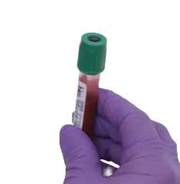
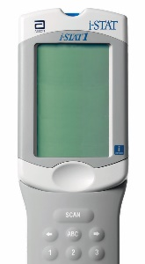
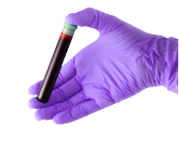
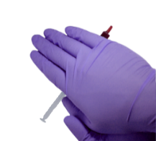
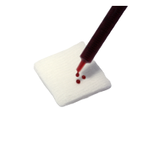
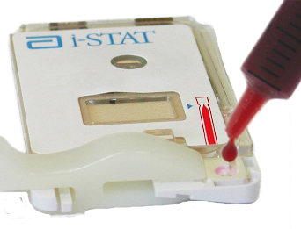
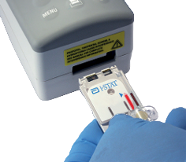
Testing Process Overview
10x
5x
1
PREPARE ANALYZER
2
COLLECT SAMPLE
3
MIX SAMPLE
4
DISCARD FIRST DROPS
5
FILL & CLOSE CARTRIDGE
6
INSERT CARTRIDGE
| 12

Slide 13
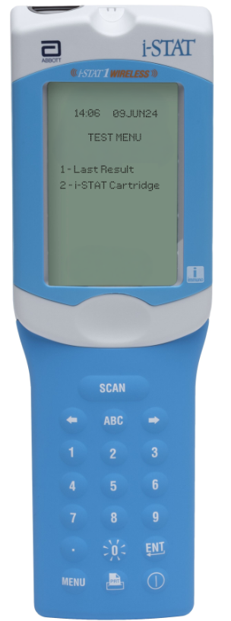


Prepare the Instrument
POWER UP THE INSTRUMENT
Press the Power button to turn on the analyzer
From the Test Menu screen, press 2 on the keypad for i-STAT Cartridge
Follow the onscreen prompts
PRESS THE POWER BUTTON
TO TURN ON THE i-STAT 1
PRESS
TO PERFORM A PATIENT TEST
| 13

Slide 14
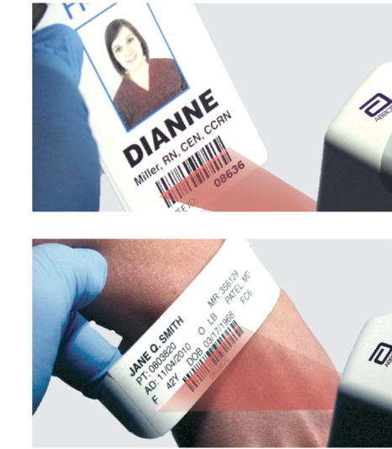
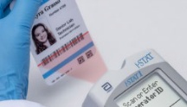
Prepare the Instrument – cont’d
BARCODE SCAN: OPERATOR ID, THEN PATIENT ID
Hold the analyzer 3 to 9 inches away from the barcode
Press and hold down the SCAN key
Laser beam must cover the entire length of the barcode
Wait for the beep or for laser beam to disappear
Release the SCAN key
Repeat if prompted
OR ENTER THE OPERATOR ID
or enter your Operator ID
OR ENTER THE PATIENT ID
IMPORTANT
DO NOT stare into the laser aperture or the laser beam or point the laser beam at others.
Class 2 laser scanners use a low power, visible light diode. As with any bright light source, such as the sun, the user should avoid staring directly into the laser beam. Momentary exposure to a Class 2 laser is not known to be harmful.

Slide 15
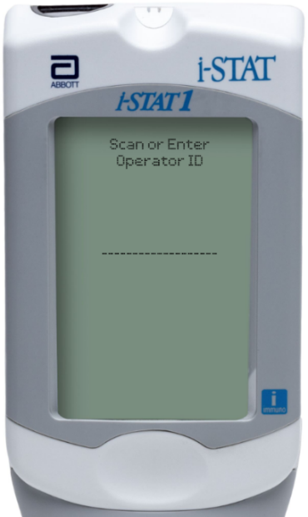
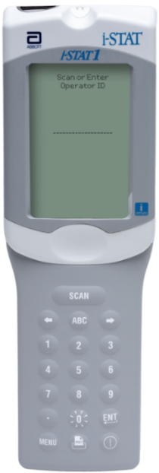
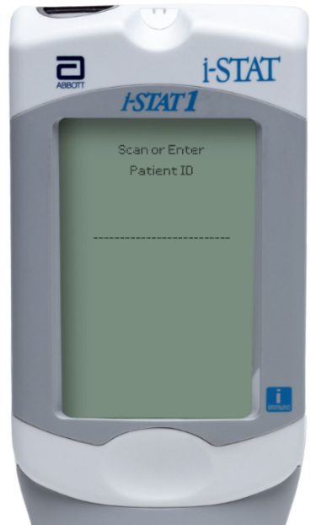
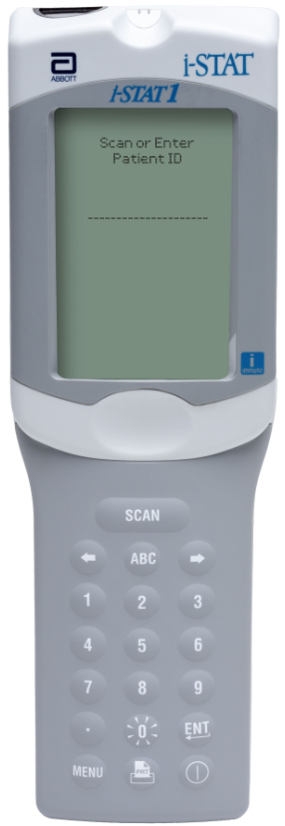
Prepare the Instrument – i-STAT 1 Analyzer
MANUAL ENTRY: OPERATOR ID, THEN PATIENT ID
Use number keys on the keypad
Press ENT key
Repeat if prompted
OPERATOR ID
PATIENT ID

Slide 16
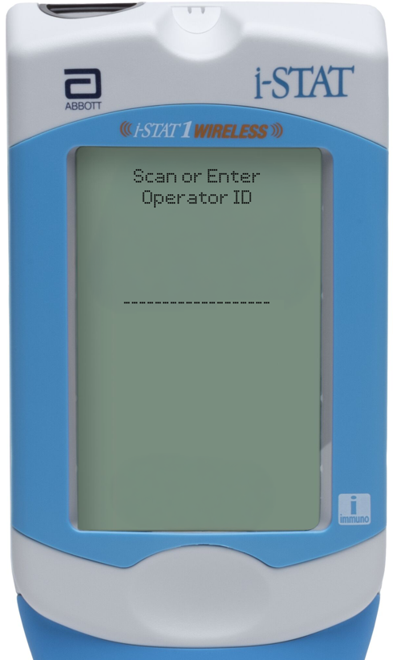
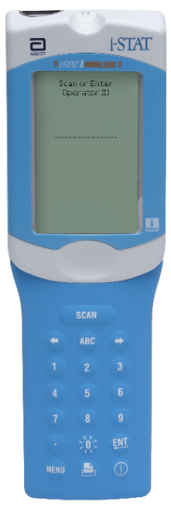
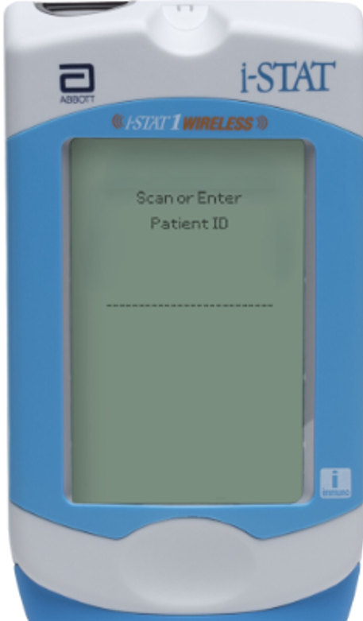
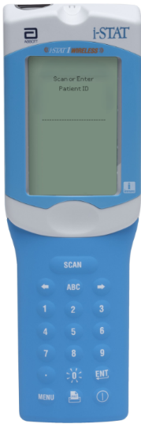
Prepare the Instrument – cont’d
MANUAL ENTRY: OPERATOR ID, THEN PATIENT ID
Use number keys on the keypad
Press ENT key
Repeat if prompted
OPERATOR ID
PATIENT ID

Slide 17
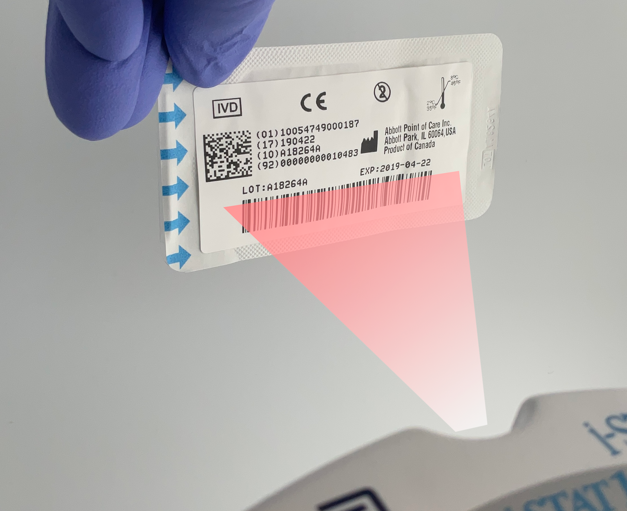
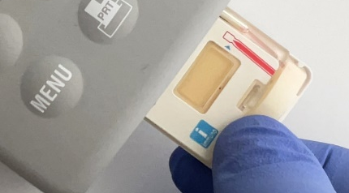

Prepare the Instrument – cont’d
SCAN CARTRIDGE (PORTION PACK) BARCODE, CONT’D
Once the cartridge barcode is scanned, you have 15 minutes to insert a filled & sealed cartridge
After 15 minutes of inactivity the instrument will turn off and will require re-entry of previous information to perform a test
THE BARCODE ON THE CARTRIDGE PORTION PACK
or enter your Operator ID
PRECAUTIONS
If an Invalid Cartridge Type window is displayed, contact the System Administrator.
Scanning is required. You must scan the barcode. This information cannot be entered manually.

Slide 18
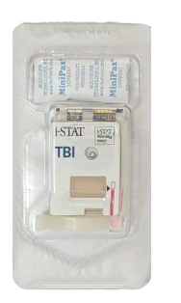
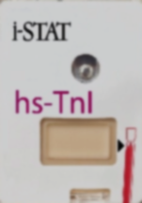

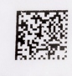
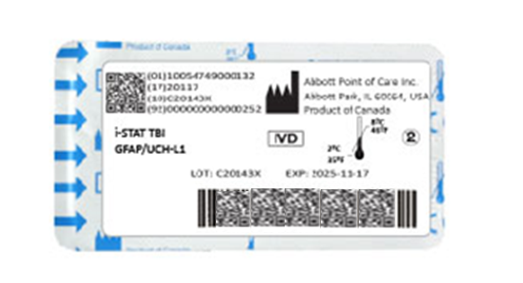


Prepare the Instrument – cont’d
FRONT
SCAN (CARTRIDGE PORTION PACK) BARCODE
Turn the portion pack over and locate the linear barcode
The lot information displays on the analyzer screen momentarily
The instrument is now ready, next prepare the sample​
SCAN THE LINEAR BARCODE​
DO NOT SCAN THE 2D BARCODE​
BACK
Back
PRECAUTIONS
If an Invalid Cartridge Type window is displayed, contact the System Administrator.
Scanning is required. You must scan the barcode. This information cannot be entered manually.
hs-TnI

Slide 19
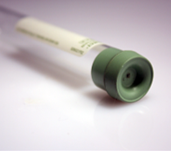
Prepare for Sample Collection
QUICK TIPS
The i-STAT hs-TnI cartridge requires fresh,
venous whole blood or plasma samples
(approximately 22μL)
DO
DO use a collection technique resulting in good blood flow
DO collect a venous specimen ensuring proper order of draw & fill a lithium heparin or nonanticoagulated blood collection tube to capacity
DO fill the cartridge to the ‘fill’ line immediately. Delay in filling may produce erroneous results
DO NOT
DO NOT collect a sample from an arm with an IV
DO NOT underfill a blood collection tube.
DO NOT incorrectly handle or incorrectly fill the cartridge

Slide 20
Prepare for Sample Collection - cont’d
BLOOD COLLECTION OPTIONS
ANALYTE | SYRINGES | TEST TIMING | EVACUATED TUBES | TEST TIMING
hs-TnI | Blood without anticoagulant. | Immediately DO NOT TEST BEYOND 3 minutes** | Blood without anticoagulant. | Immediately DO NOT TEST BEYOND 3 minutes**
 | Blood or plasma with lithium heparin anticoagulant. Syringe must be filled to labeled capacity.* Remix whole blood thoroughly before filling cartridge. | 4 hours | Blood or plasma with lithium heparin anticoagulant (with or without plasma separator). Tubes must be filled to labeled capacity.* Remix whole blood thoroughly before filling cartridge. | 4 hours
* Underfilling will cause higher heparin to blood ratios which may affect results.
** Ensure samples are not clotted.

Slide 21

Running the Test
REMOVE THE CARTRIDGE FROM THE PORTION PACK
Place the cartridge on a clean, flat, level, and vibration-free surface
Handle the cartridge by the sides
DO NOT
TOUCH THE SENSORS
PRECAUTIONS
DO NOT touch the sensors on the top of the cartridge.
DO NOT apply pressure to the central area of the label because the analysis fluid pack inside could burst prematurely.
DO NOT expose cartridges to temperatures above 30°C (86°F).
DO NOT place the cartridge and/or instrument in an oxygen-enriched atmosphere.
DO NOT TOUCH THE CENTER OF THE CARTRIDGE

Slide 22

Running the Test – cont’d
WHOLE BLOOD: COLLECT AND MIX THE SAMPLE
Collect a whole blood sample into a lithium heparin evacuated blood collection tube
Invert the lithium heparin collection tube at least 10 times
If sample was collected into a syringe, invert syringe for 5 seconds, then roll between the palms (hands parallel to the ground) for 5 seconds, flip and roll for an additional 5 seconds
Expelling 2 drops before filling a cartridge is desired
10x
PRECAUTIONS
Cautions should be used when handling materials that may contain transmissible infectious agents.
Fill evacuated tube per manufacturer’s recommendations.
5x

Slide 23
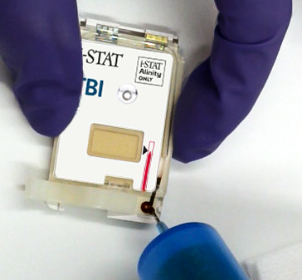
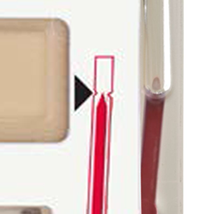
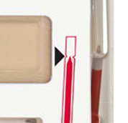
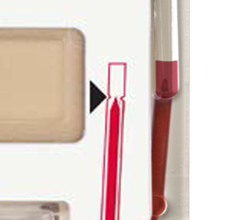
Running the Test – cont’d
WHOLE BLOOD: FILL THE i-STAT CARTRIDGE
Fill the cartridge immediately after mixing
Direct the hub of syringe or tip of the transfer device (syringe or dispensing tip) into the sample well of the cartridge.
Slowly dispense sample into the sample well until the sample reaches the fill mark indicated on the cartridge. Cartridge is properly filled when the sample reaches the ‘fill to’ mark
CORRECTLY FILLED TO FILL MARK
    UNDER-FILLED
    CARTRDIGE
    OVER-FILLED
    CARTRDIGE

Slide 24
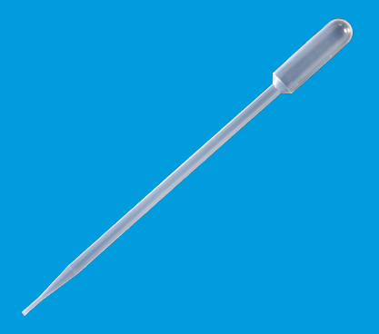
Running the Test – cont’d
PLASMA: COLLECT AND MIX THE SAMPLE
Using a transfer device without anticoagulant, remove a small plasma sample from the lithium heparin tube that has been spun down being careful not to disturb the lipid layer between the plasma and red blood cells
PRECAUTIONS:
Standard precautions should be used when handling materials that may contain transmissible infectious agents.
Fill evacuated tube per manufacturer’s recommendations.

Slide 25
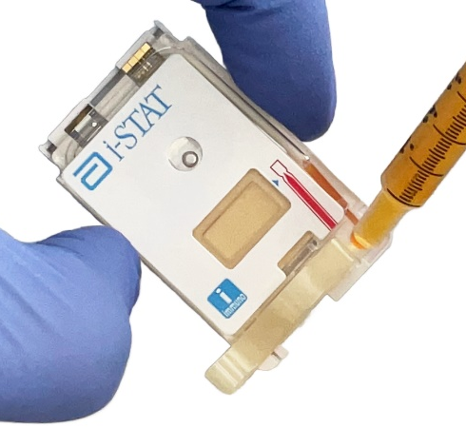
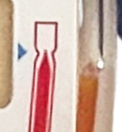
Running the Test – cont’d
PLASMA: FILL THE i-STAT CARTRIDGE
Using a transfer device without anticoagulant, remove a small plasma sample from the lithium heparin tube that has been spun down being careful not to disturb the lipid layer between the plasma and red blood cells
Fill the cartridge by directing the tip of the transfer device into the sample well of the cartridge
Slowly dispense sample until the sample reaches the ‘fill to’ mark indicated on the cartridge. Cartridge is properly filled when the sample reaches the ‘fill to’ mark
CORRECTLY FILLED
TO THE “FILL TO” MARK

Slide 26
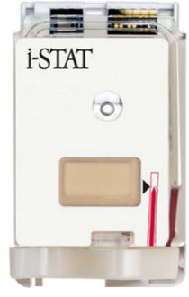
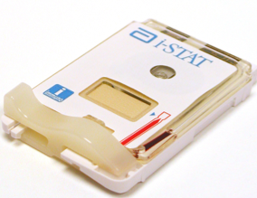
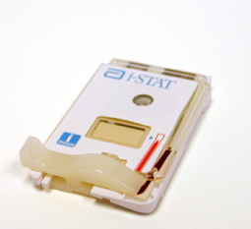
Running the Test – cont’d
CLOSE AND SEAL THE i-STAT CARTRIDGE
To close and seal the cartridge:
Hold the cartridge by its side edges and away from the sample well.
Slide the plastic closure clip to the right until it locks into place over the sample well.
PROPERLY CLOSED CARTRIDGES
IMPROPERLY CLOSED CARTRIDGE
PRECAUTIONS
Incorrect handling and filling of the i-STAT cartridge will result in a quality check failure.

Slide 27

Running the Test – cont’d
INSERT THE CARTRIDGE
Insert the cartridge into the i-STAT analyzer’s cartridge port
  Sensors facing up, and on leading edge
PRECAUTIONS
DO NOT touch the sensors on the top of the cartridge.
DO NOT apply pressure to the central area of the label because
the analysis fluid pack inside could burst prematurely.
DO NOT place the cartridge and/or instrument in an oxygen-enriched atmosphere.

Slide 28
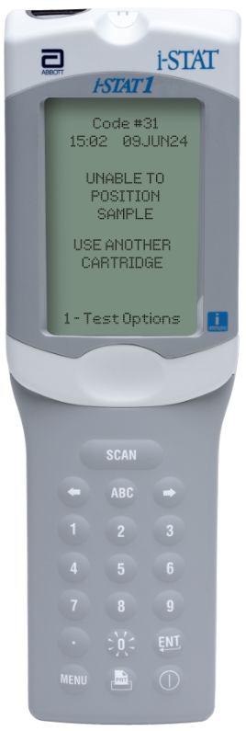
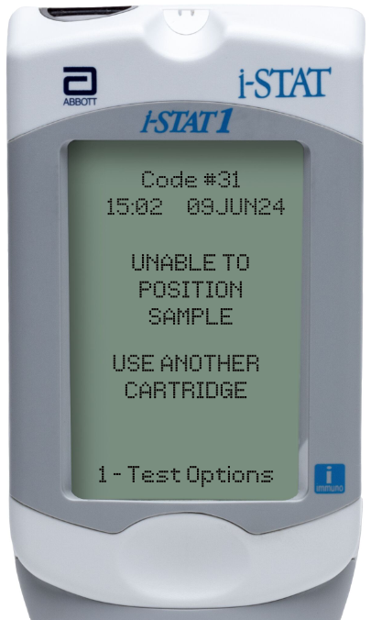
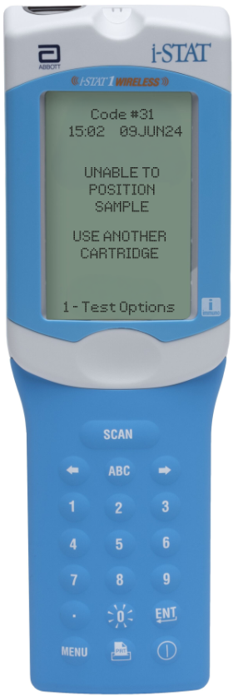
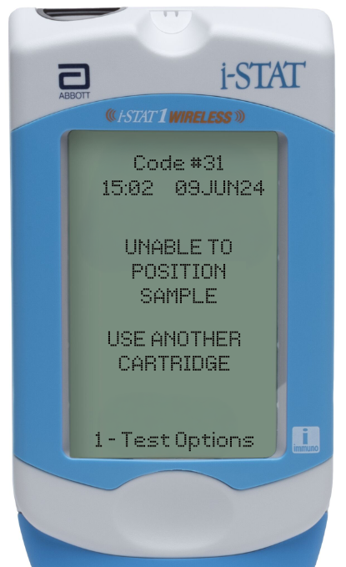
Running the Test – cont’d
PRIOR TO TESTING
The handheld will perform quality checks
Failure of a quality check will result in a Quality Check Code

Slide 29
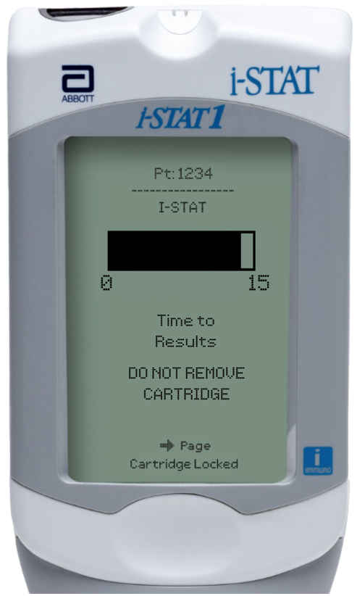
Running the Test – cont’d
TIME TO RESULTS
Once the cartridge is inserted, Contacting Cartridge will display followed by the countdown bar
  This allows the user to estimate the time to results
Alerts such as Cartridge Locked are also displayed
The i-STAT hs-TnI test is a 15-minute test
PRECAUTIONS
DO NOT attempt to remove the cartridge while the message
“Cartridge Locked” remains on the screen.

Slide 30
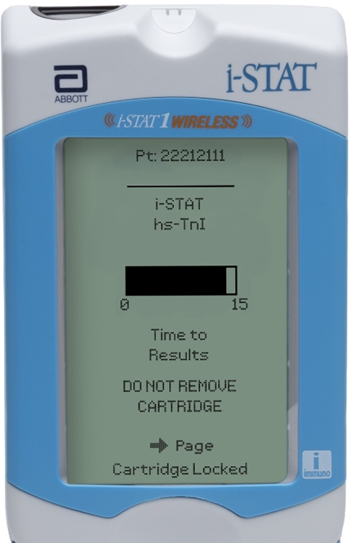
Running the Test – cont’d
TIME TO RESULTS
Once the cartridge is inserted, Identifying Cartridge will display followed by the countdown bar
  This allows the user to estimate the time to results
  Alerts such as Cartridge Locked are also displayed
The i-STAT hs-TnI test is a 15-minute test
PRECAUTIONS
DO NOT attempt to remove the cartridge while the message
“Cartridge Locked” remains on the screen.

Slide 31
PERFORMING A PATIENT TEST
Entering Results in Meditech

Slide 32

CAUTION:
Both EXL and i-STAT hs-Troponin I are resulted under the same test order (mnemonic TROPH). Failure to change the method to i-STAT will result in reporting the EXL reference ranges, which are very different.
Follow the steps on the next two slides to change the test method in Meditech.

Slide 33
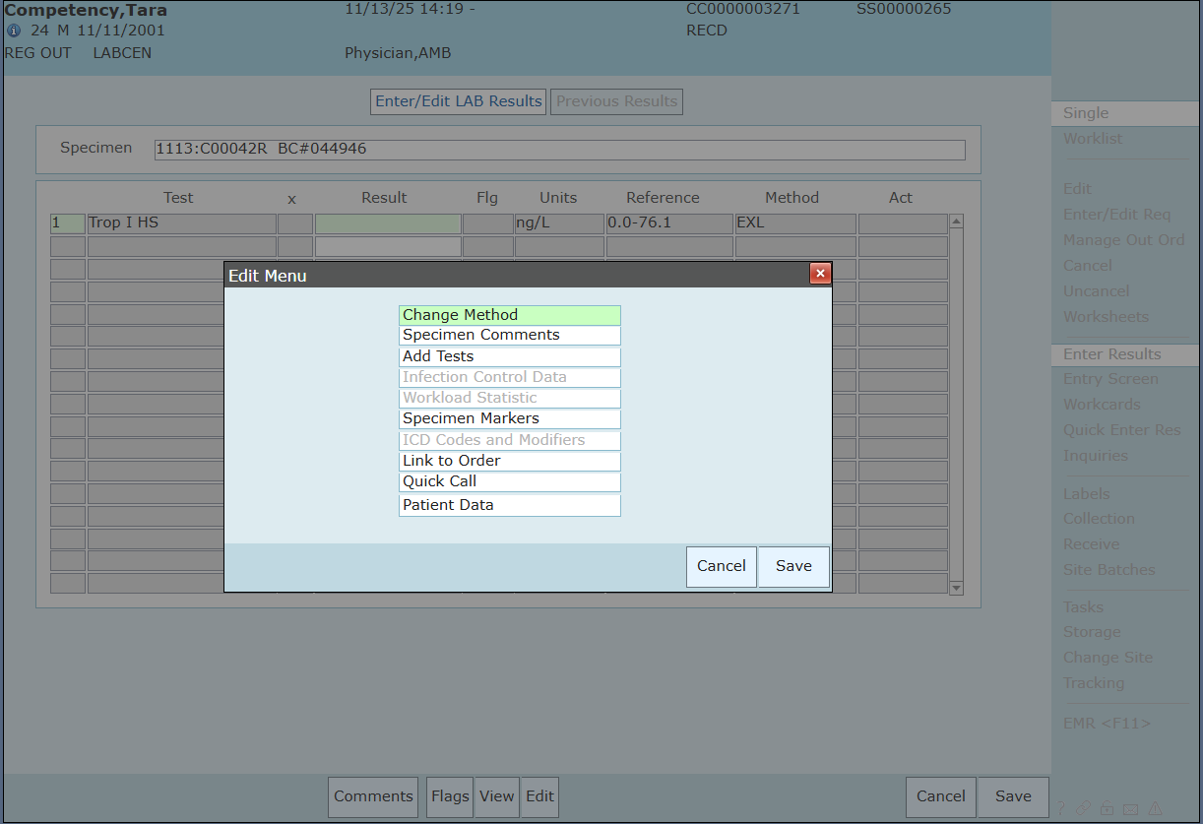
Option 1: Click Edit and Change Method
1. Select Edit
2. Select Change Method

Slide 34
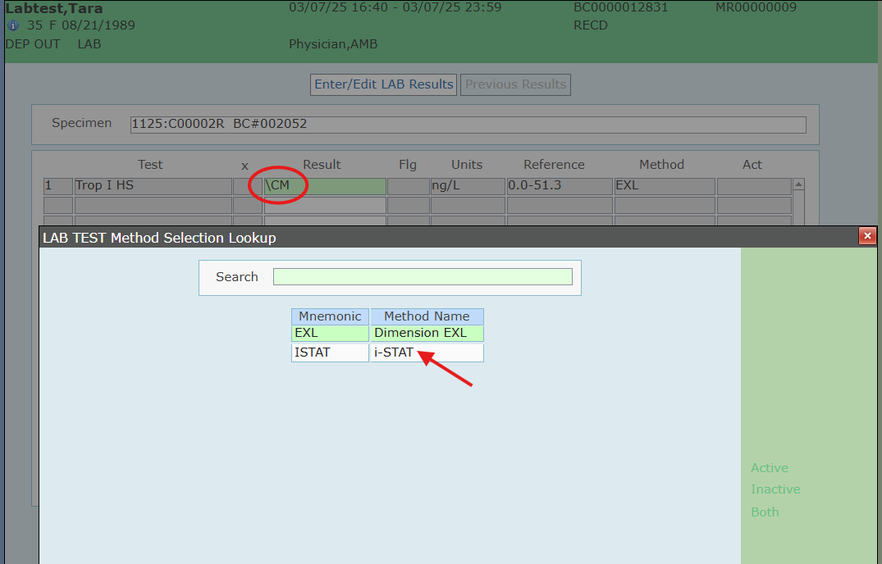
Option 2: Change Method by Entering \CM in the result field
1. Type \CM
2. Select i-STAT

Slide 35
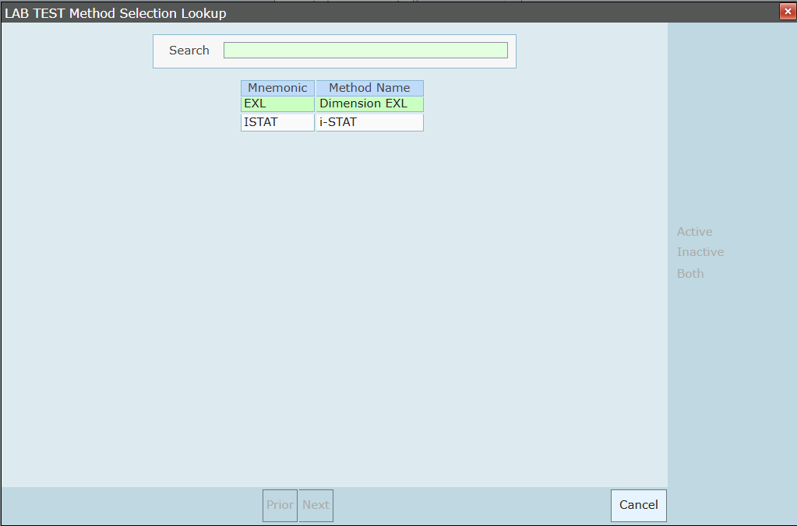

Change the method during result entry to apply the appropriate i-STAT reference ranges
3. Select i-STAT
You should see these reference ranges
on the Result Entry screen.

Slide 36
PERFORMING A PATIENT TEST
Troubleshooting

Slide 37

Troubleshooting Basic Errors
TROUBLESHOOTING & ERRORS
Error Messages and Quality Check Codes
There are potential pre-analytical conditions, especially during the training period, that may not be detected by the operator.
The analyzer will detect the condition, halt the test cycle, and display a cause message followed by the action message
“USE ANOTHER CARTRIDGE.”
QUICK TIPS TO PREVENT ERRORS
The cartridge and instrument must be at room temperature
(18-30 °C or 64-86 °F) to perform the test.
The cartridge must be correctly filled, closed and sealed.
The instrument must remain on a level surface. Level surface includes performing the test with the instrument in the downloader/recharger.

Slide 38




Troubleshooting Basic Errors– cont’d
AVOID AFFECTING hs-TnI RESULTS
Keep analyzer on a level surface during the testing process
Do not move the analyzer during the testing process
Mix blood collection devices thoroughly
Prevent hemolysis
HEMOLYSIS

