Slide 1
UPMC St Margaret
Department of Pathology
Point of Care Testing Program
HemaPrompt FG
Electronic Documentation Guidelines (Cerner)

Slide 2
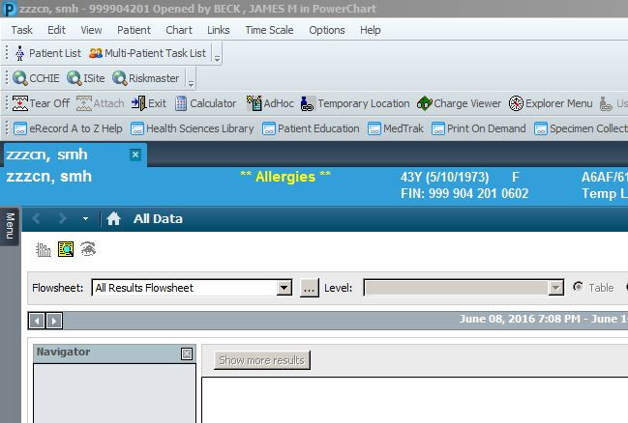
Within Patient EMR, select AdHoc Charting

Slide 3
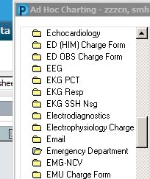
Open Emergency Department Folder

Slide 4
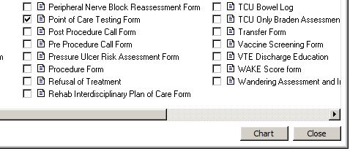
Check the Point of Care Testing Form

Slide 5
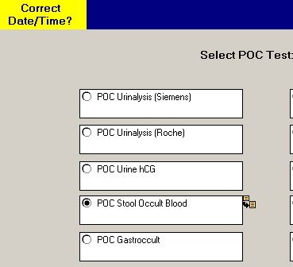
Select either POC Stool Occult Blood or POC Gastroccult

Slide 6
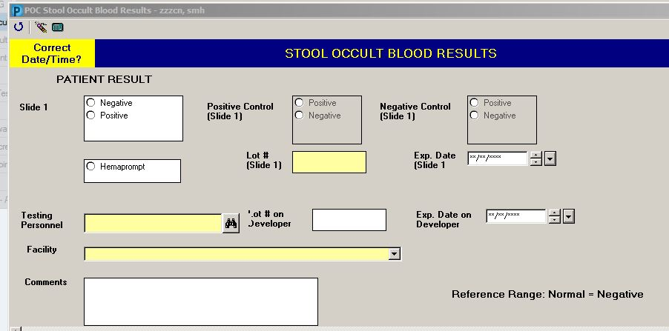
Select appropriate patient result

Slide 7
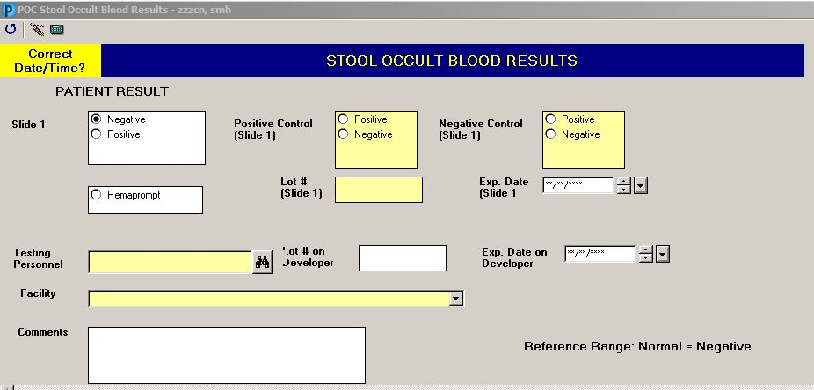
Positive Control (checkmark turns blue = Positive)
Document HemaPrompt FG Control card results:
Negative Control
(clear background behind blue checkmark = Negative)

Slide 8
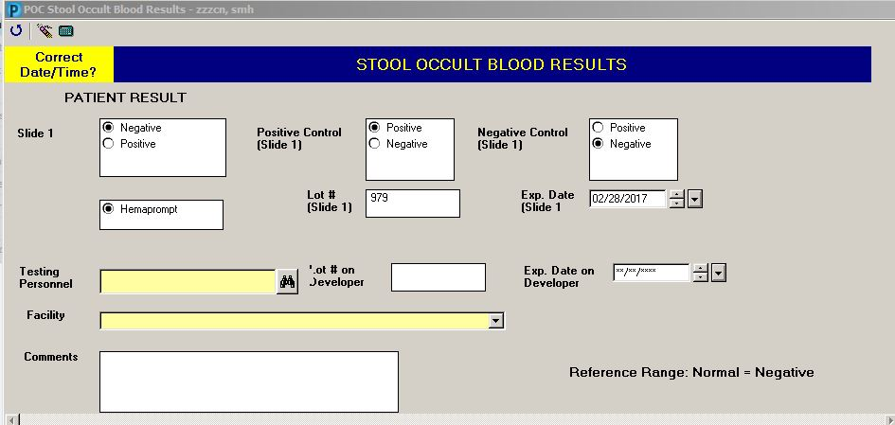
Select HemaPrompt box, complete lot# and expiration date fields

Slide 9
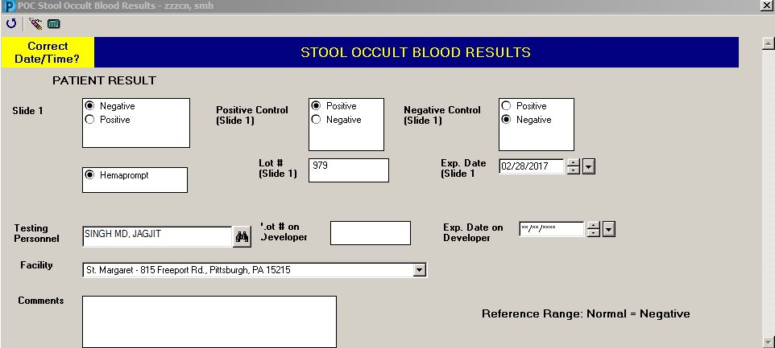
Complete the Testing Personnel box (this is the person performing and interpreting the test – not the person completing the document) by typing the last name to invoke a search.
Select the facility name from the drop-down menu.

Slide 10
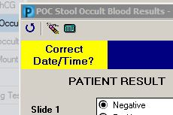
Click on the blue circle at the top left to exit the electronic form

Slide 11
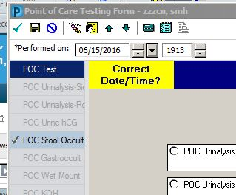
Chart the form by clicking on the green checkmark at the top left

Slide 12
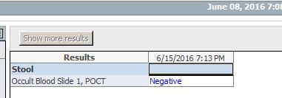
Documentation is now complete. Refresh chart. Result will appear under Lab Data/All Data

