Slide 1
Point of Care
Proficiency Testing

Slide 2
CLIA and CMS
NOTE: Congress passed the Clinical Laboratory Improvement Amendments (CLIA) in 1988 establishing quality standards for all laboratory testing to ensure the accuracy, reliability and timeliness of patient test results regardless of where the test was performed. The final CLIA regulations were published in the Federal Register on February 28, 1992. The requirements are based on the complexity of the test and not the type of laboratory where the testing is performed. On January 24, 2003, the Centers for Disease Control and Prevention (CDC) and the Centers for Medicare & Medicaid Services (CMS) published final CLIA Quality Systems laboratory regulations that became effective April, 24, 2003.

Slide 3
What is Proficiency Testing?
Proficiency testing or PT is the testing of unknown samples sent to a laboratory by a CMS approved PT program.
Most sets of PT samples are sent to participating laboratories two to three times per year.
After testing the PT samples in the same manner as its patient specimens, the laboratory reports its sample results back to their PT program.
The program (CAP) grades the results using the CLIA grading criteria and sends the laboratory scores reflecting how accurately it performed the testing. CMS and accreditation organizations routinely monitor their laboratories’ performance.

Slide 4
Why is PT Important?
PT is important because it is a tool the laboratory can use to verify the accuracy and reliability of its testing. Routine reviews of PT reports by the laboratory staff and director will alert them to areas of testing that are not performing as expected and also indicate subtle shifts and trends that, over time, would affect their patient results.

Slide 5
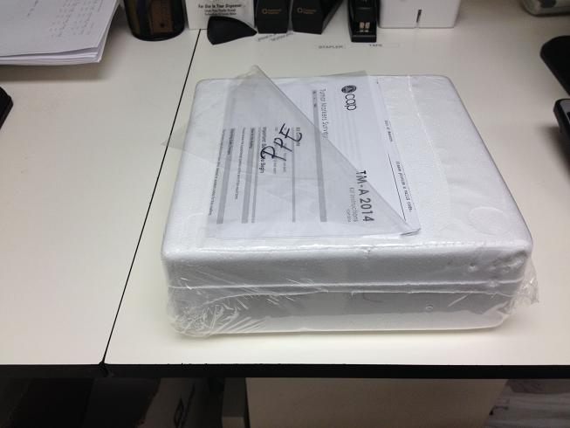
How Do I Recognize A Proficiency Test Kit?
Most Proficiency Testing Kits are transported in a Styrofoam container. Note: Keep the kit at the appropriate storage temperature prior to performing Proficiency Testing (Usually 2 to 8 degrees Celsius). Refrigerate Proficiency Test Kit immediately upon receipt.

Slide 6
So…
What will you find inside ?

Slide 7
PROFICIENCY TESTING SAMPLES
Glucose Testing:
Whole Blood Glucose testing three or more sample vials will be enclosed.
Urine Dips:
Urine Dip Testing, Bottles of Urine Samples will be enclosed.

Slide 8
Method Summary Page
In the Example
Glucose WB – Site A
Glucose WB – Site B
Glucose WB – Site C
Glucose WB – Site D
Glucose WB – Site E
Refers to the Number of Instruments/Glucometers in your Department
If there is just one Glucometer in your department. You will label your site “A”, two or more Glucometers “A and B” and so on……

Slide 9
Instrument Method Page
The Method Code is Placed on the Result Page .
Nova Stat Strip Glucometer Code
2184.

Slide 10
Results Page
Includes
Instrument Method Code boxes: enter 2184 for whole blood glucose testing.
Locate the appropriate method code for Siemens Urine Dips.
Results Boxes: Enter blind sample results according to sample id
Note: Results submission due date of November 6th 2013 which is located to the top left hand corner of the Result Form.
All survey results are to be submitted before the due date or risk an evaluation score of ZERO

Slide 11
Examples
Instrument Method Code
Result Entry

Slide 12
PT Sample Instructions
Perform your QC prior to beginning Proficiency Testing.
Follow the storage and stability instructions to insure that sample are not compromised prior to testing.
Perform Proficiency Testing as you would a patient test, and record your results on the result form.
After survey completion and submission, keep the survey refrigerated until the results(Evaluations) are received from CAP.

Slide 13
Attestation Page
Testing Personnel (staffs performing the Proficiency Test) must sign.
Director/Designee (Department Head or Lead) must sign.

Slide 14
Example of Attestation Page
Signature of testing Staffs
Signature/Signatures of Department Leads

Slide 15
Results Submission to CAP
Complete Fax Cover Sheet
Fax Completed Results Form and Attestation Page
Fax Results to (866-329-2227)
Keep your fax confirmation and submitted results in you CAP 2014 Binder. (Just incase your results were not received by CAP)

Slide 16
Evaluation
CAP (College of American Pathologist) will evaluate and return the results of the survey to the submitting department
CAP Evaluation will be reviewed by department Director/Designee using the Proficiency Testing Follow-up Form.
If survey results are acceptable check appropriate boxes and sign where indicated.
See follow-up form on the next slide.

Slide 17
Proficiency Survey Follow-Up Form

Slide 18
Completed Proficiency Testing and Evaluation
Place submitted survey along with fax confirmation into CAP Binder.
Place CAP Evaluation into the same tab as submitted results.
Note: CAP Evaluations are to be completed with Proficiency Survey Follow-up form only if any part the PT is failed. The form must be completed and the survey reviewed before being placed into the binder.

Slide 19
Please contact Point of Care Coordinator with any questions
Glen Grant
Office: 301-816-6328
Cell: 301-481-7776
glen.k.grant@kp.org

