Slide 1


KPMAS Laboratories
Phlebotomy Training and Competency 2014

Slide 2
KPMAS Laboratories
Phlebotomy Training and Competency 2014
All KPMAS laboratory staff who perform phlebotomy will complete the following:
Presentation review
Direct observation (form to be completed by supervisor)
Written phlebotomy competency assessment ( passing score 80%)
Written competency Risk Complications (passing score 80 %)
Note: This includes Regional Lab staff who work in facility labs as phlebotomists and MLA’s.

Slide 3
KPMAS Laboratories
Phlebotomy Training and Competency 2014
Supply list for routine venipuncture:
Non-Latex Tourniquet
Non-Latex gloves
2x2 gauze pad
Alcohol pad
Disposable barrel
21 or 22 gauge needle
Correct vacutainer tubes
Bandaid or tape

Slide 4
KPMAS Laboratories
Phlebotomy Training and Competency 2014
Supply list for difficult or oncology venipuncture:
Non-Latex Tourniquet
Non-Latex gloves
2x2 gauze pad
Alcohol pad
Disposable barrel
23 or 25 gauge butterflies
Correct vacutainer tubes
Band-Aid , tape, or Co-Flex bandage

Slide 5
KPMAS Laboratories
Phlebotomy Training and Competency 2014
Supply list for pediatric venipuncture
Non-Latex Tourniquet
Non-Latex gloves
2x2 gauze pad
Alcohol pad
Disposable barrel
23 or 25 gauge butterflies
Correct pediatric vacutainer tubes
Band-Aid , tape, or Co-Flex bandage

Slide 6
KPMAS Laboratories
Phlebotomy Training and Competency 2014
Supply list for pediatric finger stick or heel stick:
Non-Latex gloves
2x2 gauze pad
Alcohol pad
Disposable barrel
Finger lancet or Heel Lancet
Correct Microtainer Bullet tubes
Band-Aid , tape, or Co-Flex bandage

Slide 7
KPMAS Laboratories
Phlebotomy Training and Competency 2014
Patient Identification:
Staff at front desk will ask member for Kaiser Permanente Card and a picture ID.
Phlebotomist will ask the member to STATE their Name and Date of Birth.
Identification Discrepancy:
If member does not have a picture ID; alternate ID will be requested.
If information is incorrect( DOB, Sex etc) Lab staff will follow center specific guidelines for reporting incorrect patient demographics.
The lab supervisor should be contacted for resolution

Slide 8
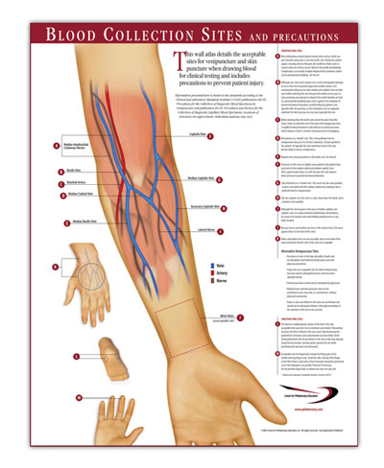
KPMAS Laboratories
Phlebotomy Training and Competency 2014
Selecting the correct site for venipuncture:
The median cubital and cephalic veins are most commonly used for venipuncture. Alternative sites are the basilic vein on the dorsum of the arm or dorsal hand veins. Due to its close proximity to the brachial artery and median nerve, the basilic vein, which is located on the pinkie side of the arm, should be used only if there is not another more prominent arm vein. Veins in the foot and ankle should be utilized only as a last resort. Veins on the underside of the wrist should be avoided. Certain other sites should also be avoided.

Slide 9
KPMAS Laboratories
Phlebotomy Training and Competency 2014
Sites to be avoided:
Extensive scarring from burns or surgery
The upper extremity on the side that a mastectomy was performed.
Hematoma
Cannula, Fistula or Vascular Graft
Edematous extremities
Sites with noticeable skin conditions, such as eczema or infection.
Intravenous therapy/Blood Transfusions

Slide 10
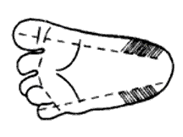
KPMAS Laboratories
Phlebotomy Training and Competency 2014
Selecting the proper site for a heel stick
The recommended location for blood collection on a newborn baby or infant is the heel. The diagram to the right indicates the proper area to use for heel punctures for blood collection.

Slide 11

KPMAS Laboratories
Phlebotomy Training and Competency 2014
Selecting the correct site for a finger stick:
The best locations for finger sticks are the 3rd (middle) and 4th (ring) fingers of the non-dominant hand. Do not use the tip of the finger or the center of the finger. Avoid the side of the finger where there is less soft tissue, where vessels and nerves are located, and where the bone is closer to the surface. The 2nd (index) finger tends to have thicker, callused skin. The fifth finger tends to have less soft tissue overlying the bone. Avoid puncturing a finger that is cold or cyanotic, swollen, scarred, or covered with a rash.

Slide 12


KPMAS Laboratories
Phlebotomy Training and Competency 2014
Correct order of Draw:
Blood collection tubes must be drawn in a specific order to avoid cross-contamination of additives between tubes. The recommended order of draw for plastic vacutainer tubes is:
1. Sterile blood culture bottle or tube (yellow or yellow-black top)
2. Coagulation tube (light blue top).
3. Non-additive serum tube (red top)
4. Additive tubes in this order:
  SST (red-gray or gold top). Contains a gel separator and clot activator.
  Sodium heparin (dark green top)
  PST (light green top). Contains lithium heparin anticoagulant
  EDTA (lavender top)
  Oxalate/fluoride (light gray top) or other additives
NOTE: Tubes with additives must be thoroughly mixed. Clotting or erroneous test results may be obtained when the blood is not thoroughly mixed with the additive.

Slide 13
KPMAS Laboratories
Phlebotomy Training and Competency 2014
Venipuncture Procedure:
1. Positively identify the patient by two forms of identification. Ask the patient to state his/her Name and DOB.
2. Gather the tubes and supplies that you will need for the draw.
3. Position the patient comfortably in a chair and ask them to extend their arm forward onto the counter so that it forms a straight line from shoulder to wrist. An arm support cushion may be used if desired. If a child is to be held by the parent, be sure the child is held firmly to prevent any injury. If the patient is lying down, ask them to lie on their back with the arm extended in the same manner as when sitting.
4. Wash your hands
5. Select a suitable site for venipuncture, by placing the tourniquet 3 to 4 inches above the selected puncture site on the patient.
6. Do not put the tourniquet on too tightly or leave it on the patient longer than 1 minute. If the tourniquet will be on the arm for more than 1 minute, release and reapply after 2 minutes.
7. Put on non-latex gloves, and palpate for a vein
8. When a vein is selected, cleanse the area in a circular motion, beginning at the site and working outward. Allow the area to air dry. After the area is cleansed, it should not be touched or palpated again. If you find it necessary to reevaluate the site by palpation, the area needs to be re-cleansed before the venipuncture is performed.

Slide 14
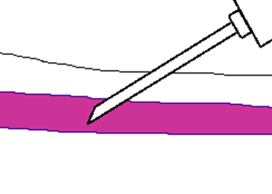
KPMAS Laboratories
Phlebotomy Training and Competency 2014
9. Ask the patient to make a fist; avoid “pumping the fist”. Grasp the patient’s arm firmly using your thumb to draw the skin taut and anchor the vein. Swiftly insert the needle through the skin into the lumen of the vein. The needle should form a 15-30 degree angle with the arm surface. Avoid excess probing.
10. When the last tube is filling, remove the tourniquet.
11. Remove the needle from the patient's arm using a swift backward motion.
12. Place gauze immediately on the puncture site. Apply and hold adequate pressure to avoid formation of a hematoma. After holding pressure for 1-2 minutes, tape a fresh piece of gauze or Band-Aid to the puncture site. ( Co-flex bandage can be used on sensitive or frail skin)
13.Dispose of contaminated materials/supplies in designated containers.

Slide 15
KPMAS Laboratories
Phlebotomy Training and Competency 2014
Finger Stick Procedure:
Follow steps #1 through #5 of the procedure for venipuncture as outlined above.
When a site is selected, put on gloves, and cleanse the selected puncture area.
Massage the finger toward the selected site prior to the puncture.
Using a sterile safety lancet, make a skin puncture just off the center of the finger pad. The puncture should be made perpendicular to the ridges of the fingerprint so that the drop of blood does not run down the ridges.
Wipe away the first drop of blood, which tends to contain excess tissue fluid.
Collect drops of blood into the collection tube/device by gentle pressure on the finger. Avoid
excessive pressure or “milking” that may squeeze tissue fluid into the drop of blood.
7. Cap, rotate and invert the collection device to mix the blood collected.
8. Have the patient hold a small gauze pad over the puncture site for a few minutes to stop the
bleeding.

Slide 16
KPMAS Laboratories
Phlebotomy Training and Competency 2014
Heel Stick Procedure:
Prewarming the infant's heel (42° C for 3 to 5 minutes) is important to increase the flow of blood for collection.
Wash your hands, and put gloves on. Clean the site to be punctured with an alcohol sponge. Dry the cleaned area with a dry gauze pad.
Hold the baby's foot firmly to avoid sudden movement.
Using a sterile blood safety lancet, puncture the side of the heel in the appropriate regions shown above. Make the cut across the heel print lines so that a drop of blood can well up and not run down along the lines.
Wipe away the first drop of blood with a piece of clean, dry cotton gauze. Since newborns do not often bleed immediately, use gentle pressure to produce a rounded drop of blood. Do not use excessive pressure because the blood may become diluted with tissue fluid.
Fill the required microtainer(s) as needed.
When finished, elevate the heel, place a piece of clean, dry cotton on the puncture site, and hold it in place until the bleeding has stopped. Apply tape or Band-Aid to area if needed.
Be sure to dispose of the lancet in the appropriate sharps container. Dispose of contaminated materials in appropriate waste receptacles.
Remove your gloves and wash your hands

Slide 17
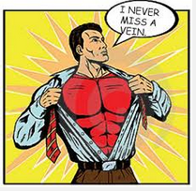
I never miss a vein
But when I do…
Risk guidance on complications of phlebotomy

Slide 18
We conduct many venipunctures in our region and phlebotomy complication rates may be benchmarked to about 1 in 6,300 donors suffering a nerve injury according to a 1996 study. Let’s bring our best practices forward to prevent venipuncture complications.
Risk history of phlebotomy injuries. Many resulted in causes of action/ settlements. Many may be avoidable following some best practice advice.
Location | Description | Event Name | Date Rec in QM. | Event Date
Laboratory | Sharp sensation down arm with tingling into hand when blood was drawn | Proc/Surg-Injury | 07/08/2013 | 5/24/2013
Laboratory | pain and bruising after blood draw | Proc/Surg-Injury | 09/05/2013 | 5/13/2013
Laboratory | Single stick lab draw w/ nerve injury | Proc/Surg-Injury | 03/03/2011 | 2/24/2011
Laboratory | Allege traumatic blood draw for 9 month old | Proc/Surg-Injury | 04/29/2011 | 4/26/2011
Laboratory | Phlebotomy technique did not follow IC guidelines | Lab Issue | 10/04/2011 | 10/4/2011
Laboratory | Allege phlebotomist hit nerve | Proc/Surg-Injury | 04/19/2011 | 4/13/2011
Laboratory | allege median nerve damage from blood draw from wrist | Proc/Surg-Injury | 02/07/2014 | 1/21/2014
Laboratory | Allege nerve injury post lab needle stick | Proc/Surg-Injury | 06/17/2013 | 7/22/2010
Laboratory | Nerve injury post blood draw | Proc/Surg-Injury | 04/10/2012 | 4/10/2012
Laboratory | Hematoma post blood draw | Lab Issue | 02/18/2011 | 2/10/2011
Laboratory | Bruise, ongoing elbow pain s/p blood draw | Proc/Surg-Injury | 01/16/2013 | 11/2/2012

Slide 19
When a phlebotomist chooses the site for a venipuncture, he/she runs greater risk of causing harm to their patients if the wrong site is chosen.
If a phlebotomist has chosen to use the basilic vein when there is a usable median antecubital vein or cephalic vein, and the patient suffers an arterial nick or nerve damage -- with the possibility of loss of arm movement or bleeding into the arm -- legal action may be taken by the patient or the doctor.
If no written order from the doctor exists and the phlebotomist performs a foot draw and complications arise there will be no possible defense in the courtroom should the patient or the doctor take legal action.
If a phlebotomist uses the underside of the wrist, which is a no-draw area, there is the possibility of hitting the radial or ulnar nerve or artery. Hitting the nerve in the underside of the wrist can cause temporary or permanent nerve damage and the patient may lose the ability to open and close their hand.
Finger and heel sticks:
When performing finger sticks puncturing the little finger may result in hitting the bone.
Phlebotomists who choose to ignore the appropriate sites on a neonatal heel and use the toes or the center back of the heel run the risk of hitting bone. Punctures in these areas may result in osteomyelitis and/or osteochondritis. Should these compromised areas of the baby foot come into contact with feces from a soiled diaper infection might occur, which in turn may lead to septicemia.
Possible nerve injury, What actions do I take?
Stop puncture immediately, do not continue to probe for vein at that site
Notify the ordering physician
- Ask for referral to evaluate nerve injury and nerve conduction
- Submit a UOR
Source: Phlebotomy Puncture Juncture: Preventing Phlebotomy Errors - Potential For Harming Your Patients. Helen Ogden-Grable, MT(ASCP)PBT, Gary W. Gill, CT(ASCP), Lab Med. 2005;36(7):430-433.

Slide 20
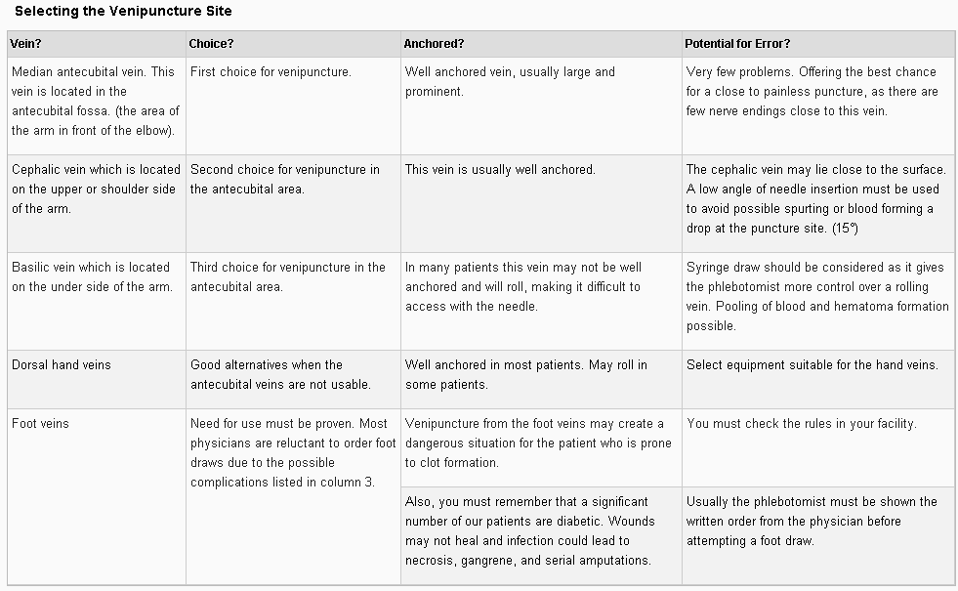
Guide to selecting the venipuncture site.

Slide 21
Technical and Procedural Detail
Complication | Awareness | Potential for Error
Allergies to antiseptics adhesives or latex. There may be the occasional patient who will react from exposure to iodine, the glue found on adhesive bandages or to latex containing products. | The phlebotomist must listen to the patient who may be alerting them to an allergic condition. They must watch for color-coded armbands or posted signs indicating specific patient allergies | Failure to identify allergies may cause reactions that vary from minor to fatal in nature.
Bleeding from the puncture site. Many patients are on blood thinners, which may cause prolonged bleeding following venipuncture procedure. | The phlebotomist must make checking the site for bleeding the last step in the venipuncture procedure. Do not leave a patient who is still bleeding from the puncture site without notifying their nurse. Do not allow an outpatient to leave while the arm is still bleeding. | With the hospital patient failure to check the arm for prolonged bleeding may result in the nurse finding blood on the patient and on the bed sheets. In our facility this will result in a Variance Report being written and corrective action for the phlebotomist responsible.
 |  | Failure to properly check the arm of an outpatient for prolonged bleeding may result in the patient finding blood running from their arm after leaving the draw site. There is also the possibility that the patient will collapse in shock upon seeing the blood and suffer injury from a fall.
Syncopy or fainting. Some patients feel weak and become dizzy or faint at the sight of blood. Some patients have a morbid fear of needles. This fear is very real to the patient. Patients in the hospital are in a safe place in their hospital bed. Outpatients are ambulatory and will be sitting in a blood draw chair. | Watch and listen to your patients. They may bring an order from the doctor stating that the patient should be drawn in a bed or in a safe chair due to a history of syncope. Patients have no control over this condition and under no circumstance should the phlebotomist take the warning lightly or make fun of the patient. | Failure to properly respond to a patient who is trying to tell you that they feel weak or dizzy or who has a history of syncopy may result in the patient fainting in the phlebotomy chair. If they slip under the armrest they may strangle themselves by getting their chin caught on the armrest. In addition they could chip a tooth or hurt themselves as they land on the floor.
 | Should the patient faint or collapse the phlebotomist must call for help and quickly lower the patient to the floor and treat them for shock.
 | The phlebotomist must respond by calling for help and quickly moving the patient to a safe place for the blood draw.
Hematomas | The phlebotomist must be aware that using correct technique when performing venipuncture will help avoid the formation of hematomas in their patients. | If the needle is inserted partially into the vein or if the needle penetrates the lower wall of a vein a hematoma may form.
 |  | Using veins that are fragile may result in hematoma formation.
 |  | If the phlebotomist performs a blind stick (unable to see or palpate the vein) or probes (both should be outlawed in your facilities) a hematoma may form.
 |  | If the needle is pulled out of the vein while the tourniquet is still in place a hematoma may form.
 |  | If the phlebotomist fails to hold firm pressure (or have the patient hold pressure) over the venipuncture site; a hematoma may form.
Nerve damage | The phlebotomist must know the anatomy of the antecubital area and dorsal hand area. They must know how to properly insert a needle into the vein. | If the phlebotomist does not choose the correct vein or if they are rushing using jerky movements or if they probe they may hit a nerve and cause temporary or sometimes permanent damage to the nerve which may result in loss of movement to the arm or hand. This type of injury is preventable and may result in legal action against the phlebotomist.
Vein damage | The phlebotomist must be aware of correct technique to avoid errors that may cause vein damage. | If the phlebotomist does not follow protocol or probes blindly, vein damage may occur and scar tissue may form, making venipuncture more difficult.
Pain | The phlebotomist should always be honest with the patient and explain that there will be a small amount of pain. They should alert the patient to every step of the procedure: Placement of the tourniquet on the arm. When we are about to clean the skin with alcohol. When the needle is about to be inserted into the arm. Removal of the tourniquet. Removal of the needle. | If the phlebotomist is not honest with the patient and does not warn the patient that there may be minimal pain, she may lower the confidence level of the patient. The patient may accuse the phlebotomist of lying or withholding information.
 |  | Failure to allow the alcohol to completely dry on the skin will cause a stinging pain when the needle is inserted.
 |  | If the phlebotomist does not remind the patient to hold still when inserting the needle, the patient may jump and force the needle deep into the arm, causing serious pain and possible nerve damage.
 |  | Any probing is excessive, and deep vigorous probing will be extremely painful, and lead to numbness and nerve involvement. Each facility should have a policy on how to handle a patient who has pain

Slide 22

At completion of this presentation , please complete the following two Written Competency Tests available on the WSLH website :
Phlebotomy Procedure Written Competency
What to do when I miss a Vein; Risk Guidance Written Competency
References:
KPMAS Laboratory Procedure SC7.011
CSLI Venipuncture Standard (H3)

