Slide 1
Processing

Slide 2
Objectives
Explain the basic use and principle of how a centrifuge works.
List nine (9) general rules for the operation of the clinical centrifuge.
Identify two (2) important factors for proper balance of tubes in a centrifuge.
Explain the dangers associated with operating an imbalanced centrifuge.
Distinguish between whole blood, serum and plasma for testing purposes.
Explain how EDTA and heparin prevent blood from coagulating.
Define and recognize hemolysis, icterus, and lipemia and explain their effects on laboratory tests
State five (5) items that must be included on a tube labeled for an aliquot.
State the different types of plasma used in testing.

Slide 3
Define pre-analytical error and identify the phlebotomist role in preventing them.
List 14 reasons that a specimen would be rejected by the laboratory.
State the action which must be taken when a sample is rejected by the laboratory.
Explain the importance of verifying the blood specimen identification with the requisition slip.
Demonstrate appropriate specimen processing by comparing requisitions with specimens and noting any discrepancies, problems with specimen suitability, and/or missing specimens.
State the resolution of any problems noted on the Specimen Accession Log.
Correctly label a transfer tube for serum or plasma aliquot.
Safely and accurately separate serum or plasma from cells using appropriate PPE.

Slide 4
CENTRIFUGES
Instruments that use centrifugal force to separate suspensions in liquids. The most frequent laboratory use of the centrifuge is to separate the heavier cellular components of blood from the liquid serum/plasma so that it may be used for testing.
Centrifuges vary in size, capacity, configuration and speed capability. Centrifuges that have a fixed angle head will hold and keep the sample at an angle during the spinning process. Swinging head or swinging bucket centrifuges have a hinge that allows the sample to swing outward. How the blood sample appears depends on whether it was spun in a fixed head or swinging bucket type of centrifuge.
Common types of clinical laboratory centrifuges

Slide 5
Operation of Centrifuges
The following are general rules; always follow manufacturer’s instructions for your instrument’s operation and maintenance.
Preventive Maintenance. Centrifuges must be evaluated and undergo preventative maintenance regularly. The routine checks of revolutions per minute using a tachometer are absolutely essential for consistent results that meet quality control standards. The timer must also be checked.
All checks should be recorded in the appropriate Quality Assurance manual.
ALWAYS wear gloves when handling specimens. Follow the facility protocols for wearing additional appropriate PPE, such as disposable lab coats, protective eyewear, safety goggles, or face shields.
NEVER spin specimens that do not have a stopper or cap. Spinning open-top specimens creates potentially harmful aerosols.

Slide 6
ALWAYS use tubes appropriate for centrifugation in the type of instrument you are operating.
NEVER operate a centrifuge on an uneven or slanted work surface. Centrifuges must be kept on a level and firm work bench.
NEVER operate a centrifuge with the lid open. Do not open the centrifuge lid while the rotor is moving. Although a ‘safety shutoff’ switch will be triggered if the centrifuge’s lid is opened, the rotor will continue to spin until friction eventually stops it.
NEVER put your hands into the centrifuge until it has come to a complete stop, or try to stop it with your hand.

Slide 7
ALWAYS balance the contents of the centrifuge before operating. Running a centrifuge with an unbalanced load could permanently damage the instrument AND poses a safety risk to you and those around you.
  Balance each tube in terms of size and volume. For every tube placed in a centrifuge, there must be a balance tube of identical type and must have an identical volume. For example, you would balance an SST tube with another SST tube. Most labs have a rack of balance tubes, which consist of the various tube used by that lab with water in them. These are used to balance the load.
  Balance the load across the rotor head. The rotor is the part of the centrifuge which holds the tubes and rotates during the operation of the centrifuge. Specimens that have been matched up in terms of size and volume are placed opposite from each other across the rotor.

Slide 8
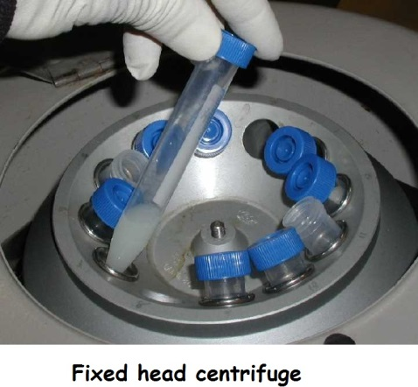

Slide 9
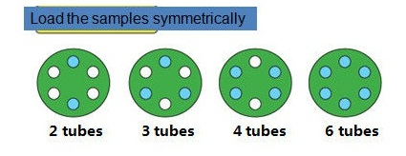

Slide 10


Slide 11
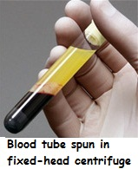

Slide 12
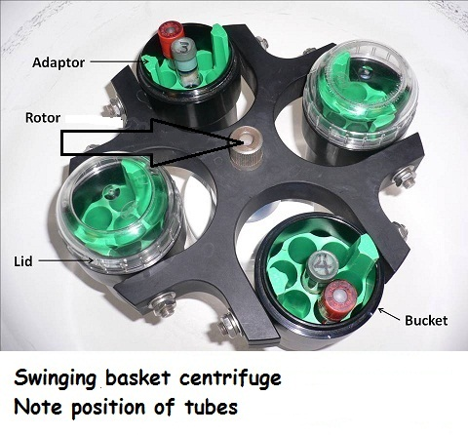

Slide 13
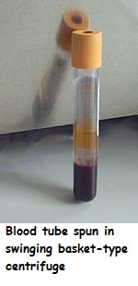

Slide 14
TYPES OF BLOOD SAMPLES
Whole blood is composed of all cellular elements; red blood cells (RBCs), white blood cells (WBCs), and platelets (PLTs) suspended the liquid component, plasma.
Adult blood has about 40% cellular elements and 60% liquid
The blood is mixed with an anticoagulant at the time of collection, kept in a mixed or suspended state, and is NOT spun down.
The most common laboratory test on a whole blood sample is the complete blood count (CBC). Other examples of whole blood tests include the Westergren sedimentation rate (ESR), Reticulocyte count.

Slide 15
Serum is the liquid expressed from clotted blood (blood drawn into a tube with no anticoagulant additive). Blood is allowed to clot and fibrinogen, along with some of the other coagulation factors, is used up in the formation of the clot. Serum, therefore, does not contain fibrinogen or most of the other coagulation factors. Serum is the preferred specimen for most chemistry, blood bank and serology tests because fibrinogen, which interferes with many tests, is removed.

Slide 16
Plasma is the liquid present in anticoagulated blood and contains all the coagulation factors, except one. Because plasma contains most of the clotting factors, it tends to be somewhat hazier than serum. Plasma is used for stat chemistries and coagulation studies.
Most anticoagulants, including EDTA, act by binding or chelating calcium, a necessary component of the coagulation process. The lack of available calcium prevents the blood from clotting.

Slide 17
Heparin is a naturally occurring anticoagulant which acts as an anti-thrombin. Thrombin is another essential component of the coagulation mechanism. The effects of heparin are relatively short-lived compared to other anticoagulants. After about 48 hours, blood drawn in heparin will begin to clot.

Slide 18
SERUM AND PLASMA APPERANCE
Once the patient sample has been centrifuged, observe its appearance. Generally it should be clear to hazy and some shade of pale yellow to yellow in color. Any usual color or appearance should be noted and may cause the specimen to be rejected for testing. The following are important appearance variations you must be aware of.

Slide 19
Hemolysis
When the serum / plasma has a red or reddish color.
Hemolysis results when red cells rupture releasing the hemoglobin molecules.
Gross hemolysis, where the serum or plasma appears bright red, affects most lab tests and the specimen should be recollected.
Some tests will be affected by even slight hemolysis, when the serum or plasma is even slightly pink. Examples of tests that are affected by slight hemolysis include the chemistry potassium test and enzymes LDH (lactate dehydrogenase) & AST (aspartate aminotransferase).

Slide 20
The sample may need to be re-collected.
Hemolysis usually occurs when the venipuncture is traumatic, i.e., vein collapses, needle is moved several times, or negative pressure causes hemolysis of the fragile red cells. In most cases it is possible to avoid hemolysis by obtaining the blood sample with a ‘clean, non-traumatic stick’.

Slide 21
Icterus
When the serum or plasma is deeply yellow, amber or even brownish due to liver disease, damage or excessive red cell breakdown inside the body.
Patients with icteric samples may have hepatitis and are said to be jaundiced.
Like hemolysis, icterus can affect many lab tests, but, unfortunately, recollection of the specimen would not improve the serum or plasma appearance.
Appearance should be noted on the lab report.

Slide 22
Lipemia
A ‘lipemic’ sample has a milky appearance to the serum or plasma.
Slight milkiness may be caused when the specimen is drawn from a non-fasting patient who has eaten a heavy meal.
A heavy milky appearance occurs in rare cases of hereditary lipemia.

Slide 23
As with icterus, the appearance should be noted on the lab report - "Serum lipemic".
Lipemic specimens are usually avoided by drawing specimens from fasting patients.

Slide 24
ALIQUOTING THE SPECIMEN
Take great care not to put the wrong specimen in the wrong tube. One way to avoid this devastating error is to work with only one patient specimen at a time.

Slide 25
Serum or Plasma Tubes WITHOUT GEL: The tube is centrifuged and the serum or plasma is carefully pipetted off into another clean, properly labeled test tube with a clean, disposable pipette. Care must be taken not to remix plasma specimens or contaminate either the serum or plasma with red blood cells. Red cells present in a serum or plasma sample will alter the results of many laboratory tests. Must not get close to the buffy coat.
Serum Tubes WITH Gel: During centrifugation the gel moves above the clot to form a physical barrier between the serum and the clot. The serum can then be poured off without contamination by red blood cells.

Slide 26
ACCESSIONING SPECIMENS
Every lab has a procedure to accession specimens in the lab.
Patient names and identification numbers are logged in on a computer along with the test(s) to be performed. This accessioning serves as a record of tests done and is a convenient way to check if the specimen has actually arrived in the lab for testing.
It is extremely important that all patient information is correctly transcribed, that includes spelling of the patient's first and last names and the correct identification numbers. Remember, most lab errors are clerical in nature. Examples of these types of errors include: misspelling of the patient name, and transposing identification numbers.

Slide 27
PRE-ANALYTICAL ERROR AND SPECIMEN REJECTION
Because the goal of the laboratory is to turn out accurate results, any problem with a specimen that compromises the quality or integrity of the results often means that the sample must often be recollected.
Stand your ground and reject improperly labeled and/or collected specimens

Slide 28
The following is a list of some of the reasons samples will be rejected / or will need to be recollected:
Labeling errors such as name misspelled or wrong name.
Identification number does not match the requisition’s number.
Date of collection, time of collection and/or phlebotomist’s initials are missing.
Unlabeled tubes.
Wrong tube was collected.
Patient was not fasting (when test required a fasting specimen).
Timed specimen not collected at correct time.
“Quantity not sufficient” (QNS) – specimen collected had an inadequate volume.
Specimen hemolyzed.
Anticoagulated specimen has clots in it.
Improper transport (time, temperature, light exposure).
Outdated (expired) supplies were used.
Contaminated specimens.

