Slide 1


Presented by:
Boyce and Bynum Pathology Laboratories along with
Missouri Employers Mutual
NEEDLE STICK INJURY PREVENTION

Slide 2
Boyce & Bynum’s Training
Mission and Goal:
To provide training to BBPL Patient Care staff in order to reduce occupational needle stick injuries, the main source of bloodborne pathogen exposure for healthcare workers.

Slide 3
What is Needle Stick Injury
A needle stick injury is a percutaneous piercing wound typically set by a needle point, but possibly also by other sharp instruments or objects. Commonly encountered by people handling needles in the medical setting, such injuries are an occupational hazard in the medical community. These events are of concern because of the risk to transmit bloodborne diseases through the passage of the hepatitis B virus (HBV), the hepatitis C virus (HCV) and the Human Immunodeficiency virus (HIV).

Slide 4
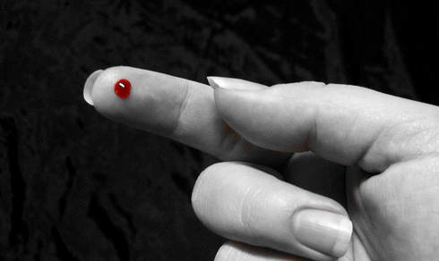
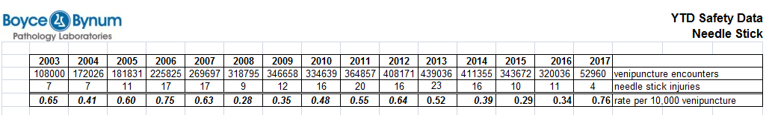
Reports on Needle Stick Injury
35 Million Health-Care workers, 2 million experience percutaneous exposure to infections diseases each year. In 2002 the World Health Report 37.6% were (HBV) 39% (HCV) & 4.4% (HIV/AIDS) in Health-Care Workers around the world are due to needle stick injuries

Slide 5

Center for Disease Control
According to the Centers for Disease Control and Prevention (CDC), about 385,000 sharps injuries occur annually to Health-Care employees.
Potential Hazard
Exposure to blood and other potentially infectious materials (OPIM) because of unsafe needle devices
Improper handling and disposal of needles and other sharps.

Slide 6
Recapping the Leading Cause of Injury
Recapping can account for 25 to 30 percent of all needle stick injuries of nursing and laboratory staff. It is the single most common cause.
It is extremely dangerous to hold a needle in one hand and attempt to cover it with a small cap held in the other hand.
Needle misses cap and accidently enters the hand holding it.
Needle pierces the cap and enters the hand holding it.
Poorly fitting cap slips off of a recapped needle and the needle stabs the hand.
Not using the safety shield or following manufacture guidelines regarding activation of safety shield.

Slide 7
Activities with Potential for
Needle Stick Injuries
Improper activation of safety features
Improper use of Butterfly needles
Recapping needle
Failure to dispose of used needles in puncture resistant sharps containers
Working too quickly
Bumping into a needle, or a sharp while gathering supplies.

Slide 8
Employers Responsibilities
Eliminate the use of needle devices whenever safe and effective alternatives are available.
Provide needle devices with safety features.
Provide sharps containers for workers.
Provide training and information to staff regarding safety/manufacture guidelines.
Investigate all sharps-related injuries.
Provide post-exposure medical evaluations.

Slide 9
Staff Responsibilities
Avoid using needles whenever safe and effective alternatives are available.
Avoid recapping or bending needles that might be contaminated.
Follow BBPL safety & manufacture safety features and guidelines provided.
Participate in employer safety training.
Report any needle stick and other sharps injury immediately to BBPL.

Slide 10
Injuries are Preventable
Needle stick injuries can be preventable if safety is followed in the work place.
Many needle stick injuries cause fear among the Health care workers, leading to liabilities on the employer.
When the needles handled with safety in mind several injuries can be avoided.
Health education, understanding of Universal precaution using safety devices the way they were intended by the manufacture to dispose needle will protect both the employee and employer.

Slide 11
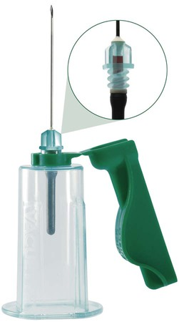
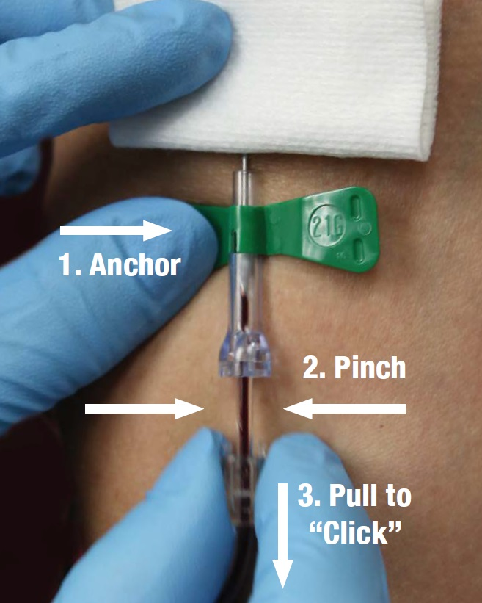
SAFETY Devices
The following safety devices are available :

Slide 12

QuickShield Safety Complete Plus
Proper Use Video

Slide 13
QuickShield Safety Holder
Proper Use Video

Slide 14
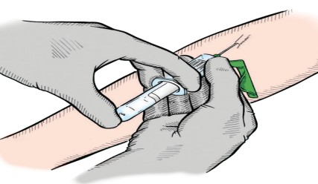
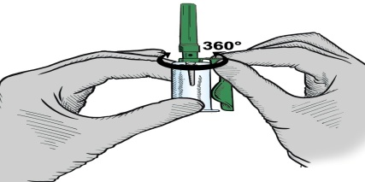
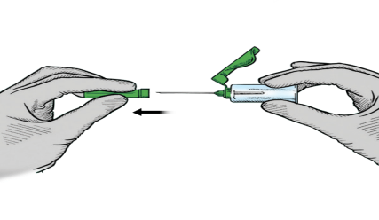
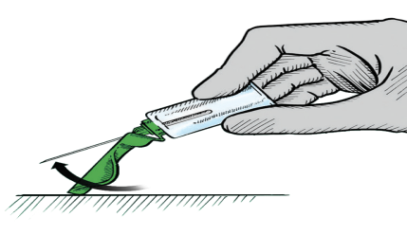
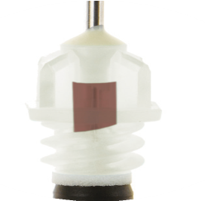
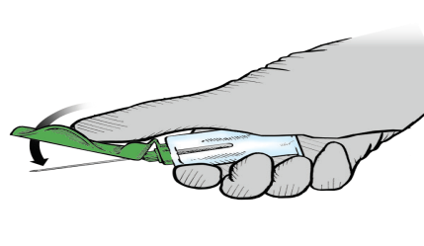
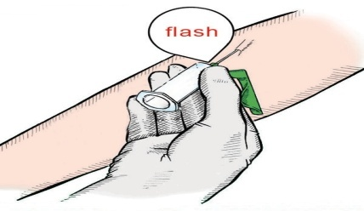
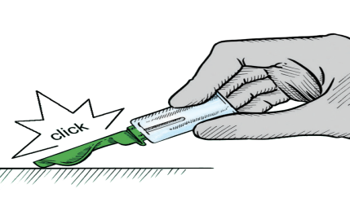

QUICKSHIELD Complete PLUS with rotational shield Instructions for Use
1 The dot on the needle cap indicates the location of the bevel.
The shield can be rotated to the preferred position on the holder where it remains stable during venipuncture.
4 Push the tube into the QUICKSHIELD Holder and onto the needle valve puncturing
the rubber diaphragm. Center tubes in the QUICKSHIELD Holder when penetrating
the cap to prevent sidewall penetration and subsequent premature vacuum loss.
2 Place the patient’s arm in a downward position. Remove the needle cap. Perform the venipuncture, with the patient’s arm downward and the tube cap upper- most.
5 Activate the safety shield by gently pressing the shield towards the needle on a stable surface.
6 Thumb activation is also possible, whereby the thumb should remain behind the shield at all times.
Close-up of red flash in VISIO PLUS hub.
3 Commence the venipuncture. QUICKSHIELD
Complete Plus has a unique translucent hub that flashes red upon successful venipuncture.
7 An audible click is made ensuring the user the safety shield has been properly and fully activated. The risk of
a needlestick injury is thus virtually eliminated. Dispose
of the used needle with holder in an appropriate disposal device.
Tech Services 1.800.515.8112
| www.gbo.com

Slide 15
Wing Collection Set
Proper use.

Slide 16
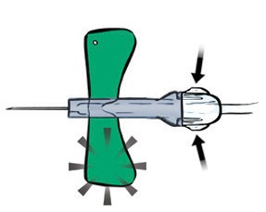
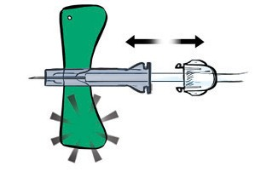
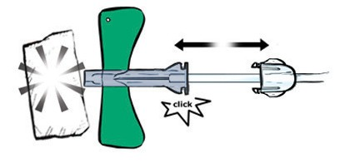
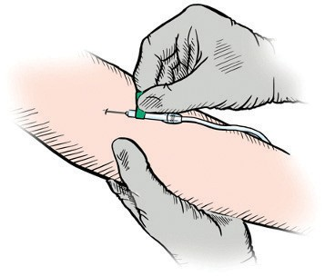
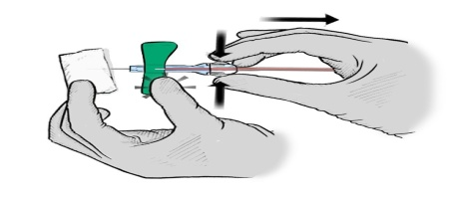
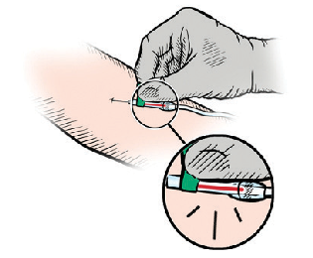
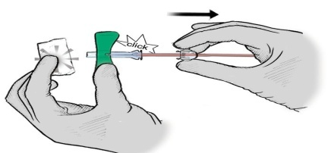
Safety Blood Collection Set
Instructions for Use
RECOMMENDATIONS:
Remove VACUETTE® Safety Blood Collection Set from packaging.
Check to make sure that the wing protector is securely locked into its safety mechanism.
Activate the safety mechanism when the blood collection has been completed and the needle of the VACUETTE® Safety Blood Collection Set is in the patient’s vein.
NOTES:
If individual packaging has been opened or tampered with, please choose another needle.
Do not apply undue pressure to the puncture site.
Maintain pressure on the puncture site according to facility protocol.
Activate the safety mechanism by pressing in both sides of the hub to release the lock.
Slide the hub backward.
An audible click is heard
when the safety mechanism has been correctly activated.
The needle will be completely retracted into the wing protector.
Perform venipuncture with patient’s arm in downward position.
After completion, place gauze over site and hold
wing with a thumb or finger. Activate the safety mechanism by squeezing both sides of the hub.
Flashback will confirm
successful venipuncture. Collect VACUETTE® Blood Collection Tubes.
Slide the safety mechanism backward
until an audible click is heard. The click is a sign that the safety mechanism has been correctly activated.
Tech Services 1.800.515.8112 http://us.gbo.com

Slide 17




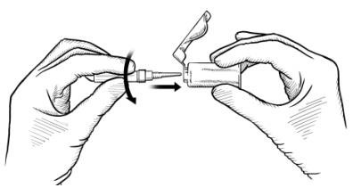
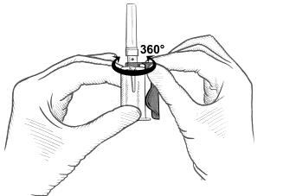
VACUETTE® QUICKSHIELD Safety Tube Holder
(with rotational shield) Instructions for use
Intended Use: The VACUETTE® QUICKSHIELD Safety Tube Holder is intended to be used only with VACUETTE® Multiple Use Drawing Needles, VACUETTE® VISIO PLUS Needles and VACUETTE® Blood Collection Tubes as a system in routine venipuncture procedures. This device is designed with a safety shield, which can be activated to cover the needle immediately following venipuncture to aid in the protection against accidental needlestick injury.
This device is to be used by properly trained healthcare professionals only in accordance with these instructions.
Product Description: The VACUETTE® QUICKSHIELD Safety Tube Holder is a non-sterile, single-use plastic tube holder, designed with a safety shield, which can be activated to cover the needle immediately following venipuncture.
Precautions/Cautions
Do not use VACUETTE® QUICKSHIELD Safety Tube Holder when damaged.
Any VACUETTE® QUICKSHIELD Safety Tube Holder that becomes contaminated with blood is considered hazardous and must be disposed of immediately.
Do not recap needle.
Do not bend needle.
After venipuncture, dispose of used needle with VACUETTE® QUICKSHIELD Safety Tube Holder as one unit in appropriate sharps container in accordance with policies and procedures of your facility.
Keep hands behind needle at all times during use and disposal.
Handle all biological samples and blood collection sharps according to the policies and procedures of your facility.
Obtain appropriate medical attention in the event of any exposure to biological samples (for example, through a puncture injury), since these samples may transmit HIV, viral hepatitis or other infectious disease.
Discard all blood collection “sharps” in biohazard containers approved for their disposal.
Gloves should be worn at all times during venipuncture to minimize exposure hazard.
NOTE: VACUETTE® QUICKSHIELD Safety Tube Holders are designed for optimal use with VACUETTE® Multiple Use Drawing Needles (except 18G) and VACUETTE® VISIO PLUS Needles from Greiner Bio-One. The use of needles from other manufacturers becomes the responsibility of the user.
Storage
Store holders at 4–25°C
NOTE: Avoid exposure to direct sunlight. Exceeding the maximum recommended storage temperature may lead to impairment of the holder.
Handing Procedures
READ THIS ENTIRE CIRCULAR BEFORE PERFORMING VENIPUNCTURE.
Wear gloves during venipuncture and when handling blood collection tubes to minimize exposure hazard.
Remove the cover from the valve section of the needle.
NOTE: The perforated label not only serves to simplify identification, but is also an indicator of sterility and product integrity. If the perforation is broken or damaged, dispose of the needle and select another.
Thread the needle into the VACUETTE® QUICKSHIELD Safety Tube Holder. Ensure the needle is firmly seated so that it does not unthread during use.
NOTE: Improper threading of the needle into the VACUETTE® QUICKSHIELD Safety Tube Holder can result in damage to the threads of the holder and/or needle. This damage can cause the needle to loosen during venipuncture.
NOTE: Do not bend needles or use VACUETTE® QUICKSHIELD Safety Tube Holder when needle is bent.
The dot on the needle cap indicates the location of the bevel.
4.
The shield can be rotated to the preferred position on the holder where it remains stable during venipuncture.
5.
Select the puncture site. Apply the tourniquet (max. 1 minute) Prepare the venipuncture site with appropriate antiseptic. Do not palpate the venipuncture area after cleansing!

Slide 18
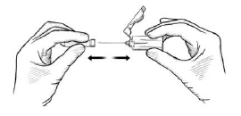
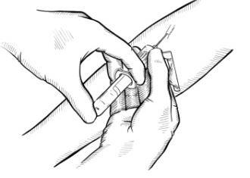
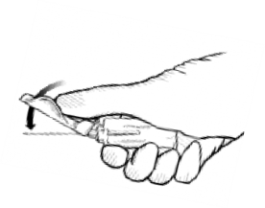
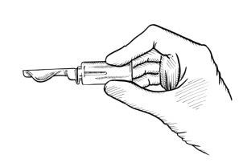
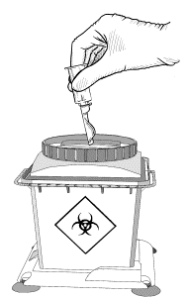
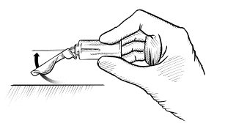
6.
Place the patient’s arm in a downward position. Remove the needle cap. Perform the venipuncture, with the patient’s arm downward and the tube cap upper-most.
7.
Push the tube into the VACUETTE® QUICKSHIELD Safety Tube Holder and onto the needle valve puncturing the rubber diaphragm. Center tubes in the VACUETTE® QUICKSHIELD Safety Tube Holder when penetrating the cap to prevent sidewall penetration and subsequent premature vacuum loss.
8.
Remove the tourniquet as soon as blood appears in the tube. Do not allow the contents of the tube to contact the cap or the end of the needle during the procedure, i.e. under no
circumstances should the tube be turned upside down during the procedure. Always hold in place by pressing the tube with the thumb to ensure complete vacuum draw.
NOTE: Blood may occasionally leak from the needle sleeve. Practice universal safety precautions to minimize hazard exposure.
Place succeeding tubes in the holder. Ensure that the contents of the tube do not come into contact with the cap or the needle tip during blood collection.
As soon as blood stops flowing into the last tube, carefully remove the needle from the vein, applying pressure to the puncture site with a dry sterile swab until bleeding stops. Once clotting has occurred, apply an adhesive plaster or bandage if desired.
Do not recap the needle! Recapping of needles increases the risk of needlestick injury.
NOTE: After venipuncture, the top of the cap may contain residual blood. Take proper precautions when handling tubes to avoid contact with this blood.
Activation of safety shield
Immediately after removing needle from the vein, the following procedures are used to activate the safety shield to prevent needlestick injury.
Activate the safety shield by gently pressing the shield towards the needle on a stable surface. Thumb activation is also possible, whereby the thumb should remain behind the shield at all times. (See A1/A2)
An audible click is heard ensuring the user the safety shield has been properly and fully activated. The risk of a needlestick injury is thus virtually eliminated. (B)
Dispose of the used needle with VACUETTE® QUICKSHIELD Safety Tube Holder in an appropriate disposal device. (C)
A1 A2 B C
NOTE: Do not forcefully release or re-activate the safety mechanism after it has been activated.
Disposal
The general hygiene guidelines and legal regulations for the proper disposal of infectious material should be considered and followed. Disposable gloves may prevent the risk of infection.
Contaminated holders must be disposed of immediately after blood collection in suitable biohazard disposal containers, which can then be autoclaved and incinerated.

