Slide 1
Unit 2B: The Circulatory System

Slide 2
Objectives
Demonstrate basic knowledge of the terminology, structures, functions, organization, and processes of the circulatory system.
Discuss the cardiac cycle, how an ECG tracing relates to it, the origins of heart sounds and pulse rates, and how to take and interpret blood pressure readings.
Distinguish between the different types of blood vessels and blood components, and describe the structure and function of each, identify blood types and explain their importance, and trace the flow of blood throughout the circulatory system.

Slide 3
Objectives (cont.)
Name and locate major arm and leg veins and evaluate the suitability of each for venipuncture.
List the disorders and diagnostic tests of the circulatory system.

Slide 4
Overview
Functions of the Circulatory System
Carries oxygen & food to cells of body
Carries carbon dioxide & other wastes away from cells to excretory organs, kidneys, lungs, & skin
Aids in coagulation process
Assists in defending body against disease
Aids in regulation of body temperature
Main Components
Cardiovascular: heart, blood vessels, & blood
Lymphatic: lymph vessels, lymph nodes, & lymph

Slide 5
The Heart
Function
Pulse
Palpable rhythmic throbbing caused by alternating expansion & contraction of an artery as blood passes through
Blood pressure
Force exerted by blood on walls of blood vessels
Sphygmomanometer: blood pressure cuff
Systolic: pressure in arteries during contraction of ventricles
Diastolic: arterial pressure during relaxation of ventricles

Slide 6
The Heart (cont.)
Disorders
Angina pectoris
Aortic stenosis
Bacterial endocarditis
Congestive heart failure
Myocardial infarction
Pericarditis
Diagnostic Tests
Arterial blood gases
AST or SGOT
Cholesterol
Creatine kinase (CK)
CK-MB
Digoxin
ECG LD isoenzymes
Microbial cultures
Myoglobin

Slide 7
The Vascular System
Functions
Pulmonary circulation
Carries blood from right ventricle of heart to lungs
Carbon dioxide is removed; oxygen is picked up
Oxygenated blood returns to left atrium of heart
Systemic circulation
Carries oxygenated blood & nutrients from left ventricle to body cells
Returns deoxygenated blood with carbon dioxide & wastes from cells to right atrium

Slide 8
The Vascular System (cont.)
Structures
Arteries
Carry oxygenated blood away from heart to tissues
Thick walls to withstand high pressure
Aorta is largest artery
Arterioles: small branches of arteries that join capillaries

Slide 9
The Vascular System (cont.)
Structures (cont.)
Veins
Return deoxygenated blood from tissues to heart
Thin walls, low pressure
Blood is moved by skeletal muscle movement, valves that prevent backflow, & pressure changes in cavities in breathing
Venules: small veins that join capillaries
Capillaries
Microscopic, one-cell-thick vessels that connect arterioles & veins
Site of gas exchange between blood & body tissues

Slide 10
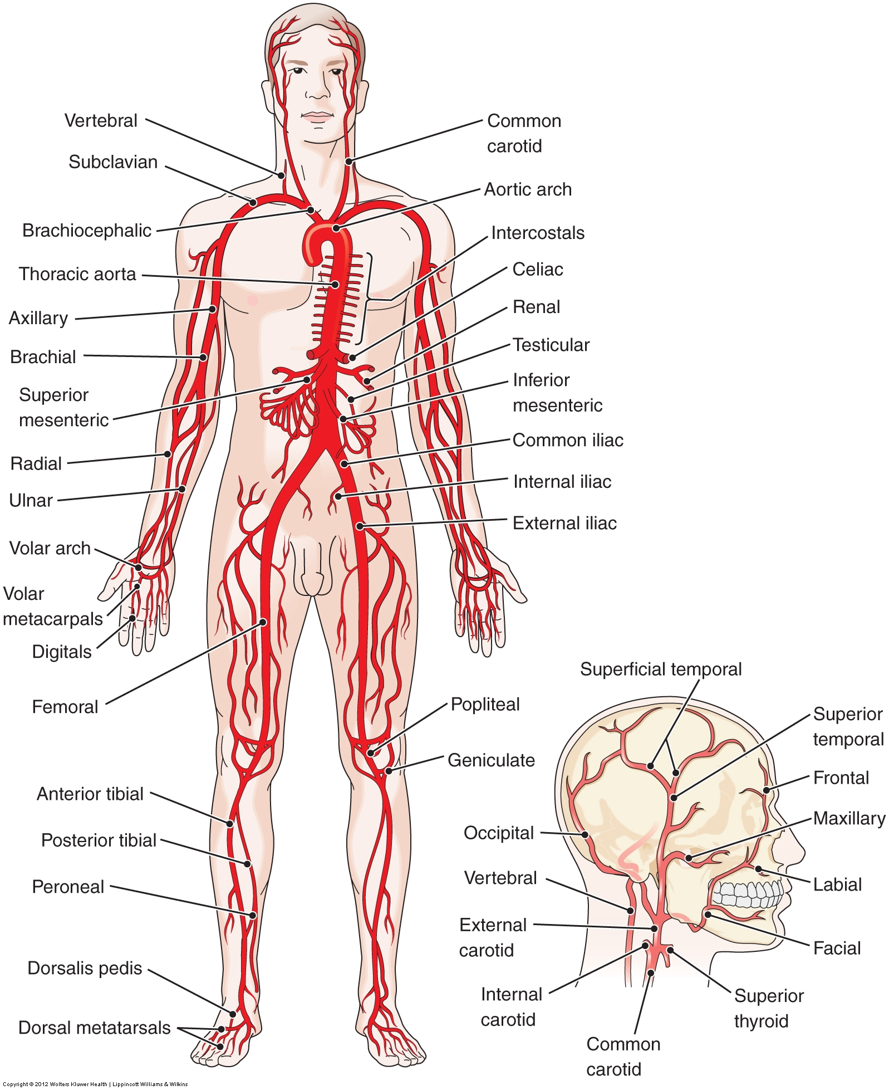
The Vascular System (cont.)
The principal arteries of the body
Copyright © 2016 Wolters Kluwer • All Rights Reserved

Slide 11
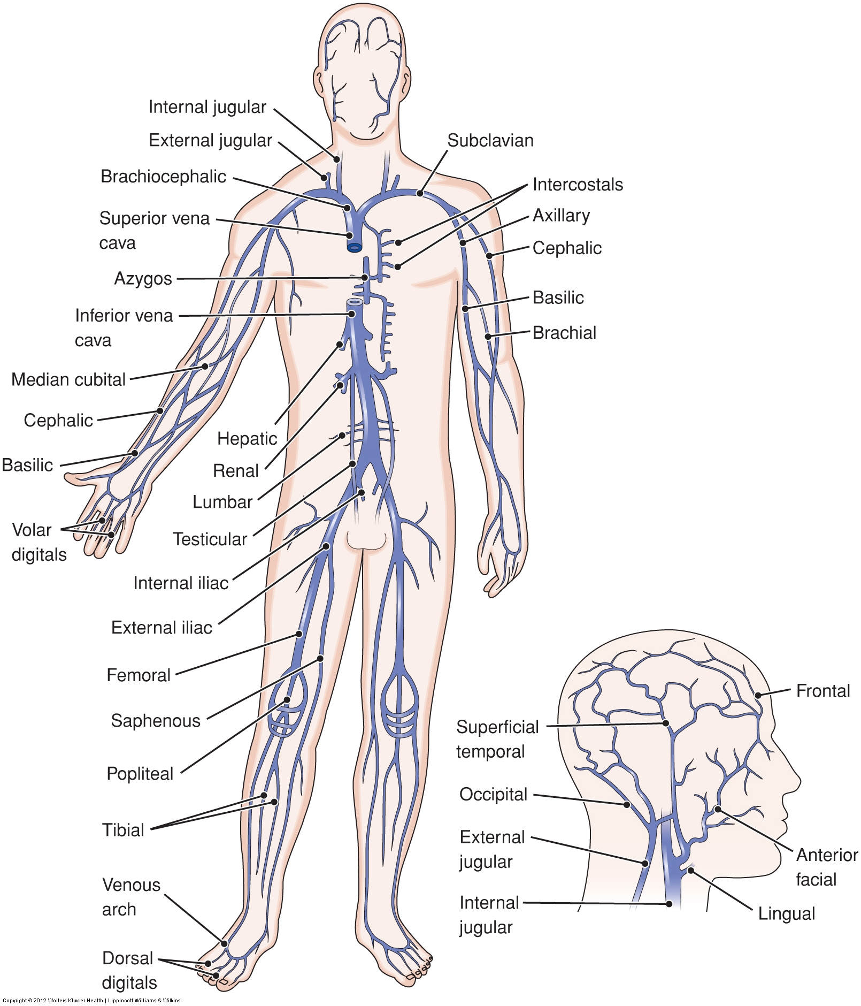
The Vascular System (cont.)
The principal veins of the body
Copyright © 2016 Wolters Kluwer • All Rights Reserved

Slide 12
The Vascular System (cont.)
Blood Vessel Structure
Lumen
Internal space of a blood vessel, through which blood flows
Valves
Thin, membranous leaflets in veins prevent backflow of blood

Slide 13
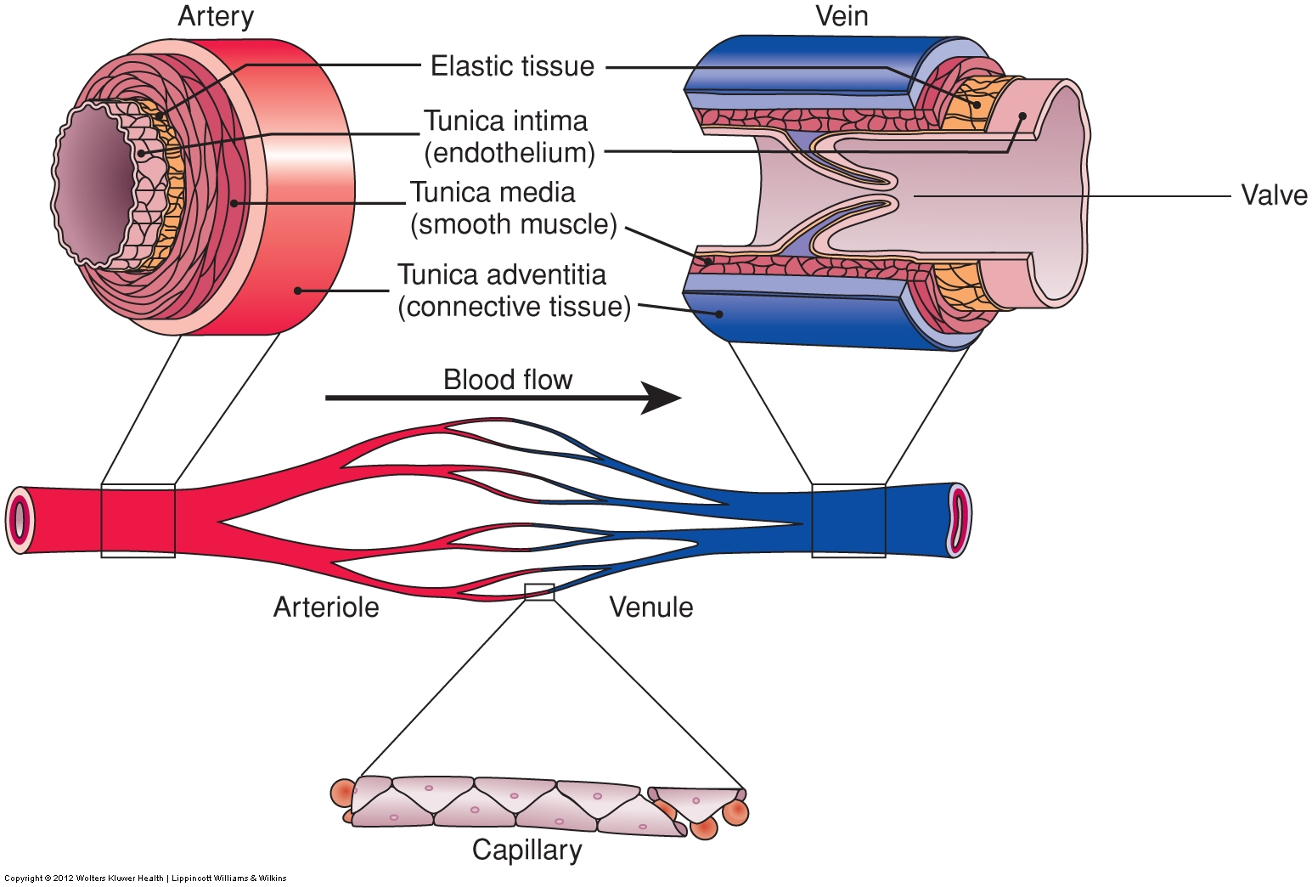
The Vascular System (cont.)
The artery, vein, and capillary structure
Copyright © 2016 Wolters Kluwer • All Rights Reserved

Slide 14
The Vascular System (cont.)
Phlebotomy-Related Vascular Anatomy
Antecubital fossa
Shallow depression in arm anterior to & below bend of elbow
Site of major veins, & thus first choice for venipuncture
H-Shaped antecubital veins (in 70% of population)
M-Shaped antecubital veins
Veins on back of hand & wrist
WORKBOOK Labeling Exercises 6-5 and 6-6 will help you learn the names and locations of the AC veins.

Slide 15
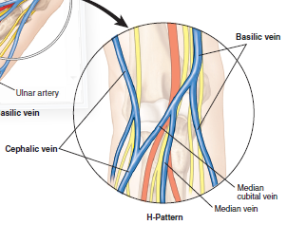
The Vascular System (cont.)
H-Shaped pattern of antecubital veins
Median cubital vein
Located near center of AC
Preferred vein/first choice
Cephalic vein
Located in the lateral aspect of AC
Second choice
Basilic vein
Located in the medial aspect of AC
Last choice
Displayed by approximately 70% of population
Copyright © 2016 Wolters Kluwer • All Rights Reserved

Slide 16
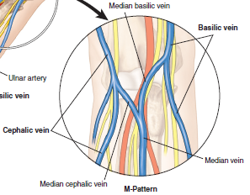
The Vascular System (cont.)
M-Shaped pattern of antecubital veins
Cephalic vein
Median vein
First choice
Median cephalic vein
Second choice
Median basilic vein
Third choice
Basilic vein
The greatest chance of nerve injury is associated with venipuncture in the most medial and lateral portions of the antecubital fossa.
Copyright © 2016 Wolters Kluwer • All Rights Reserved

Slide 17
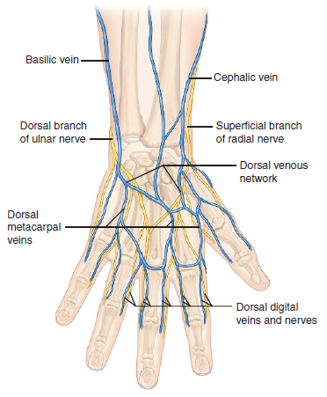
The Vascular System (cont.)
Other arm and hand veins
Dorsal forearm
Dorsal branch of ulnar
Superficial branch of radial
Metacarpal veins
Veins on the side of the wrist above the thumb must not be used as nerve injury could occur in this area.
Copyright © 2016 Wolters Kluwer • All Rights Reserved

Slide 18
The Vascular System (cont.)
Disorders
Aneurysm
Arteriosclerosis
Atherosclerosis
Embolism
Embolus
Hemorrhoids
Phlebitis
Thrombophlebitis
Thrombus
Varicose veins
Diagnostic Tests
DIC screen
Lipoproteins
Prothrombin time
Partial thromboplastin time
Triglycerides
Check out WORKBOOK Knowledge Drill 6-1 to see how well you remember the key points in this chapter.

Slide 19
The Blood
Blood Composition
Plasma
90% water
Gases (O₂, CO₂, N)
Minerals (Na, K, Ca, Mg)
Carbs & lipids
Proteins
Waste products
Vitamins, hormones, drugs

Slide 20
The Blood (cont.)
Formed elements
Erythrocytes (red blood cells)
Most numerous cells in body
Carry O₂ & CO₂
Produced in bone marrow
Leukocytes (white blood cells)
Formed in bone marrow & lymphatic tissue
Neutralize or destroy pathogens
Types: granulocytes & agranulocytes
Thrombocytes (platelets): essential to coagulation
Unscramble the name for a type of WBC in WORKBOOK Knowledge Drill 6-2.

Slide 21
The Blood (cont.)
Blood Type
Inherited
Determined by presence or absence of antigens on surface of red blood cells
A person’s blood either contains or has the ability to develop antibodies directed at the opposite blood type
Blood transfusion of the wrong type can agglutinate and hemolyze red blood cells (transfusion reaction)
Two commonly used blood group systems

Slide 22
The Blood (cont.)
ABO blood group system (see text Table 6-6)
2 antigens (A & B)
4 blood types (A, B, AB, & O)
Rh blood-group system
Based on the “D” antigen (also called Rh factor)
Rh positive (Rh +)
- RBCs have the D antigen
Rh negative (Rh -)
- RBCs lack the D antigen

Slide 23
The Blood (cont.)
Hemolytic disease of the newborn
RhoGam
Compatibility test/cross-match
Test that determines whether donor blood and recipient’s blood are compatible (suitable to be mixed together)

Slide 24
The Blood (cont.)
Blood Specimens
Serum
Fluid portion of blood remaining after clotting
Can be separated from clot by centrifugation
Does not contain fibrinogen (used up in clotting)
Plasma
Fluid portion of whole blood separated from the RBCs, WBCs, & platelets by centrifugation
Contains fibrinogen

Slide 25
The Blood (cont.)
Blood Specimens
Plasma (cont.)
Specimen must be collected in an anticoagulant tube
Used in cases when serum cannot be used
Whole blood
Blood in the same form as it is in the bloodstream
Not allowed to clot or separate
Specimen must be collected in an anticoagulant tube
Must be mixed a minimum of 2 minutes just prior to test

Slide 26
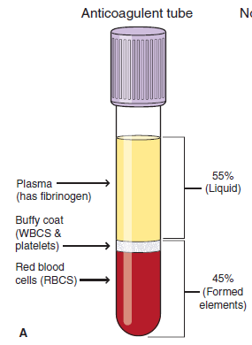
The Blood (cont.)
Separated whole blood specimen
Test your ability to identify layers of a separated whole-blood specimen with WORKBOOK Labeling Exercise 6-10.
Copyright © 2016 Wolters Kluwer • All Rights Reserved

Slide 27
The Blood (cont.)
Disorders
Anemia
Leukemia
Leukocytes
Leukocytosis
Leukopenia
Polycythemia
Thrombocytosis
Thrombocytopenia
Diagnostic Tests
ABO & Rh type
Bone marrow
Complete blood count
Cross-match
Differential
Erythrocyte sed. rate
Hematocrit
Hemoglobin
Iron

Slide 28
Hemostasis and Coagulation
Hemostasis
Arrest or stoppage of bleeding after injury as a body response
Requires coordinated interaction of endothelial cells lining blood vessels, platelets, other blood cells, plasma proteins, & clotting
Is ongoing daily, in conjunction with vessel repair
Process (4 interrelated responses)
Vasoconstriction
Formation of a primary platelet plug
Progression to a stable blood clot
Fibrinolysis (dissolving of clot)

Slide 29
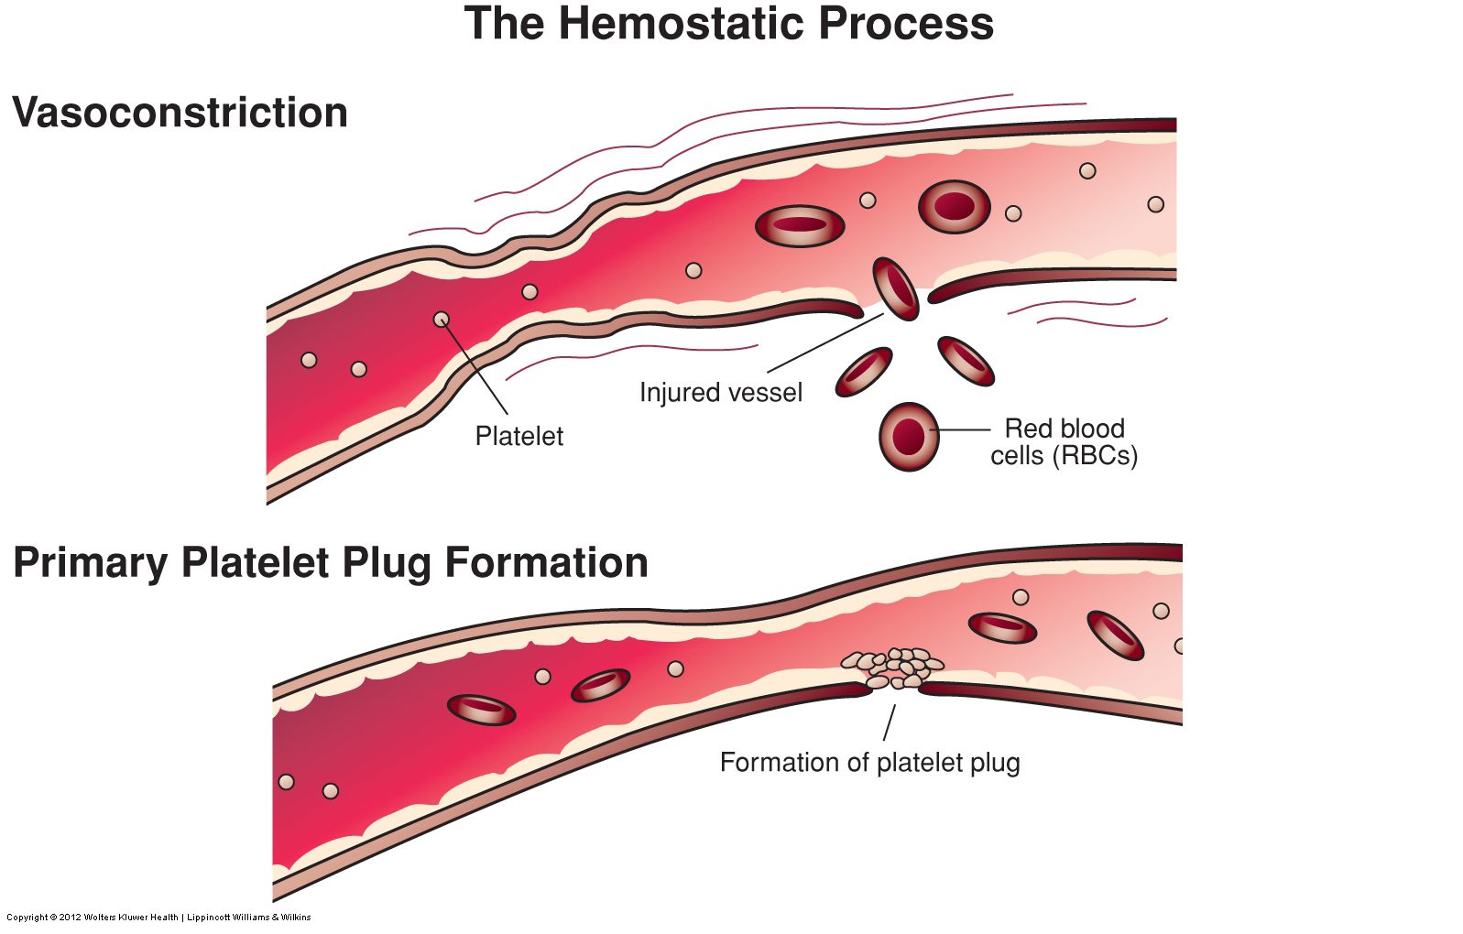
Hemostasis and Coagulation (cont.)
The process of hemostasis
Copyright © 2016 Wolters Kluwer • All Rights Reserved

Slide 30
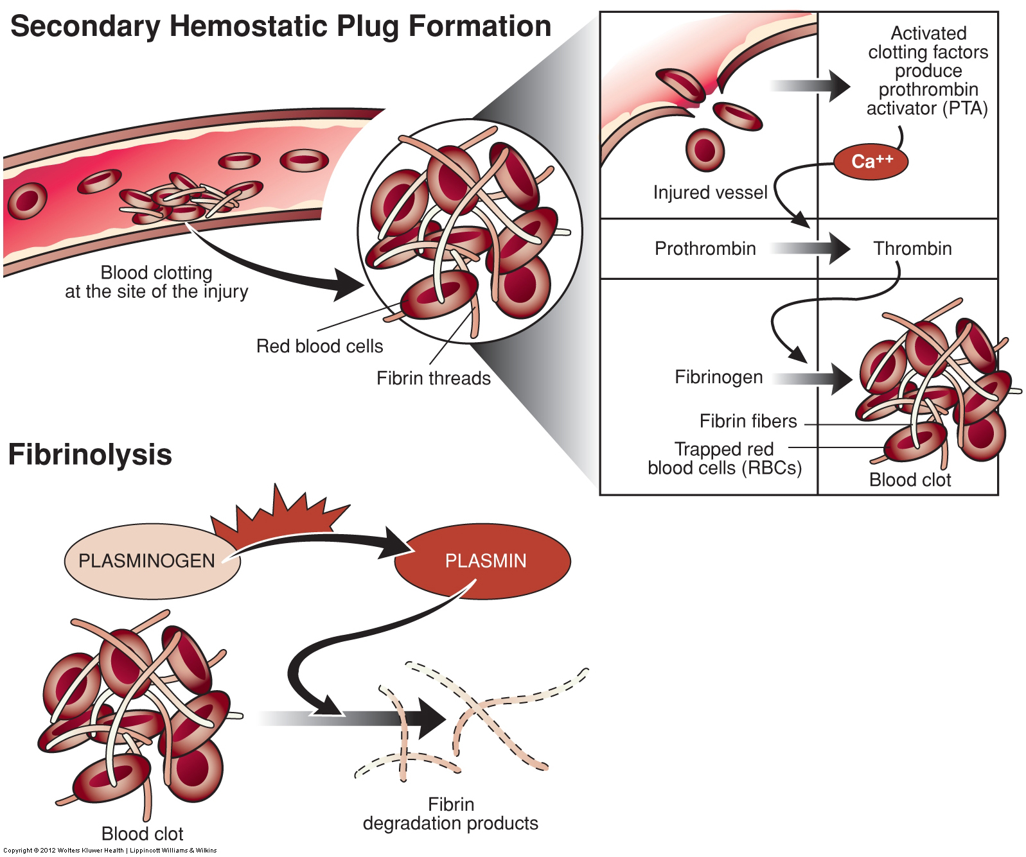
Hemostasis and Coagulation (cont.)
The process of hemostasis
Copyright © 2016 Wolters Kluwer • All Rights Reserved

Slide 31
Hemostasis and Coagulation (cont.)
Coagulation Factors and Pathways
Coagulation factors: proteins required for coagulation
Types
Enzyme precursors: precursor proteins that become enzymes when activated
Cofactors: proteins that accelerate enzymatic reactions in coagulation process
Substrates: substances acted on & changed by enzymes
Extrinsic Pathway
Extrinsic: outside bloodstream
Initiates the coagulation process

Slide 32
Hemostasis and Coagulation (cont.)
Coagulation Factors and Pathways (cont.)
Intrinsic Pathway
Intrinsic: inside bloodstream
Produces thrombin on the surface of activated platelets
Cell-based coagulation phases
Initiation
Amplification
Propagation

Slide 33
Hemostasis and Coagulation (cont.)
The Role of Thrombin
Enzyme that plays the major role in coagulation
Generated at injured site from prothrombin
Converts fibrinogen to soluble fibrin
Amplifies coagulation
Supports platelet plug formation
Activates factor XIII to cross-link fibrin
Controls its own formation & coagulation process by activating protein C

Slide 34
Hemostasis and Coagulation (cont.)
The Hemostatic Process in Vivo
Vasoconstriction
Reduction in diameter of blood vessel
Caused by contraction of smooth muscle fibers in vessel
Decreases blood flow past injured area & limits blood loss
Platelet plug formation
Initiation phase
Secondary hemostatic plug formation
Amplification
Propagation

Slide 35
Hemostasis and Coagulation (cont.)
Fibrinolysis
Process by which fibrin is dissolved
Ongoing process:
Dissolves clots that form in intact vessels, reopening them
Removes hemostatic clots from tissue as healing occurs
The Role of the Liver in Hemostasis
Synthesizes many coagulation factors: V, VIII, prothrombin, & fibrinogen
Produces bile salts, needed for synthesis of some factors
Produces heparin

Slide 36
Hemostasis and Coagulation (cont.)
Disorders
Deep venous thrombosis
Disseminated intravascular coagulation
Hemophilia
Thrombocytopenia
Diagnostic Tests
Bleeding time
D-dimer
Factor assays
Fibrin degradation products
Platelet function assay
Prothrombin time
Partial thromboplastin time

Slide 37
NAACLS Entry Level Competencies Met in This Chapter
3.00 Demonstrate basic understanding of the anatomy and physiology of body systems and anatomic terminology in order to relate major areas of the clinical laboratory to general pathologic conditions associated with the body systems.
3.1 Describe the basic functions of each of the main body systems, and demonstrate basic knowledge of the circulatory, urinary, and other body systems necessary to perform assigned specimen collection.

Slide 38
NAACLS Entry Level Competencies Met in This Chapter (cont.)
3.2 Identify the veins of the arms and hands on which phlebotomy is performed.
3.3 Explain the functions of the major constituents of blood, and differentiate between whole blood, serum, and plasma.
3.4 Define hemostasis.
3.5 Describe the stages of coagulation.
3.6 Discuss the properties of arterial blood, venous blood, and capillary blood collection.

Slide 39
Questions?

