Slide 1
Confronting Adult Abuse in Missouri
Make a Difference. Make the Call.

Slide 2
What is Adult Abuse?
Who is a Victim?
Missourians who are unable to protect their own interests or perform or obtain services to meet their needs and are….
60 years and older
OR
18-59 years with a mental or physical disability

Slide 3
What is Adult Abuse?
Types of Abuse
Physical Abuse, including Sexual Abuse
Emotional Abuse
Caregiver Neglect or Abandonment
Financial Exploitation
Self-Neglect

Slide 4
Where Can Adult Abuse Occur?
Abuse can occur anywhere, such as:
Adult’s Home or Apartment
Relative’s Home
Long-Term Care Facility

Slide 5
What are the Warning Signs?
Physical Abuse
Hidden Injuries.
Sudden change in behavior.
Bruising
Caregiver’s behavior

Slide 6
What are the Warning Signs?
Sexual Abuse
Bruising on breasts or genital area
Sudden interest in sexual issues
Questions regarding pregnancy

Slide 7
What are the Warning Signs?
Caregiver Neglect
Dehydration / Malnutrition
Poor personal hygiene
Untreated health problems
Health & safety hazards in living environment

Slide 8
What are the Warning Signs?
Self-Neglect
Not keeping medical appointments
Inability to manage personal finances
Poor hygiene
Changes in intellectual functions
Inadequate housing or homeless
Hazardous living conditions

Slide 9
What are the Warning Signs?
Financial Exploitation
Inability to explain finances.
Disparity between assets & lifestyle.
Caregiver behavior.
Sudden change in banking practices
Misuse of a Power of Attorney

Slide 10
Common Perpetrators
Adult Children
Other relatives (grandchildren, nephews, etc.)
Spouses/partners
Friends/neighbors
DPOA/Guardians
Paid Caregivers (home health aides, in home service workers, Hospice workers, adult day care staff)

Slide 11
Common Traits of a Perpetrator
History of Drugs/Alcohol abuse
History of Mental Illness
Unemployment
Socially isolated
Criminal History
Shared living situation
Dependent on elder
Feelings of resentment/overwhelmed
“Advanced inheritance”

Slide 12
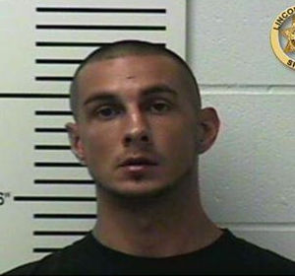
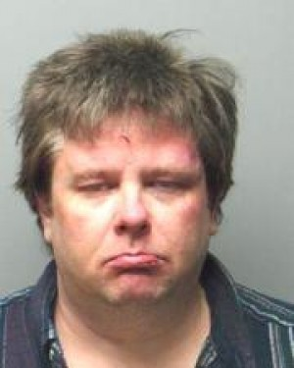
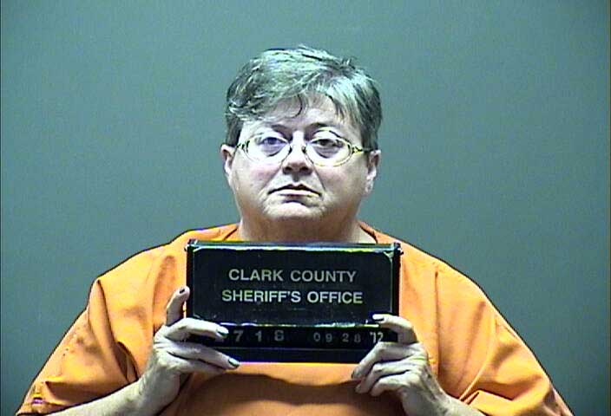
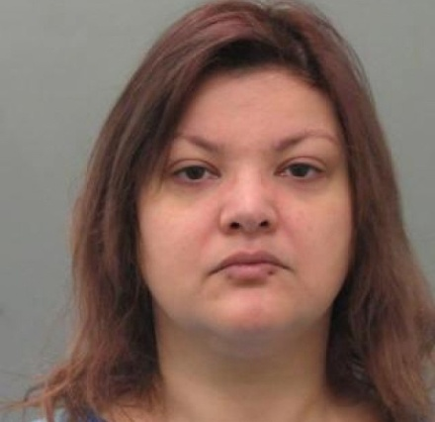
Adult Abuse
St. Charles Man Beats 79-Year-Old Mom, Breaks Bones, gets 8 years in Prison - Fox 2 Now Dec 17 2013
87-year-old Hawk Point woman beaten by grandson, police say – St. Louis Post-Dispatch January 28, 2014
Real stories
Rural Kahoka woman found guilty of elder abuse in case involving her mother Quincy Herald-Whig Sept 28 2012
St. Louis County police seek stiffer charges in deadly elder abuse case – St. Louis Post-Dispatch Dec. 5 2012

Slide 13
What are the Barriers to Detecting Abuse?
Societal Barriers
Similarity between symptoms of chronic disease or accidental injury & signs of abuse
Ageism
Family business

Slide 14
What are the Barriers to Detecting Abuse?
Personal Barriers
Previous involvement of others has worsened the abusive situation
Lack of self confidence
Lifetime of abuse
Shame or fear
Abuser control

Slide 15
What are the Barriers to Detecting Abuse?
Personal Barriers
Victim unwilling to press charges against a loved one
Loss of caregiver equates to loss of independence
Victim’s credibility
Inability to communicate

Slide 16
What can we do together to Confront Adult Abuse in Missouri?

Slide 17
Adult Abuse and Neglect Hotline
Missouri Department of Health and Senior Services
1-800-392-0210
Make a Difference. Make the Call.
7a.m. -12 Midnight, 365 Days a year.

Slide 18
Make a Difference. Make the Call.
What Information Do I Need to Make a Report?
The alleged victim's name, address, telephone number, sex, date of birth or Medicaid number if known and general condition;
The alleged abuser's name, address, sex, age, relationship to victim and condition;
The circumstances which led the reporter to believe that the adult is being abused, neglected or financially exploited, with as many specific details as possible;

Slide 19
Make a Difference. Make the Call.
What Information Do I Need to Make a Report?
Whether the alleged victim is in immediate danger, the best time to contact the alleged victim, if he or she knows of the report, and if there is any danger to the worker going out to investigate;
The name, daytime telephone number, and relationship of the reporter to the alleged victim;
The names of others with information about the situation;
If the reporter is not a mandated reporter, whether he or she is willing to be contacted again; and
Any other relevant information.

Slide 20
What can we do together to Confront Adult Abuse in Missouri?
Request materials from the Department of Health and Senior Services to spread awareness in your community.

Slide 21
Confronting Adult Abuse in Missouri
What is Adult Abuse?
What are the Warning Signs?
What are the Barriers to Detecting Abuse?
What can we do together to Confront Adult Abuse in Missouri?

Slide 22
What can we do together to Confront Adult Abuse in Missouri?
Provide respite to relieve a caregiver
Visit an elderly or disabled friend

Slide 23
Contact us
Cindy Jobe, Chief of Central Registry Unit
Jessica Bax, Constituent and Emergency Services Coordinator
Division of Senior and Disability Services
Cindy.Jobe@health.mo.gov
(573) 522-1081
Division of Senior and Disability Services
Jessica.Bax@health.mo.gov
(573) 751-2413

