Slide 1

EA Conway Medical Center
Lockout/Tagout
Training
Created December 2012 by Karen Williams

Slide 2
Definition:
Energy runs machines and moves their parts. That energy can be electrical, mechanical, hydraulic or pneumatic. Sometimes the energy is stored, as in springs, steam, or as pressurized air or liquids. Any type of energy, however, can be a serious safety hazard, especially if it comes on or is released unexpectedly while servicing or maintaining equipment. That is why OSHA has developed lockout/tagout procedures to help make sure that anyone working on equipment isn't electrocuted, hit, cut, crushed or otherwise injured during machinery service or repair. If there are any questions regarding the following procedures or safety questions, ask your supervisor.

Slide 3

Key steps to proper lockout:
SHUT OFF and lockout electricity.
RELEASE and lockout energy.
DRAIN and lockout material.

Slide 4
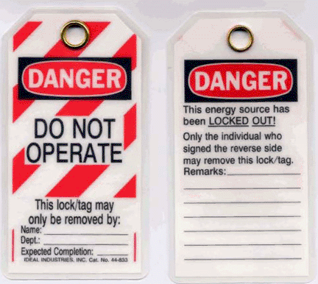
After all the energy has been shut off and drained, lockout is the safest method of keeping you from getting hurt. The law requires you to lockout machine power whenever possible. Only when you can't lockout, do you tagout using a warning tag.

Slide 5
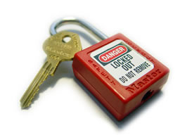
Lockout means putting a lock on the part of the machine that controls the energy, i.e., a circuit breaker, switch, block, valve. This locks the energy control device in an "off" position and prevents the machine from starting up or releasing energy accidentally. A lockout lock can have a key or a combination. It cannot be a lock that's used for any other purpose than lockout.

Slide 6
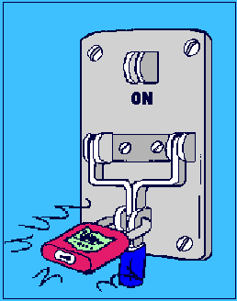
Lockout locks must be:
Durable enough for the heat, cold, humidity or corrosiveness in the area where it's used, for as long as it is needed.
Standardized by color, shape or size throughout the facility.
Strong enough so it cannot be removed without heavy force or tools like bolt cutters.
Identified by the name of the employee who installs and removes it.

Slide 7
AUTHORIZED STAFF:
Staff authorized to perform lockouts will be assigned by the Engineering Department Director. Those assigned this responsibility will be trained in specific lockout procedures and will learn how to recognize the type and amount of energy used by the machines and equipment and how to control that energy.
If a team is used for lockout/tagout, one (1) member of the group must have primary responsibility. That person makes sure that all group members are safe during lockout. Each authorized group member puts his or her own lock or tag on during the group lockout.
Never remove anyone else's lock or permit anyone else to do so.
Report lost keys to your supervisor immediately and have the lock destroyed.
Always use your own lock and key.

Slide 8


Slide 9

AFFECTED STAFF:
Staff that can be affected by any LOTO work within their department or in general areas of the hospital, such as hallways, lobbies, etc.

Slide 10

RESPONSIBILITIES OF AFFECTED STAFF
Through your supervisor, be aware of any LOTO work being conducted within your department or general areas.
Do not attempt to remove any lock or tag located on equipment or electrical breakers that are located in your department or general area.

Slide 11
ALL STAFF:
All staff who work with equipment must be trained in basic lockout procedures. They need to understand why lockout/tagout is important, how the procedure works and the importance of not attempting to repair or service machinery without going through proper procedures.
Other staff need to be familiar with lockout/tagout procedures and know the importance of not trying to restart locked or tagged equipment or try to work on equipment which is not part of their job.
Never remove, ignore or bypass locks or tags you find on machinery.

Slide 12


Slide 13
LOCKOUT PROCEDURE:
Locate and identify power sources, potential hazards and all control devices.
Notify all staff involved.
Turn off all power controls.
Isolate all power sources by blocking, bleeding and venting energy that may be stored in springs, hydraulic systems and pneumatic systems.
Lockout all switches and power controls in the "Off" or "Safe" position.

Slide 14
LOCKOUT PROCEDURE:
Test for safety with operating controls in the "On" position. Before testing, always ensure that no one is in danger of injury.
Return all operating controls to the “Off” position.
Perform necessary work.
Remove lockout devices once the equipment is fully operational and all affected employees are notified. Lockout devices must be removed by the person who puts them on.

Slide 15
TAGOUT:
Definition:
Some equipment cannot be locked out. This does not mean it cannot be dangerous if it starts or is energized accidentally. That where tagout comes in. Tagout means using special tags that warn people of the danger of starting up the machine. A tag has a printed warning about what could happen if the equipment starts up. The tags must be special tags, used only for this purpose. Remember, tags do not provide physical restraints; they are simply warning devices. Do not let tags provide a false sense of security.

Slide 16
TAGOUT:
These tags must meet the same standards that the locks do; they must be durable, strong, standardized and show the identity of the person doing the work. They must also have the same print and format throughout the facility and be tough enough so they cannot be accidentally removed. The law also states that they must be attached with something similar to nylon cable and cannot be reused. They also must be self-locking and cannot be released with less than 50 pounds of strength. A tagout must be attached at the same locations as a lockout device would have been attached.

Slide 17
GETTING BACK ON LINE:
When maintenance or service is done, only the same authorized person who installed the lock or tag may remove it. Special circumstances may apply during shift changes or unavailability. Specific facility procedures must be followed.

Slide 18
Removal procedure:
Make sure all staff are a safe distance from equipment.
Remove tools from machine or equipment.
Reinstall any machine guards.
Remove lockout devices.
Turn on energy.
Notify other staff that the machines are working again.

Slide 19
WHO WILL RECEIVE LOCKOUT/TAGOUT TRAINING:
Lockout/tagout training will be conducted for all new maintenance employees. Retraining will be conducted when there is:
A change in job assignment
New hazard due to a change in machine, equipment or process
Change in procedure
Annual evaluation reveals inadequacies in lockout/tagout procedures or employee knowledge

Slide 20
Outside Contractors
When outside contractors are to be used, the contractor and the Engineering Department Director must make each other aware of their respective lockout/tagout procedures.

Slide 21
REFERENCE:
Content found in this presentation was taken directly from the E.A. Conway Medical Center Physical Plant Department Lockout/Tagout Training Procedure.

Slide 22
Happy Holidays!

