Slide 1

The Joint Commission Sentinel Alert
Medical Device Alarm Safety in Hospitals
E.A. Conway Medical Center
Laboratory
May 2013

Slide 2
Medical Alarms
Many medical devices have alarm systems; among them are bedside physiologic monitors that include ECG (electrocardiogram) machines, pulse oximetry devices, and monitors of blood pressure and other parameters; bedside telemetry; central station monitors; infusion pumps; and ventilators.

Slide 3

Medical Alarms
These alarm-equipped devices are essential to providing safe care to patients in many health care settings; clinicians depend on these devices for information they need to deliver appropriate care and to guide treatment decisions.

Slide 4
Medical Alarms
These devices present a multitude of challenges and opportunities for health care organizations when their alarms create similar sounds, when their default settings are not changed, and when there is a failure to respond to their alarm signals.

Slide 5

Medical Alarms
The number of alarm signals per patient per day can reach several hundred depending on the unit within the hospital, translating to thousands of alarm signals on every unit and tens of thousands of alarm signals throughout the hospital every day.

Slide 6
Medical Alarms
It is estimated that between 85 and 99 percent of alarm signals do not require clinical intervention, such as when alarm conditions are set too tight; default settings are not adjusted for the individual patient or for the patient population; ECG electrodes have dried out; or sensors are mispositioned.

Slide 7

Medical Alarms
As a result, clinicians become desensitized or immune to the sounds, and are overwhelmed by information – in short, they suffer from “alarm fatigue.” In response to this constant barrage of noise, clinicians may turn down the volume of the alarm setting, turn it off, or adjust the alarm settings outside the limits that are safe and appropriate for the patient – all of which can have serious, often fatal, consequences.

Slide 8

Alarm Related Events
The Joint Commission’s Sentinel Event database* includes reports of 98 alarm-related events between January 2009 and June 2012. Of the 98 reported events, 80 resulted in death, 13 in permanent loss of function, and five in unexpected additional care or extended stay. For the reported events, among the major contributing factors were:
Absent or inadequate alarm system
Improper alarm settings
Alarm signals not audible in all areas
Alarm settings inappropriately turned off

Slide 9
Contributing Factors
• Alarm fatigue – the most common contributing factor
• Alarm settings that are not customized to the individual patient or patient population
• Inadequate staff training on the proper use and functioning of the equipment (e.g., inconsistent team training, response, and interpretation of alarm signals)
• Inadequate staffing to support or respond to alarm signals
• Alarm conditions and settings that are not integrated with other medical devices
• Equipment malfunctions and failures

Slide 10

Alarm Fatigue

Slide 11

Laboratory Alarm Fatigue
Although Laboratory Alarms are not associated with direct patient care, if ignored these alarms could cause as much if not more harm than the bedside alarms mentioned previously.
It is important for all laboratory employees to be aware of all alarms not only in their department but all departments.
Laboratory alarms may signal problems or may sound during specific processes or may sound at the end of a test or run.

Slide 12

E.A. Conway Laboratory Alarm Inventory

Slide 13
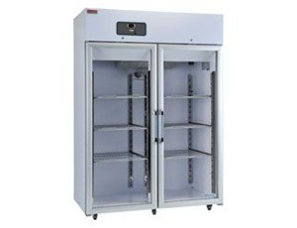
Blood Bank Alarms
ProVue
Horizon Plasmafuge 12
Transfusion Service Refrigerator A
Transfusion Service Freezer D
Surgery Refrigerator G
Genesis 2006 Plasma Thawer
Dade Cell Washer
Sorvall Cell Washer
IEC Centra-W Cell Washer
Therapeutic Phlebotomy Scale
Morgue Refrigerator

Slide 14
Important Blood Bank Alarms For ALL Techs to know
Transfusion Service Refrigerator A
  All Packed Red cells are stored in Refrigerator A
Transfusion Service Freezer D
  All Frozen Blood Components are stored in Freezer D
Surgery Refrigerator G
  Located in Surgery—Blood components for patients currently in surgery are stored here.
Morgue Refrigerator
  Morgue Refrigerator will be discussed in Histology

Slide 15
Blood Bank Alarms
Transfusion Service Refrigerator A
Transfusion Service Freezer D
Surgery Refrigerator G
Morgue Refrigerator
Once the temperature of the above refrigerators/freezer approach the upper or lower limits of their temperature range, the department is notified by the switchboard operator.
Once the temperature has reached or exceeded their lower or upper limits, an audible alarm will be heard.
Do not ignore the call or the alarm. The problem must be addressed immediately.

Slide 16
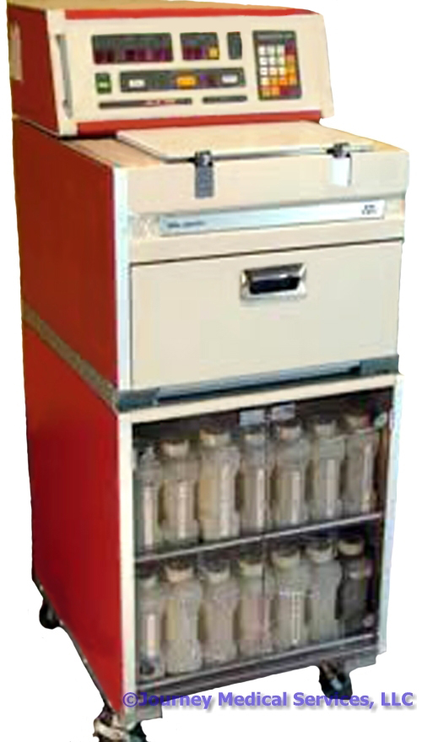
Histology Alarms
VIP Tissue Processor
Morgue Alarm

Slide 17
Histology Alarms for ALL Techs to know
VIP Tissue Processor
  Will activate the AST alarm when something fails during processing
Morgue alarm
  Once the temperature approaches the upper or lower limits of their range, Blood Bank is notified by the switchboard operator and the AST alarm is activated.

Slide 18

Histology Alarms
Do not ignore the call or the alarm. The problem must be addressed immediately.

Slide 19
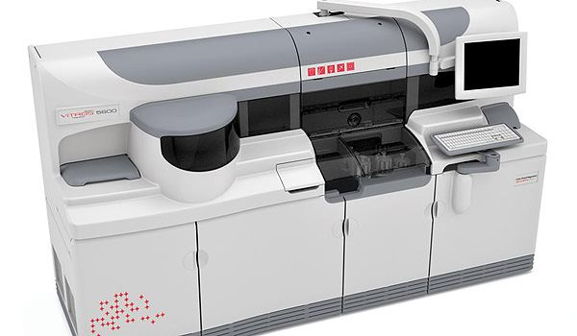
Chemistry Alarms
Vitros
Osmometer
Freezers
Refrigerators

Slide 20
Chemistry Alarms for ALL Techs to Know
Chemistry Refrigerators and Freezers alarm when the temperature is out of range.
These alarms should be addressed immediately and not ignored.

Slide 21
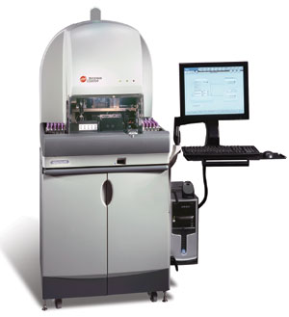
Hematology Alarms
Urisys 2400
UF 1000i
ACL Tops 500
DxH 800-1 and DxH800-2
  visual—(red marker on top of the analyzer)
  audible silenced

Slide 22
Hematology Alarms
All Hematology Alarms should be addressed by employees working or trained in the Hematology Department.

Slide 23
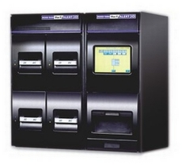
Microbiology Alarms
BACT/ALERT 3D
Vitek II
Bio-Safety Hoods
Mechanical Rotator

Slide 24
Microbiology Alarms for ALL Techs to know
Bact/Alert 3D
  Distinctive visual and audible alarms for a positive blood cultures and mechanical issues
  Mechanical issues with the BACT/ALERT 3D need to be addressed immediately. Do not ignore the alarm.
  Positive blood cultures are critical values and need to be addressed immediately by the tech working in the department.
Bio-Safety Hood Alarms
  Need to be addressed immediately if working under the hood.
  If the alarm sounds, the hood is not functioning properly putting the employee at risk of infection.

Slide 25
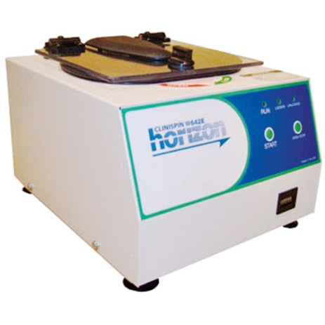
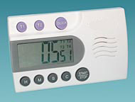
General Laboratory Alarms
General Laboratory Alarms are found in all areas of the Lab. They include:
Fire Alarm
Timers
Printers
Centrifuges (including Cyto- Centrifuges)
UPS

Slide 26
Summary
Avoid alarm fatigue
Do Not Ignore Alarms

Slide 27
The End!

