Slide 1
Urine Sediment
Provider Performed Microscopy

Slide 2
Urine Sediment
The microscopic examination is the most common diagnostic procedure for the detection of renal and/or urinary tract disease.
Interpretation of urine sediment requires time, skill, training, and experience acquired through the use of various methods and pathophysiologic correlation of the sediment findings with the macroscopic results and clinical status of the patient.

Slide 3
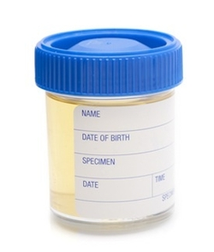
Specimen
Fresh Urine Specimen.
Specimen should not stand for more then 2 hours before testing
Refrigerate specimens if testing can not be performed within 2 hours of collection.
MUST BE labeled with two positive patient identifiers.
Documentation in EPIC should include the type of urine specimen collected. (Clean Catch, Void, Cath, etc.)
John Doe
07/17/1979
06/08/15
0800 KW

Slide 4
Procedure
Mix urine well.
Pour 12 ml of well-mixed urine into a conical centrifuge tube labeled with two positive patient identifiers. If 12 ml is not available, use 3 ml.
Cap centrifuge tube
Centrifuge at 400 RCF for 5 minutes.
Remove the tube from the centrifuge carefully so as not to dislodge sediment.
Decant supernatant retaining approximately 1.0 ml of sediment at the bottom of the tube.
Note: If a 3 ml specimen was used, decant all liquid quickly, retaining a small drop in which to re-suspend the sediment.
Mix the sediment in the tube.
Insert pipette and transfer to a slide.
Examine the sediment within the viewing area under low power (10 objective) and enumerate epithelial cells and casts. Enumerate all other formed elements under high power (40 objective) scanning 10 – 20 fields.

Slide 5
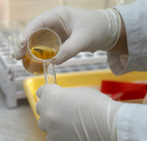
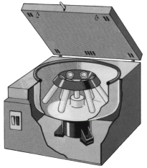
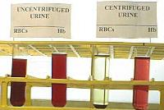
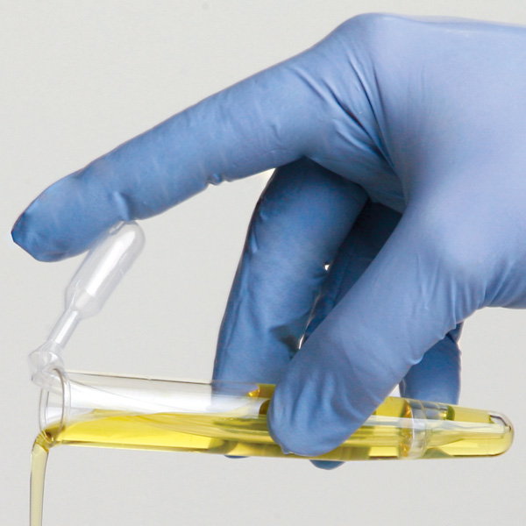
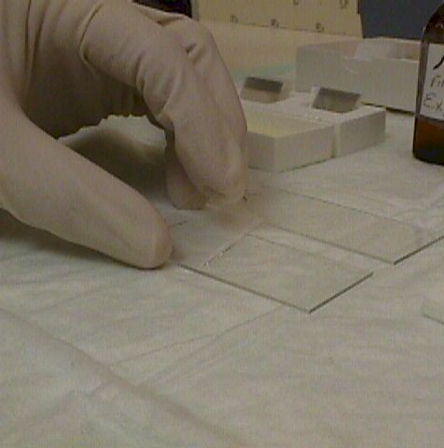
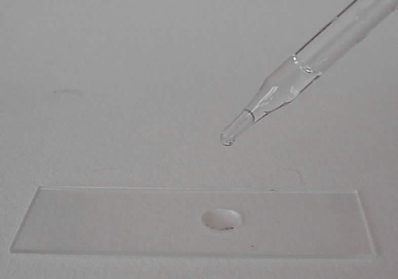
Procedure
Centrifuge for 5 minutes.

Slide 6
Expected Results
WBC: 0-5 /hpf
RBC: 0-2/hpf
Squamous Epi Cells: 0-20/lpf
Bacteria: None
Trichomonas: None
Yeast: None
Hyaline Casts: 0-2/lpf
Crystals (non-path): 0-3/lpf

Slide 7
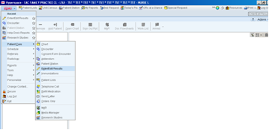
Entering Results into EPIC
Results MUST be entered into EPIC
Log into Epic
Use the Epic drop down tab located in the upper left side of the screen.
Select Patient Care then Enter/Edit results.

Slide 8
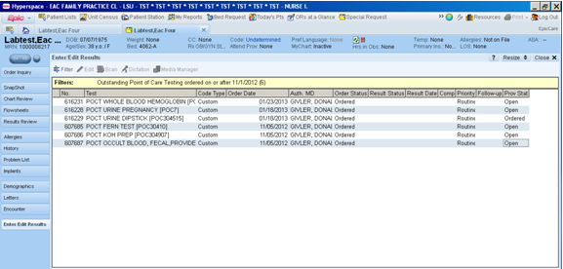
Entering Results into EPIC
Enter patients name or medical record number.
The following screen will come up if the filter is set to POCT. (Note: The filter button can be used to select POCT to result).

Slide 9
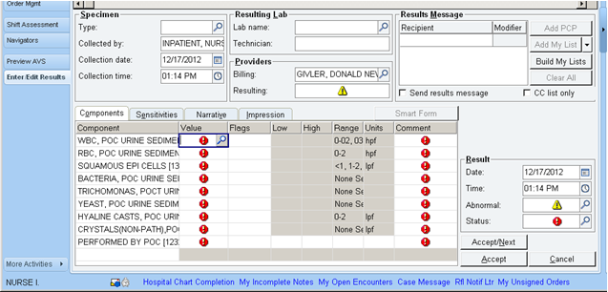
Entering Results into EPIC
Double Click the ordered test and the following screen will appear:
Result the red and yellow exclamation boxes.
Click Accept to file into the patients record.

Slide 10
Quality Control, Competency , Proficiency Testing
Quality Control is not required if a chart of Urine Sediment is posted for reference.
CAP reference books for urinalysis can be found attached to the wall near each of the microscopes where testing is performed.
Urine Sediment examination is a Provider Performed Microscopy Procedure.
The Provider must be privileged in PPMP to perform this test.
All testing personnel must participate in University Health Conway’s competency program.
All testing personnel are subject to participating in CAP proficiency testing program as chosen by the POC department in the laboratory.

Slide 11
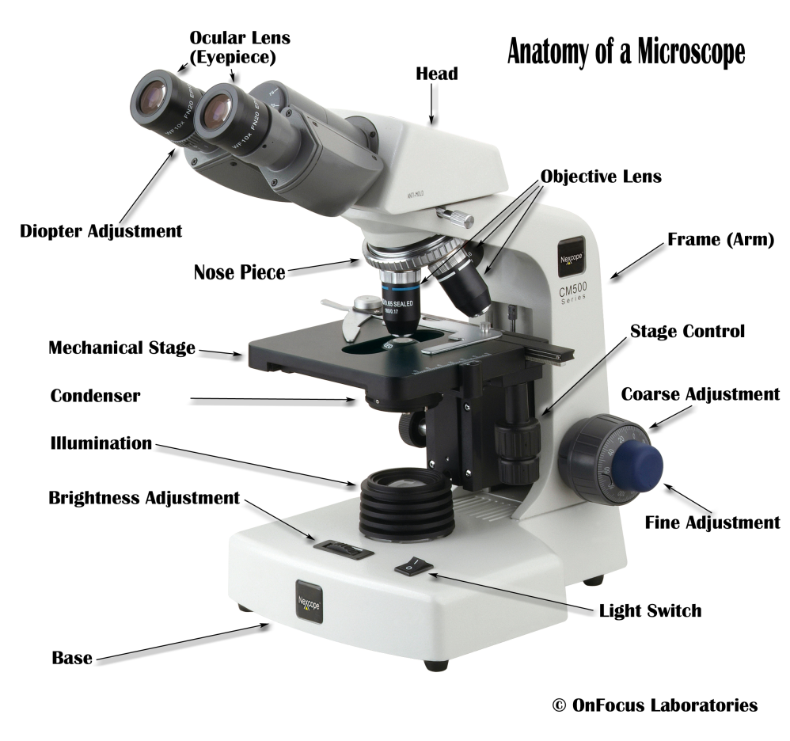
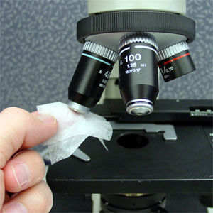
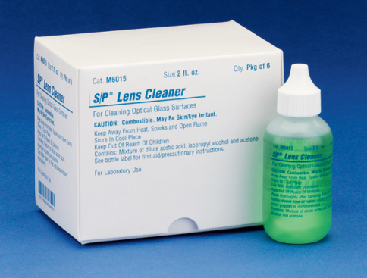
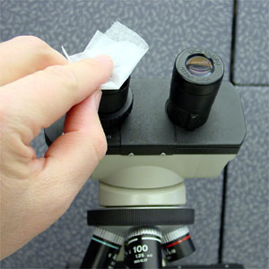
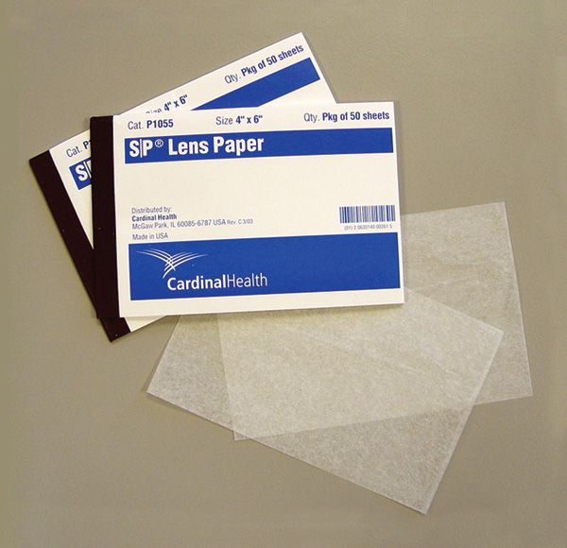
Microscope Maintenance

Slide 12
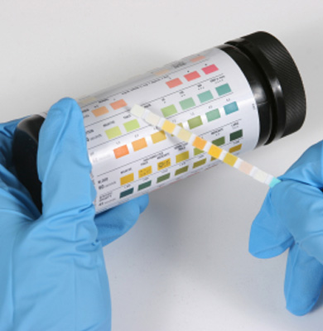
Common Urine Sediment Findings
If you are not sure of what you see, do not hesitate to send the specimen to the laboratory.
Correlate Findings with your dipstick results.

Slide 13
POLICIES AND PROCEDURES
Policies and Procedures for waived testing are found on the U: Drive.
U:\Hospital Policies\LABORATORY POLICY\Laboratory Procedures for Nursing Services\PPM and PPT Testing

Slide 14
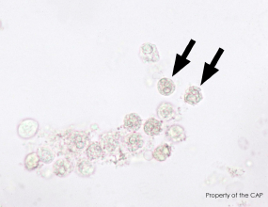
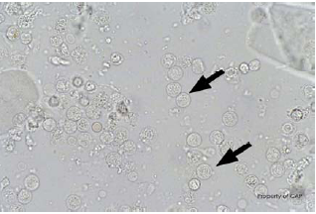
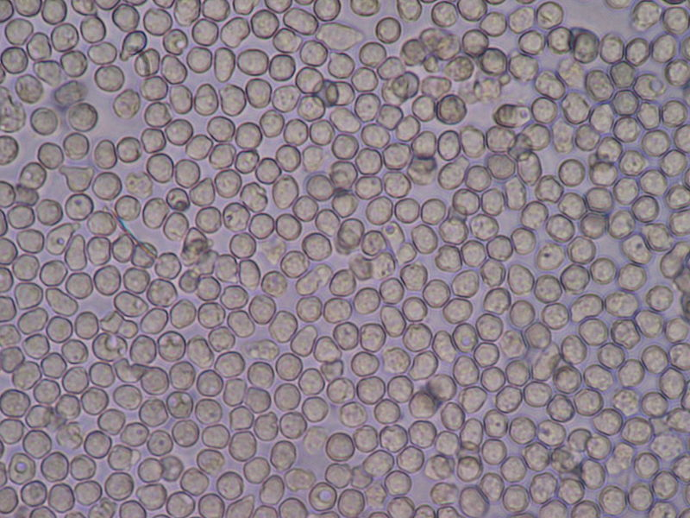
WBC—White Blood Cells

Slide 15
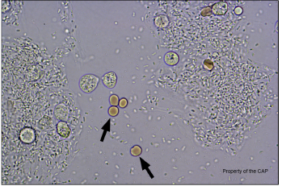
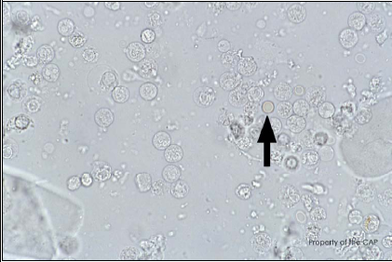
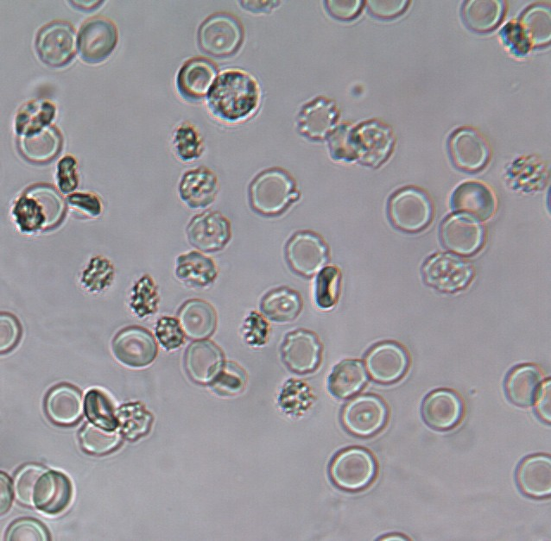
RBC—Red Blood Cells

Slide 16
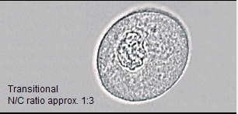
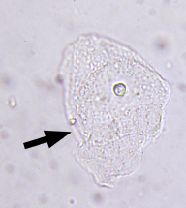
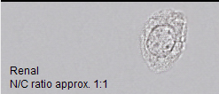
Epithelial Cells
Squamous
Transitional
Renal Tubular

Slide 17
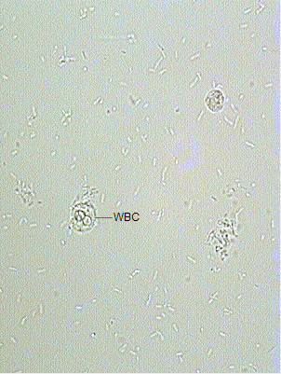
Bacteria

Slide 18
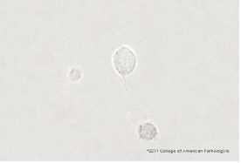
Trichomonas
Must observe the classic jerky motility of Trichomonas.

Slide 19
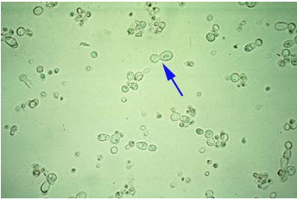
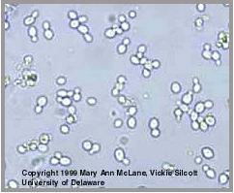
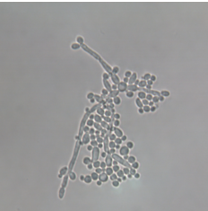
Yeast

Slide 20
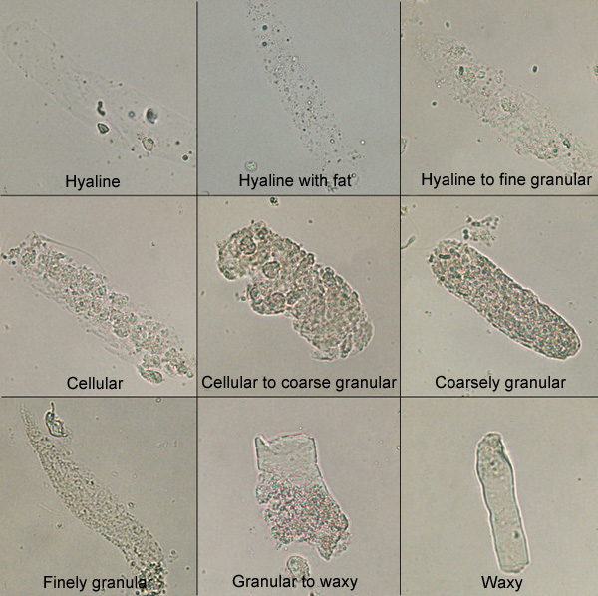
Casts

Slide 21
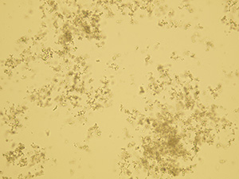
Urinary Crystals
Remember pH of Urine is useful in determining what crystal you have.
Amorphous Sediment

Slide 22
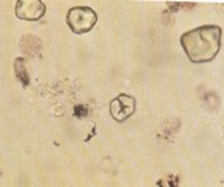
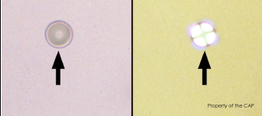
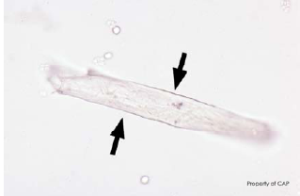
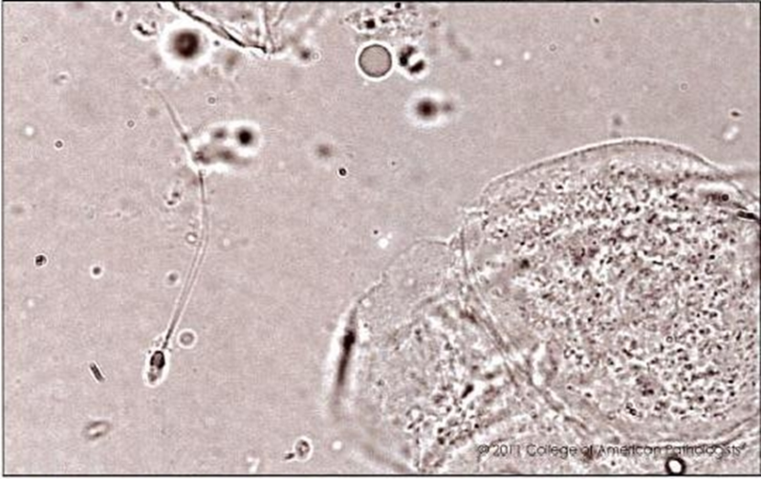
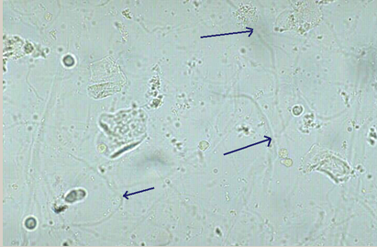
Other
Mucus
Starch
Fiber
Fat Droplet
Sperm

