Slide 1
Microscope
Use and Care

Slide 2
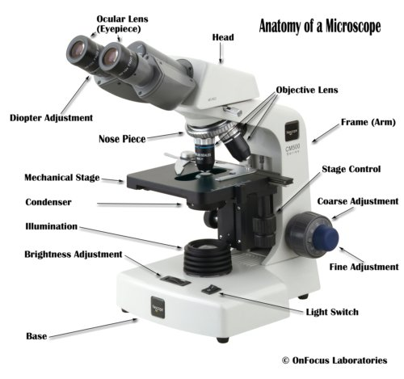
Microscope Parts

Slide 3
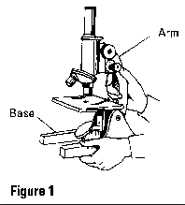
Components
Structual Components
Head/Body --houses the optical parts in the upper part of the microscope
Base--supports the microscope and houses the illuminator
Arm--connects to the base and supports the microscope head. It is also used to carry the microscope.
When carrying a compound microscope always take care to lift it by both the arm and base, simultaneously.

Slide 4
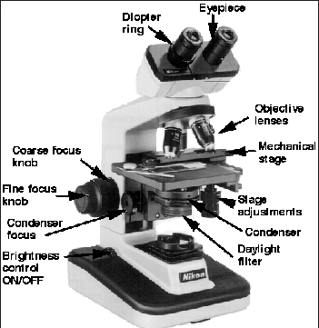
Components
Optical Components
Eyepiece or Ocular --standard eyepieces have a
magnifying power of 10x, but can range from 5x-30x.
Eyepiece Tube--holds the eyepieces in place above the objective lens.
Binocular microscope heads typically incorporate a diopter adjustment ring that allows for the possible inconsistencies of our eyesight in one or both eyes. Binocular microscopes also swivel (Interpupillary Adjustment) to allow for different distances between the eyes of different individuals.
Objective Lenses --are the primary optical lenses on a microscope. They range from 2x-100x and typically, include, three, four or five lenses on most microscopes..

Slide 5
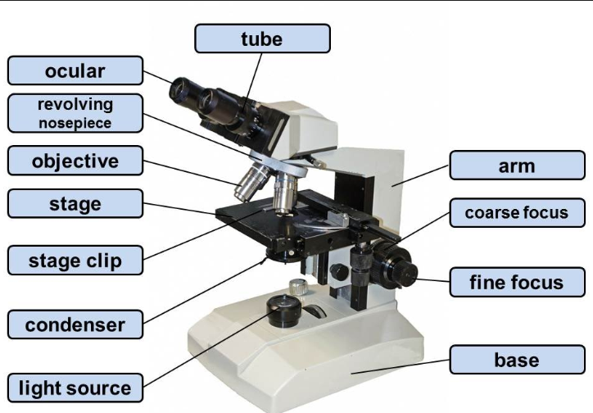
Components
Nosepiece--houses the objectives. Rotates so objectives can be conveniently selected. Standard objectives include 4x, 10x, 40x and 100x although different power objectives are available.
Coarse and Fine Focus knobs--used to focus the microscope.
Stage--where the specimen to be viewed is placed. A mechanical stage is used when working at higher magnifications where delicate movements of the specimen slide are required.
Stage Clips --are used to hold the specimen in place.
Aperture--the hole in the stage through which the base (transmitted) light reaches the stage.

Slide 6
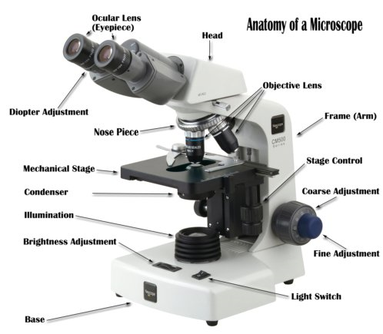
Components
Illuminator--the light source for a microscope, typically located in the base of the microscope. Most light microscopes use low voltage, halogen bulbs with continuous variable lighting control located within the base.
Condenser--used to collect and focus the light from the illuminator on to the specimen.
Iris Diaphragm--controls the amount of light reaching the specimen.
Condenser Focus Knob--moves the condenser up or down to control the lighting focus on the specimen.

Slide 7
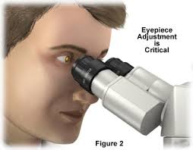
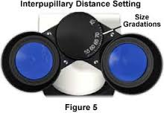
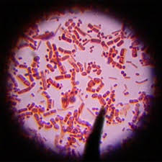
Oculars
Interpupillary Adjustment: When using a binocular microscope there must be an adjustment for the distance between the eyes. The eyepiece lenses will spread apart or get closer together to fit each individual. This should be the first adjustment to make so that you are comfortably viewing the specimen with both eyes.
Make sure that the image seen by both eyes is equally sharp. Most microscopes have a length adjustment on the tube on the oculars.

Slide 8
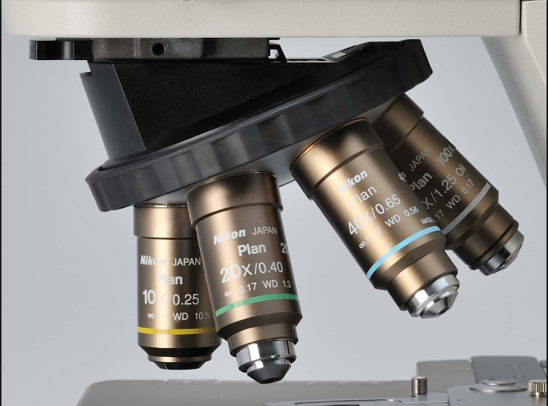
Objectives
The most common objectives
4X—Used for large specimens such as tissues.
10X—Used for scanning slides and initial focusing of the slide.
40X—Also known as “High Dry” objective. This objective does NOT require immersion oil. It is used for identification and should be the most commonly used objective for Wet Preps, KOH preps, Semen Analysis, Fern Tests and Urine Sediments
NEVER USE IMMERSION OIL WITH THE 4X, 10X OR 40X OBJECTIVES!
50X—Requires immersion oil. Usually used for blood smears.
100X—Requires immersion oil. Usually used to observe fine details of a specimen. Usually used for gram stains and cell identification.

Slide 9
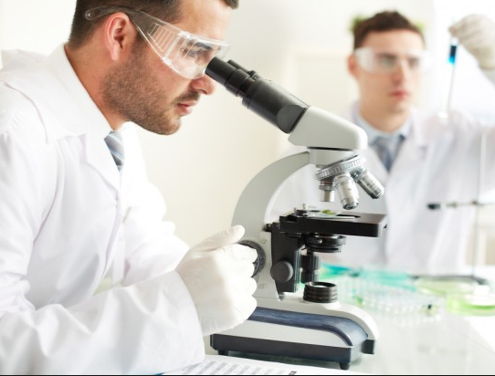
Focusing the Microscope
Always start with the lowest power objective lens (the shortest one). Be sure the lens is "clicked" into position. This objective is the easiest to focus and center the image in the field of view.
Adjust the inter-pupillary distance and the focus for each eyepiece if necessary.
Adjust the illuminator and diaphragm until you attain the maximum, comfortable level of light.
Ensure the stage is at its highest position.
Place your specimen in the stage clips and ensure your specimen is in the center of the objective.
Using your coarse adjustment, bring the specimen into broad focus by moving the stage down away from the objective.
Using the fine adjustment, bring the specimen into fine focus.

Slide 10
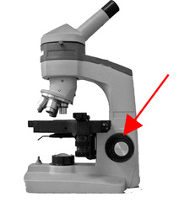
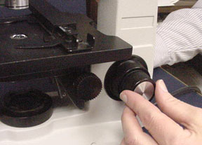
Focusing the Microscope
Coarse Adjustment
Move the microscope slide until the image is in the center of the field of view. Then readjust the illuminator or diaphragm in order to attain the clearest image.
Once you have attained a clear image, you should be able to change to a higher power objective lens with only minimal use of the fine focusing adjustment.
If you cannot focus on your specimen, repeat the above steps and work from objective to objective until the higher power objective lens is in place.
The range of the fine focus knob is much smaller than that of the coarse focus knob, but its movement is much more precise.
Always use the coarse adjustment to move the stage down away from the objective. If you are not careful you can break your slide and scratch the objective.
Fine Adjustment

Slide 11
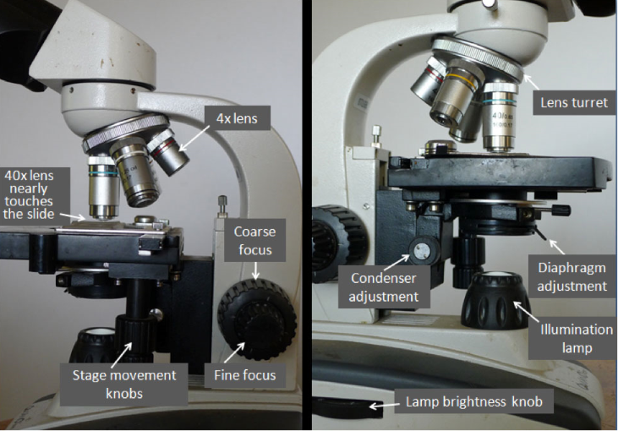
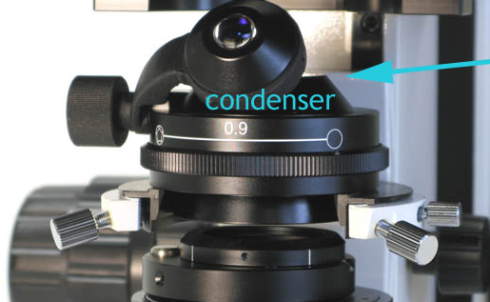
Adjusting the Condenser
Turn the condenser height all the way up taking care not to collide with the specimen slide above. Look through the low-power objective (4x or 10x)
Lower the condenser height down until fine details appear visible
The illuminator at the base provides a light source which travels through the condenser
The condenser concentrates light onto the specimen. It can be focused on the specimen by racking up and down
Note: Optimal condenser height varies with the type of slide to be viewed. When viewing a wet slide, the condenser must be lowered relative to the stage. Permanent, fixed, dry slides require the condenser to be closer to the stage

Slide 12
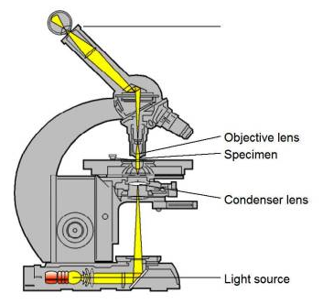
Illumination
The goal of using a microscope is to obtain increased magnification, resolution and contrast of a specimen. Magnification depends on the choice of optics used, and is relatively easy to adjust. Resolution and contrast are largely dependent on specimen illumination
Resolution and Contrast are more complex, involving illuminator, field diaphragm, condenser, condenser diaphragm, and objective lens

Slide 13
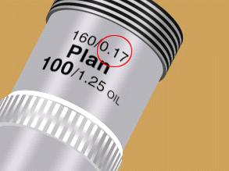
Coverslips and Immersion Oil
The coverslip is the optical window through which you view the specimen. Most specimens are placed on a glass slide and covered with a thin glass coverslip
Coverslips must be used for all PPM testing
Correct cover slip thickness is essential for optimal image quality. Most microscope objectives are corrected for use with cover slips that are 0.17 mm (170 microns) thick, which are designated "#1.5" cover slips.
Some objective lenses (higher power ones) are designed for use with immersion oil to increase resolution. This is done by placing a drop of immersion oil on the coverslip over the area to be observed, and carefully rotating the oil immersion lens into place.
None of the PPM testing performed at University Health Conway requires immersion oil.
NEVER use immersion oil on an objective that does not require oil.

Slide 14
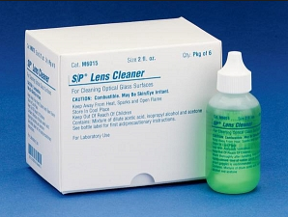
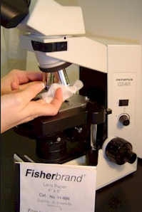
Cleaning the Oculars and Lenses
Even a small amount of residue on the ocular or objective lenses - such as dust, a fingerprint or unnecessary immersion oil - can reduce the resolution significantly
When the lenses become dirty, you must clean them properly to avoid abrasive damage.
Using lens paper and lens cleaner, gently wipe the ocular or the bottom of the objective starting in the center and working outward.
This may need to be repeated until the surface is clean. Excess moisture can be wiped with dry lens paper.
Only use lens paper. Avoid using materials such as standard tissue paper or paper towels. These items may scratch the objective.
Document any microscope cleaning on the microscope maintenance form.

Slide 15
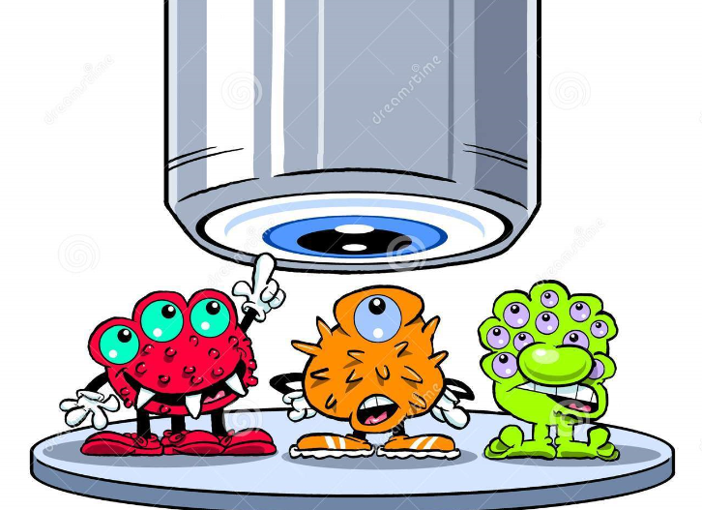
Microscope Care and Maintenance
Monthly Maintenance for the microscopes consists of:
Ensuring that each of the following are working properly for each microscope
Coarse adjustment
Fine adjustment
Condenser fork
Mechanical Stage
Interpupillary distance
Slide Adjustments
Iris Diaphragm
Cleaning each microscope
Light bulbs are changed as needed
All cleaning and maintenance must be documented on the POC Microscope maintenance form located by each microscope.
Everyone using the scope is responsible for cleaning up after use.
The POC Coordinator is responsible for making sure that monthly maintenance is performed on each POC microscope.

Slide 16
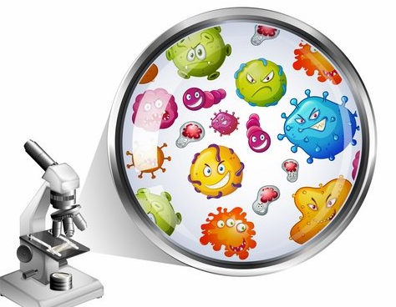
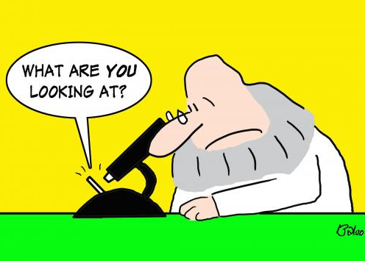
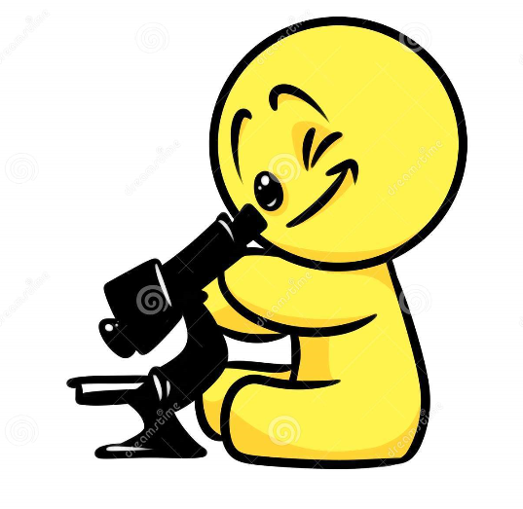

Slide 17
Please Tell Us How We Are Doing
Please complete the Laboratory Physician Satisfaction survey at:
https://www.surveymonkey.com/r/CT2S7VD

