Slide 1
LABORATORY COMPLIANCE
PRESS F5
(Function buttons on the top row)
WHEN READY TO BEGIN POWERPOINT PRESENTATION AND BE SURE YOUR SPEAKER IS ON…
ENJOY!

Slide 2
LABORATORY COMPLIANCE TRAINING
2013
HEALTHALLIANCE LABORATORY COMPLIANCE

Slide 3
When you leave this training session, you will….
Be familiar with our Code of Ethics & Business Conduct
Know how to recognize and communicate problems or potentially illegal practices
Understand why Compliance is important
Be aware of the High-Risk areas
Understand the Laboratory Compliance Policies
Notes:
Every effective compliance program begins with a formal commitment by the hospital's governing body and senior managment.

Slide 4
Code of Ethics & Business Conduct
President’s Letter
Our Mission, Vision, & Values
Business Conduct Guidelines
Compliance with Laws & Regulations
Adherence to Ethical Standards
Patient Care
Nondiscrimination
Confidentiality
Notes:
GIVE EXAMPLES SPECIFIC TO LAB - DO NOT READ EACH ITEM
I have listed out the basic guidelines.
Applies to ALL employees - so it is important to become familiar with it.
Established to guide our decision making regarding patient care, employee relations & business practices.
Patient Care - quality of results
confidentiality - accessing patients your working on not friends or family
The lab compliance plan promotes this higher level of ethical and lawful conduct throughout our laboratory

Slide 5
Code of Ethics & Business Conduct
Business Conduct Guidelines (continued)
Health Insurance Portability and Accountability Act of 1996 (HIPAA)
Accuracy of Financial Reporting and Billing
Document Retention & Security
Protection of Assets
Avoidance of Conflict of Interest

Slide 6
Code of Ethics & Business Conduct
Business Conduct Guidelines (continued)
Contracting
Business Relationships
Physicians Arrangements
Vendor Gifts, Entertainment and Sponsored Meetings and Training
Political Activities and Contributions
Notes:
PSC's Outreach physicians

Slide 7
Code of Ethics & Business Conduct
Business Conduct Guidelines (continued)
Academic/Research Integrity
Environmental Laws
Occupational Safety
Maintenance of an Alcohol & Drug-Free Workplace
Marketing
Notes:
Your all familiar with OSHA
Marketing - outreach efforts

Slide 8
Code of Ethics & Business Conduct
Compliance Office Confidential Reporting Line.
978-466-4333
Available to all employees to discuss possible violations of the law, regulation or policy.

Slide 9
What is Laboratory Compliance?
The attitudes and actions of a laboratory provider that result in honest and ethical reimbursement.
Why do we need a Laboratory
Compliance Program?

Slide 10
Public and Federal Perceptions
Healthcare is under increased scrutiny from federal & state governments.
It is estimated that 10% of $1 trillion spent on healthcare is for fraud, waste, and/or abuse.
Federal and state healthcare programs are facing financial difficulties.
Medicare
Medicaid
Notes:
If we ever did get in trouble federal sentencing guidelines provide for more lenient penalties for organizations that maintain an effective program.

Slide 11
Laboratory Compliance
1990’s
The primary mission of the Office of Inspector General (OIG), Office of Investigations (OI), is to investigate allegations of fraud, waste and abuse in the Medicare program.
One of the most successful efforts in the battle against Medicare fraud was a project known as LabScam.
Project LabScam began in 1993 and grew out of criminal investigation of National Health Laboratories (NHL) and its fraudulent billing schemes.
Notes:
An example today is the OIG's investigation in Boston & Health Alliance for the abuse of the blood administration charge.
Motorized wheelchair scam - Medicare paying $5000.00 when similar models could be purchased for $1500.00 by consumers
- a lot of people did not meet criteria for wheelchair use.
I do want to add that the vast majority are law-abiding and above board.

Slide 12
Laboratory Compliance
1990’s
Project LabScam focused on the billing practices of
all of the major independent clinical diagnostic
laboratories in the country.
The Laboratory industry’s awareness of the
Government’s efforts in this area spawned a series of
qui tam lawsuits (whistleblowers), investigations
against smaller laboratories and a national project
targeting hospital-based laboratories.
Notes:
qui tam - whistleblowers

Slide 13
Laboratory Compliance
Project LabScam Cases:
SmithKline Beecham Clinical Laboratories, Inc., agreed to pay $325 million for filing false claims.
Damon Clinical Laboratories, agreed to pay $119 million
Quest Diagnostics Incorporated, agreed to pay $15 million
Brigham and Women’s Hospital Pathology Foundation, agreed to pay $476,167 for improper billing practices.

Slide 14
Laboratory Compliance
The Federal Government is enforcing compliance with laws and regulations:
Operation Restore Trust (1995)
Portability and Accountability Act (HIPAA-1996)
Balanced Budget Act of 1997
OIG Compliance Guidance for Clinical Laboratories (1998)
Notes:
ORT - Anti fraud & abuse initiative implemented by President Clinton in May 1995. To protect the health care trust funds - within the first 2yrs it recovered 190 million from fraudulent healthcare schemes.
HIPPA - Established national standards for electronic health care transactions & addresses security & privacy of health data.
BBA - Was enacted to control the growth of Medicare spending and provide beneficiaries additional choices for care through private health plans.
The plan is to establish set standards and guidance for the lab industry - contains 7 basic elements that the OIG identified for an effective compliance plan
1) implementing written policies & procedures
2) designation of a compliance officer & committee
3) conducting effective training & education - (important to be effective and not just a "paper" program)
4) develope lines of communication - hotline
5) enforce standards through well publicized disciplinary guidelines
6) conduct internal monitoring & audits
7) respond promptly to detected offenses & corrective action

Slide 15
OIG’s Compliance Guidance
Establish set standards and guidance for the lab industry - contains 7 basic elements that the OIG identified for an effective compliance plan:
1) implementing written policies & procedures
2) designation of a compliance officer & committee
3) conducting effective training & education - (important to be
effective and not just a "paper" program)
4) develop lines of communication - hotline
5) enforce standards through well publicized disciplinary
guidelines
6) conduct internal monitoring & audits
7) respond promptly to detected offenses & corrective action

Slide 16
Laboratory Compliance
Other Federal Laws & Regulations Affecting Laboratories.
Sexual and Racial Discrimination
Americans with Disabilities Act
OSHA
Anti-Kickback Statutes
- Safe Harbors
Notes:
OSHA - enforcement of safety and health
Anti-Kickback - prohibits the offer or receipt of certain remuneration in return for referrals
examples: -discounting services
-phlebotomists in Doc's offices performing other
duties
-free pickup & disposal of biohazardous products,
sharps unrelated to the collection of lab work
-free equipment not used strictly for lab work
Safe Harbors - if certain requirements are met protects individuals from prosecution under the Anti-Kickback

Slide 17
Laboratory Compliance
Other Federal Laws & Regulations Affecting Laboratories.
Stark Law
Anti-Trust Laws
False Claims Act
CLIA
Deficit Reduction Act
Notes:
Stark - generally the law prohibits physicians from referring mx or md patients to an entity if the physician has a direct or indirect financial relationship w/the entity
Anti-Trust - protects competition
False Claims - permits a person w/knowledge of fraud to file a law suit on behalf of the government
CLIA - Clinical Laboratory Improvement Amendments (covered through CAP)
DRA - of 2005 requires any entity that receives at least 5 million/yr in MD reimbursement to establish policies and procedures regarding federal & sate false claims laws, whistleblower protection & detection of fraud, waste & abuse.
a section (6034) of the DRA established the md integrity program (MIP), it increased CMS resources to combat md fraud & abuse, the MIP represents CMS 1st national strategy to combat fraud & abuse in the 41 yr history of the md program

Slide 18
Government Initiatives
A variety of preventive measures have been
undertaken to reduce Medicare and Medicaid’s
exposure to fraud and abuse.
Exclusions: Individuals and companies excluded from participation in Federal Government medical care programs.
Compliance Guidelines: The OIG Model Compliance Plan for Outpatient Clinical Laboratories issued in March 1997 – OIG revised the plan issued in August 1998.
Fraud Alerts: Fraud Alerts regarding inappropriate arrangements for the provision of clinical laboratory services.
Notes:
Going back to the DRA congress has appropriated 5 million in FY 2006
2007 & 2008 FY will have an additional 50 million
to 75 million annually in FY 2009 and each year after
Exclusions - checked thru Human Resources

Slide 19
Laboratory Compliance
What are we doing?
The Lab Compliance Program –
Covering the 7 Elements
Development and distribution of written standards of conduct, as well as written policies and procedures.
Designation of a Lab Compliance Officer
– Vicki Heinz
Development and implementation of regular, effective education and training.
Anonymous hotline to receive complaints.
Notes:
As listed our program covers the 7 elements of an effective compliance program identified by the OIG

Slide 20
Laboratory Compliance
The Lab Compliance Program (continued)
Disciplinary actions for violations of laws or compliance policy.
Audits to monitor compliance
Investigation and remediation of identified problem areas

Slide 21
Laboratory Compliance
Why?
We want our compliance program to prevent regulatory problems
Help us discover and remedy violations before becoming major problems
Fines for fraudulent billing can be as high as $11,000 per claim
Our program will save the organization money
Notes:
Examples: Labs charging for indices
calculations
charging a transfusion charge with every unit of
blood transfused instead of one/day
adding an extra test to a panel without the
physicians knowledge and charging for it

Slide 22
Laboratory Compliance
Is HealthAlliance required to be compliant all
of the time?
Zero Tolerance
Notes:
So what do you think zero tolerance means
This is also the governments - zero tolerance

Slide 23
Laboratory Compliance
What is Zero Tolerance?
Zero tolerance means HealthAlliance’s liability for compliance is so great that failing to follow policies and procedures or failing to report suspected or known problems of illegal activities constitutes a serious breach of company policy and will result in disciplinary action up to and including termination.

Slide 24
Laboratory Compliance
Employees ARE accountable!
YOU are accountable for knowing what is proper and illegal.
Please ask questions if there are any areas you do not clearly understand or are concerned about.
It is better to ask a question than
to continue toward disaster.
Notes:
The purpose of the lab compliance committee (LCC) is to come to with your questions or concerns

Slide 25
Compliance Affects These Key Areas in Business Every staff member plays a part

Slide 26
Compliance Affects These Key Steps in Business
Closing the Sale  | Patient Registration & Test Ordered  | Daily Demographic & Billing Edits 
New Client Set Up  | Specimen Requisition ABN Arrive at Lab  | Bill Claim Goes Out 
Departmental Responsibilities  | Testing & Resulting  | Payment - Denial  
Train Clients | Information from Lab to Billing | Follow up & Appeal  
 |  | Money or Written Off
Notes:
There is risk for the laboratory in any of these steps of business
closing the sale - contracts are compliant
new client set up - requisitions, custom profiles, reflex testing
dept.respons. - sales & marketing, processing, LIS, phleb.
train clients - equipment
patient reg.&test ord. - ICD-9 codes, ABN's, Medical necessity
testing&reslting - test not perf. must not be charged
info from lab to billing - essential data needed in order to bill
daily demograph.&billing edits - incomplete data, ICD-9 codes
money or written off - or patient billed

Slide 27
Policies and Procedures
High-Risk Area Policies
Inducements
Operations & Sales/Marketing
Regulatory/Legal
Billing
Notes:
These are all part of the compliance manual

Slide 28
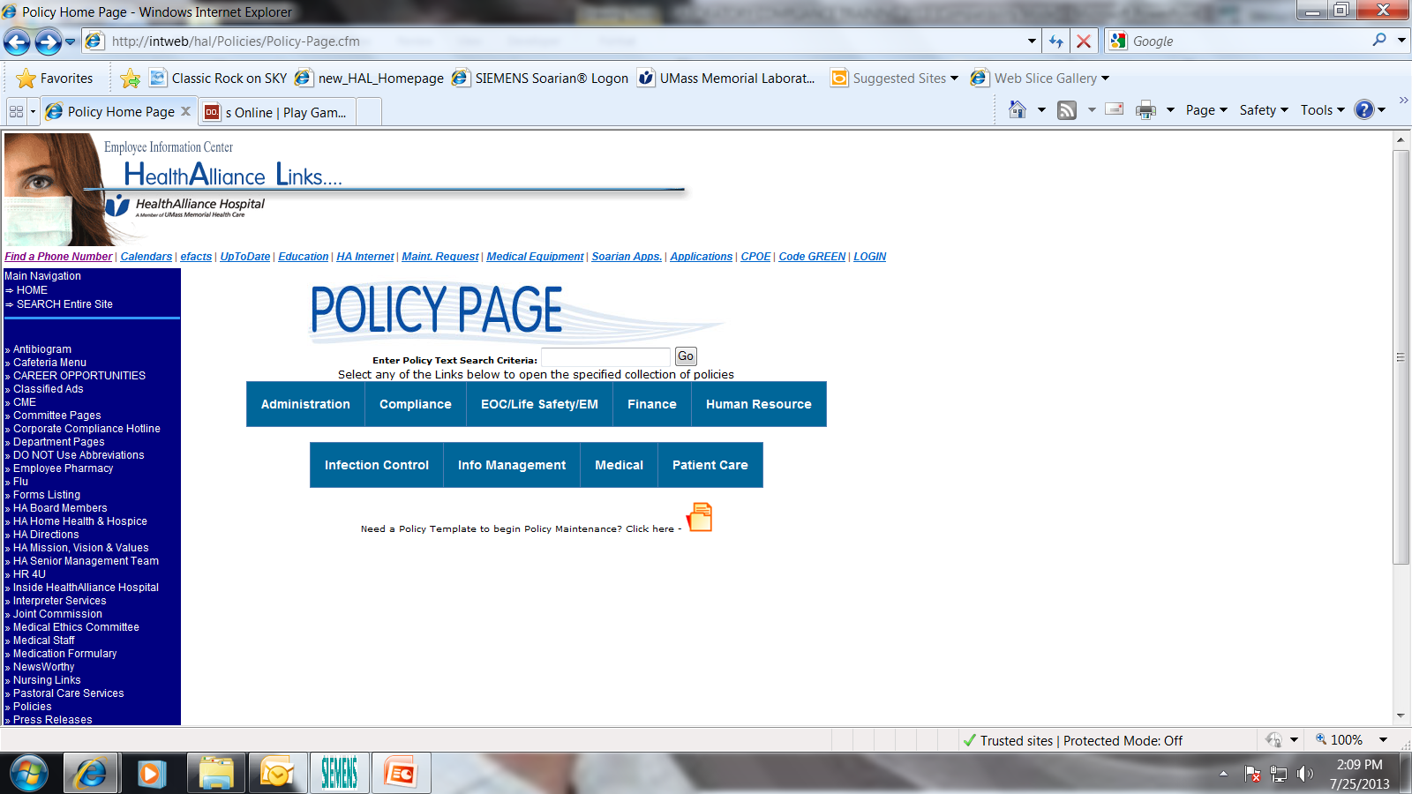
Laboratory Compliance
Compliance Policies are available on….
HAL Intranet
Click on
1. Policies
2. Compliance

Slide 29
Laboratory Compliance
What is Next?
Roll out and train all staff on this module
Additional job-specific training
Department specific policies
Notes:
Additional job-specific training for the high risk areas

Slide 30
Employees ARE Accountable
We all have a responsibility to comply with applicable statutes, regulations, and other Federal health care program requirements to ensure that accurate claims are submitted.
No one is excluded, ALL employees regardless of position are accountable and Must Strive to be compliant ALL OF THE TIME!
Questions

