Slide 1
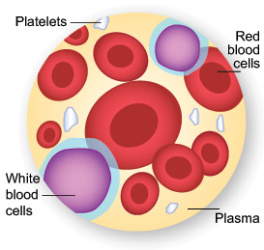
Hematology QC, Troubleshooting, & Clumped Platelets Algorithm
Speaker: Charles Gaillard, Hematology Supervisor
Atlanta VAMC Pathology & Laboratory Service Line
Facilitator and Editor: Dr. Julie West, Laboratory Technical Specialist

Slide 2
ATL VAMC CORE VALUE:
Commitment: Work diligently to serve Veterans and other beneficiaries. Be driven by an earnest belief in VA’s mission. Fulfill my individual responsibilities and organizational responsibilities.

Slide 3
Remember when…?

Slide 4
Objectives for today:
Review QC requirements
Review Troubleshooting in Hematology
Review Clumped Platelets algorithm

Slide 5
Before we begin:
Most common errors at ATL VAMC Hematology Laboratory (all shifts)…
Pre-analytic: clots, hemolysis
Analytic: QC concerns
Analytic: Troubleshooting of clots and hemolysis, “Rule of Three”, discerning instrument flags
Post-analytic: Delta checks; data entry errors (allowing a result to cross the interface to patient chart; how to report when platelet clumps are present); failure to notify or record provider notification
We will discuss each item.

Slide 6
Pre-analytic: clots, hemolysis
How do we know?
How do we check?
What do we do next?

Slide 7
Analytic: QC concerns
Sysmex
Coag
Manual tests (ESR, SickleCell, etc.)
A word about Coag substitution testing: Time limit for pooled normal plasma (thawed); QC; troubleshooting
A word about CAP surveys…
Synonym | Protime mixing study
Synonym | Prothrombin time substitution

Slide 8
Analytic: Troubleshooting of clots and hemolysis, “Rule of Three”, discerning instrument flags
How do we know?
What do we see on instrument printout(s)?
What do we do next?

Slide 9
Rule of Three
Checks for artifacts
Hct = 3X hgb
Quiz:
What if you see this? Hgb 10.7 g/dL, Hct 17.8%

Slide 10
RBCS:
MEAN CORPUSCULAR
VOLUME (MCV)
• Very accurate
• Measurement of the size of the cell
In general:
80-100 fL = normocytic cells
<80 fL = microcytic cells
>100 fL = macrocytic cells
Slide Courtesy of: JoAnn Deasy, PA-C. MPH
San Francisco, CA
jadeasy@sbcglobal.net

Slide 11
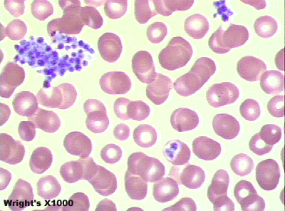
PERIPHERAL SMEARS: Describe what is seen in this slide…

Slide 12
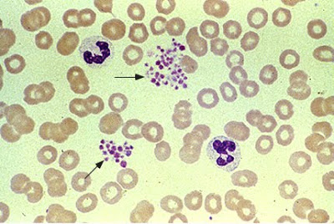
Describe what is seen in this slide…

Slide 13
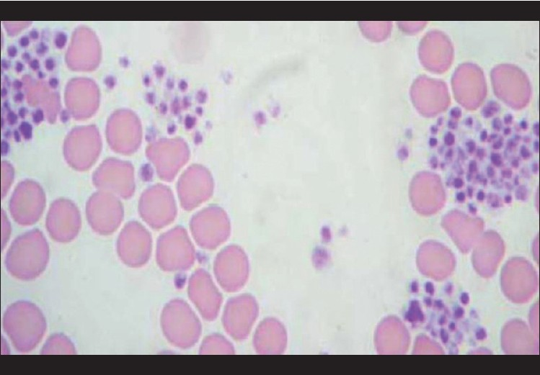
Describe what is seen in this slide…

Slide 14
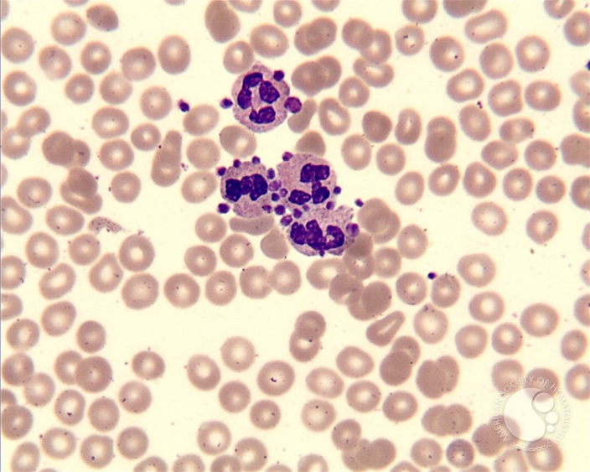
Describe what is seen in this slide…

Slide 15
Describe what is seen in this slide…
Courtesy of NY State Dept. of Health

Slide 16
Coagulation: Inhibitors
Anti-thrombin III with heparin: II, IX, X, XI, XII
Protein C and protein S: slow down VIII and V
Heparin: quick acting but short lived and need AT-III
Coumarin: vitamin K antagonist

Slide 17
Specimen
Clean phlebotomy required
3.2% vs 3.8% citrate
1:9 citrate to blood ratio
Transport to lab quickly and separate plasma
Platelet poor plasma (PPP)
Test without delay or store frozen

Slide 18
Instrumentation
Electro-mechanical (e.g., Fibrometer)
Physical detection of clot
Cannot be automated
Optical (e.g., MLA, ACL)
Interference with icteria or lipemia
Can be automated

Slide 19
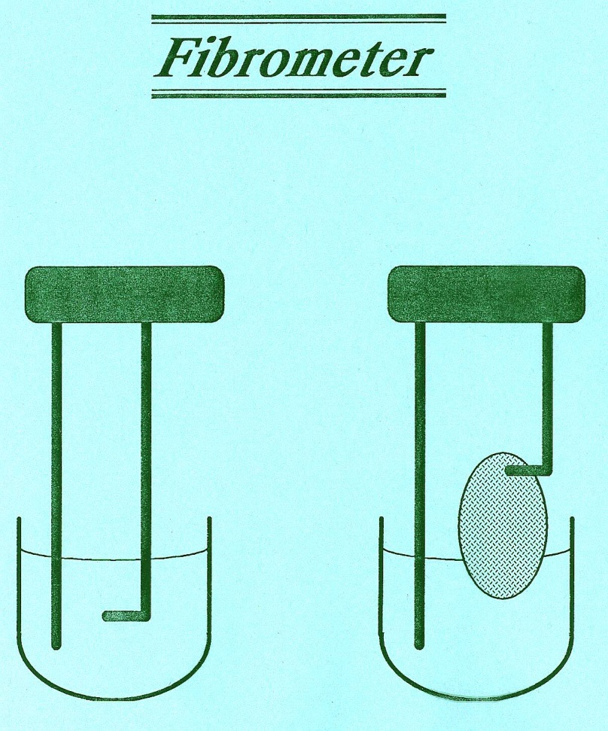
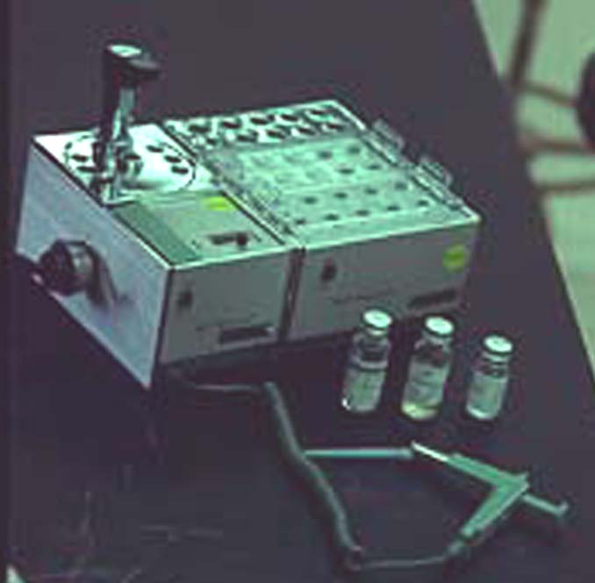

Slide 20
Basic Hemostasis Tests
Plasmatic factors
Thrombin time
Prothrombin time
Activated Partial Thromoplastin time
5M urea test (factor XIII)
Platelet
Platelet count
Platelet function test
Vascular integrity
Bleeding time
Tourniquet test
Others
FDP, D-dimer
Factor assays
Anti-thrombin III
Proteins C and S
Factor V Leiden

Slide 21
Activated Partial Thromboplastin Time (APTT)
For intrinsic pathway factors
Lee-White clotting time
Whole blood at 37ºC
Glass test tube for surface
Phospholipid platelet substitute
Activator: kaolin
0.02M CaCl₂
Monitor heparin therapy

Slide 22
Prothrombin Time (PT)
For extrinsic pathway factors
Tissue thromboplastin (rabbit brain) with Ca⁺⁺
European labs use Tpl from human source, so more sensitive
INR = (Pt PT/normal PT)^{ISI}
Monitor coumarin therapy

Slide 23
Activated Partial Thromboplastin Time (APTT)
For intrinsic pathway factors
Lee-White clotting time
Whole blood at 37ºC
Glass test tube for surface
Phospholipid platelet substitute
Activator: kaolin
0.02M CaCl₂
Monitor heparin therapy

Slide 24
Prothrombin Time (PT)
For extrinsic pathway factors
Tissue thromboplastin (rabbit brain) with Ca⁺⁺
European labs use Tpl from human source, so more sensitive
INR = (Pt PT/normal PT)^{ISI}
Monitor coumarin therapy

Slide 25
WBCS and Platelets… PLATELET CLUMPING ALGORITHM
In our lab, when should a manual diff be performed?
Where do you find this information?
Hematology Standard Operating Procedures…

Slide 26
CRITERIA FOR REVIEW OF PLATELET RESULTS
3. Platelet Clumps (instrument platelet clumping flag and/or visual clumps on smear):
Primarily an artifact in EDTA-anticoagulated specimens. Platelet clumps tend to occur in EDTA specimens not mixed immediately after collection, although they may occur in well-collected specimens from some patients. Platelet clumps may decrease the automated platelet count. When platelet clumping is noted by instrument flagging or on a peripheral smear, the following procedure is followed. SEE SIMPLIFIED FLOW CHART AT END OF THIS PROCEDURE:
Check tube for a clot. (If clotted, reject the specimen.)
Vortex EDTA tube for 3 minutes (at or near the highest setting, if using a variable speed vortex). Re-run on Sysmex. Make a blood smear. If the instrument platelet clumping flag goes away, verify that there is no platelet clumping present and perform a platelet count estimate (as described above). If no clumping is seen and the estimate matches the instrument count, report the instrument count.
If clumping persists, perform a platelet estimate (see 1b above). Report only the slide estimate as adequate, decreased, or increased, markedly increased, or markedly decreased (“adequate” roughly corresponding to our reference range of 150-400 k/uL), if an estimate is possible. Do not report the instrument count (* SEE EXCEPTIONS BELOW), but add the comment: “Unable to report PLT count due to platelet clumping. Per slide estimate, platelets appear (adequate/ decreased/ increased)”—[canned comments: UTP1, UTP2 (type “adequate”, “decreased”, “increased”, “markedly decreased”, or “markedly increased” as appropriate)].

Slide 27
CRITERIA FOR REVIEW OF PLATELET RESULTS
*EXCEPTIONS: - If there is a platelet clump instrument flag, BUT the instrument count is greater than 100K/uL AND only minimal visible platelet clumping is seen on the smear AND the slide estimate matches the instrument count, the technologist may report the instrument count with the following comment: “Platelet clumping present. The patient’s true platelet count may be higher than the reported result.” [Canned comments: PCP1, PCP2]
- If the instrument PLT count is in the high critical range (>999K/uL) AND there is ANY DEGREE of platelet clumping, ALWAYS report the instrument count and follow the critical value reporting protocol in addition to adding the comment: “Platelet clumping present. The patient’s true platelet count may be higher than the reported result.” [Canned comments: PCP1, PCP2]

Slide 28
CRITERIA FOR REVIEW OF PLATELET RESULTS
In all new cases of unresolved platelet clumping, notify ordering provider, and request that they order “Citrate Platelet Count”. If the provider does not respond in a timely manner, add comment: “If numerical platelet count is needed, please order CITRATE PLATELET COUNT--lavender AND blue top tube draws required.” [Canned comment—CPC1, CPC2]. When this is ordered, the lab should receive both an EDTA and citrate tube and only platelet results are reported. Proceed as instructed in (e) below. If platelet clumping persists in EDTA, alert phlebotomists in VISTA to obtain both citrate and EDTA tubes on all future CBC orders.
When both EDTA and sodium citrate tubes are received in a patient with prior platelet clumping, immediately upon receipt run the EDTA tube first. If no clumping is seen on the EDTA tube, use this tube for all CBC parameters (note: if “Citrate Platelet Count” has been ordered, only the platelet count is reported). Add the comment: “Platelet Count Results Obtained From EDTA tube.” —[canned comments: PLTET]
- If a clumping flag/visual clumps persist in the EDTA tube and are not present in the citrate tube, run the sodium citrate tube and use for platelet counts only. Multiply the instrument platelet count by 1.1 to correct for the volume of anticoagulant in the blue top tube and report the corrected result after verifying instrument counts by peripheral smear estimate. If the blue top tube was required, add comment: “Platelet Count Results Obtained From Citrate Tube” —[canned comments: PLTCT]. Never use a citrate tube to report any parameters other than a platelet count. Use the EDTA tube for all other CBC parameters and the differential.
If the repeat EDTA tube continues to clump, alert phlebotomists in VISTA to obtain citrate in addition to EDTA tubes on all future CBC orders.

Slide 29
CRITERIA FOR REVIEW OF PLATELET RESULTS
4. Platelet satellitism: Satellitism is an in vitro phenomenon seen almost exclusively in smears prepared from EDTA tubes, and refers to the formation of rosettes with four or more platelets on the cytoplasmic margins of neutrophils or bands. If seen in at least every other field (100x objective), satellitism may result in spuriously decreased platelet count. Do not report the instrument count, but add the comment: “Unable to report PLT count due to platelet satellitism. Per slide estimate, platelets appear (adequate/ decreased/ increased)”—[canned comments: SAT1, SAT2]. Notify ordering provider, and request that they order “Citrate Platelet Count” in addition to a repeat routine CBC. Only the platelet count should be reported from the citrate tube (multiply PLT by 1.1 to correct for anticoagulant in citrate tube). Otherwise, report a manual differential.
5. Giant platelets: Platelets greater than 7 mm in diameter may be counted as leukocytes, resulting in spuriously low platelet count and high WBC. If significant numbers of giant platelets are present, an optical platelet may be performed to avoid this interference.

Slide 30
Describe what is seen in this slide…
Courtesy of NY State Department of Health

Slide 31
Describe what is seen in this slide…

Slide 32
Describe what is seen in this slide…

Slide 33
Describe what is seen in this slide…

Slide 34
Describe what is seen in this slide… hmmm… tricky…
Courtesy of NY State Department of Health
Notes:
NRBC

Slide 35
Describe what is seen in this slide…

Slide 36
Post-analytic: Delta checks; data entry errors (allowing a result to cross the interface to patient chart); failure to notify or record provider notification…
Examples:
1. Clotted: “Oops, I released the result”
2. Delta check present: “Oops, I released the result”
3. Rule of threes violation: “Oops, I released the result”
What to do next?
Case-by-case. Repeat if warranted; follow your SOPs
Correct report, notify provider, enter notification in VISTA
Document on occurrence report for QM (CAP requirement)

Slide 37
Reminders:
It is in the best interest of the lab, the provider, and the patient if we PREVENT or CATCH errors before we make them.
Documentation in VISTA: What is included?
How to document a previous critical value?
Anything else?

Slide 38
QUESTIONS?
THANK YOU!

