Slide 1
LEAN “5-S” for LAB
May 2016
Trainer: Dr. Julie West, Lab Technical Specialist

Slide 2
What is LEAN? What is “5-S”?
What is 5S?
5S is a systematic form of visual management utilizing everything from floor tape to operations manuals, that are not just simply about cleanliness or organization, but created to maximize efficiency and profit. Instead, it is a framework that emphasizes the use of a specific mindset and tools to create efficiency and value. It involves observing, analyzing, collaborating, and searching for waste and also involves the practice of removing waste.
5S includes five terms that all start with the letter “S.”
History:
The history of 5S goes back as far as the 16th Century and Venice shipbuilders. In an effort to streamline the assembly process, workers used quality process production to build ships in hours instead of days or weeks.
Toyota engineers… to modern day use of LEAN, 5-S, Six-sigma methodologies
Reference: 5S Comprehensive Training, Education and Resource Center

Slide 3
5-S

Slide 4
Another way to look at 5-S…

Slide 5
Why do it?
Improve workflow
Mitigate points of potential confusion
Improve safety
In our lab:
Decrease frustration
Prevent lost specimens, patient/provider call-backs
Improve work experience

Slide 6
Tools for 5-S
Shadow Boxing –Shadow boxes feature an outline of where tools belong and allow employees to quickly identify which tools are missing. Shadow boxes help with both tool organization and tool accountability.
Floor Markings – Floor markings are a staple within many well-organized workspaces.
Signage – The use of signage in an efficiently run work environment is essential. Not only does signage help increase safety, but it also creates a visual environment for employees to thrive in
Labeling – Labeling is a BIG component of efficient organization for 5S. Virtually anything can be labeled to help keep work areas organized, efficient, and visual to employees. For instance, some things that can be labeled are shelving, storage units, bins, workspaces, pipes, etc.
Reference: 5S Comprehensive Training, Education and Resource Center

Slide 8
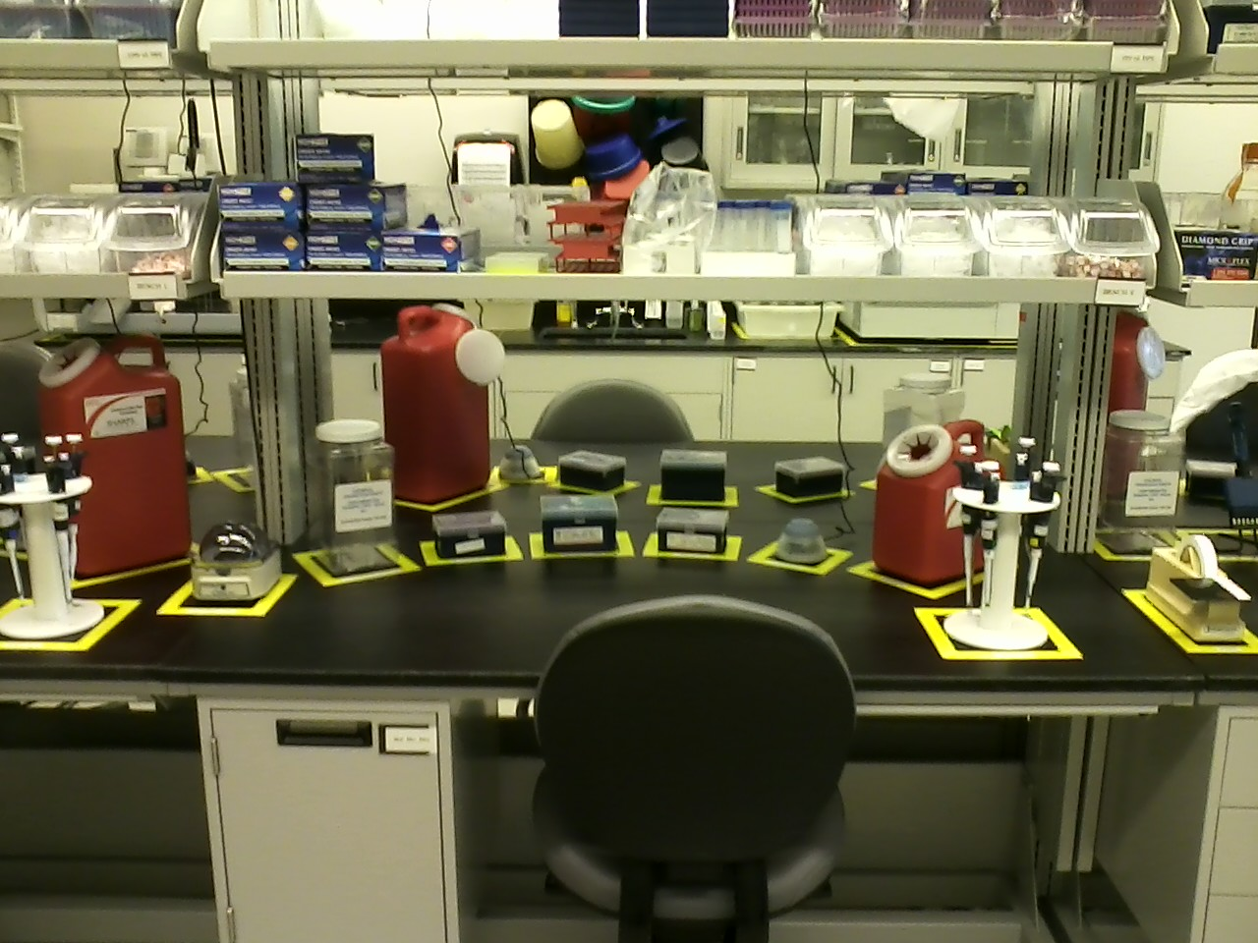

Slide 9
Now – how to begin 5-S
In our lab, we have:
A label maker (located in Blood Bank office)
White tape /markers
Employees with GREAT ideas for our lab!

Slide 10
Discussion
Roundtable Discussion between stakeholders
LET’s BEGIN!
Homework: Choose one thing that you want to improve
Discuss how to begin 5-S
Report back to Julie within 1 week on progress
Continue with a new item every month – reporting progress back to monthly supervisor meetings

Slide 11
Thank you!
You have to start somewhere, right? “If you don't know where to start remember that you have to start somewhere to get somewhere and doing NOTHING will get you nowhere.”
-Sonya Parker quotes

