Slide 1
HAZARDOUS MATERIALS TRAINING
SEPTEMBER 2015
ATL VAMC LABORATORY
PACKAGING & SHIPPING
Facilitator: Julie West, PhD
MLS (ASCP), SM (ASCP)

Slide 2
Goal:
To ship patient specimens SAFELY!
and in a timely manner…by adhering to rules and regulations.

Slide 3
Regulations and Requirements
Maintain compliance with DOT and IATA regulations
Meet CAP and Joint Commission requirements
CAP GEN.20374, GEN.40511, GEN.40512, GEN.40515, GEN.40530
Includes: Recurring training of staff every two years (IATA) and every 3 years DOT/JCAHO, CAP

Slide 4
You need to be certified if you:
Prepare a shipping paper
Sign a shipper’s declaration form
Classify Division 6.2 materials
Select packaging for 6.2 materials
Pack hazardous materials for transport
Label or mark a package containing hazardous materials
Ship
Transport (courier drivers)

Slide 5





What is IATA? DOT?
IATA – International Air Transport Association (anything traveling by airplane – FEDEX or UPS, or Quest Diagnostics, West Haven or Dorn VAMC)
DOT – Department of Transportation (anything traveling by ground vehicle to GPHL, or USPS)

Slide 6
What kind of training?
1. General Awareness (Recognize and ID hazardous materials)
2. Function-Specific (Detailing exactly what you do in your lab section)
3. Safety Training (Safe handling: Chemical Hygiene, Blood borne Pathogen, Occupational Health)
4. Security Awareness Training (threats)
5. In-Depth Security Training (VA security plan; Select Agent awareness)

Slide 7
1. General AWARENESS
You should already have one of the following:
GPHL Certificate of Training in Packaging and Shipping of Hazardous Materials
CDC Certificate of Training (CDC TRAIN) in Packaging and Shipping Division 6.2 Materials for Laboratory Personnel
MTS or TMS training – Specimen Transport course

Slide 8
2. Function Specific Training
Risk Assessment for your particular lab section
Discussion:
Do you send DOT? IATA? Stat Courier? Grounds Courier? Quest Diagnostics Courier?
What is destination? GPHL? West Haven or Dorn VAMC? Quest Diagnostics? From CBOCs to main lab?
Note: Our SENDOUT department is DE-Centralized. Each Lab Section has different duties and responsibilities.

Slide 9
Category?
What is Category A?
What is Category B?
What is a SELECT AGENT?

Slide 10
Examples in our lab:
Category A? UN 2814
Coccidioides immitis cultures
MTB cultures
Shigella dysenteriae
Yersinia pestis
Bacillus anthracis
Brucella
E.coli (verotoxigenic)
Category B? UN3373
Patient specimen (saliva, sputum, fluid, etc.) capable of harboring the microbe
“EXEMPT HUMAN SPECIMEN”?
SELECT AGENT? Biological Agent able to be used as a bioweapon – CALL GPHL immediately for assistance. Our lab is not prepared to ship SELECT AGENTS.

Slide 11
Dry ice ???
What hazards may we encounter when using dry ice? How do we avoid these hazards?
What is the symbol for packaging/shipping?

Slide 12
Do you…
Pack a box for shipment via FEDEX and then take it to the post office downstairs for shipping/air bill completion?
Remember: If you pack it, you must complete the air bill /declaration.

Slide 13
3. SAFETY TRAINING
Chemical Hygiene review; Spill Cleanup – part of your annual lab review of Standard Operating Procedures (SOPs)
Blood borne Pathogen review (your TMS certificate is REQUIRED)
Occupational Health – Supervisor will use ASSISTs program to document any mishaps

Slide 14
4. Security
BIOSAFETY: Containment intended to limit exposure to potential pathogens and toxins
versus
BIOSECURITY: Containment intended to prevent use of microbes for illegitimate and malicious purposes

Slide 15
Consider Bioterrorism Events…
1995 Tokyo Subway Sarin Release
2001 US Anthrax attacks
Outbreaks of Salmonella and Shigella caused by intentional contamination of salad bars and other food items.

Slide 16
What to do?
Microbiology:
Do not advertise your Category A organisms! Freezer / QC organism lists should be kept out of direct view.
Lab send-out area:
Do not leave packages for Quest Diagnostics pickup unattended or in an unsecure location!
What other things should we consider? Think about it…

Slide 17
Question
The greatest threat to a facility is posed by an outsider.
True or False?
Why?
The answer is FALSE. Insiders have detailed knowledge about facility and practices.

Slide 18
5. Biosecurity Plan
Elements? Consider the following:
Facility: Can you think of physical security or access control examples? (locks on doors, police)
Information: How do we keep our information safe? (passwords)
People and Procedures: Personnel/plans
Agents: Inventory and Accountability (QC inventories in microbiology; shipping manifests)

Slide 19
More on: In-Depth Security Training
VAMC police response
Disruptive Behavior training
Call 4911 for all emergencies
Select Agents: Special Consideration for the following organisms --
Francisella tularensis
Bacillus anthracis
Brucella abortus
Brucella melitensis
Brucella suis
Burkholderia mallei*
Burkholderia pseudomallei
Yersinia pestis

Slide 20
IMPORTANT: What is required to complete Pack/Ship certification?
Initial training record
Awareness training: GPHL, CDC, MTS, or TMS (etc.) training every 2 years
Safety Training: Blood borne pathogen training certificate from TMS
Security Training: THIS (ATL VAMC) .ppt training every 2 years, or obtain a separate CDC TRAIN certificate
FUNCTION SPECIFIC TRAINING: DEMONSTRATION competency and signoff of the Training Crosswalk check-sheet in front of your supervisor
Signature of the Chief Medical Technologist (or designee – your supervisor acting as the EMPLOYER representative)

Slide 21
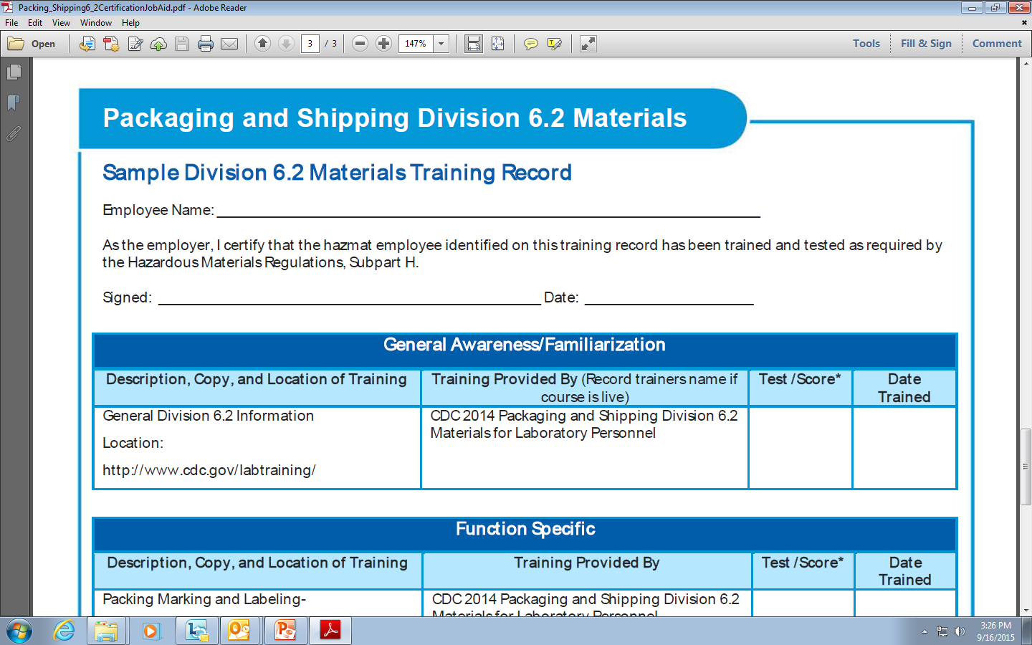
Supervisors: Use this form

Slide 22
Record retention
All Pack/Ship (shipper’s declaration) forms, airway bill copies, or manifests must be kept accessible in the lab. This includes all signed CBOC shipping manifests. Save for 2 years per DOT!!
(Supervisors: Keep a file in your lab section.)
Training documentation must be accessible and kept in the lab until 90 days after employee’s last date of employment with the facility.

Slide 23
in addition…
Grounds personnel must have basic transportation and blood borne pathogen safety training.
Any change in lab needs or employee job responsibilities requires additional education and documentation.
Ongoing: Needs assessments, trainings, and records maintenance will be monitored by Supervisors, Quality Management, and Safety personnel.

Slide 24
Thank you
Your compliance is appreciated.
Training Resources are available.
See Dr. Julie West or your immediate laboratory supervisor for additional information.

