Slide 1
Introductory Hain LPA
Overview and Assessment
20 April 2018

Slide 2
HAIN Genotype Line Probe Assay (LPA):
Background
The LPA uses PCR and reverse hybridization methods for rapid detection of mutations associated with drug resistance.
The LPA is designed to identify MTB complex and simultaneously detect mutations associated with drug resistance.
The LPA is should be performed in laboratories with a proven capacity to conduct molecular testing including appropriate laboratory infrastructure and equipment.
This must also include the necessary biosafety precautions and the prevention of contamination.

Slide 3
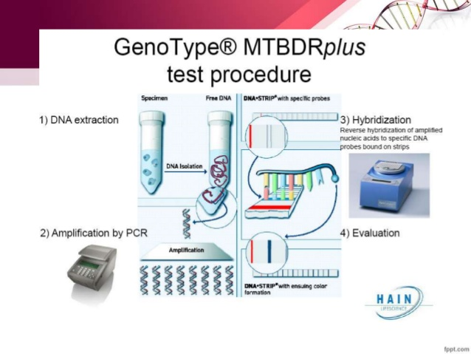
LPA Procedures: Key Steps
DNA extraction
  a. Clinical pulmonary specimens (decontaminated)
  b. Cultured isolates (solid or liquid cultures)
Amplification
Reverse Hybridization
Analysis

Slide 4
LPA Test Controls
Conjugate Control (CC) -Included on Strip
  Demonstrates efficient conjugate binding and substrate reaction
  Line must be present for a valid result
Amplification Control (AC)-Included on Strip
  Demonstrates successful amplification
Negative Control (NC)-Recommended Test/Batch
  Contains water instead of DNA to control for contamination
  Only the CC and AC bands should be present on this strip

Slide 5
MTBDRplus Assay: Tests for Mutations in INH and Rifampin
rpoB: If mutation present, this may correlate with resistance to Rifampin
inhA: If mutation present, this may correlate with resistance to INH (low level resistance)
katG: If mutation present, this may correlate with resistance to INH (high level resistance)

Slide 6
MTBDRsl Assay: Tests for Mutations in Fluoroquinolones, Aminoglycosides and Ethambutol (Note differences in test versions!)
gyrA or gyrB: If mutation present, this may correlate with resistance to Fluoroquinolone (Ex: Ofloxacin, Moxifloxacin)
rrs/eis: If mutation present, this may correlate with resistance to Aminoglycosides (Amikacin, Kanamycin)
embB: If mutation present, this may correlate with resistance to Ethambutol

Slide 7
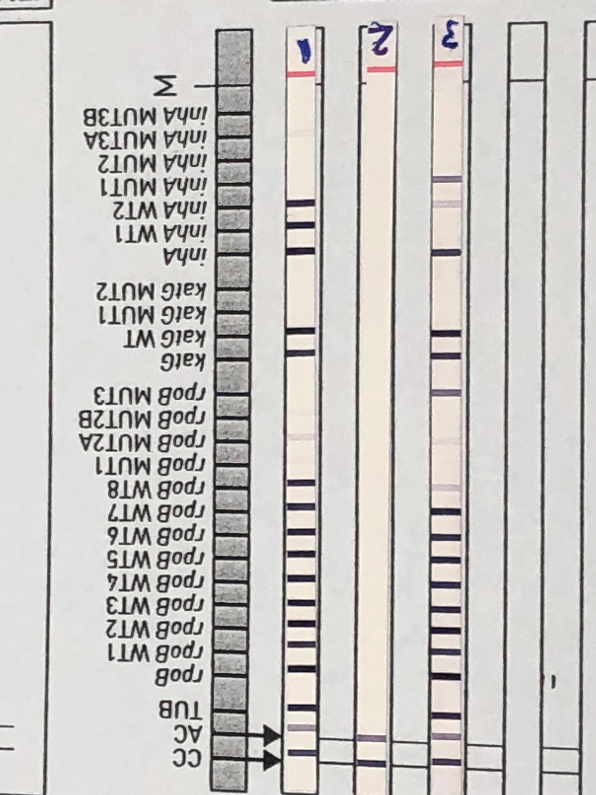
Interpreting Line Probe Assay Strips
Step 1: Look at the "CC” band, “AC” band and “TUB” band.
Conjugate Control (CC) Band: This should be present for each test (if not, the test is invalid)
Amplification Control (AC) Band: This band should be present for each test (if not, the test is invalid)
M. tuberculosis complex (TUB) Band: This band should hybridize with all members of the MTB complex. A positive (+) test result shows the band present, while a negative (-) test result shows the band as absent.
Notes:
Add details here

Slide 8
Interpreting Line Probe Assay Strips
Step 2: Look at the drug control bands (called Locus controls, these are the non-WT or MUT bands)
For a valid test, there should be a band present for each of the drug control bands.
If the TUB band is present (indicating an MTBC positive result) and the drug control band is absent, the results for that particular drug are indeterminate.
If the TUB band is absent (indicating an MTBC negative result), there should be NO drug control bands present for that particular sample*.
(*NOTE: If TUB band is negative but there is still an evaluable susceptibility pattern, MTB complex is suspected but the test should be repeated)
The picture on the right shows control bands present for all 3 drug control bands on Sample #1 and Sample #3, but absent for Sample #2 (this is because the TUB band was negative on Sample #2, indicating a negative result).
Notes:
Add details here

Slide 9
Interpreting Line Probe Assay Strips
Step 3: Look at the results of the “WT” and “MUT” bands (only interpret bands that are darker or as dark as the AC band)
Wild Type (WT) probes:
Bands should be present for all WT probes for a specific drug (some bands will appear weaker in intensity than others). See the yellow circle in the picture to the right.
If any WT bands are missing, this means there could be a mutation that confers resistance.
Mutation (MUT) probes:
If there is a band present (and it is darker than the AC control), this means a mutation is present that could confer resistance. See the red circle in the picture to the right, that shows a clear rpoB mutation (MUT3) in Sample #3.
Notes:
Add details here

Slide 10
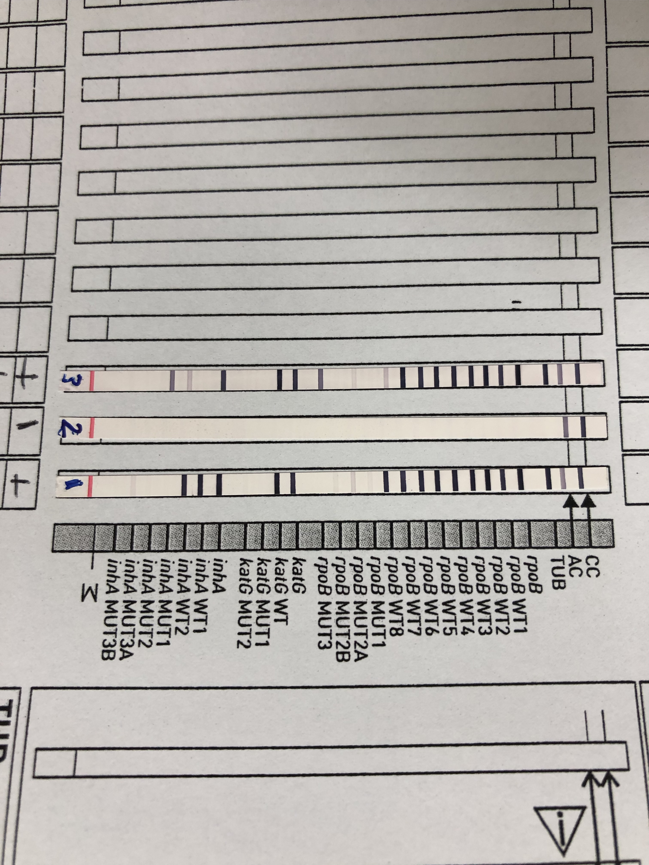
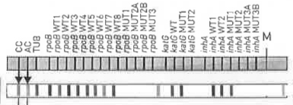
Interpreting Line Probe Assay Strips: A word of caution!
Make sure to align the strips on the sheet to correspond with the correct band location!
(Otherwise this could make it more challenging for interpretation)
Strip alignment is correct, and inhA results can be matched
to the banding patterns
Strip alignment is slightly shifted, making inhA result
interpretation a bit more difficult (The resulting bands present
here should indicate inhA and WT bands present only)
Notes:
Add details here

Slide 11
Strip interpretation: M. tuberculosis complex strain
Sample #1: CC, AC and TUB bands all present: This is a valid positive MTBC result.
Sample #2: CC, AC bands are present, but TUB band is absent: This is a valid negative MTBC result.
Sample #3: CC, AC and TUB bands all present: This is a valid positive MTBC result.

Slide 12
Strip interpretation: Susceptibility Patterns
Sample #1: All 3 drug control loci (rpoB/katG/inhA) have bands present, so the mutation data is valid. Comparing the WT and MUT bands to the AC band, all WT bands present, and there are no MUT bands that are darker than the AC band. Therefore this is an MTBC strain showing no mutations for INH or RIF.

Slide 13
Strip interpretation: Susceptibility Patterns
Sample #2: There are only CC and AC bands present. Since this is a valid negative result, there are no results for susceptibility.

Slide 14
Strip interpretation: Susceptibility Patterns
Sample #3: All 3 drug control loci (rpoB/katG/inhA) have bands present, so the mutation data is valid.
For RIF→
rpoB: All WT bands are present, and there is 1 MUT band (MUT3) that is darker than the AC band
Summary: This indicates a RIF mutation that may correlate with resistance
For INH→
inhA: The WT band is NOT present for inhA WT1, but faintly present for WT2. In addition, there is a MUT band present (MUT1).
katG: The WT band is present and there are no MUT present.
Summary: There is a mutation in INH (inhA) that may correlate with low-level phenotypic resistance

Slide 15
Interpreting Line Probe Assay Strips: MTBDRsl
Interpret the same way as the MTBDRplus assay
  CC/AC/TUB control present?
  Drug control bands present?
  Review WT and MUT bands
Make sure to interpret based on the correct test version!

Slide 16
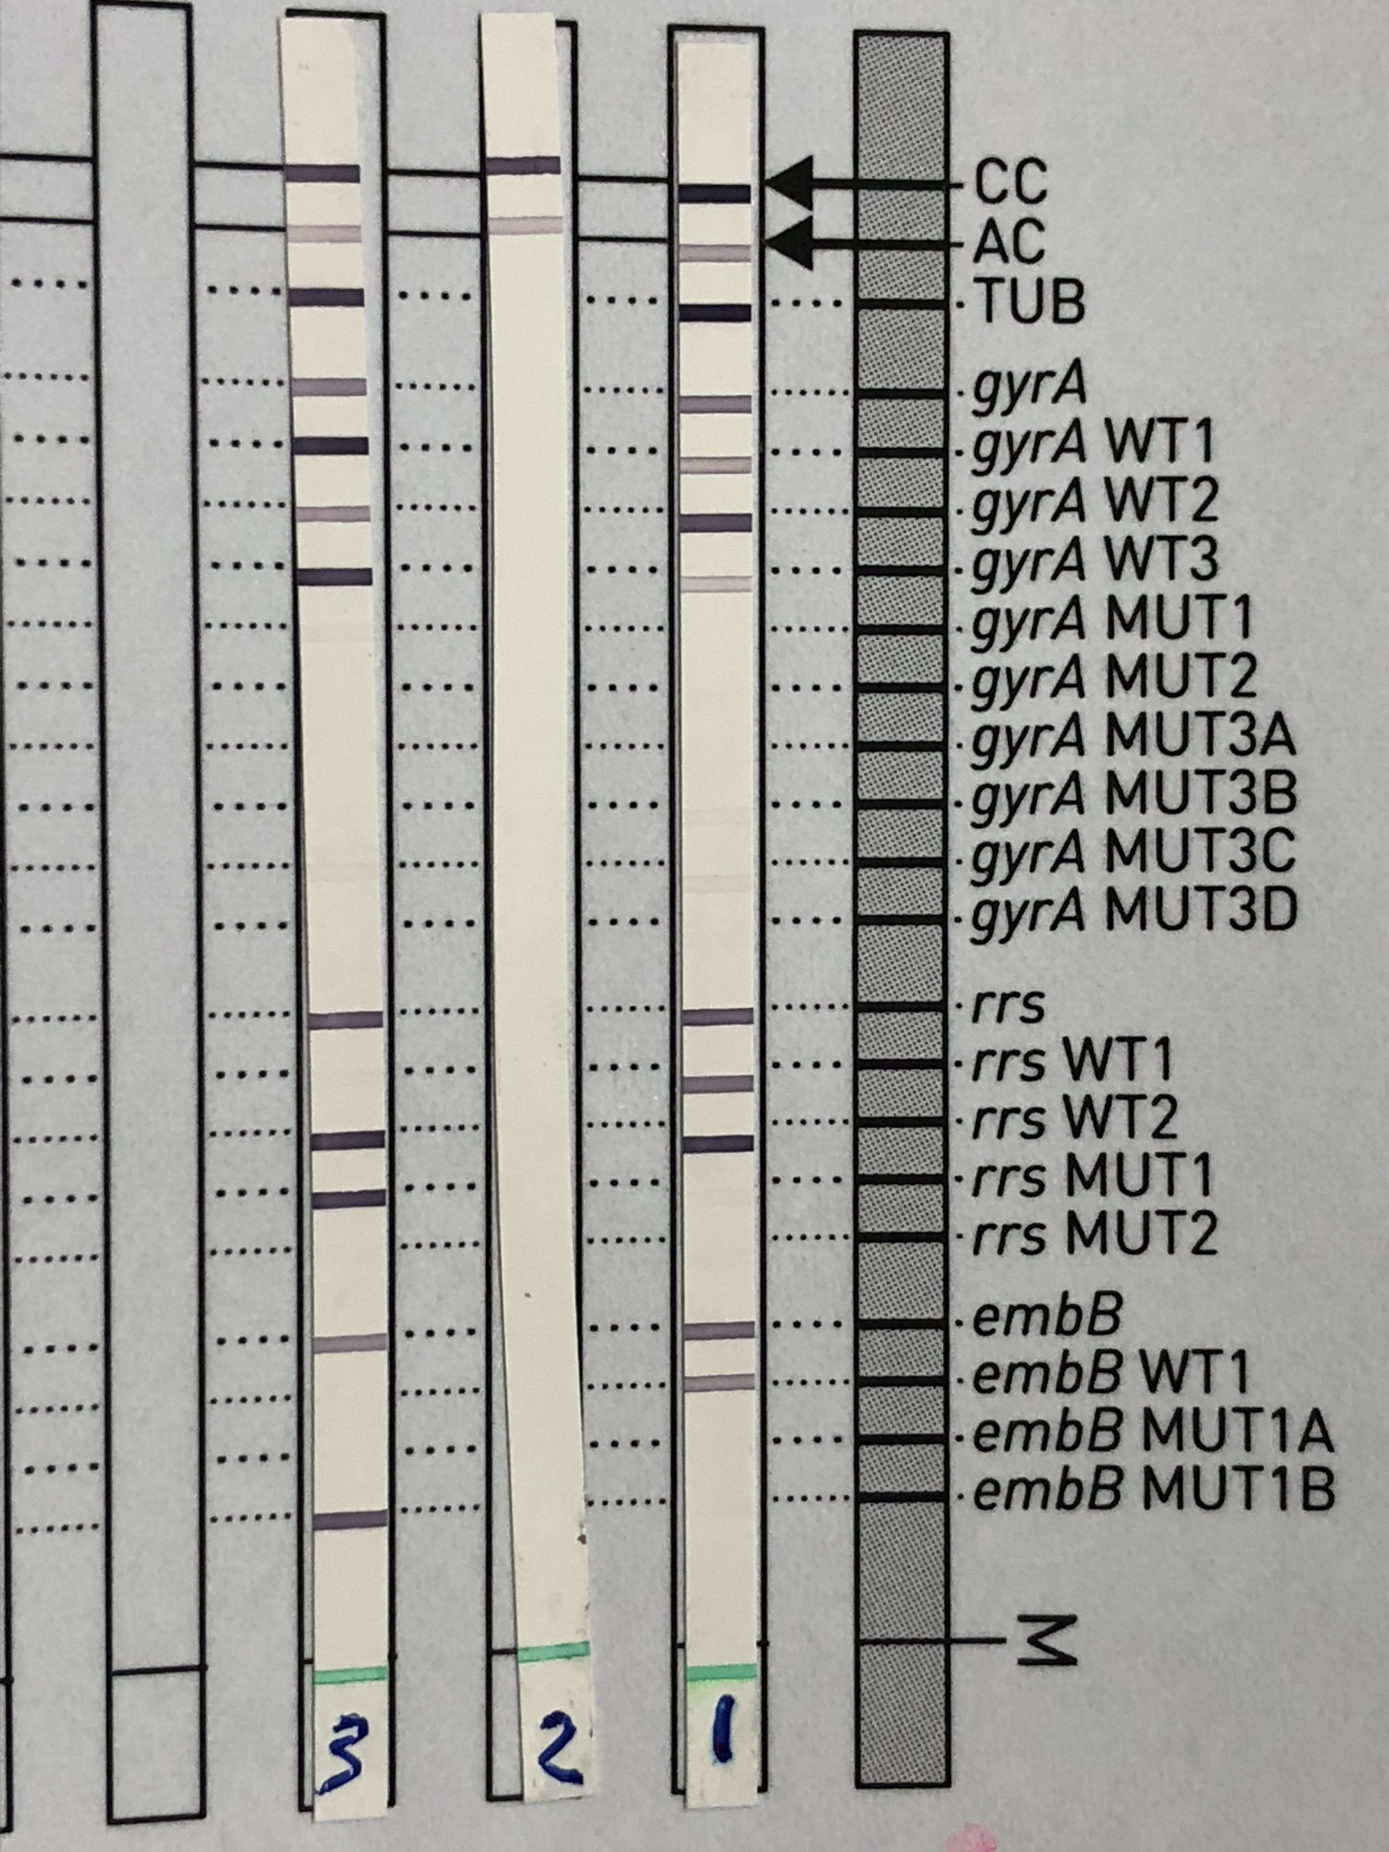
MTBDRsl (V1.0) example:
Sample #1:
  CC, AC and TUB bands present: MTB complex (+)
  Drug control bands present
  WT bands present for all drugs
  NO MUT bands present
  Interpretation: MTB complex (+), no mutations found
Sample 2:
  CC, AC bands present, TUB bands absent: MTB complex (-)
  Drug control bands absent
  WT bands absent for all drugs
  NO MUT bands present
  Interpretation: MTB complex (-)
Sample 3:
  CC, AC and TUB bands present: MTB complex (+)
  Drug control bands present
  WT bands present for gyrA and embB, missing WT1 for rrs
  MUT band present for rrs (MUT1) and embB (MUT1B)
  Interpretation: MTB complex (+), mutation in rrs and embB may confer resistance.

