Slide 1
Advanced Hain LPA Overview and Assessment Part 1: Hain MTBDRplus

Slide 2
Objectives
Briefly review the Hain MTBDRplus assay
Discuss three common challenges when performing the assay and reviewing test strips
Interpret and assess unusual LPA test strip results

Slide 3
Review: HAIN Genotype Line Probe Assay (LPA)
The LPA uses PCR and reverse hybridization methods for rapid detection of mutations associated with drug resistance.
The LPA is designed to identify MTBC and simultaneously detect mutations associated with drug resistance.
The LPA should be performed in laboratories with a proven capacity to conduct molecular testing including appropriate laboratory infrastructure and equipment.
This must also include the necessary biosafety precautions and the prevention of contamination.

Slide 4
Review: LPA Test Controls
Conjugate Control (CC) -Included on Strip
Demonstrates efficient conjugate binding and substrate reaction
Line must be present for a valid result
Amplification Control (AC)-Included on Strip
Demonstrates successful amplification
Negative Control (NC)-Recommended Test/Batch
Extraction control (contains water instead of sample) to control for contamination
Only the CC and AC bands should be present on this strip

Slide 5
MTBDRplus Assay: Tests for Mutations in INH and Rifampin
rpoB: If mutation present, this may correlate with resistance to Rifampin
inhA: If mutation present, this may correlate with resistance to INH (low level resistance)
katG: If mutation present, this may correlate with resistance to INH (high level resistance)

Slide 6
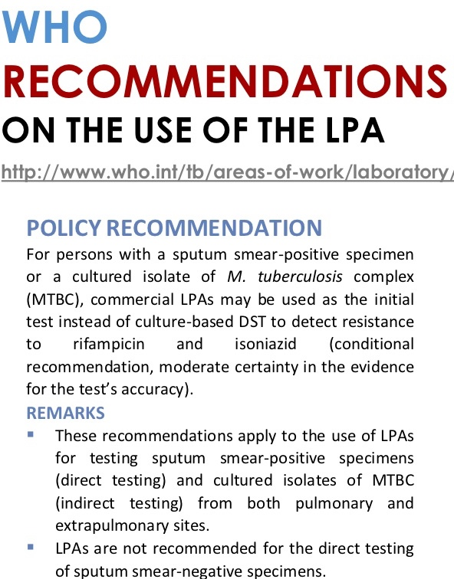
Challenge #1: LPA Testing on Smear Negative (-) Specimens
Challenge #1: LPA Testing on Smear Negative (-) Specimens
Hain package insert allows for the testing of smear negative (-) clinical samples, but WHO does not recommend this practice, based on mixed sensitivity/specificity data→
Hain Package Insert (v2.0)

Slide 7
Challenge #1: LPA Testing on Smear Negative (-) Specimens: Recommendations
If smear (-) samples are tested, there is the possibility of a higher number of indeterminate or uninterpretable strips, based on lower bacillary loads in the sample.
Repeat testing may be necessary due to indeterminate or uninterpretable banding patterns.
It is recommended that laboratories track the results from smear (-) samples as a quality indicator in their internal quality management system.

Slide 8
Challenge #2: Interpretation of LPA Strips with missing AC bands
Quote from package insert (V2.0)
The Amplification Control (AC) band ideally should be present in most cases, however it could be faint/missing.
If a positive (+) TUB band is present, the test can be interpreted and does not need to be repeated.
If there is no TUB band present (possible negative result), testing should be repeated.

Slide 9
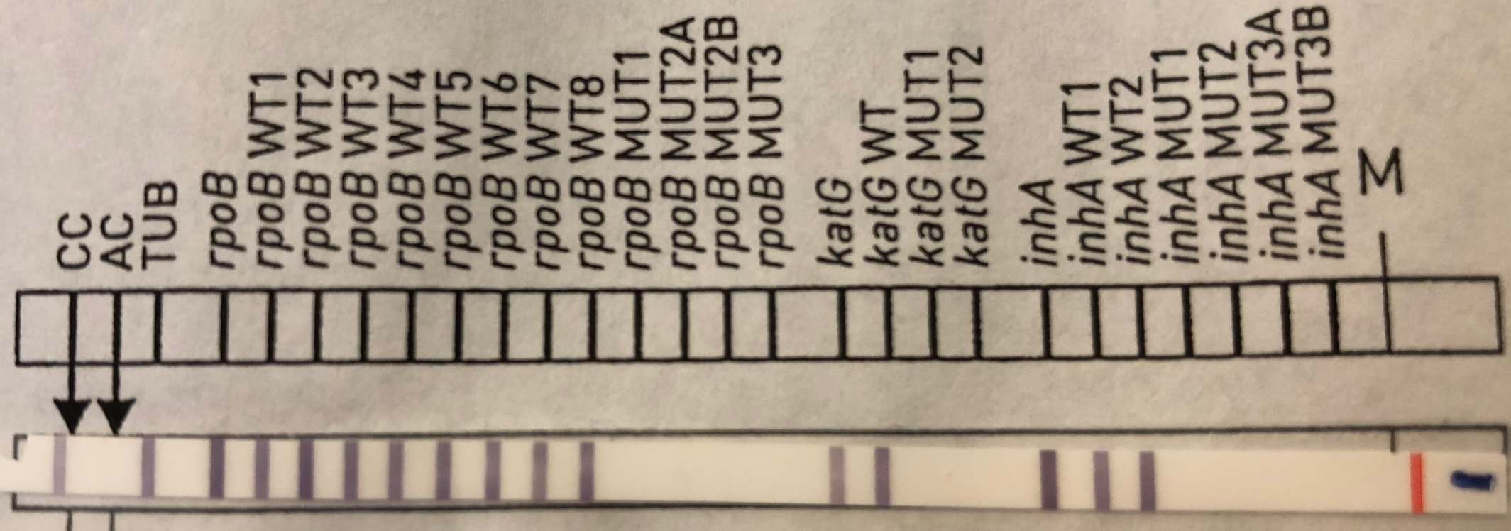
Example: AC band missing
In the above example, note that only the CC band is present.
Results are indeterminate and need to be repeated.

Slide 10
Challenge #3: Heteroresistance
What is it?
Two or more strains of MTB complex that have different resistance patterns are found in a sample
How does it appear on the Line Probe Assay strip?
The full wild type sequence will be present, along with one or more mutation bands
How to interpret?
If all WT bands as well as 1 or more mutant bands appear, MTB complex is confirmed and heteroresistance may be present. Drug resistance cannot be determined from this strip for this particular drug, and either testing should be repeated, or another method should be used for testing.
If the above occurs only for one drug but the LPA strip shows determinate results for the other drug, these can be reported.

Slide 11
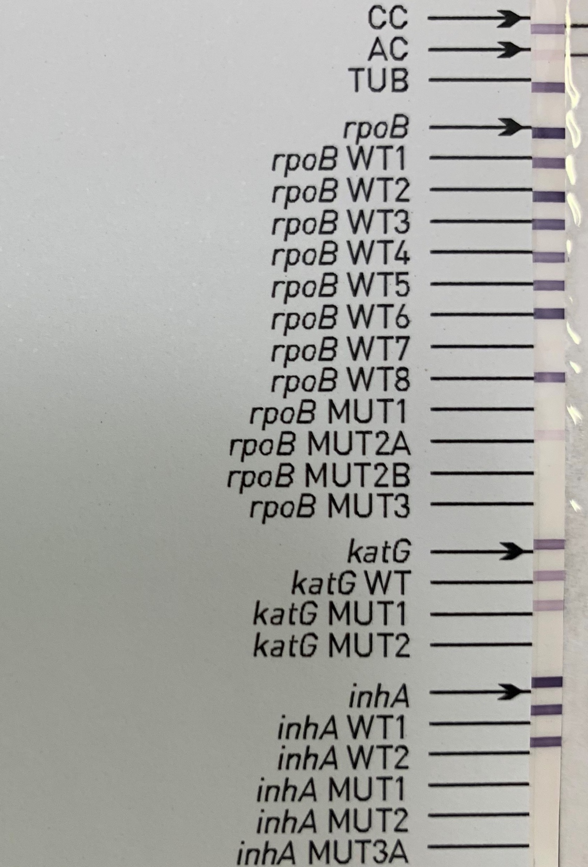
Example of Heteroresistance in INH
Note that for katG, the locus band and Wild Type (WT) bands are present, as well as a katG MUT1.
This suggests the presence of two MTB complex strains showing different resistant profiles to INH. Testing should be repeated, or confirmed using another method.

Slide 12
Advanced LPA Strip Interpretation for Hain TBDRplus: Competency Module
The following 8 slides provide images and case studies for assessment. Choose the most appropriate answer from the list provided

Slide 13
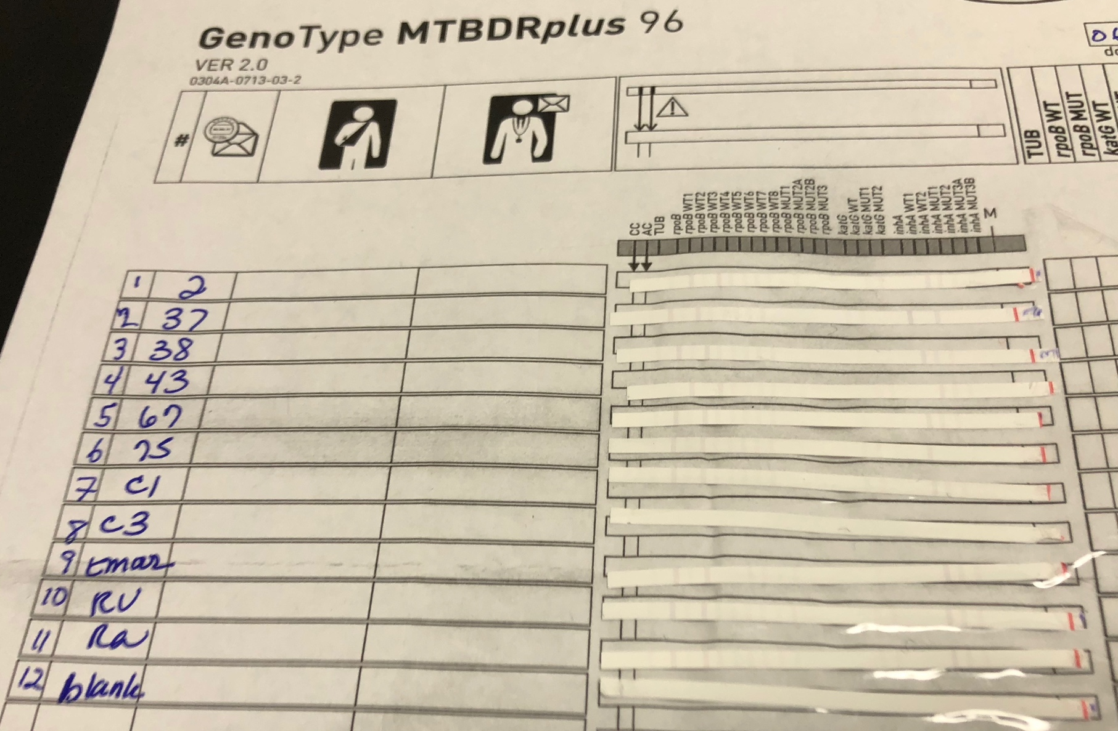
Question #1
A technician ran a full set of samples with the results shown here. Is this run valid? (Note “RV” and “RA” are positive MTB complex controls, and the “blank” is the negative control
Yes→all results are valid
Yes→only controls are valid
No→only the TUB bands are present
No→Results are not interpretable due to all control bands being faint and/or absent.

Slide 14
Question #1
This is an example of a failed run due to improper conjugate addition. Testing
should be repeated.
A technician ran a full set of samples with the results shown here. Is this run valid? (Note RV and RA are positive controls, and the blank is the negative control
Yes→all results are valid
Yes→only controls are valid
No→only the TUB bands are present
No→Results are not interpretable due to all control bands being faint and/or absent.

Slide 15
Question #2
A technician shows their manager the above LPA strip results, as they need assistance with interpretation. What should the manager tell their technician?
Results show MTB complex (-)
Results show MTB complex (+), mutation found in katG
Results indicate AC band missing, but the TUB band is present as well as interpretable banding patterns for all drugs. Results show MTB complex (+) without mutations present.
Results indicate AC band missing, but this is not needed for interpretation.

Slide 16
Question #2
The AC band should be present, but could disappear if there is competition during amplification. Since the CC and TUB bands are clearly present, results can be interpreted.
A technician shows their manager the above LPA strip results, as they need assistance with interpretation. What should the manager tell their technician?
Results show MTB complex (-)
Results show MTB complex (+), mutation found in katG
Results indicate AC band missing, but the TUB band is present as well as interpretable banding patterns for all drugs. Results show MTB complex (+) without mutations present.
Results indicate AC band missing, but this is not needed for interpretation.

Slide 17
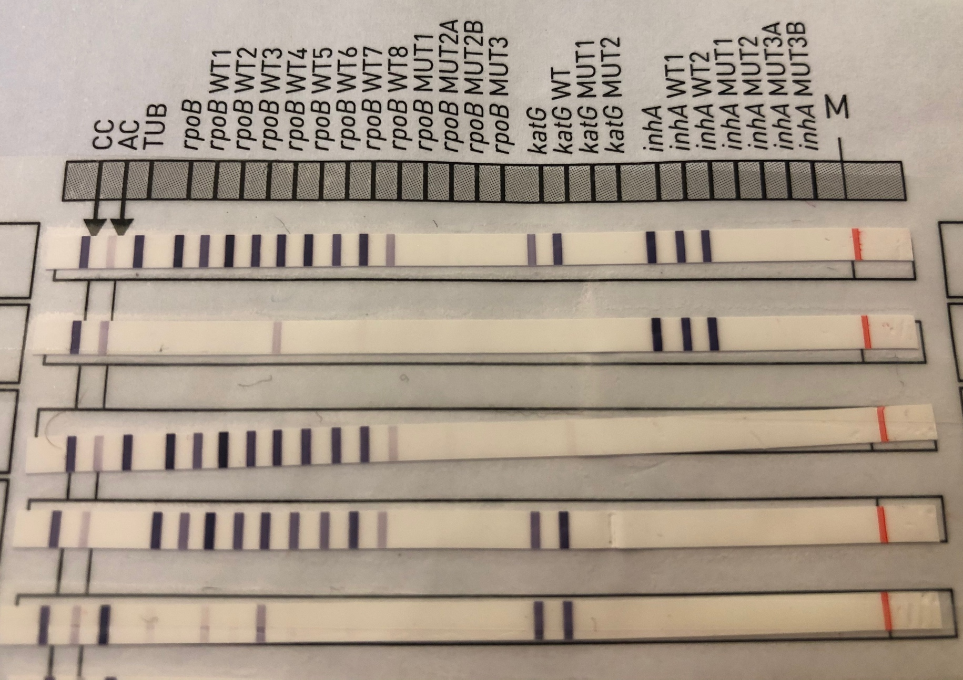
Question #3:
Five patient results are shown to the right-which can be interpreted as MTB complex showing no mutations for INH or RIF?
#1 only
#1 and #3
#1, #3, #5
#1, #2 and #4
1
2
3
4
5

Slide 18
Question #3:
Only #1 shows a fully interpretable banding pattern for both MTB complex and INH/RIF.
Five patient results are shown to the right-which can be interpreted as MTB complex showing no mutations for INH or RIF?
#1 only
#1 and #3
#1, #3, #5
#1, #2 and #4
1
2
3
4
5

Slide 19
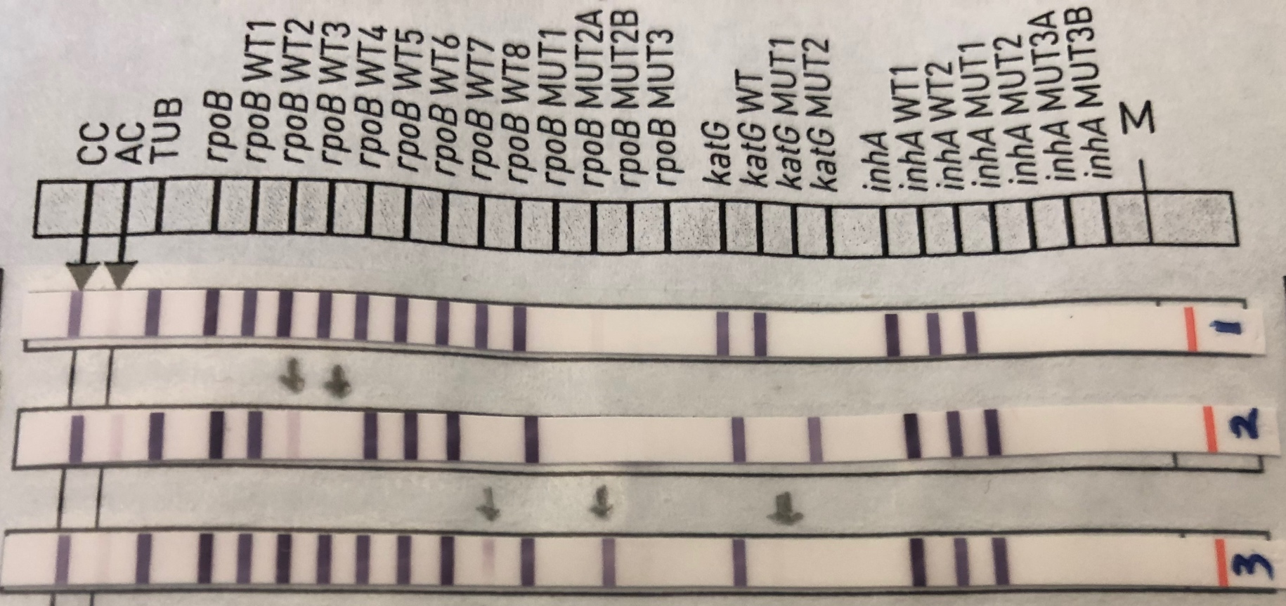
Question #4:
For Strip #3, how should INH be interpreted?
MTB complex (+), no mutations found to confer resistance
MTB complex (+), the absence of WT and MUT bands for katG suggest the presence of a mutation
MTB complex (+), only low level INH resistance found
MTB complex (+), the absence of MUT bands for inhA suggest the presence of a mutation

Slide 20
Question #4:
inhA bands show no mutations, but katG WT and MUT bands are missing, which suggests
INH resistance. It is advised to repeat testing using an alternative method.
For Strip #3, how should INH be interpreted?
MTB complex (+), no mutations found to confer resistance
MTB complex (+), the absence of WT and MUT bands for katG suggest the presence of a mutation
MTB complex (+), only low level INH resistance found
MTB complex (+), the absence of MUT bands for inhA suggest the presence of a mutation

Slide 21
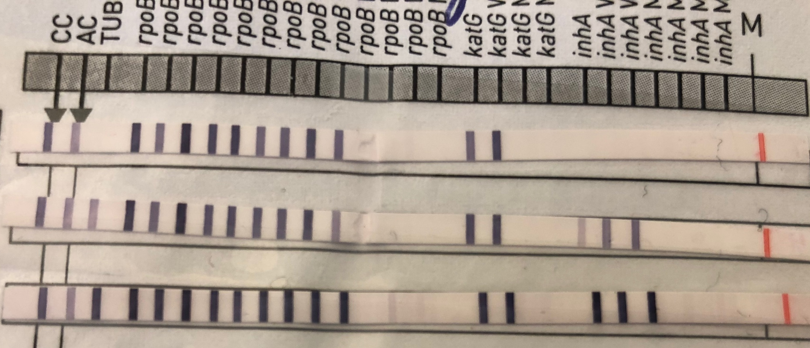
Question #5
H37rV
Sample 1
Sample 2
Reviewing these results, the technician is questioning their positive control (H37rV) result—what advice would you give?
The TUB band is missing, but rpoB and katG bands are present-this indicates a valid result with no mutations.
The TUB band is missing but there is a partial set of banding patterns that are present-this indicates suboptimal hybridization, and testing should be repeated for all samples.
The TUB band is missing, but this is not needed for interpretation since the CC and AC bands are present.
None of the above.

Slide 22
Question #5
H37rV
Sample 1
Sample 2
Reviewing these results, the technician is questioning their positive control (H37rV) result—what advice would you give?
The TUB band is missing, but rpoB and katG bands are present-this indicates a valid result with no mutations.
The TUB band is missing but there is a partial set of banding patterns that are present-this indicates suboptimal hybridization, and testing should be repeated for all samples.
The TUB band is missing, but this is not needed for interpretation since the CC and AC bands are present.
None of the above.
Since there is an evaluable resistance pattern here, the presence of MTB Complex should
be suspected. However testing should be repeated for all samples, since there were problems with hybridization.

Slide 23
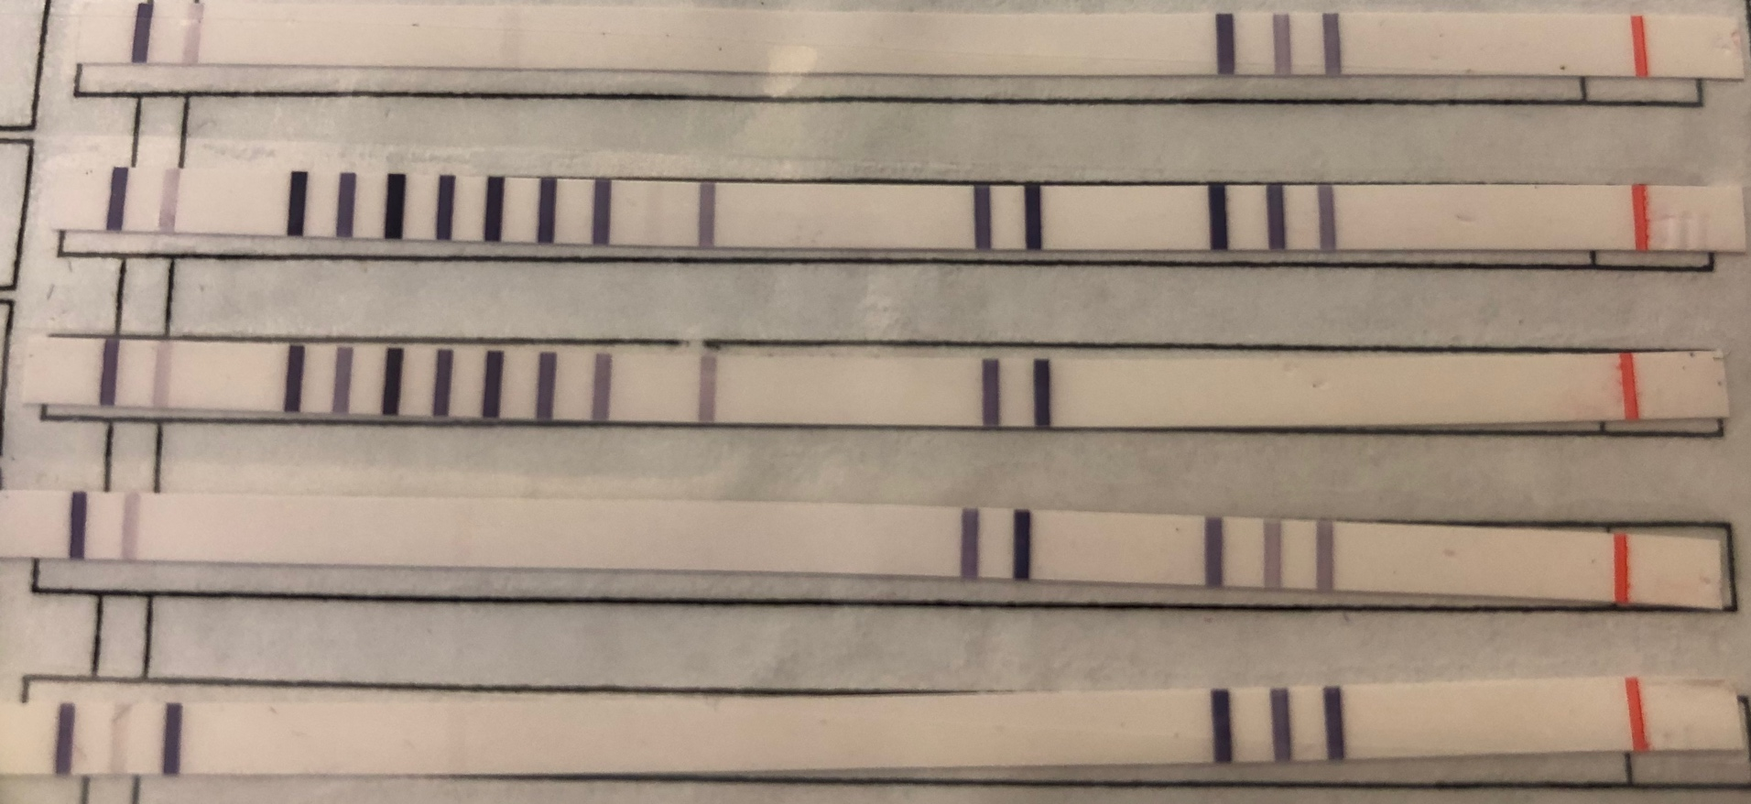
Question #6:
1
2
3
4
5
Five smear (+) sputa samples have their LPA test results above. Which of the following is NOT true?
All five tests have valid CC and AC results.
All tests should be repeated as resistance results are indeterminate.
#5 is the only strip confirmed to contain MTB complex and does not need to be repeated.
#2 and #3 most likely contain MTB complex, but testing should be repeated.

Slide 24
Question #6:
There is an evaluable resistance pattern in #2,3,4,5 which indicate the possibility of
MTB complex. Even though the TUB band is only evident in #5, testing should be repeated for all.
1
2
3
4
5
Five smear (+) sputa samples have their LPA test results above. Which of the following is NOT true?
All five tests have valid CC and AC results.
All tests should be repeated as resistance results are indeterminate.
#5 is the only strip confirmed to contain MTB complex and does not need to be repeated.
#2 and #3 most likely contain MTB complex, but testing should be repeated.

Slide 25
Question #7
Strip #7 results are from a patient with suspected MDR-TB. Do these results show this profile?
Yes, there are mutations in both rpoB and katG
Yes, there are mutations in both rpoB and inhA.
No, there is only an inhA mutation present.
No, this strip cannot be interpreted as the AC band is too faint.

Slide 26
Question #7
Strip #7 results are from a patient with suspected MDR-TB. Do these results show this profile?
Yes, there are mutations in both rpoB and katG
Yes, there are mutations in both rpoB and inhA.
No, there is only an inhA mutation present.
No, this strip cannot be interpreted as the AC band is too faint.
AC band: Faint, but present.
rpoB: There is weak staining at the WT8 band while rpoB MUT3 is
clearly present. With this combination, the WT8 band is considered negative.
inhA: WT1 band is missing while a MUT1 band is present. This indicates possible INH resistance
katG: No mutation present.

Slide 27
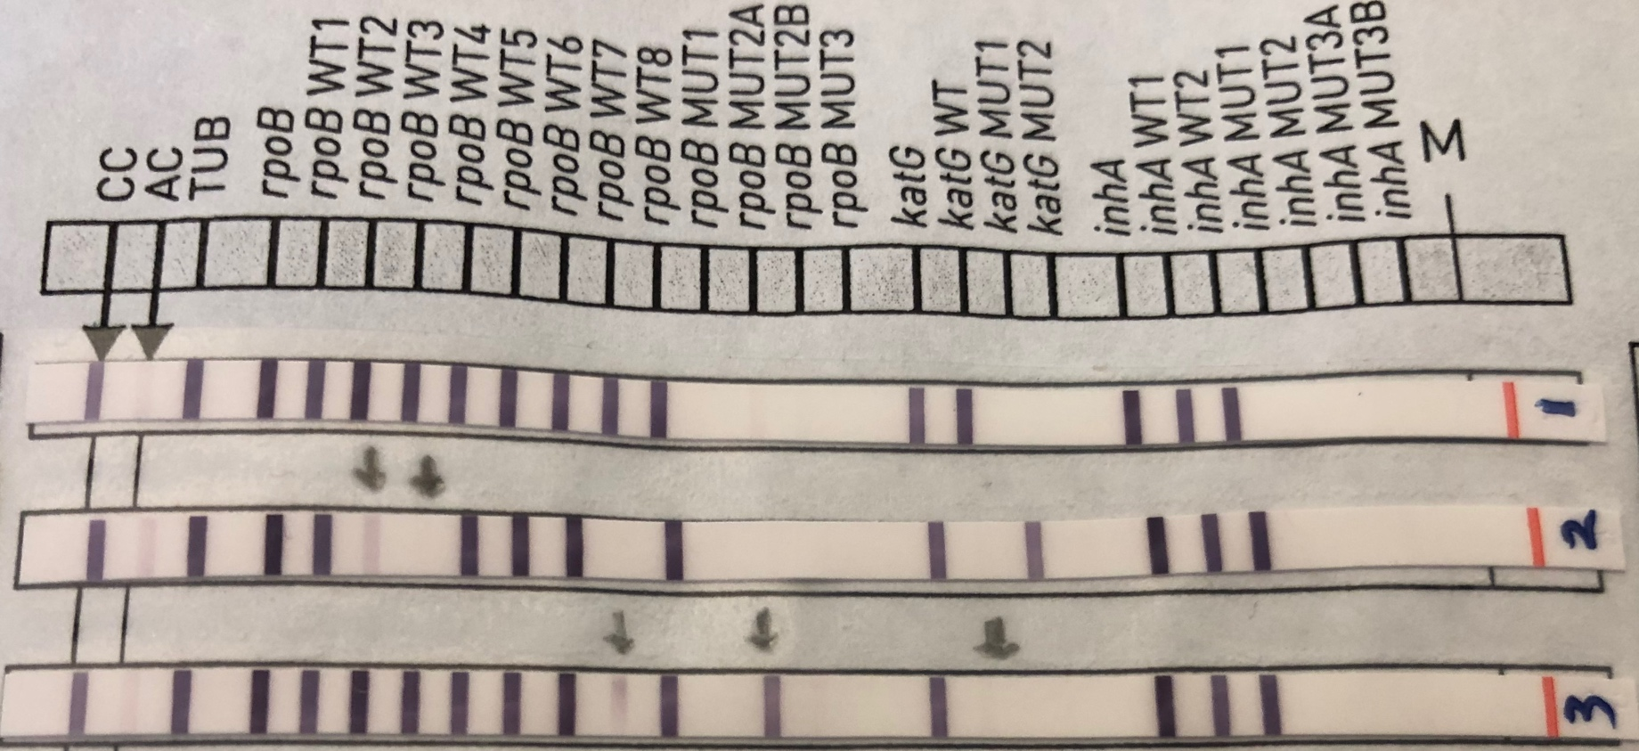
Question #8
The technician read the LPA strip results but had questions about Strip 2 and 3 as indicated by the arrows. Are these strips showing potential resistance-conferring mutations OR possible heteroresistance?
Both show mutations in rpoB only
Both show possible heteroresistance for rpoB
Only #3 shows possible heteroresistance for rpoB
There are no mutations or possible heteroresistance seen.

Slide 28
Question #8
#2 shows mutations in both rpoB and katG, with missing WT3 and WT7 bands in rpoB and katG WT missing.
#3 has a faint band in rpoB WT7 as well as a clear MUT2A band. While there is a common mutation found with the combination of missing WT7 and MUT2A, the WT7 band is present and stronger than the AC band. Therefore there may be heteroresistance in this strain, and testing should be repeated.
The technician read the LPA strip results but had questions about Strip 2 and 3 as indicated by the arrows. Are these strips showing potential resistance-conferring mutations OR possible heteroresistance?
Both show mutations in rpoB only
Both show possible heteroresistance for rpoB
Only #3 shows possible heteroresistance for rpoB
There are no mutations or possible heteroresistance seen.

