Slide 1
Blood Sample Collection
Avoiding Hemolysis and
Achieving Optimal Sample Integrity during Blood Collection

Slide 2
Blood Sample Collection
DO’s and DON’Ts
DO | DO NOT
Discard sample from a traumatic draw | Leave a tourniquet on for more than 1 minute
Allow residual alcohol to dry over puncture site | Use a needle with a bore smaller than 23 G
Fill collection tubes with appropriate volumes using fill lines as a guide | Pull too hard on syringe plunger during collection or push too hard when filling tubes
For Blood Culture Collection:
DO | DO NOT
Perform a 30-second friction scrub to venipuncture site with ChloraPrep®, using a back and forth motion and allow site to dry for at least 30 seconds before specimen collection. | Touch site after prepping skin. (If it is necessary to palpate the site after cleansing, a sterile glove is worn on the hand used for palpation.)
Hemolysis may affect results by: • Increasing Potassium (K) Results • Decreasing Ionized Calcium (iCa) Results • Decrease detection of: cTnI, CK-MB, bnp • Compromising Prothrombin Time /(PT/INR) results Blood Culture Contamination (due to improper collection technique) • Can lead to unnecessary treatment with antibiotics. • Can lead to unnecessary increased length of hospital stay.

Slide 3
Avoiding Hemolysis
Factors to Consider During Sample Collection | Possible Consequences | Corrective Actions
• Venipuncture on hand veins | • Hand veins are fragile and easily traumatized. | • The veins in the antecubital area are the veins of choice. If it is necessary to draw distally to the antecubital area, a 22 G or 23 G needle with a syringe and avoid pulling the plunger with too much force during collection.
• Prolonged tourniquet time | • Hemoconcentration. • Rupture of RBC’s. | • If possible, release the tourniquet as soon as blood flow is established in the first tube. • Tourniquet should be released after no more than 1 minute from initial placement.
• Cleansing procedure with isopropyl alcohol | • Performing the venipuncture before the alcohol is allowed to thoroughly dry may cause the RBCs to rupture. | • Allow alcohol to thoroughly dry.
• Needle readjustment | • Vein trauma may result when the needle placement is not accurate. | • The needle should be parallel to the vein. Enter at a 30° angle or less. • Reposition the needle forward or backward (vertically). • Avoid probing.
• Needle occlusion | • May cause the blood to flow slowly and initiate RBC shearing. | • Needle bevel may be positioned against the vein wall. Pull back slightly on the needle. • Avoid rotating or changing the angle of the needle.
• Needle gauge — Bore too large (= lower gauge) Ex. 18 G – Bore too small (= higher gauge) Ex. 25 G | • Blood enters tube faster and more forcefully and may result in hemolysis. • When used with a full draw tube, the RBCs may rupture due to vacuum force. • Blood travels through an extremely small opening under a great force. This may cause the RBC wall to shear. | • Select a needle gauge appropriate for the vein size, location, and patient condition.

Slide 4
Avoiding Hemolysis (continued)
Factors to Consider During Sample Collection | Possible Consequences | Corrective Actions
• Syringe collection | • Too much force applied to the plunger during blood collection. • Blood may begin to clot and hemolyze while being aspirated into a large volume syringe. • Forceful transfer of blood from the syringe into the blood collection tube. | • Before use, move the plunger within the barrel of the syringe to ensure freedom of movement. • Do not use a syringe size much larger than the amount of blood needed. • Transfer the blood into the tube immediately after venipuncture. • Use a blood transfer device (BTD). • Do not apply force to the plunger during transfer of the blood into the blood collection tube. • After attachment to the BTD, angle the syringe. This allows the blood to flow slowly down the side of the tube wall.
• Catheter collection | • Blood may travel through several different internal diameters (catheter and connectors). The turbulence may cause the cells to rupture. | • Ensure all connections fit together securely. • Do not mix manufacturers’ components. • Collect discard tube. • Use extension tubing. • Increase catheter size. • Use the BD Vacutainer® Luer-Lok™ Access Device (LLAD) for all valve ports.
• Loose connections of component parts (i.e., needle to holder, blood collection set hub to luer adapter or syringe) | • Air may be introduced into the sample and cause frothing. This may result in hemolysis. | • Ensure all connections fit together securely. • Do not mix manufacturers’ components.
• Tube choice | • Tube vacuum might cause the blood to enter the tube forcefully and may cause cell rupture. | • Based upon the condition of the patient’s vein, select a tube with the appropriate amount of vacuum.
• Tube fill volume | • Excessive concentrations of additives can cause rupture of the RBC cell membrane, e.g., oxalate. | • Fill tubes to their proper draw volume to ensure proper blood to additive ratio.
• Vigorous mixing | • May cause the RBCs to rupture. | • Gentle tube inversion, 180° down and up.

Slide 5
Blood Draw
Order of Collection
To avoid cross contamination of additives from one tube to the next,
blood collection tubes must always be collected in this order
#1
Blue
#2
Red
#3
Gold
#4
Green
#5 Purple
#6
Pink

Slide 6
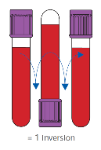
Inversion of Tubes
Blood collection tubes must be adequately mixed immediately after collection
to ensure proper mixing of blood with additive.
Mix by gently inverting 8-10 times
Inadequate mixing can lead to clotting
Overly vigorous mixing can lead to hemolysis

Slide 7
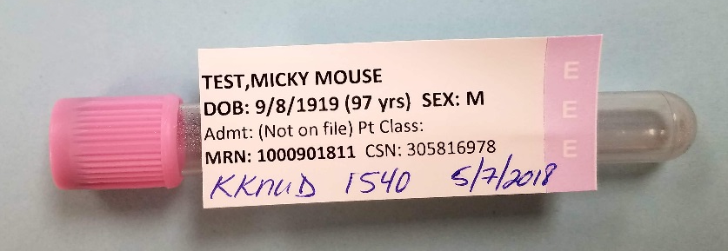
Labeling of Blood Bank Tubes
Pink top tube for Blood Bank must be labelled with ALL of the following:
Two patient identifiers (Full Name and MRN)
Date of collection
Time of collection
Initials of person collecting sample
Example of properly labelled blood bank tube:

Slide 8
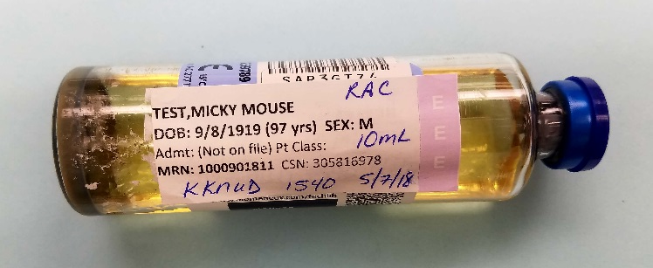
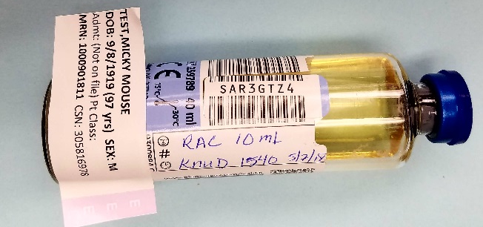
Blood Culture Volumes
To ensure proper blood-to-media ratio (and most reliable culture outcomes), a minimum volume of 5 mL should be added to each blood culture bottle.
  Whenever possible, the ideal volume of 10 mL should be added to each bottle.
  The following chart should be followed when filling blood culture bottles:
Venipuncture Volume | Anaerobic Bottle (Purple) | Aerobic Bottle (Blue)
18-20 ml | Split equally between vials
15-17 ml | 5- 7 ml | Remaining 10 ml
12-14 ml | 5 ml | Remaining 7-9 ml
7-11 ml | Total volume minus 5-6 ml (to be used for aerobic) | 5-6 ml
2-6 ml | 1 ml | Remaining 1-5 ml
1 ml | None | 1 ml
Bottles must be labelled with:
            Two patient identifiers (Full Name and MRN)
            Time of collection
            Volume of blood added
            Initials of person collecting sample
            Place label on tube taking care not to cover barcode or lot#
Examples of properly labelled blood culture bottles:

Slide 9
POC Sample Handling
Green tops or syringes used for POC testing must be mixed well before testing
to prevent inaccurate hematocrit results.
Samples that have been set down prior to testing must be re-mixed.
Mix green tops by gently inverting 8-10 times.
Mix syringes by rolling in hand for 5 seconds, inverting and repeating.
Discard the first few drops before filling cartridge

