Slide 1
The Ins and Outs of Point of Care Testing at CMC

Slide 2
What is Point of Care Testing?
Is testing designed to occur at or near the patient’s bedside.
Often times by non-laboratory professionals

Slide 3
Who Performs Point of Care Testing?
Doctors
PA/ARNP/Midwives
Perfusion Staff
Nurses
Nursing Assistants (LNA’s/MA’s)
Radiology Staff
The General Public

Slide 4
How?
I’m confused if anyone can do laboratory testing why did I spend 2-4 years in school to be able to work here?

Slide 5
What is CLIA?
The Clinical Laboratory Improvement Act of 1988
CLIA Licenses are required by all Laboratories that tests human tissue
CLIA defines a Laboratory as a facility that performs testing on materials derived from the human body for the purpose of providing information for the diagnosis, prevention, or treatment of any disease or impairment of, or assessment of the health of, human beings.

Slide 6
CLIA
CLIA defines the educational requirements needed for testing personal who perform Waived, Moderately Complex, and Highly Complex testing.

Slide 7
Testing
Waived Testing
No educational requirements
Moderate Complex Testing
A high school diploma*
State of NH requires an Associates Degree
Highly Complex Testing
Minimum of an Associates degree in Medical Technology/Laboratory Science

Slide 8
Examples of Waived Testing
Urine Pregnancies
Quidel Mono
BINAX Now RSV
Sure-vue Signature Rapid Strep A
i-STAT Chem8+
Urine Dips
Glucose (fingerstick)
PT/INR
Cholesterol at NEHI
Hemoglobin A1C
Flu Kit testing
Occult Bloods

Slide 9
Examples of Moderate Complex Testing
CA 1500
Sysmex 2100
Vistas
TEGs
Sedrates
Biosites
Fetal Fibronectin
Centaur
Immunite
Semen
Provue*
MTS Gel System
GeneXpert
i-STAT (Cartridge dependent)

Slide 10
Examples of High Complexity Testing
Cytology
Blood Bank*
Manual Differentials
Remel Cryptococcus Antigen
HPV assay
*High complexity when used for compatibility testing
http://www.accessdata.fda.gov/scripts/cdrh/cfdocs/cfCLIA/search.cfm

Slide 11
Why is CLIA Important?
With out a CLIA License you can not get reimbursement from CMS (Center for Medicare/Medicaid services.

Slide 12
Types of CLIA Licenses
Certificate of Waiver
Certificate of Provider Performed Microscopy
Certificate of Registration
Certificate of Compliance
Certificate of Accreditation

Slide 13
So What’s The Difference?
Different licenses allow for the facility to do different types of testing
A COW (Certificate of Wavier) only allows the facility to perform tests classified as waived.
A PPM (Provider Performed Microscopy) allows waived testing and qualified providers to use a microscope.

Slide 14
Accreditation vs. Compliance
Both allow you to do the same types of testing. (Waived, Moderate and High Complexity)
The difference is in who inspects you.
If you have a Certificate of Compliance it means that CLIA inspects your laboratory

Slide 15
Certificate of Accreditation
If you have a Certificate of Accreditation it means you have your inspections from one of 6 deemed agencies:

Slide 17
Great So What does this have to do with Point of Care At CMC??

Slide 18
Licenses at CMC
1 Certificate of Accreditation
Lab at CMC at 100 McGregor St.
3 Certificates of Provider Performed Microscopy
FHWCB
WBFP
FPM
9 Certificate of Waivers
WSIM
APC
GPC
GSIM
Hillcrest Terrace
HPC
MGM
QCM
Community Mobile Health
1 Certificate of Compliance
Urgent Care at Bedford Medical Park

Slide 19
Outpatient Point of Care Tests Performed
Mono
Flu
Strep
Pregnancy
Urine Dips
Hemoglobin A1C
Chem8
PT/INR
Glucose
Lipid Profile
AST/ALT
CBC***
Wet Preps
Ferning
KOH Preps
Occult Bloods
There are Currently 106 Active Outpatient Users

Slide 20
Inpatient Point of Care Tests Performed
Blood Gases
ACT
Glucose (glucometer)
Glucose (i-STAT)
Chem8
Heparin Dose Response
TEG
O₂ Saturation
Urine Dips
Wet Preps
KOH
Ferning
We currently have 622 active POC Testing personnel

Slide 21
Where does POC Testing Occur?
C100
EP Lab
ICU
Cholesterol Management / NEHI
Anticoagulation Clinic / NEHI
Diabetes Resource / NEHI
Emergency Department
Specials Radiology
Cardiac Cath Lab
Endoscopy
Wound Center
West Side Neighborhood HC
RMU
Mom’s Place
Special Care Nursery
E100
E200
D100
D200
CIU
PACU/ASU
Operating Room
Cardiac Rehab
Every CMC Physician Practice
Urgent Care
The real question is where is POC Testing not done

Slide 22
That’s all good but how much POC Testing is really done?

Slide 23
2009-2012
2009
8884 i-STATs
99490 Glucose
2010
9907 i-STATs
99883 Glucose
2011
11656 i-STATs
127513 Glucose
2012
10824 i-STATs (projected)
125070 i-STATs (projected)

Slide 24
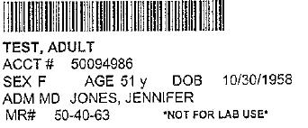
So if you have so many users how do the results all make it into the system?
Auto-verification ☺
The end users on the floors use the glucometers or the i-Stats to scan the patient's bar-coded wristband after properly identifying the patient.

Slide 25
Resulting
The bar-code is the patient’s current account number and is unique to that patient and that stay
They perform the test and when complete they return the i-Stat to the dock or plug the glucometer in
The results flow either over the wireless network or a hardwired network connection
Provided the account number is entered correctly everything auto flows to SoftLab and then on to Sunrise

Slide 26
When things go wrong
If the account number does not go in correctly the result gets bumped out in QML
We estimate that <1% of tests need to be fixed in QML in any given month

Slide 27
WebMRE
WebMRE is a fantastic program used to get results from manual testing into the EMR.
It’s easy to use and makes manual result entry quick and easy
It is used at Urgent Care to result
Strep A
Flu
Occult Bloods
Mononucleosis
Pregnancy
PT/INRs
Glucose*

Slide 28
Internet log on screen that is accessible from any CMC computer

Slide 29
Result entry screen lists the tests that the operator is certified and competent to perform. People only get access to the testing that they do

Slide 30
WebMRE does not let them verify any information unless all of the boxes with a * are filled in. This makes it so there is no way to bypass important information

Slide 31
Benefits of Point of Care Testing
The rapid turn around time allows immediate care decisions to be made
The faster the results the quicker the turn around of patients
Can promote better patient care

Slide 32
Draw Backs to Point of Care Testing
Expensive
Results are only as good as the person doing them
Can be a lot to manage
Documentation can be problematic

Slide 33
Questions?

Slide 34
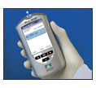
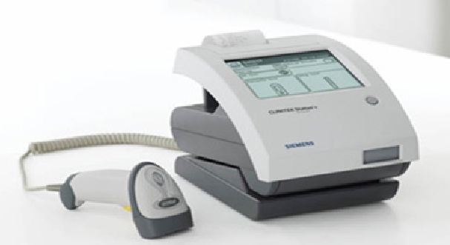
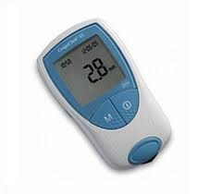
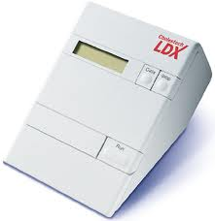
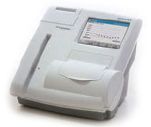
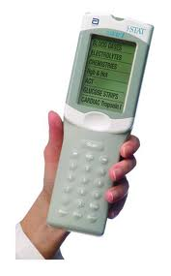
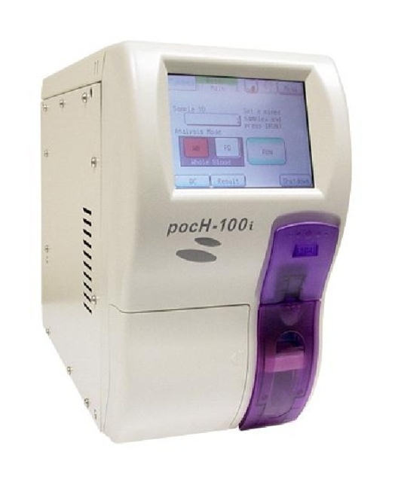
Thanks!!

