Slide 1
ABO Discrepancy
Linda Bayrd, MT (ASCP)SBB, CQA (ASQ)
12/13/2012

Slide 2
Objectives
To explain the ABO System
To solve an ABO Discrepancy
Entry of results in Softbank

Slide 3
ABO System
Described by Karl Landsteiner 1900
Most important blood group system in transfusion and organ transplant
ABO Typing and ABO Compatibility testing remain the foundation of pretransfusion testing and before transplantation

Slide 4
ABO System
ABO antigens found
Red Cells
Platelets
Tissues
Kidney
Heart
Bowel
Pancreas
Lung

Slide 5
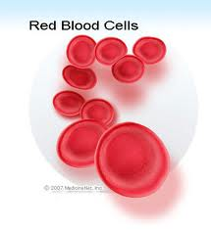
ABO System
4 major ABO phenotypes,
presence or absence of 2 antigens A and B
A
B
O
AB

Slide 6
ABO System
Also characterized by the presence or absence naturally occurring antibodies termed isohemagglutinins
An inverse reciprocal relationship exists
between the presence of A and/or B antigens on red cells
And the presence of Anti-A,
Anti-B or both in sera

Slide 7
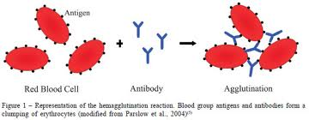
ABO System
Anti-A | Anti-B | A1 Cells | B Cells | Interpretation
+ | 0 | 0 | + | A
0 | + | + | 0 | B
0 | 0 | + | + | O
+ | + | 0 | 0 | AB

Slide 8
ABO System
Biochemistry
A and B antigens defined by 3 sugar terminal epitopes on glycolipids and glycoproteins.
(H antigen)

Slide 9
ABO System
ABO in Development
Red Cells
detected on red cells of embryos as early as
5 -6 weeks
Adult levels of ABO expression are observed by age 2 to 4 years
Anti-A and anti-B
Not present at birth
Displayed in sera at 1 year of age
Adult levels 5 to 10 years old

Slide 10
ABO System
ABO Subgroups
Differ in the amount of A and B antigens carried on red cells
Present in secretions
Detected by discrepancies between forward and reverse grouping
A subgroup more common than B subgroup
Most Common A₁ (80%) A₂ (20%)
A₁ can be distinguished from A₂ with the lectin Dolichos biflorus
Agglutination occurs with A₁ not A₂ red cells

Slide 11
ABO System
ABO Subgroups
A₁ can be distinguished from A₂ with the lectin Dolichos biflorus
Agglutination occurs with A₁ not A₂ red cells
1% to 8% of A₂ individuals and 25% of A₂B individuals possess alloanti-A1 in their sera
A₂ phenotype show increased reactivity with anti-H lectin (Ulex europaeus) due to inefficient conversion of H A antigen

Slide 12
ABO System
In addition to A₂ several weaker A subgroups have bee n described A_{int,} A₃, A_{x}, A_{m}, A_{x}, A_{el}

Slide 13
ABO System
B(A) and A(B) Phenotypes
B(A) phenotype
Autosomal dominant phenotype characterized by weak A expression group B Red Cells
React strongly with anti-B and weakly with monoclonal anti-A (<2+)
Possess a strong anti-A with A₁ and A₂ red cells in their sera.
Testing with polyclonal anti-A should resolve the discrepancy

Slide 14
ABO System
A(B) phenotype
has also been described with monoclonal anti-B
Associated with elevated H antigen

Slide 15
ABO System
Acquired B Phenotype
An acquired transient serologic discrepancy encountered in group A individuals
Suspected when a patient or donor who has historically typed as group A now presents with B expression on forward red cell grouping
Serologically
Strong agglutination with anti-A
Weak agglutination with monoclonal anti-B
Strong Anti-B in serum

Slide 16
ABO System
Acquired B Phenotype
Occurs in the setting of infection by gastrointestinal bacteria.
Many enteric bacteria possess a deacetylase enzyme capable of converting A antigen to a B like analog
To resolve red cells should be retyped using a different monoclonal anti-B or acidified human anti-B

Slide 17
ABO System
ABO Antibodies (Anti-A and Anti-B)
Group A and Group B individuals: IgM predominant isotype
Group O individuals: IgG is the predominant isotype
HDFN (Hemolytic Disease of the fetus and newborn, IgG can cross the placenta
Agglutinate red cells at RT or cooler
Activate complement at 37C

Slide 18
ABO System
ABO Antibodies (Anti-A,B)
Sera from group O individuals
Reacts with both A and B red cells

Slide 19
ABO System
ABO Antibodies (Anti-A₁)
Occurs as an alloantibody in the serum of
1% to 8% of A2 individuals
22% to 35% of A2B individuals
Causes ABO Discrepancies
Leads to incompatible crossmatches
IgM istotype, reacts at RT or below
Considered clinically insignificant

Slide 20
ABO System
Routine testing
Donor samples are tested at the time of donation
Receipt of Red Cells units in a transfusion service (confirmatory testing)
Pretransfusion testing prior to Transfusion
ABO requires forward and reverse testing
Reverse testing not required
Confirmatory testing
Infants <4months

Slide 21
ABO Discrepancy
ABO Discrepancy
Exists when the results of red cell tests do not agree with serum (plasma) tests usually caused by unexpected negative or unexpected positive results in either the forward or reverse typing.
The discrepant results must be recorded, interpretation of the ABO group must be delayed until the discrepancy has been resolved.

Slide 22
ABO Discrepancy
Red Cell Testing Problems
Weak ABO expression: inheritance, leukemia and other malignancies
Mixed Field agglutination
due to out of group red cell transfusion
hematopoietic progenitor cell transplant
Subgroup A₃
Blood group chimerism in fraternal twins
Neutralization of anti-A and anti-B typing reagents

Slide 23
ABO Discrepancy
Red Cell Testing Problems (cont.)
Spontaneous agglutination or autoagglutination of serum or plasma suspended red cells caused by heavy coating of red cells by potent autoagglutinins
Nonspecific aggregation of serum or plasma suspended red cells caused by abnormal concentrations of serum proteins or infused macromolecular solutions.

Slide 24
ABO Discrepancy
Red Cell Testing Problems (cont.)
False-Positive reactions caused by a pH-dependent autoantibody, a reagent dependent antibody or rouleaux
Acquired B, B(A) or A(B)
Polyagglutination (T activation) resulting from inherited or acquired abnormalities of the red cell membrane

Slide 25
ABO Discrepancy
Problems with Serum or Plasma Testing
Small fibrin clots in plasma
Incompletely clotted serum
Lack of detectable isoagglutinins in infants less than 4 months
Absence of ABO agglutinins caused by a weak A or B subgroup
ABO Incompatible HPC transplantation
Severe hypogammaglobulinemia

Slide 26
ABO Discrepancy
Problems with Serum or Plasma Testing (cont.)
Cold alloantibodies or autoantibodies
Ab directed against constituents in the diluents used to preserve reagent A₁ and B red cells.
Nonspecific aggregation or agglutination caused by HMW plasma expanders, rouleaux, high serum protein concentrates or altered serum proteins ratios.

Slide 27
ABO Discrepancy
Problems with Serum or Plasma Testing (cont.)
Recent transfusion of out of group plasma containing components
Recent infusion of IVIG

Slide 28
ABO Discrepancy
Technical Errors
Specimen mix up
Too Heavy or too Light red cell suspensions
Failure to add reagent
Missed observation of hemolysis
Manufacturer’s instructions not followed
Under or over centrifugation of tests
Incorrect interpretation or recording of test results.

Slide 29
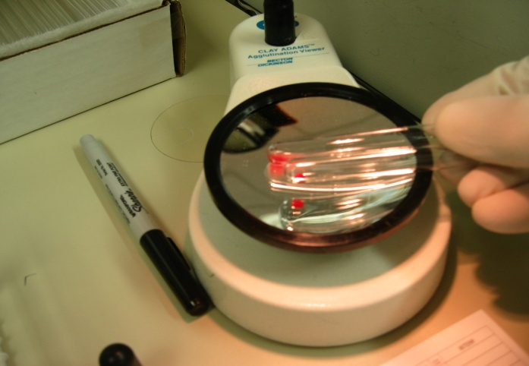
Entry of results in Softbank
ABO testing is completed
ProVue (Gel Testing)
Manual Gel
Tube Method

Slide 30
Entry of results in Softbank
Anti-A Anti-B A1C BC
1. 4+ 0 0 0
2. 2+ 0 1+ 4+
3. 4+ 0 1+ 4+
4. 0 4+mf 4+ 0
5. 4+ 4+ 2+ 2+

Slide 31
Entry of results in Softbank
Anti-A Anti-B A1C BC
4+ 0 0 0
Resolution
Order ABOR
Test sample using Tube Method, if results the same incubate for 10 minutes, enter comment

Slide 32
Entry of results in Softbank
Anti-A Anti-B A1C BC
2+ 0 1+ 4+
Resolution
Order ABOR, Anti-A1 Lectin
Test Anti-A,B, Auto Control, A1 Cells, A2 Cells

Slide 33
Entry of results in Softbank

Slide 34
Entry of results in Softbank
Anti-A Anti-B A1C BC
4+ 0 1+ 4+
Resolution
Order ABOR
Test sample using Tube Method
Rouleaux, perform Saline replacement

Slide 35
Entry of results in Softbank
Resolution
? Cold autoantibody, order & perform Minicold
Specific cold antibody, Anti-M
Test Reverse Group with Anti-M antisera

Slide 36
Entry of results in Softbank
Anti-A Anti-B A1C BC
0 4+mf 4+ 0
Resolution
Transfusion History
Modify ProVue result
Enter mf/dp comment

Slide 37
Entry of results in Softbank
Anti-A Anti-B A1C BC
4+ 4+ 2+ 2+
Resolution
Patient History and ABO of HPC donor
ABO Interpretation
Transfuse appropriately

Slide 38
Objectives
To explain the ABO System
To solve an ABO Discrepancy
Entry of results in Softbank

Slide 39
Questions and Answers

