Slide 1
Fairview Laboratories: Specimen Tracking and Transport
Reporting Lost and/or Mishandled Specimen(s)

Slide 2
Objectives
Following this presentation, you will be able to:
Understand the difference between a lost specimen and a specimen lost to testing.
Report and document a lost or mishandled (lost-to-testing) specimen in Sunquest and ICare prior to the end of your shift.

Slide 3
Purpose
A standard reporting procedure will be utilized at all Fairview sites. Sunquest and ICARE will be used to report and document these events.

Slide 4
Why we are standardizing?
To track and prevent “lost” or “lost to testing” specimens internally and externally
Ensure patient safety across Fairview Labs
Ensure standard reporting, investigation and follow up at all Fairview Labs
Comply with Fairview Risk Management mandate to report using ICare
Brand reputation

Slide 5
Procedure
Please read the procedure that outlines the changes and requirements that are highlighted in this module.
Lost Specimen or Lost to Testing Reporting Policy and Procedure

Slide 6
Definition of “Lost”
Any specimen that is missing or that has been mishandled so that testing cannot be completed, regardless of impact to diagnosis.

Slide 7
Reporting and Documenting: ICARE
Lost and mishandled specimens must be documented as “lost-to-testing” even if testing can be performed on a different specimen.
  Examples for when to complete an ICare include:
    Added to different tube from same collection
    Added to earlier collection time
    Different tissue block utilized
    Specimen is too old for testing
    Stored/transported at incorrect temperature
    Missing tube

Slide 8
Who Reports & Documents the Lost Specimen?
Standardized documentation procedure must be completed by the last known lab location to have handled the specimen.
Example:
  Lab “A” sends a specimen to lab “B”. Lab “B” never receives the specimen. Lab “A” must complete the ICare. The sending lab is responsible for the specimen until it is received by the testing location.

Slide 9
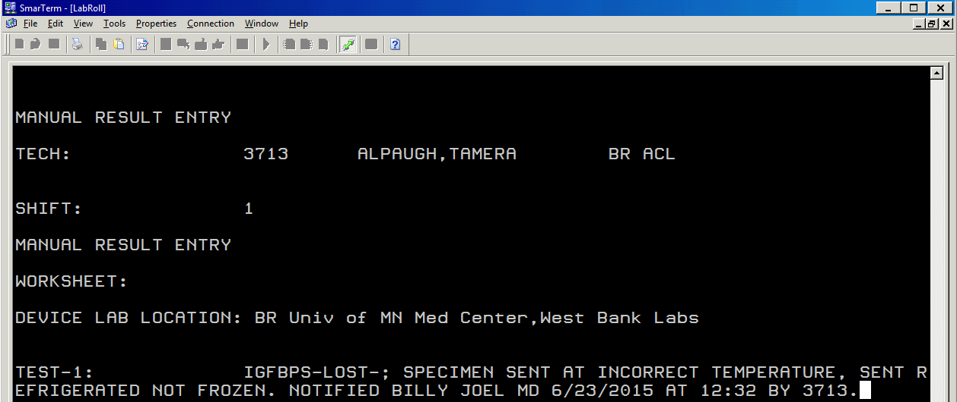
Documentation in Sunquest
Cancel the test using the “Two step cancel” step of the current procedure and use the “LOST” ETC code along with documentation of notification to the provider. Click here to view procedure: Epic/Sunquest Cancel/Credit procedure.
SmarTerm cancellation example:

Slide 10
Documentation in Sunquest
MRE (Microbiology Result Entry) cancellation example (i.e. URC):
MRE cancel/credit work aid

Slide 11
Definition of “LOST” Code
“LOST” ETC code=Specimen Lost or Mishandled and testing unable to be completed
The "LOST” ETC code must be used in Sunquest to track the number and location of lost or mishandled specimens in quality reports for ongoing performance improvement efforts.
Note: other ETC codes may be used in addition to “LOST”

Slide 12
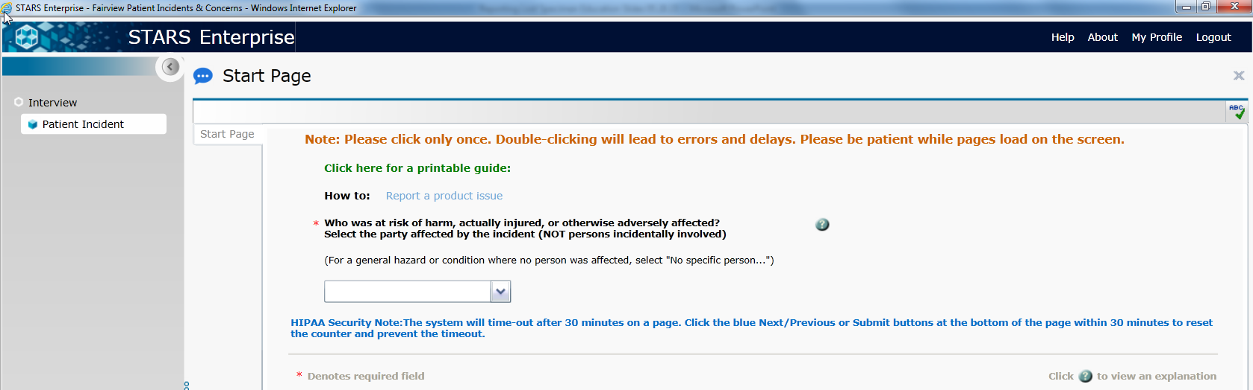
Reporting in ICare
Staff will use standardized responses when completing the ICARE report and also the specific event details. A System Laboratory Policy will define these responses.
Lost Specimen or Lost to Testing Events Reporting Policy

Slide 13
Summary
All lost or mishandled specimens need to be reported…no exception.
Two steps to complete documentation:
  Cancel/credit using “LOST” ETC code in Sunquest using two-step cancel/credit method
  Complete ICARE report following standard reporting format before the end of your shift.

Slide 14
Who to contact with questions
The following individuals are site representatives:
Cytology: Jana Holler
FMG Clinics: Lisa Karnik & Michelle Stevens-Brioschi
Lakes: Helen Brenny
Northland: Tonya Kindseth
Outreach: Joy Case
Pathology: Brooke Eguia
Ridges: Kari Amacher
Southdale: Mila Montemurro-Healy
Specimen Management: Karri Cargill & Sherry Davis
UMMC East Bank: Brad Lemke
UMMC West Bank: Vicki Zebroski

