Slide 1
Fairview Laboratories:
Specimen Tracking and Transport

Slide 2
Objectives
Following this presentation, you will be able to:
Describe the sending and receiving standard workflow for laboratory specimens.
Prepare specimens for transport according to the “Packaging and Labeling Specimens for Shipping and Transport” procedure.
Demonstrate an understanding of standard packaging and labeling of laboratory specimens.
Define Lost/Mishandled Specimen(s)
Report/Document Lost/Mishandled Specimen(s)

Slide 3
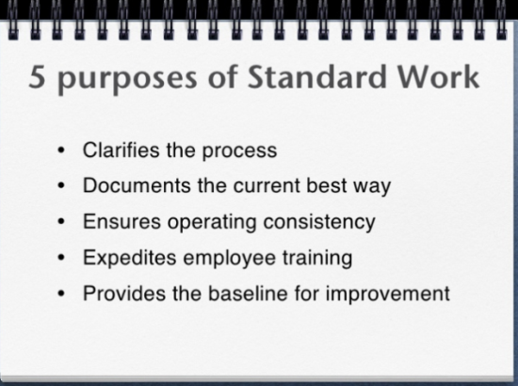
Purpose of Standardizing Tracking and Processing:
To implement a standard workflow for packaging, labeling, shipping for tracking and processing of all specimens transported on behalf of Fairview Laboratories.
To implement standard audit to verify compliance with standard work and comply with Fairview Risk Management.
Patient Care and Brand Reputation

Slide 4
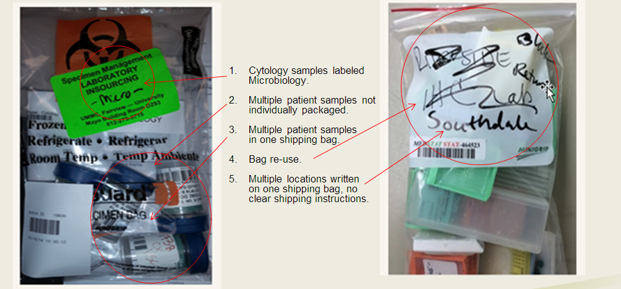
Previous State Prior to Standardization:
Resulted in increased errors, confusion, lost specimens, delays in care.

Slide 5
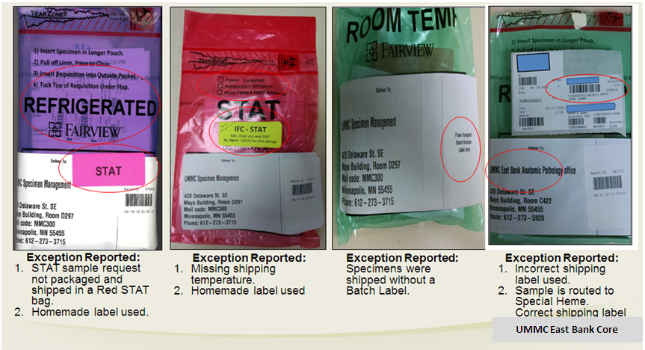
What is wrong with these pictures?
Remember:
Do NOT handwrite on label anywhere….

Slide 6
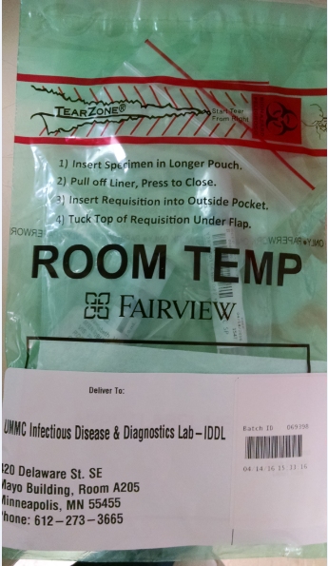
Current State:
Standard packaging, labeling, and shipping
4. IDDL specimens are individually bagged and placed into one Fairview custom shipping bag for transport.
1. Correct temperature specific Fairview custom bag is used for room temperature shipping.
2. Correct shipping label was printed and shipping label was properly placed on the shipping bag.
3. Specimens are on a batch and batch label is properly placed on the shipping label.

Slide 7
Why Is This Important?
Lost and Lost to Testing/Mishandled specimens affect:
Quality of patient care which could lead to additional procedures or testing for the patient.
Laboratory expense(s) for investigation/re-work, etc.
Reportable events to CMS (Center for Medicare and Medicaid Services). CMS mandates that lost specimens considered irretrievable or irreplaceable are to be reported.

Slide 8
Definition of LOST and LTEST:
Cancel, Credit, and Reporting in I-CARE
DEL-LOST = Specimen is Lost
    Specimen cannot be located and testing cannot be completed. An I-Care needs to be completed (If possible, a new specimen will need to be collected)
DEL-LTEST = Specimen was Mishandled
    Testing can be performed if another draw/specimen is available (regardless of impact to the diagnosis, an I-CARE must be completed). Test must be credited and reordered on a new accession number to ensure proper documentation.

Slide 9
Procedure
Please read the procedure that outlines the changes and requirements that are highlighted in this module.
Specimen Packaging and Labeling for Shipping & Transport
Workaid: Pathology Specimen Tracking
Canceling Crediting Correcting Orders and Results in Sunquest

Slide 10
Two Step Cancel Process must be used!
Lost and Lost-to-Testing: MUST USE Two Step Cancel Credit Process and not the quick One Step Cancel Credit Process!!
Why is this so important?
If a One step is used, it will NOT pull to the quality report logs for the system.
Physician will be unable to see the result and documentation in Epic in the provider view preference.
These are reportable events to CMS and must be investigated by Lab Administration.
Please refer to the Two-Step cancel credit policy here: Cancel Credit Procedure.

Slide 11
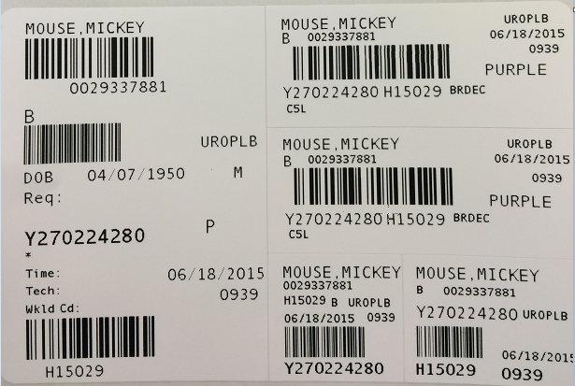
Sunquest Label Refresher
Accession number (Starts with letter for day of the week)
Hospital ID (HID)
Sunquest test code
Sunquest test spot (ex. BRDEC needs a decant step to create a child label which will route the test code to the final testing spot)
Container ID (CID- unique number that starts with Y and is followed by a 9 digit number)
Patient Order location code (Found on the big label, and each of the CID and small labels)

Slide 12
Lab Guide Refresher
Lab Guide is on the Fairview Intranet
Intranet location: Laboratory Services→ Find a Test
Each test should be looked up in Lab Guide to determine:
  Collection, Processing, & shipping instructions
  Testing location

Slide 13
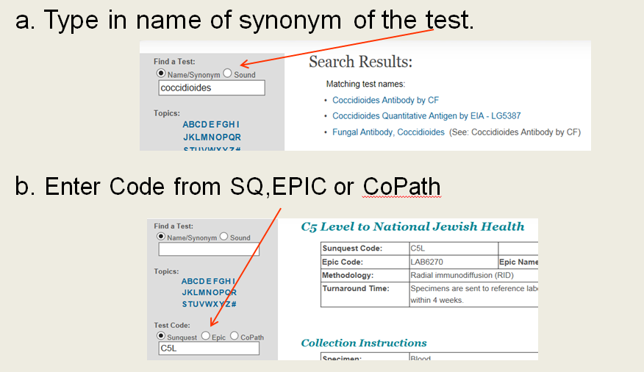
Lab Guide Refresher example:
Find test in lab guide: Two options

Slide 14
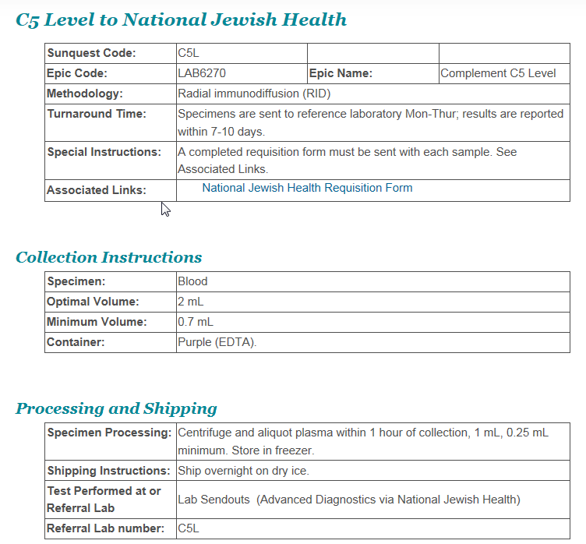
Lab Guide Refresher example:
Review collection and processing instructions
3. Determine where specimen needs to be sent for testing

Slide 15
Sending Laboratory Responsibilities
Refer to the Fairview Lab Guide to review test requirements and processing instructions.
Mandatory:
All clinical laboratory specimens must be ready for testing prior to packaging and transport/shipment according to Lab Guide instructions (Decant, ROB, and XMISC completed according to procedure).
Note: If test is not in Lab Guide, follow the reference laboratory’s processing and shipping instructions found on Reference Lab’s website (ex. Mayo, ARUP, Medtox, etc.).

Slide 16
Specimen CID Labeling
All clinical laboratory specimens must be labeled with a Sunquest CID label prior to batching
Do not label any samples, aliquot tubes and/or QTB tubes with a CID peon label. (small CID label)
The CID peon label can be used for microtainers, pathology and/or cytology vials only.
Note: Do not cover any pertinent patient and/or sample information with the CID or CID peon label.

Slide 17
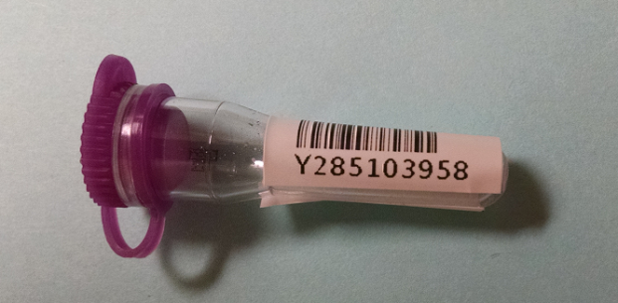
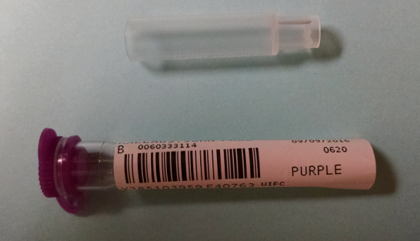
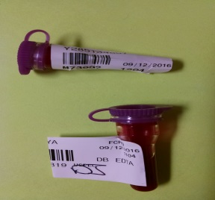
Proper Labeling of Microtainers:
UMMC Lead Levels
The Specialty Core Lab at UMMC performs capillary lead testing. Venous Lead testing goes to ARUP. Microtainers must be labeled as follows for consistent scanning of CID labels. NOTE: When ordering Lead, please use only specimen types "C" for capillary blood or "V" for venous blood.
Acceptable labeling:
Unacceptable labeling:
Microtainers with the accession peons or labels that wrap around the container do not allow for scanning into batches for transport or receipt into the testing lab.

Slide 18
Tracking in Sunquest: Obtain a CID Label
Generate Sunquest CID label for each specimen by one of the following ways:
  Release the order in Epic and receive it in Sunquest.
  Order the correct Sunquest test code(s) and/or routing code(s) per Epic/Paper Order on the appropriate CSN/Account.
  Receive the appropriate test code(s) and/or routing code(s) in Sunquest.

Slide 19
Tracking in Sunquest: Generate a Batch
Generate a batch in Sunquest by scanning individual specimen CID barcode(s) and obtain a batch label. Click here to view procedure: Processing a transport Batch
  Miscellaneous test (XMISC) order steps must be completed in Sunquest. Click here to view procedure: Miscellaneous (LAB4909) Order Workaid.
  ROB (Reference Outbound Batch) if necessary. Click here to view procedure: Reference Outbound Batches (ROB) .

Slide 20
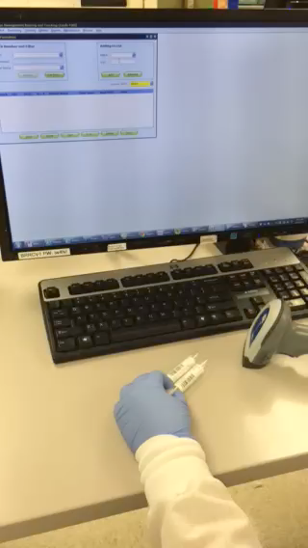
Tracking in Sunquest: Generate a Batch
Hover mouse on picture and click play button ( )below video to play
  Generate a batch in Sunquest by scanning individual specimen CID barcode(s) and obtain a batch label. Click here to view procedure: Processing a Transport Batch.

Slide 21
Where to Send Specimens
Place specimen(s) in a Fairview custom color-coded (temperature specific) shipping biohazard bag. Regular, generic biohazard (UMMC only) or clear bags will be used for internal shipping (within a facility) only.
Specimens must be batched to UMMC East Bank Core Lab, IDDL, or Cytology/Pathology (unless sending lab has a direct courier route or an on-demand/stat courier is requested).
For all laboratories that have a direct courier route to another Fairview laboratory, all specimen(s) must be put on a Sunquest transport batch.

Slide 22
Sending Laboratory Responsibilities
Pull a transport batch filter at least once per shift. This is our “safety net” to catch specimens that have been unaccounted for.
  Review any unaccounted for specimens on filter and investigate.
  Do not save this filter because it will create a batch of specimens not ready/available for transport. Click here to view procedure: Processing a Transport Batch.

Slide 23
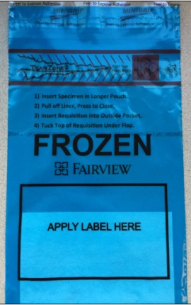
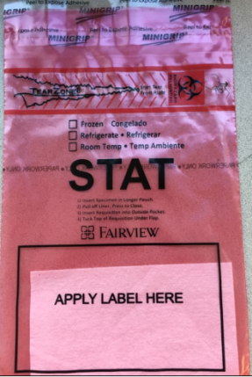
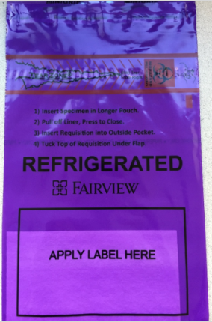
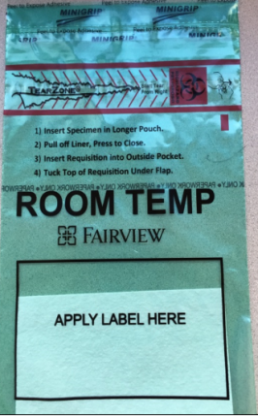
Fairview Custom Specimen Packaging
Fairview custom specimen bags are used at all laboratory sites to package specimen(s) being sent to an external Fairview location.
Fairview custom specimen bags are available in 2 sizes (6x9” and 12x15”).
    Blue=Frozen
    Red=STAT
    Purple=Refrigerated
    Green=Room Temp
Note: Indicate specific shipping temperature on any Red STAT specimen bag with a sharpie.

Slide 24
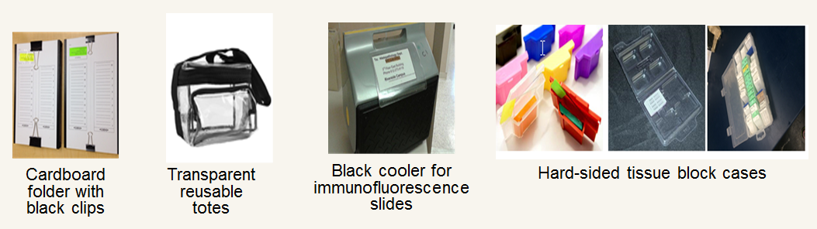
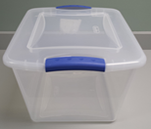
Specimen Packaging
Anatomic Pathology Laboratories will use the following resources to send specimens between their sites:
Clear plastic tote

Slide 25
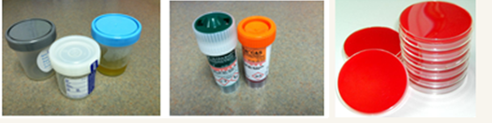
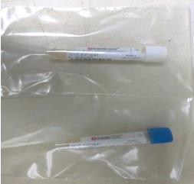
Packaging Specimens: Guidelines
Include any necessary paperwork in the external document pocket.
Tightly seal any sterile screw-top (i.e. urine, body fluids, stool) containers.
Package sterile screw-top containers, urine, GCPCR/CHPCR, eSwab and culture plates separate from all other specimen types.
  Note: All clinical specimen types can be packaged together at appropriate temperature with the exception of sterile screw-top containers, urine, GCPCR/CHPCR, eSwab and culture plates (images above).

Slide 26
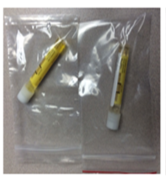
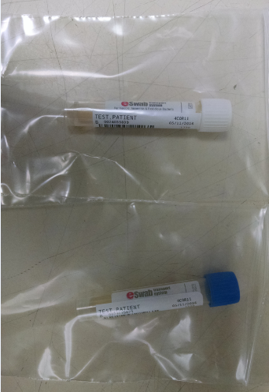
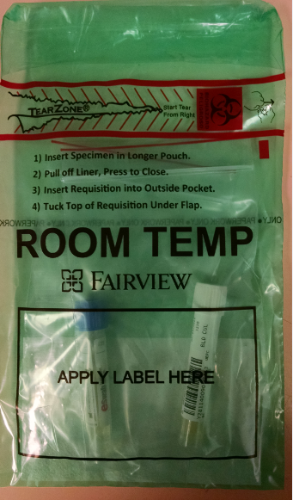
Packaging Specimens: GCPCR/CHPCR & eSwab
Package all GCPCR, CHPCR & eSwab containers individually (urine or swab Genprobe) into single small zip lock plastic bags. Example 1.
Individual zip lock bag(s) containing GCPCR, CHPCR & eSwab will be batched and placed in one biohazard bag and sent to IDDL. Example 2.
1
1
2

Slide 27
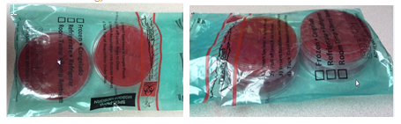
Packaging Specimens: Culture Plates
IDDL culture plates can be stacked 2 plates high with no more than 4 plates total per bio-hazard bag.
Note: Do not use tape of any kind to secure culture plates.

Slide 28
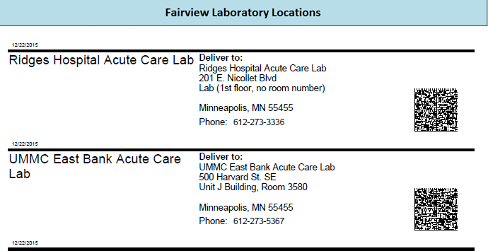
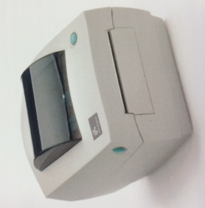
Standard Specimen Bag Labeling
Obtain an on-demand shipping label by scanning the appropriate barcode for the receiving laboratory from the standard spreadsheet.
All bags must be labeled with standard shipping label.
A master barcode shipping label list can be found on the Fairview Intranet:
Intranet.fairview.org/Clinical/Services/Lab/Procedures for Lab Staff/System Policies and Procedures/Packaging and Shipping by Courier/Barcode List for Shipping Address Labels.
Link to Address Barcode Sheets: https://fls.labqms.com/sthDMSTOC.asp?TD=246&DC=T&LD=996&ID=1098

Slide 29
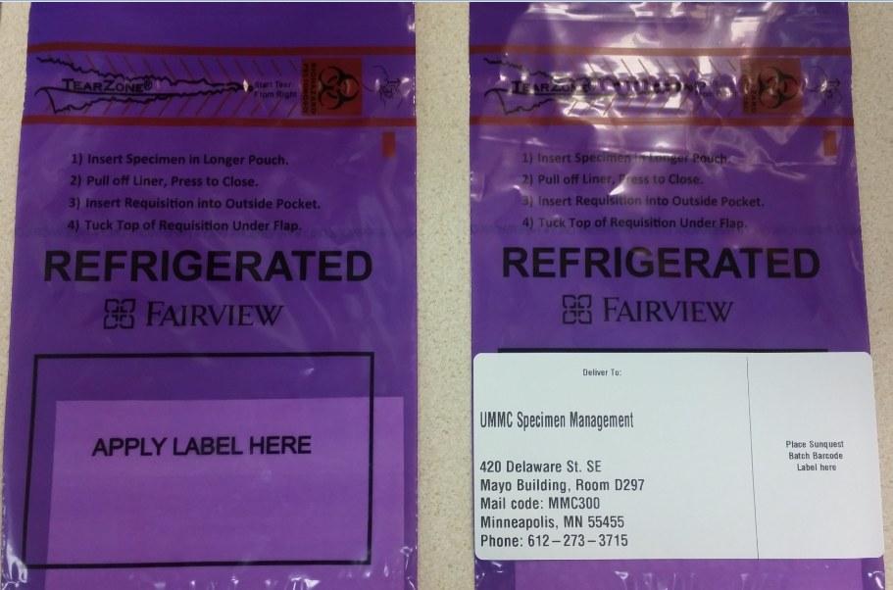
Labeling specimens Bag(s) for Transport
Place the transport shipping label onto the designated area on the bottom portion of the specimen bag over the black-outlined box that states “Apply Label Here”.

Slide 30
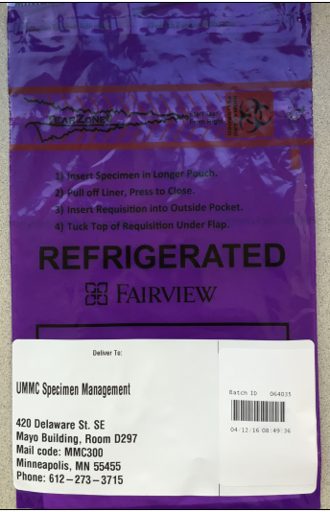
Labeling Specimens Bag(s) for Transport
Place the Sunquest batch label on top of the print-on-demand shipping destination label on the right.
Note: Placing the batch label on top of the on-demand shipping label will prevent batch labels from falling off at various temperature ranges.
Insert batch label here

Slide 31
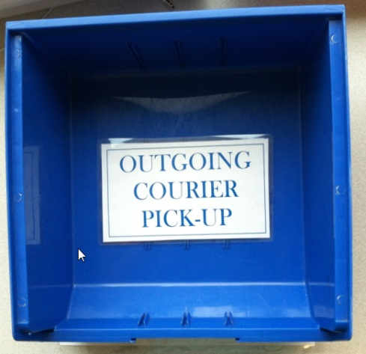
Outgoing Specimen(s): Courier Pick-up
All outgoing specimens ready for testing and courier pick-up must be placed in the appropriate BLUE outgoing courier pick-up bin. The courier bins will have a location barcode for scanning.
Note: There will be a BLUE outgoing courier pick-up bin available for all shipping temperatures.

Slide 32

Incoming Specimen(s): Courier Drop-off
All incoming specimens will be dropped off in the designated RED courier drop-off bin. The courier bins will have a location barcode for scanning.

Slide 33
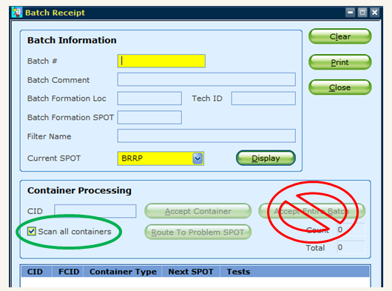
Receiving Laboratory Responsibilities
Disband all batched specimens using Sunquest SMART by scanning the CID label on each specimen individually
  Never accept the entire batch
Note: Verify the “Current spot” is correct for your receiving location.

Slide 34

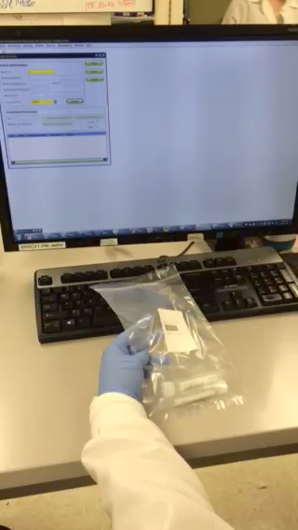
Tracking in Sunquest: Disbanding a Batch
  Disband a batch in Sunquest by scanning individual specimen CID barcode(s). Click to view procedure: Processing a Transport Batch.

Slide 35
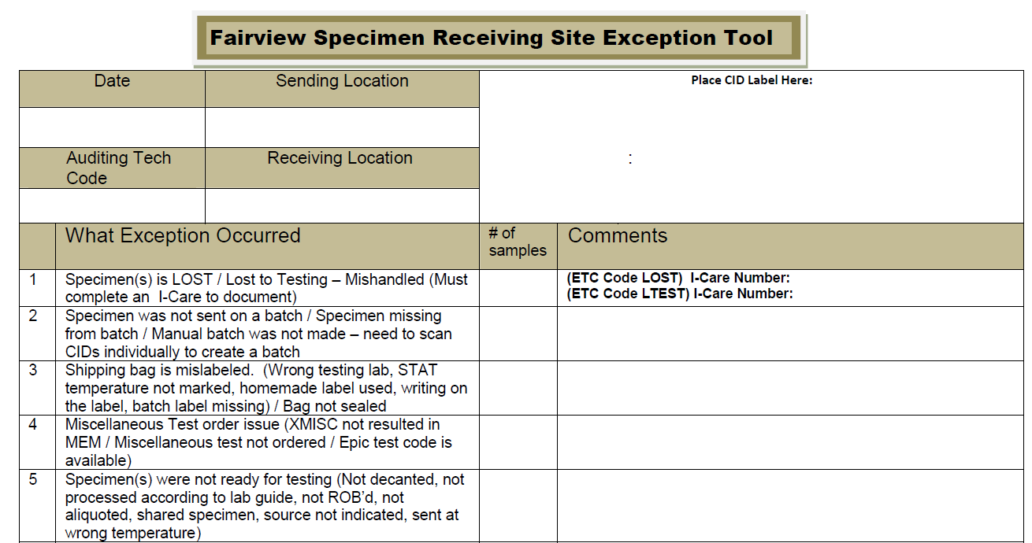
Receiving Lab Responsibilities
Any CID(s) left on the batch must be investigated immediately.
Utilize the Exception Tool to document and report any issues pertaining to samples and/or batches. Fairview Specimen Receiving Site Exception Tool.
Reporting examples:
    Report issues to sending labs about specimen issue or transport batch issues.
    Report issues w/ couriers (ex., thawed in route, in a room temp bag, but arrived frozen, etc.)

Slide 36
Receiving Location Responsibilities
If specimen is at final testing location, proceed with testing.
If specimen is not at final testing location:
  Disband batch by scanning CID label(s) individually
  Batch specimen(s) by scanning CID label(s) individually
  Package and label for transport or shipment

Slide 37
Compliance and Education
Audits are performed by each site and documented in an on-going database.
All receiving locations will complete the “Exception Tool” as part of their daily work flow when issues are identified.
Exception(s) results are shared with the System Transportation & Courier committee and with the Laboratory Leadership team.
Link: Fairview Specimen Receiving Site Exception Tool.

Slide 38
Summary
All specimen(s) must have a Sunquest CID label and be ready for testing prior to transport/shipment.
All specimens must be tracked in Sunquest by scanning each individual CID label to create and disband batches.
Specimen(s) must be packaged according the system procedure Specimen Packaging and Labeling for Shipping & Transport .
Custom Specimen Bags must be labeled with the standard address label format.
Lost or Lost to Testing/Mishandled specimens must be documented according to the System Canceling Crediting Correcting Orders and Results in Sunquest procedure.
Note: Homemade labels are unacceptable and will result in a reported exception.

Slide 39
Who to contact with questions?
Site Team Members:
Amacher, Kari (FRH) |  | Hill, Colleen (Range) |  | Smith, Natalie (IDDL)
Amirouche, Sammy (AP Office) |  | Holler, Jana (Cytology) |  | Stevens-Brioschi, Michelle (Admin Clinics)
Awker, Marya (UMMC East Bank) |  | Jones, Brian (Pathology, System) |  | Sumstad, Darin (ad hoc) (UMMC)
Bashir, Deka (UMMC East Bank Core) |  | Karnik, Lisa (Clinics) |  | Thompson, Ann (Range Clinic)
Becker, Sarah (UMMC West Bank) |  | Kindseth, Tonya (ad Hoc, Northland, Lakes) |  | Wherland, Stacy (Range)
Case, Joy (Client Services) |  | Kohler, Kacie (Pathology Labs) |  | Zebroski, Vicki (UMMC West Bank ACL)
Davis, Sherry (CSC) |  | Krone, Cassie (Northland)
Forys, Jina (UMMC East Bank Core) |  | Montemurro-Healy, Mila (FSH)
Garin, Kay (IDDL) |  | Morocho, Jennifer (Pathology Labs)

Slide 40
Thank you!

