Slide 1
Fairview Laboratories: Specimen Tracking and Transport
INSTRUCTIONS for PowerPoint:
To view all links, go to “Slideshow” at top of this page and select “From Beginning.”

Slide 2
Objectives
Following this presentation, you will be able to:
Describe the sending and receiving standard workflow for laboratory specimens.
Prepare specimens for transport according to the “Packaging and Labeling Specimens for Shipping and Transport” procedure.
Demonstrate an understanding of standard packaging and labeling of laboratory specimens.
Define Lost/Mishandled Specimen(s)
Report/Document Lost/Mishandled Specimen(s)

Slide 3
Purpose of Standardizing Tracking and Processing:
To implement a standard workflow for packaging, labeling, shipping for tracking and processing of all specimens transported on behalf of Fairview Laboratories.
To implement standard audit to verify compliance with standard work and comply with Fairview Risk Management.
Patient Care and Brand Reputation

Slide 4
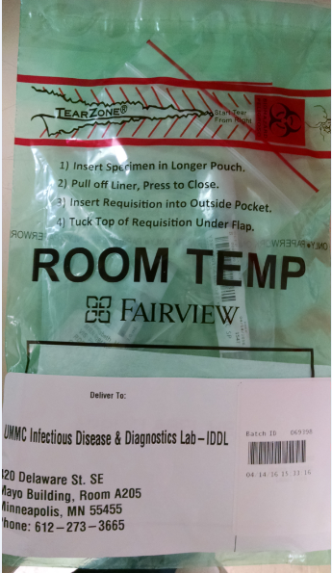
Current State:
Standard packaging, labeling, and shipping
4. IDDL specimens are individually bagged and placed into one Fairview custom shipping bag for transport.
1. Correct temperature specific Fairview custom bag is used for room temperature shipping.
2. Correct shipping label was printed and shipping label was properly placed on the shipping bag.
3. Specimens are on a batch and Sunquest batch label (or other approved barcode) is properly placed on the shipping label.

Slide 5
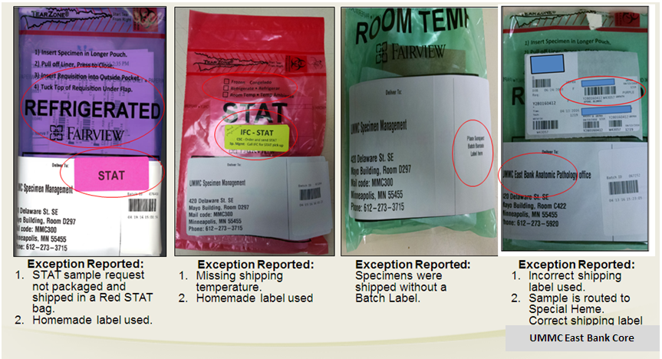
What is wrong with these pictures?
Remember:
Do NOT handwrite on label anywhere….

Slide 6
Why Is This Important?
Lost and Lost to Testing/Mishandled specimens:
In the event of a missing specimen, use the “Missing Specimen Investigation” form. Link: Missing Specimen Form
Quality of patient care can be effected which could lead to additional procedures or testing for the patient.
Reportable (lost specimen) events are reported to CMS (Center for Medicare and Medicaid Services). CMS mandates that that lost specimens are considered irretrievable or irreplaceable to be reported.

Slide 7
Definition of LOST and LTEST: Cancel, Credit, and Reporting in I-CARE
DEL-LOST = Specimen is Lost
Specimen cannot be located and testing cannot be completed. An I-Care needs to be completed (If possible, a new specimen will need to be collected)
DEL-LTEST = Specimen was Mishandled
Testing can be performed if another draw/specimen is available (regardless of impact to the diagnosis, an I-CARE must be completed). Test must be credited and reordered on a new accession number to ensure proper documentation.

Slide 8
Procedure
Please read the procedure that outlines the changes and requirements that are highlighted in this module.
Specimen Packaging and Labeling for Shipping & Transport
Workaid: Pathology Specimen Tracking
Canceling and Crediting Orders and Results

Slide 9
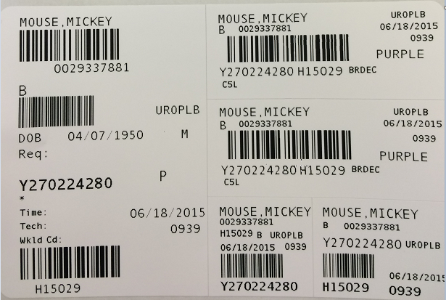
Sunquest Label Refresher
Accession number (Starts with letter for day of the week)
Hospital ID (HID)
Sunquest test code
Sunquest test spot (ex. BRDEC needs a decant step to create a child label which will route the test code to the final testing spot)
Container ID (CID- unique number that starts with Y and is followed by a 9 digit number)
Patient Order location code (Found on the big label, and each of the CID and small labels)

Slide 10
Lab Guide Refresher
Lab Guide is on the Fairview Intranet
Intranet location: Laboratory Services→ Find a Test
Each test should be looked up in Lab Guide to determine:
Collection, Processing, & shipping instructions
Testing location

Slide 11
Lab Guide Refresher example:
Find test in lab guide: Two options

Slide 12
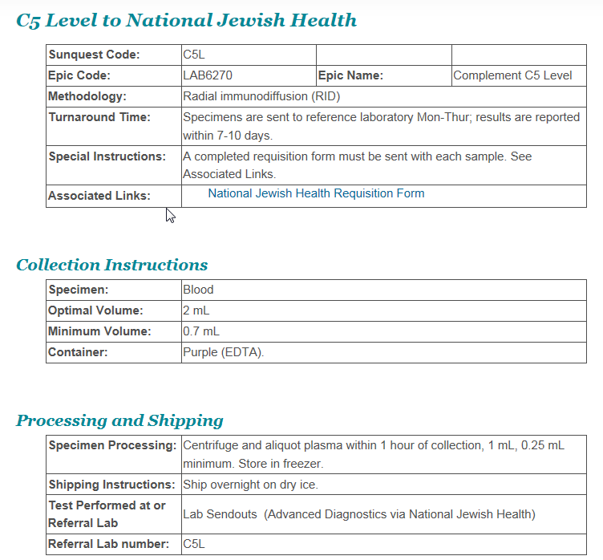
Lab Guide Refresher example:
Review collection and processing instructions
3. Determine where specimen needs to be sent for testing

Slide 13
Sending Laboratory Responsibilities
Refer to the Fairview Lab Guide to review test requirements and processing instructions.
Mandatory:
All clinical laboratory specimens must be ready for testing prior to packaging and transport/shipment according to Lab Guide instructions (Decant, ROB, and XMISC completed according to procedure).
Note: If test is not in Lab Guide, follow the reference laboratory’s processing and shipping instructions found on Reference Lab’s website (ex. Mayo, ARUP, Medtox, etc.).

Slide 14
Specimen CID Labeling
All clinical laboratory specimens must be labeled with a Sunquest CID label prior to batching
Do not label any samples, aliquot tubes and/or QTB tubes with a CID peon label. (small CID label)
The CID peon label can be used for microtainers, pathology and/or cytology vials only.
Note: Do not cover any pertinent patient and/or sample information with the CID or CID peon label.

Slide 15
Tracking in Sunquest: Obtain a CID Label
Generate Sunquest CID label for each specimen by one of the following ways:
Release the order in Epic and receive it in Sunquest.
Order the correct Sunquest test code(s) and/or routing code(s) per Epic/Paper Order on the appropriate CSN/Account.
Receive the appropriate test code(s) and/or routing code(s) in Sunquest.

Slide 16
Tracking in Sunquest: Generate a Batch
Generate a batch in Sunquest by scanning individual specimen CID barcode(s) and obtain a batch label. Click here to view procedure: Processing a transport Batch
Miscellaneous test (XMISC) order steps must be completed in Sunquest. Click here to view procedure: Miscellaneous (LAB4909) Order Workaid.
ROB (Reference Outbound Batch) if necessary. Click here to view procedure: Reference Outbound Batches (ROB) .

Slide 17
Tracking in Sunquest: Generate a Batch
Hover mouse on picture and click play button ( )below video to play
Generate a batch in Sunquest by scanning individual specimen CID barcode(s) and obtain a batch label. Click here to view procedure: Processing a Transport Batch.

Slide 18
Where to Send Specimens
Place specimen(s) in a Fairview custom color-coded (temperature specific) shipping biohazard bag or other approved clear biohazard bag.
Specimens must be batched to UMMC East Bank Core Lab, IDDL or Pathology (unless sending lab has a direct courier route or an on-demand/stat courier is requested).
For all laboratories that have a direct courier route to another Fairview laboratory, all specimen(s) must be put on a Sunquest transport batch.

Slide 19
Sending Laboratory Responsibilities
Pull a transport batch filter at least once per shift. This is our “safety net” to catch specimens that have been unaccounted for.
Review any unaccounted for specimens on filter and investigate.
Do not save this filter because it will create a batch of specimens not ready/available for transport. Click here to view procedure: Processing a Transport Batch.

Slide 20
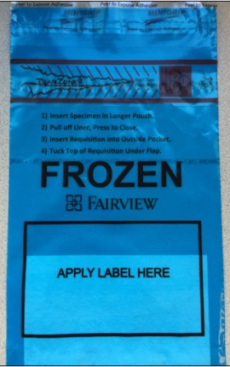
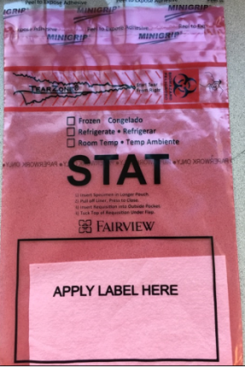
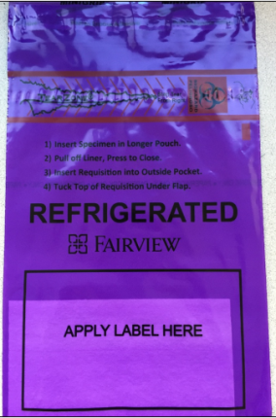
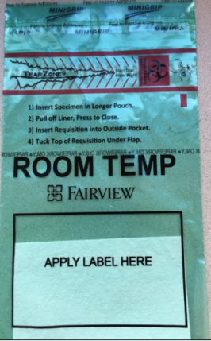
Fairview Custom Specimen Packaging
Fairview custom specimen bags are used at all laboratory sites to package specimen(s) being sent to an external Fairview location.
Fairview custom specimen bags are available in 2 sizes (6x9” and 12x15”).
Blue=Frozen
Red=STAT
Purple=Refrigerated
Green=Room Temp
Note: Indicate specific shipping temperature on any Red STAT specimen bag with a sharpie.

Slide 21
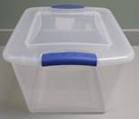
Specimen Packaging
Anatomic Pathology Laboratories will use the following resources to send specimens between their sites:
Clear plastic tote

Slide 22
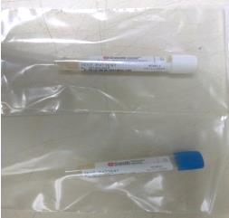
Packaging Specimens: Guidelines
Include any necessary paperwork in the external document pocket.
Tightly seal any sterile screw-top (i.e. urine, body fluids, stool) containers.
Package sterile screw-top containers, urine, GCPCR/CHPCR, eSwab and culture plates separate from all other specimen types.
Note: All clinical specimen types can be packaged together at appropriate temperature with the exception of sterile screw-top containers, urine, GCPCR/CHPCR, eSwab and culture plates (images above).

Slide 23
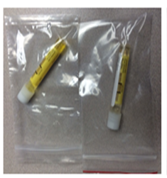
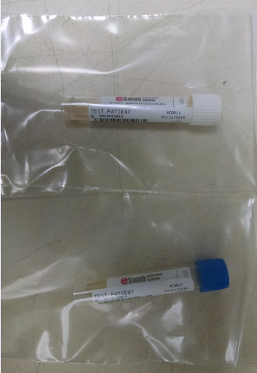
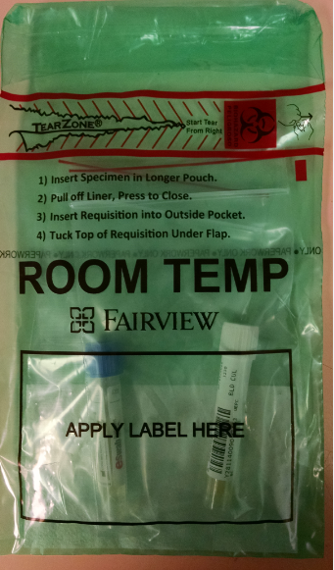
Packaging Specimens: GCPCR/CHPCR & eSwab
Package all GCPCR, CHPCR & eSwab containers individually (urine or swab Genprobe) into single small zip lock plastic bags. Example 1.
Individual zip lock bag(s) containing GCPCR, CHPCR & eSwab will be batched and placed in one biohazard bag and sent to IDDL. Example 2.
1
1
2

Slide 24
Packaging Specimens: Culture Plates
IDDL culture plates can be stacked 2 plates high with no more than 4 plates total per bio-hazard bag.
Note: Do not use tape of any kind to secure culture plates.

Slide 25
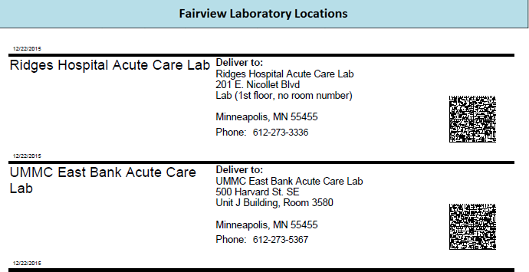
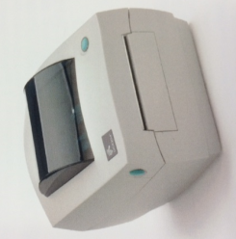
Standard Specimen Bag Labeling
Obtain an on-demand shipping label by scanning the appropriate barcode for the receiving laboratory from the standard spreadsheet.
All bags must be labeled with standard shipping label.
A master barcode shipping label list can be found on the Fairview Intranet:
Intranet.fairview.org/Clinical/Services/Lab/Procedures for Lab Staff/System Policies and Procedures/Packaging and Shipping by Courier/Barcode List for Shipping Address Labels.
Link to Address Barcode Sheets: https://fls.labqms.com/sthDMSTOC.asp?TD=246&DC=T&LD=996&ID=1098

Slide 26
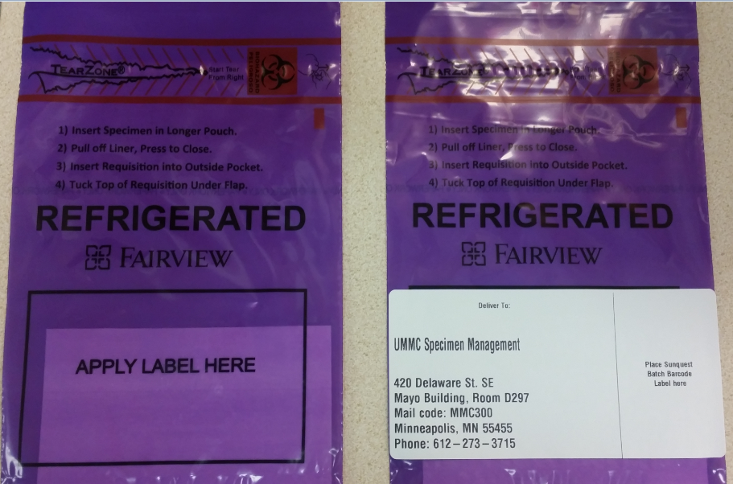
Labeling specimens Bag(s) for Transport
Place the transport shipping label onto the designated area on the bottom portion of the specimen bag over the black-outlined box that states “Apply Label Here”.

Slide 27
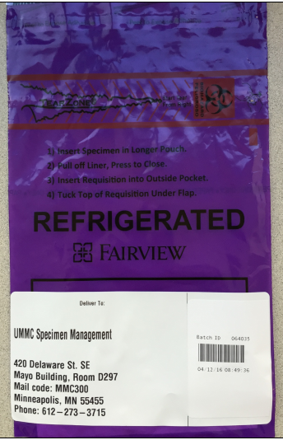
Labeling Specimens Bag(s) for Transport
Place the Sunquest batch label on top of the print-on-demand shipping destination label on the right.
Note: Placing the batch label on top of the on-demand shipping label will prevent batch labels from falling off at various temperature ranges.
Insert Sunquest batch label (or other approved barcode) here

Slide 28
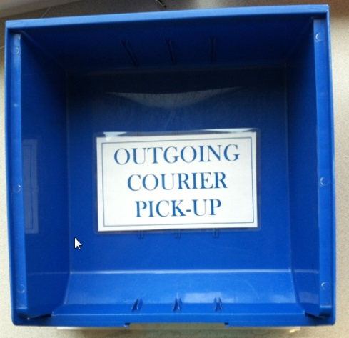
Outgoing Specimen(s): Courier Pick-up
All outgoing specimens ready for testing and courier pick-up must be placed in the appropriate BLUE outgoing courier pick-up bin. The courier bins will have a location barcode for scanning.
Note: There will be a BLUE outgoing courier pick-up bin available for all shipping temperatures.

Slide 29
Incoming Specimen(s): Courier Drop-off
All incoming specimens will be dropped off in the designated RED courier drop-off bin. The courier bins will have a location barcode for scanning.

Slide 30
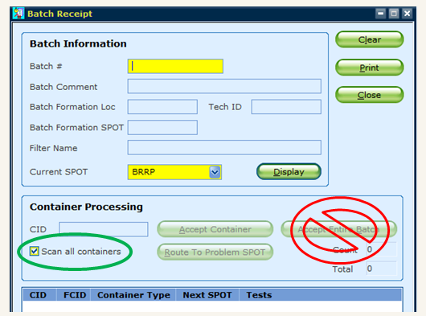
Receiving Laboratory Responsibilities
Disband all batched specimens using Sunquest SMART by scanning the individual CID label on each specimen.
Never accept the entire batch
Note: Verify the “Current spot” is correct for your receiving location.

Slide 31
Tracking in Sunquest: Disbanding a Batch
Disband a batch in Sunquest by scanning individual specimen CID barcode(s). Click to view procedure: Processing a Transport Batch.

Slide 32
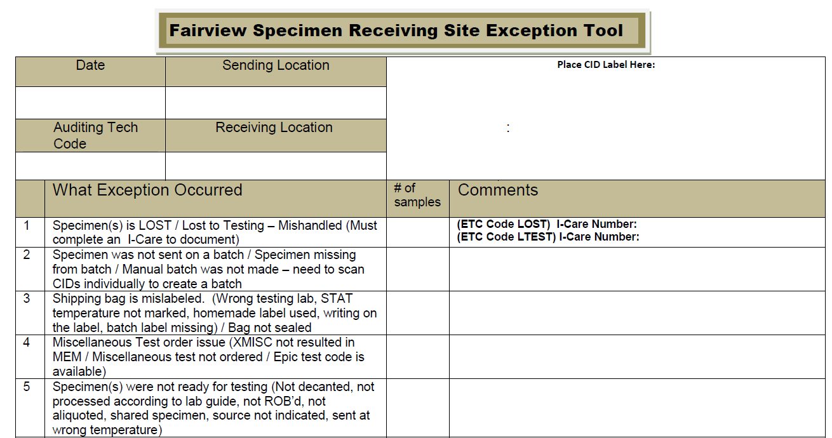
Receiving Lab Responsibilities
Any CID(s) left on the batch must be investigated immediately.
Utilize the Exception Tool to document and report any issues pertaining to samples and/or batches. Fairview Specimen Receiving Site Exception Tool.
Reporting examples:
Report issues to sending labs about specimen issue or transport batch issues.
Report issues w/ couriers (ex., thawed in route, in a room temp bag, but arrived frozen, etc.)

Slide 33
Receiving Location Responsibilities
If specimen is at final testing location, proceed with testing.
If specimen is not at final testing location and needs to be re-batched to new testing location:
Disband batch by scanning each individual CID label(s)
Re-batch specimen(s) by scanning the individual CID label(s)
Package and label for transport or shipment

Slide 34
Compliance and Education
All receiving locations will complete the “Exception Tool” as part of their daily work flow when issues are identified.
Exception(s) results are shared with the System Transportation & Courier committee and with the Laboratory Leadership team.
Link: Fairview Specimen Receiving Site Exception Tool.

Slide 35
Summary
All specimen(s) must have a Sunquest CID label and be ready for testing prior to transport/shipment.
All specimens must be tracked in Sunquest by scanning each individual CID label to create and disband batches.
Specimen(s) must be packaged according the system procedure Specimen Packaging and Labeling for Shipping & Transport .
Specimen Bags must be labeled with the standard address label format.
All deliveries must have a warm hand off between courier and lab staff.
Lost or Lost to Testing/Mishandled specimens must be documented according to the System Canceling and Crediting Orders and Results in Sunquest procedure.

Slide 36
Who to contact with questions?
For questions, please see your site Transportation and Courier Committee representative.

Slide 37
Thank you!

