Slide 1
A Change in Blood Culture Bottles
We are converting our
Blood Culture System to the
BD BACTEC Blood Culture System.
This system uses the BD BACTEC FX Analyzer.
You will notice the different shape of the blood culture collection bottles.
You will be able to use the adapters that you currently use to collect blood in our current tubes.

Slide 2
A Change in Blood Culture Bottles
The Pediatric volume blood culture bottle is Pink and has a draw volume of 1-3 mls
Minimum draw is 0.5 mls.
The pediatric blood culture bottle is a glass bottle.
The adult blood culture bottle set is made up of an aerobic bottle with the Blue band/grey cover for the top and an anaerobic/lytic bottle with a purple band and purple cover for the top.
Each adult bottle has an optimal draw of 8 mls to 10 mls.
The minimum volume for each adult bottle is 3 mls.
The adult blood culture bottles are plastic.

Slide 3
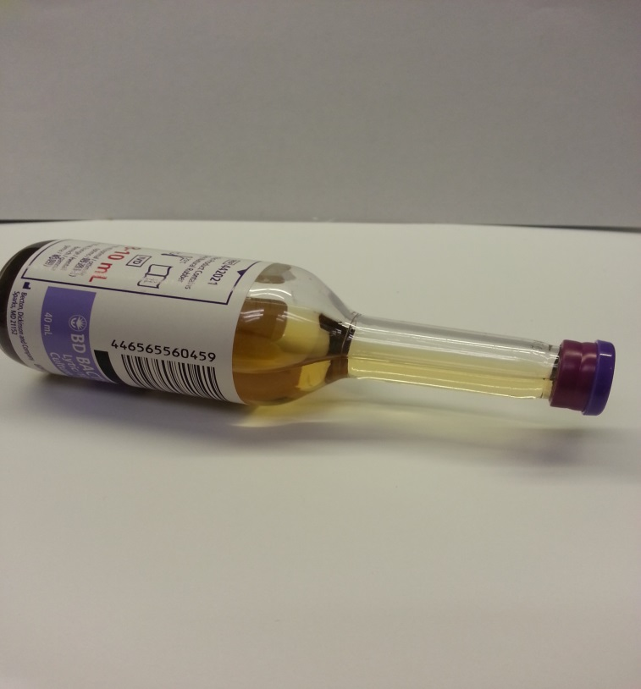
A Change in Blood Culture Bottles
At left are the adult blood culture bottles.
Please note the aerobic blood culture bottle (blue/gray top) has beads in the culture medium.
The anaerobic blood culture bottle (purple) does not have the beads in the culture medium.
The pediatric blood culture bottle (pink, not pictured here) also has beads in the culture medium.
The beads in the adult aerobic bottle and the pediatric bottle will absorb antibiotics that have been given to the patient before the blood cultures are drawn.
The adult anaerobic bottle medium will lyse the blood that is drawn into the bottle as part of the culture process.

Slide 4
Phlebotomy New Blood Culture Bottles
When preparing to do a venipuncture, it is recommended that you mark the level of the liquid culture medium on the bottle. Then mark the end point for the optimum volume to be drawn.
This will allow you to visually access when you have reached the 10 ml mark.
Adults—8-10 mls in each bottle
Pediatric – 1-3 mls. (only one bottle drawn)

Slide 5
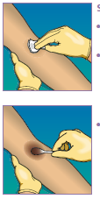
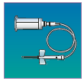
Phlebotomy New Blood Culture Bottles
Arm preparation to draw blood cultures with the new bottles has not changed. Use the same procedure you are already using.
You can use the same tube holder you are now using to draw blood in tubes.
This is nice if you have to draw additional tubes for testing.
As always, draw the blood culture bottles first.
Attach a butterfly needle to the tube holder.
You can draw blood for a culture using a butterfly and syringe, then use a transfer devise to fill the blood culture bottle.

Slide 6
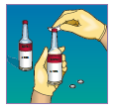
Phlebotomy New Blood Culture Bottles
Flip off the top cover on the blood culture bottle.
NOTE: Wipe the top of each bottle with a alcohol wipe (pictured at right). Do not use other products ( the stopper will start degrading)
Skin preparation is the same process we currently use.
Perform venipuncture according to the CH Blood Culture procedure.
NOTE: When drawing blood into the blood culture bottles, stand the bottles upright (pictured at right).
This is done so that you can see the volume that is being drawn and will help prevent back flow of the culture media.
Pull the bottle out of the holder when you see that 10 mls has been drawn. Immediately put the holder on the second bottle. If not, the bottle will continue to draw blood over the 10 ml mark if allowed. You don’t want to go over 10 mls.
The volume of culture media in the adult bottle is specifically measured to facilitate optimal growth using 8-10 mls of blood.
The same hold true for a pediatric draw. Keep the bottle in a upright position while drawing blood, and you don’t want to go over 3 mls.

Slide 7
Phlebotomy New Blood Culture Bottles
The blood culture bottles have a bar code label affixed by the manufacturer.
When placing the patient order bar code label to not cover the manufacturer’s bar code label
The Analyzer needs to read both bar code labels.
By placing the order bar code label across from the volume markings (pictured at right), the patient information, manufacturer’s bar code, and the bottle’s lot number and expiration date will be visible to the staff in Microbiology.
Once drawn, the blood culture bottles can remain at room temperature for up to 48 hours before needing to get them into the analyzer.
Do not refrigerate.

