Slide 1
Maintenance for the
Medtronic ACT Plus

Slide 2
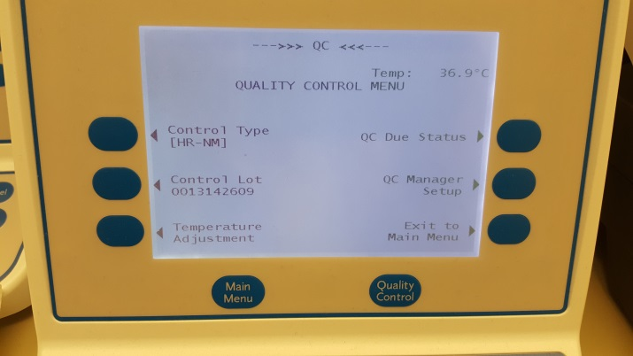
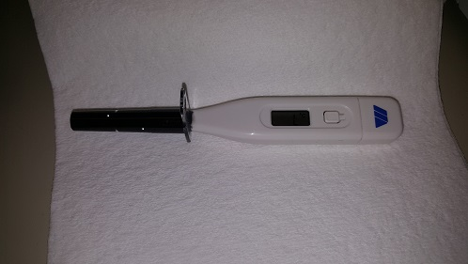
Monthly Temperature Check
The actuator(heat block) that holds the test cartridges in the ACTPlus, must be at 36.5C – 37.5C to perform the ACT test accurately. The ACTPlus will automatically adjust the temperature of the heat block as needed (you may see the temperature change on the menu screen display).
The internal temperature is displayed at the top right on the menu screen.
We use the Medtronic Temperature Verification Cartridge (thermometer) provided by Medtronic to confirm the temperature of the heat block.
The Temperature Verification Cartridge (thermometer) is kept in the black carry case along with the ACTrac used for electronic QC.

Slide 3
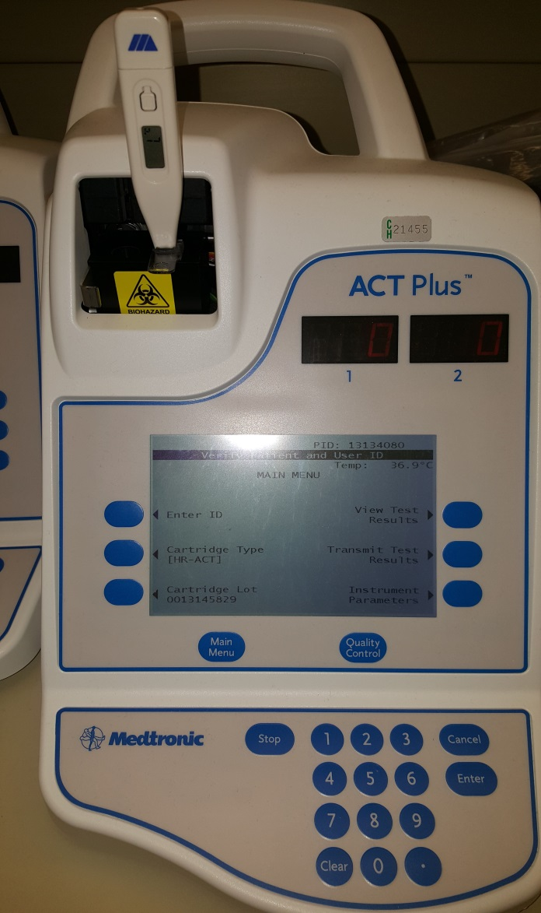
Monthly Temperature Check
The ACTPlus should already be on. If it is off, turn on and allow 15 minutes for it to warm up.
Press the button located on the front of the thermometer. The display will read 188.8 indicating the cartridge is working correctly.
Release the button. The display will show L with MC on the right side. After a few seconds the C will begin to blink.
Insert the thermometer into the heat block of the ACTPlus.
After approximately 10 minutes, the thermometer will reach equilibrium, the C will stop blinking and the beeper will sound.

Slide 4
Monthly Temperature Check
The temperature on the thermometer should be 36.5-37.5C and within 0.5C of the temperature displayed on the Main Menu Screen.
If the two temperatures are acceptable (within range) document the temperature on the QC log for that date and your initials.
If the temperature is out of range, repeat the test, making sure you leave it in the heat block for the full 10 minutes.
If the temperatures between the ACTPlus and the thermometer still do not agree, call Point of Care. Take the ACTPlus out of service. Testing cannot be done until the problem is resolved.

Slide 5
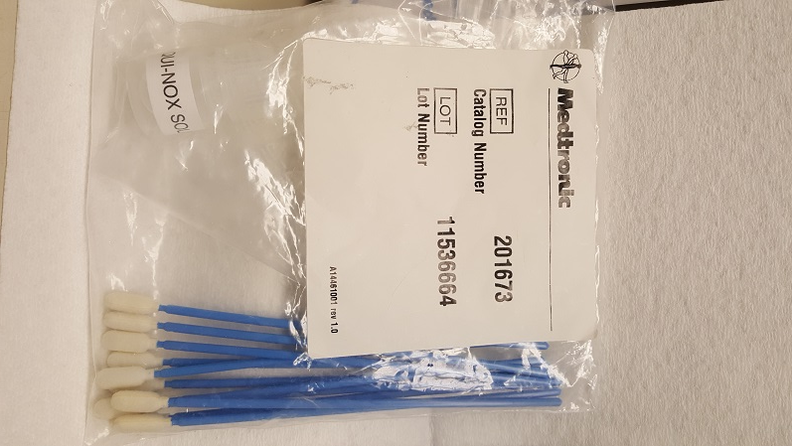
Cleaning the Timer
To ensure proper performance of the ACTPlus, it is important to clean the test Timer area of the ACTPlus.
We use the cleaning kit purchased from Medtronic.
No substitutions.

Slide 6
Cleaning the Timer
Dip the swab provided in the packed into the Liqui-Nox Solution.
When the kit is opened for use, write an expiration date of one year (for both the cleaning solution and the swabs) on the bag containing the materials...
Exp 5-31-2016

Slide 7
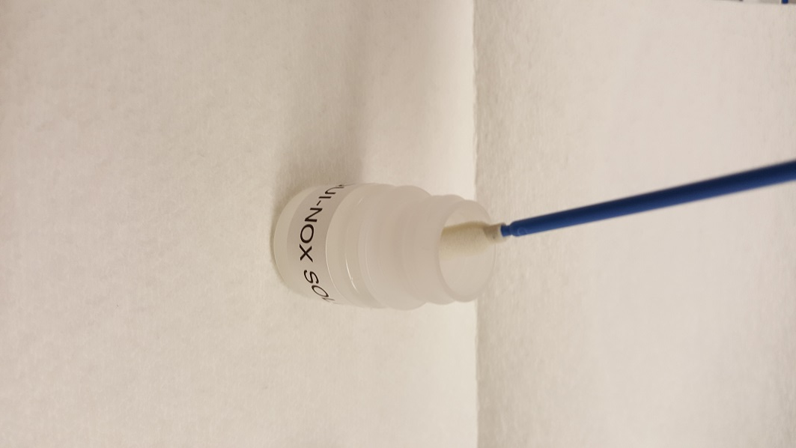
Cleaning the Timer
Dip the swab from the kit into the bottle of Liqui-nox solution.
Run the sponge tip along the rim of the bottle to get excess solution out of the sponge tip of the swab so it does not drip.

Slide 8
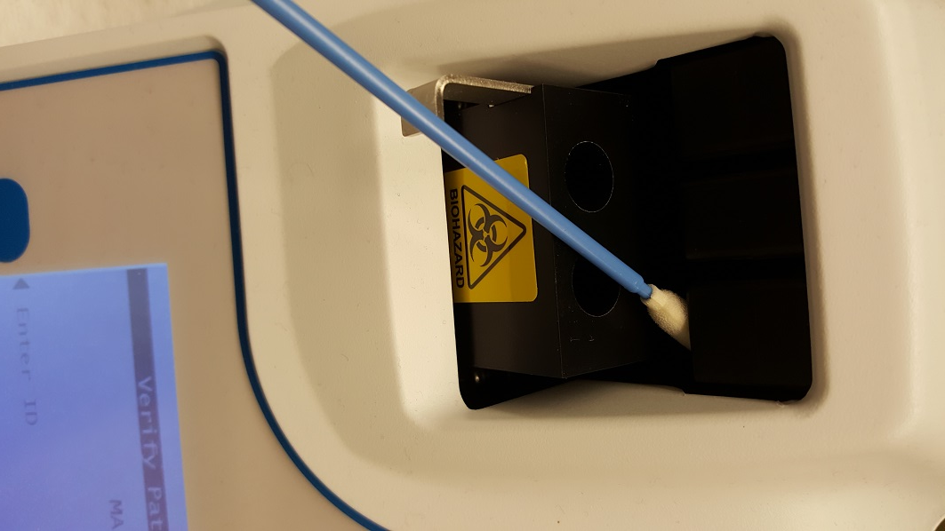
Cleaning the Timer
Swab the flag lift wire removing all blood.
Repeat process with new swab until the swab comes out clean.
If the sponge tip comes off the end of the swab, call Bio Med. They have the tools to open the ACTPlus and remove the sponge tip.

Slide 9
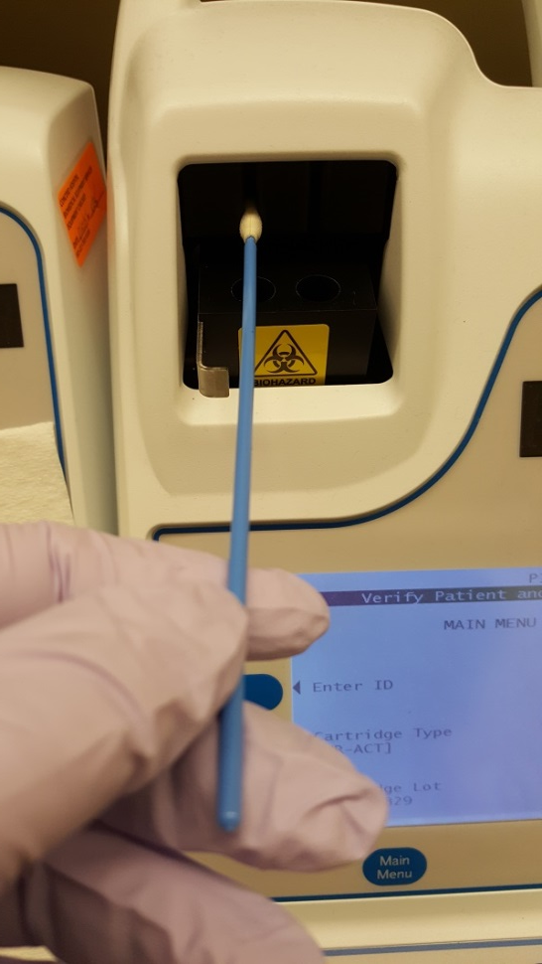
Cleaning the Timer
Swab inside the actuator cover, especially the detector and emitter areas of the photo-optical system ( two vertical openings).
Repeat until swabs are no longer bloody.

Slide 10
Cleaning the Timer
Remove excess Liqui-nox solution with a dry swab, being careful not to loose the sponge tip.
If blood gets into the detector or lamp area and you are unable to remove it with a swab, and Error Code 4 may be displayed.
Contact Bio Med. They can open the ACTPlus and do a thorough cleaning.

Slide 11
Cleaning the Exterior Case
Before the ACTPlus leaves the patient area it must be cleaned.
  To CLEAN the exterior case, use a Clorox Germicidal Wipe to thoroughly wet the exterior case. Squeeze the Clorox wipe to remove excess fluid. Be careful not to get fluid into the ACTPlus
  Allow the surface to stay moist for 1 minute.
  To DISENFECT the exterior case, use a second Clorox Germicidal Wipe to thoroughly wet the exterior case. Squeeze the Clorox wipe to remove excess fluid. Be careful not to get fluid into the ACTPlus
  Allow the surface to stay moist for 3 minutes.
  After time has lapsed, dry the exterior case using a clean dry paper towel.

