Slide 1
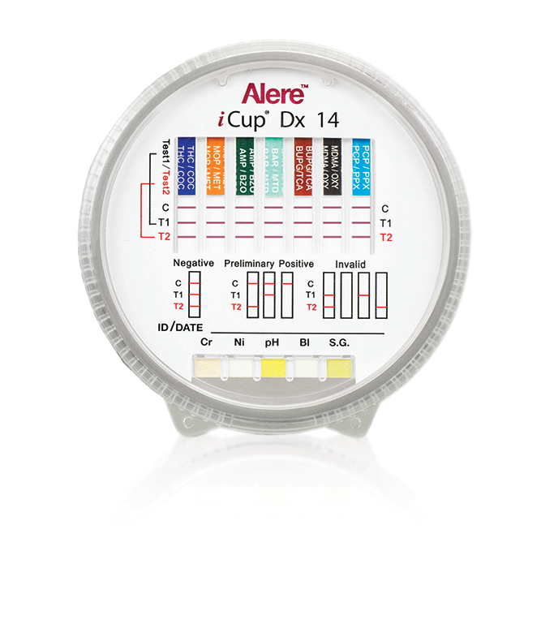
Alere iCup Dx 14 Drug Screen Testing

Slide 2
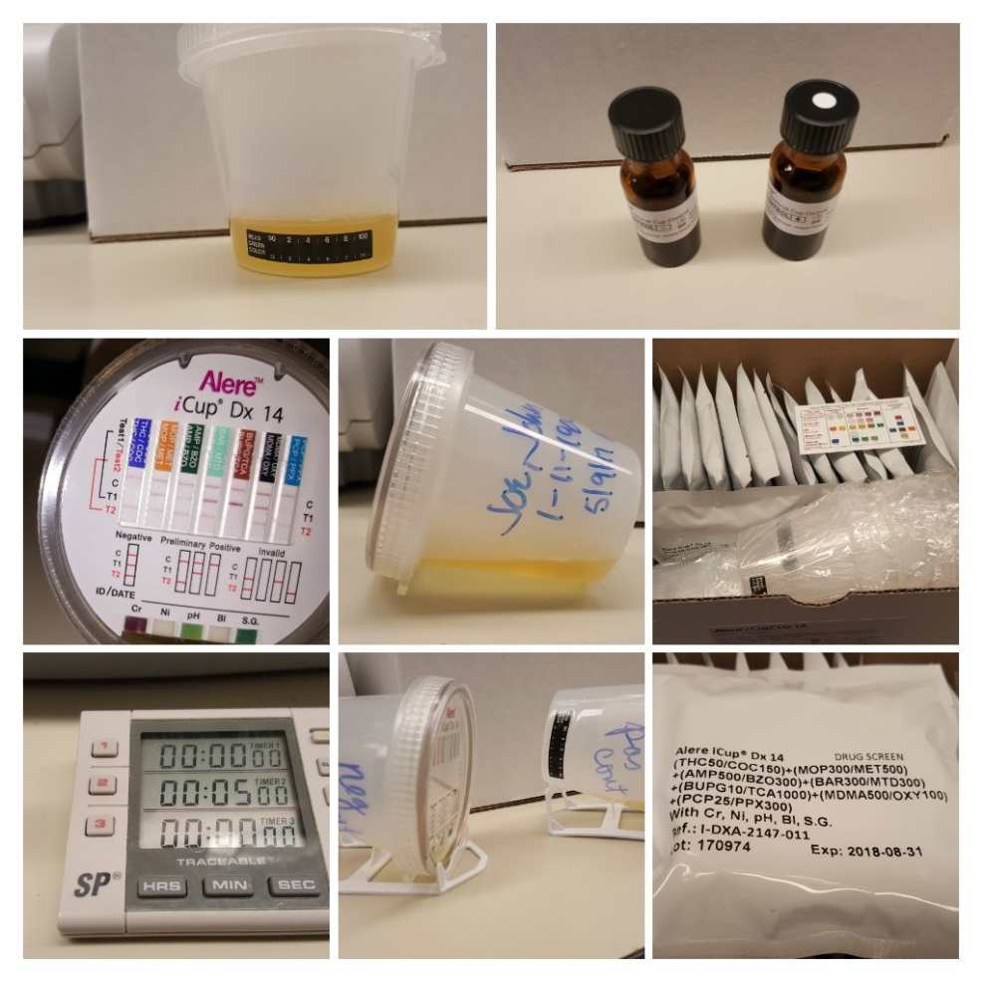
Alere iCup Dx 14 Drug Screen Testing
In this presentation you will learn how to perform
The iCup Dx14 Drug Screen test with Specimen Validity.
Included is:
Technical information
Product overview
Ordering and handling information
Performance of Quality Control
Specimen collection
Testing procedures
Recording test results

Slide 3
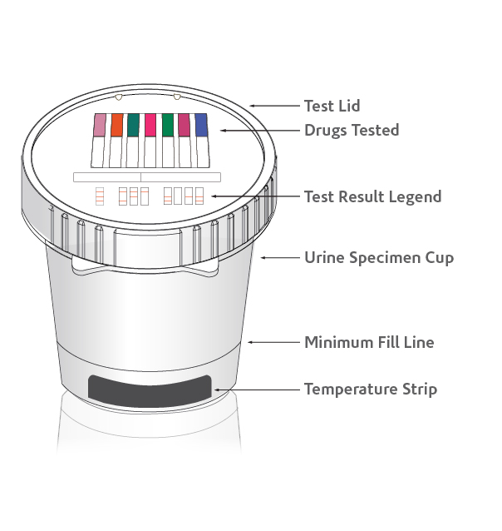
Overview:
i-Cup Dx 14 test device
with specimen validity tests
CLIA-waived
Integrated urine test cup targets 14 illicit
and prescription drugs
Simple procedure: collect specimen, tilt cup, and read results in five minutes
Specimen validity test combinations:
Bleach (BL), Creatinine (CR), Nitrate (NI), pH (pH), and Specific Gravity (SG)
Self-contained cup is ideal for sending presumptive positive specimens for confirmation
Each test strip has an Internal QC line
External QC is performed on each shipment (same lot number) and for trouble shooting

Slide 4
Ordering
Both the iCup Dx 14 Drug Screen test cups and the liquid QC material have been added to your HEMM ordering template.
One box of test cups contains 25 cups. HEMM item # 48317
One box of Urine drug controls contain 1 bottle of negative control and 1 bottle of positive control. HEMM item # 48318.
When you place an order for test cups and you want more than one box, please add a note requesting the same lot number for all boxes ordered.
At the same time you will order 1 box of the urine drug control.
Note: QC is performed on receipt of your shipment. If all your boxes of test cups are the same lot number, QC is done once for the whole shipment.

Slide 5
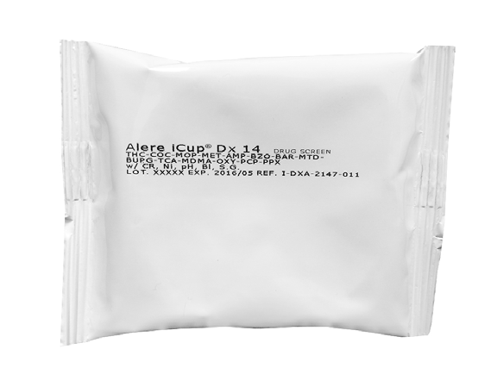
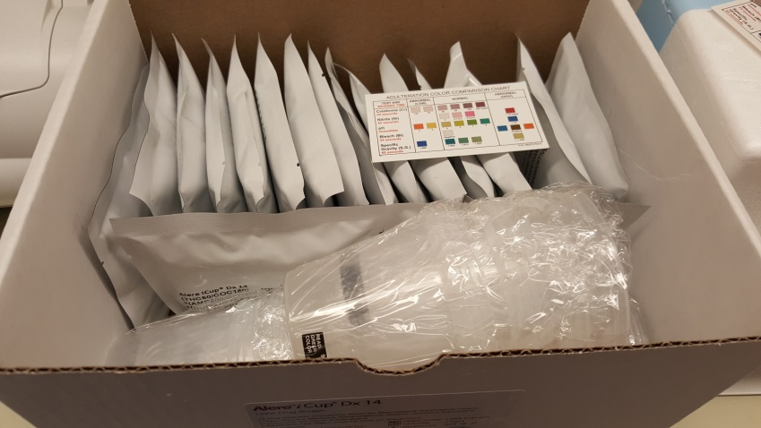
Receipt of iCups and QC
On receipt of your materials, the box of test iCups is stored at room temperature. The QC material needs to be refrigerated on receipt and stored at refrigerated temps until you perform your shipment QC.
When you open the box of iCups you will have 25 cups, individually packaged, 25 covers individually packaged, one specimen verification reference card and the manufacturer’s instructions for use.
Select a cap package and look for the lot number and expiration date. It should match the lot number and expiration date on the front of the box. Do not take the cap out of it’s sealed pouch until use.
When you perform QC testing you will open the box of QC. In the box you will have one bottle for a positive control and one bottle for a negative control and a plastic tray. Keep the tray.

Slide 6
Perform Shipment QC
Bring your QC up to room temperature before testing. This will take about 20 minutes.
You will need a timer.
You will need the Alere iCup Dx 14 QC log sheet to record lot numbers ,expiration dates and results. One form is used to document both the positive and negative controls .
You will need two iCups and caps.
Label an iCup positive and negative, one for each control.
Just prior to use, gently mix the QC by swirling or inverting the bottles. DO NOT SHAKE.
Pour the entire contents of the negative control into the iCup labeled negative.
Pour the entire contents of the positive control into the iCup labeled positive.
Open a pouch and remove the cap and screw it onto the iCup. Make sure it is secure to prevent leakage.
The tray that came with the controls has one side that is higher than the other. Place the lower side facing you.

Slide 7
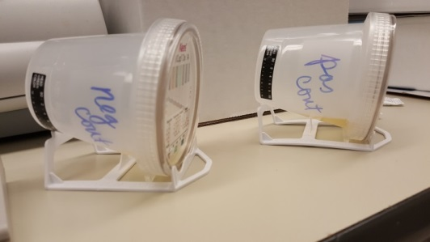
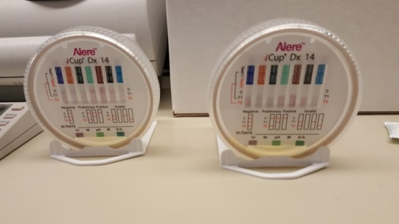
Perform Shipment QC
Tipping the cup on to it’s side, place it in the tray so the bottom of the cup rests on the higher support of the tray the cover is resting against the lower end that is facing you. Make sure the test strips are aligned straight up.
Start your timer for 5 minutes.
Watch to make sure the fluid moves up the test strips. You will see a pink color as the fluid climbs up. The pink color will go away. The creeping action will be faster on some test strips than others.
At 5 minutes record your results on the QC log.
If a control line does not appear the QC needs to be repeated.
If you have a test strip that did not have the fluid move up, the QC needs to be repeated.

Slide 8
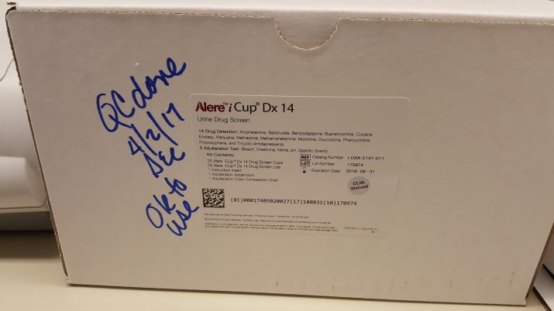
Perform Shipment QC
You will notice that we do not record any QC results for the Specimen Verification tests. The Specimen Verification results are only recorded when performing a patient test. More to come on that.
On the QC log we will be recording :
The lot number and expiration date on the box of iCups.
The date you received the order.
The lot number and expiration date for the QC material.
The negative and positive QC results are recorded separately.
Your initials, date, and time QC was performed.
On the box you will record “QC OK” and the date the QC was done with your initials.
When you receive a new lot number, you can perform QC on the new shipment before you finish your current supply.

Slide 9
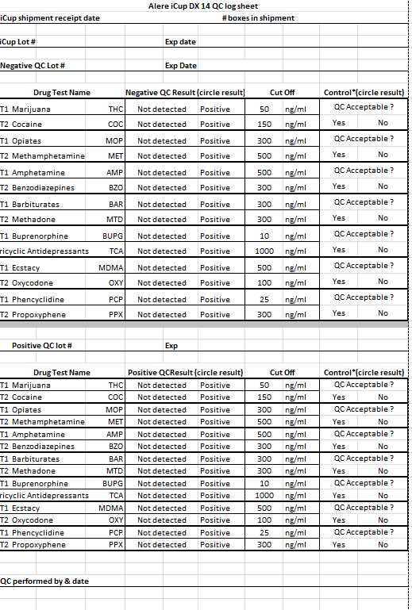
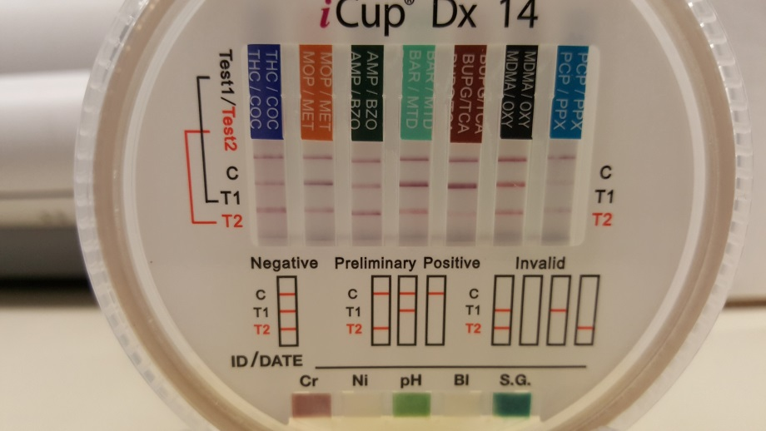
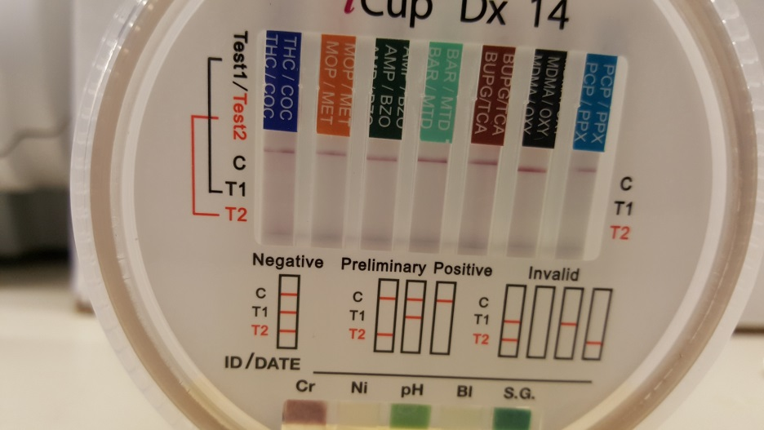
QC Results and Log

Slide 10
QC Results
Record all results no matter what they are
Positive Control
All results should be positive
Negative Control
All results should be negative
Control Line- QC Acceptable?
All results should be yes
IF:
If all the results are acceptable, you can use the iCups from this shipment for patient testing.
If any of the results are NOT acceptable, STOP. Repeat QC with a new cover and a new log sheet. Record all results on the new log sheet.
If all the repeat results are acceptable, you can use the iCups for patient testing. We need to keep all documentation in the event we need to call the company to report a problem.
If any of the repeat QC results are NOT acceptable :
record all result on the second log sheet and
call Point of Care ext 4643 or 4645.
Do not perform any patient testing using iCups from this shipment until the problem is resolved.

Slide 11
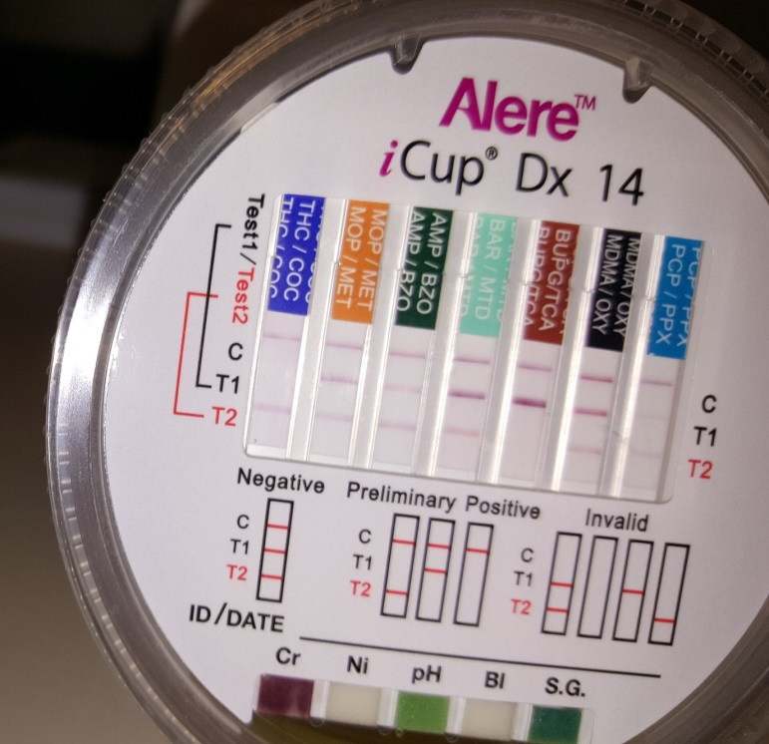
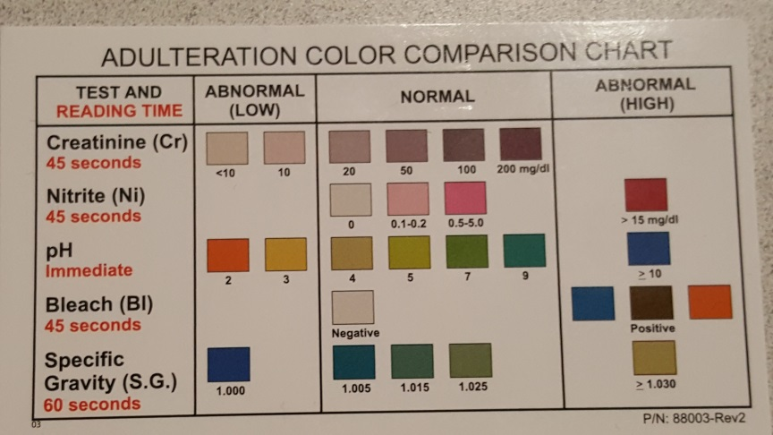
Patient testing/Sample Validity testing
iCup Cover- Where all the action happens!!
There are seven test strips.
Each test strip has a control line at the top followed by T1 and T2 which indicates a drug test.
Mid way on the cover you will see a legend that shows examples:
Negative test results
Positive test results
Invalid test results
We will not be using the ID/Date line
At the very bottom of the cap you will see the Specimen Validity Test (SVT) pads. At the prescribed time found on the chart (in red) you will match the color for each test and record the corresponding result on the patient result log.

Slide 12
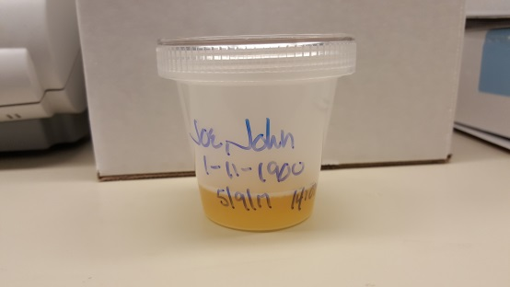
Patient Testing/Sample Validity testing
iCup caps will only work with iCup cups. They will not fit on other urine cups used for routine urine testing .
If you need to do other testing on the sample, such as a urine dip test or a pregnancy, it can be performed before or after urine drug testing. Specimen temperature must be read at 2-4 minutes following specimen collection. As the temperature of the specimen cools, the temperature on the strip will change as well.
If the patient says they can give a sample, label the iCup with the patient’s name, DOB or MRN, and the date of collection. Hand the iCup to the patient for collection.
When the specimen is handed back to you check that the iCup has the minimum volume needed for testing. Then break the seal on a pouch containing a cap and screw the cap on the iCup.
Add the collection time and your initials to the patient information on the iCup.

Slide 13
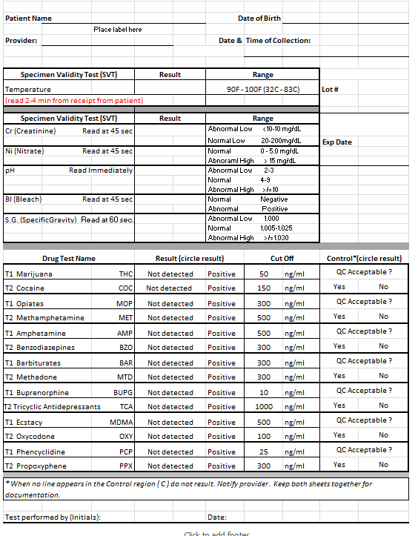
Patient testing/Sample Validity testing
On patient result form you will write:
Patient information & date and time of collection
The lot number and expiration date for the pouch that contained the cap.
Specimen Validity Results
Temperature
Cr (Creatinine)
Ni (Nitrate)
pH
Bl (Bleach)
S. G. (Specific Gravity)
Drug test results
Control results

Slide 14
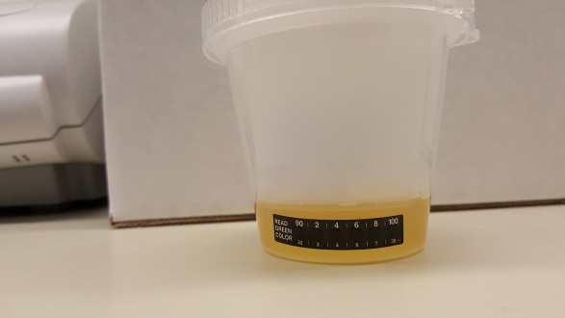


Patient testing/Sample Validity Testing

Slide 15
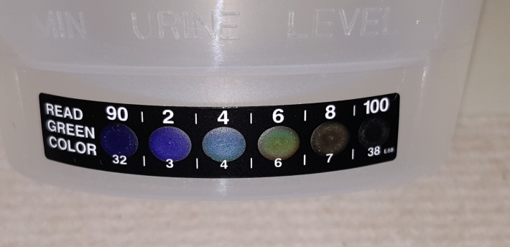
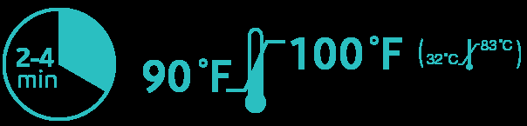
Sample Validity Testing - Temperature
Look at the temperature strip and record result.
  Note: the minimum fill line is just above the placement of the temperature strip. You need enough sample volume to completely fill the area where the temperature strip is on the cup.
The temperature is read at 2-4 minutes of the donor providing the specimen.
Read the green color on the temperature strip.
A freshly voided specimen will be in the range of 90-100°F.
The example shown to the right would be read as a temperature of 96°F.
As the sample cools, the temperature on the strip will change.

Slide 16
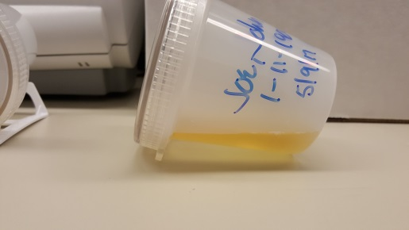

Specimen Validity Testing – Adulteration Detection
  Sample Validity Test (SVT) Results
Tip the cup on it’s side and start your timer. You will notice the tray you used for the QC is not used for patient testing. You will want the cover of the cup to face you.
SVT results are read rapidly after the cup it tilted onto it’s side. You may want to time these tests with a watch that has a second hand. The read times to follow on the Comparison Color Chart are in red. Record the number/word that corresponds to the color on the chart.

Slide 17
Patient Testing
Drug Screen Test results
When your timer goes off at 5 minutes the drug screen tests are read.
The control line ( C )must always be present. The control lines may not be the same density and strength of color.
Any red line is an acceptable control line.
There is one control line for every two drug screen tests.
The second line matches T1 which is for the top drug listed on the top of the test strip.
The third line T2 matches the second drug listed on the test strip
Example: first test strip on left is THC/COC

Slide 18
Patient Testing
When looking at the drug test strips:
Red lines will vary in color intensity.
Any visible red line is resulted as a “not detected”
The absence of a visible red line is resulted as “positive”
We use the term “not detected” instead of negative because it is possible for someone to have a drug in their system, but it is at a level that is too low to detect with this test.

Slide 19
Patient Resulting
The paper patient result log/down time form lists the drugs in order to match the test strips.
If only one of the control lines is deemed not acceptable, none of the drugs will be resulted. Repeat testing or confirmation testing is needed.

Slide 20
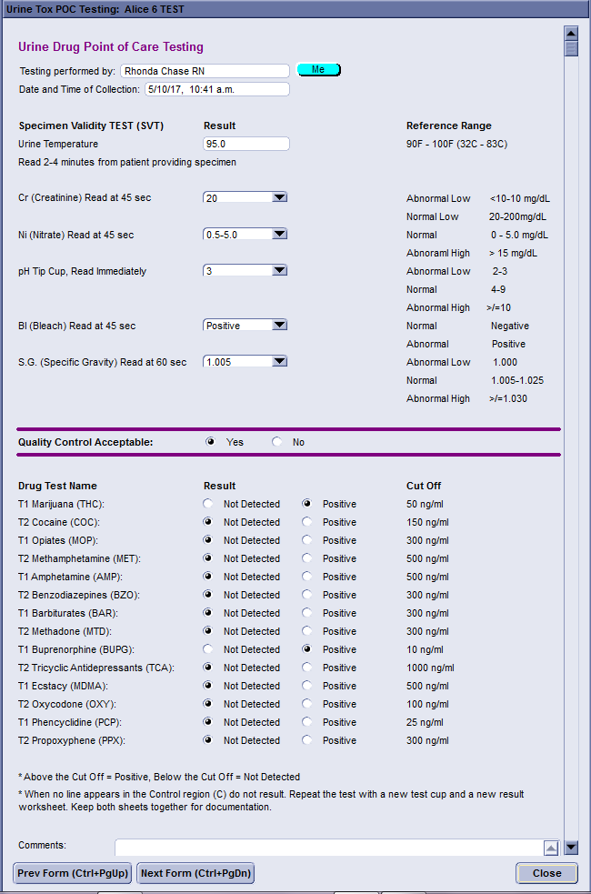
Patient Drug Screen Result in Centricity
The Result page in Centricity is setup in the same way.
There is one difference. Quality Control has only one result instead of the seven on the paper form.
The Centricity form if completed after the paper form.
To result the Drug Screen Tests in Centricity, all results are acceptable.
If there are problems with any results, nothing is resulted in Centricity until the event is resolved on paper.
If confirmation is ordered, the iCup is sent to the main lab with the appropriate order.

