Slide 1
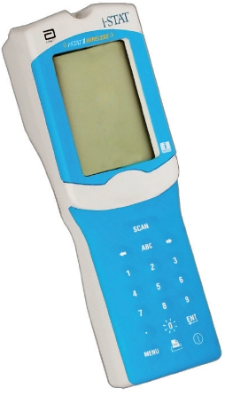
Point of Care - iSTAT ACT Kaolin

Slide 2
What is ACT?
Activated clotting time (ACT) is a whole blood coagulation test sensitive to the presence of heparin.
Clay particles (Kaolin) activate the intrinsic clotting pathway leading to activated thrombin which acts on a synthetic thrombin substrate forming an electrochemically active product.
The time of detection is measured in seconds.
Intended Use
The iSTAT ACTk is an in-vitro diagnostic test that uses fresh, whole blood, and is used to monitor high-dose heparin anticoagulation frequently associated with cardiovascular surgery.

Slide 3
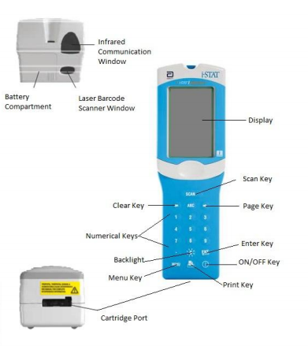
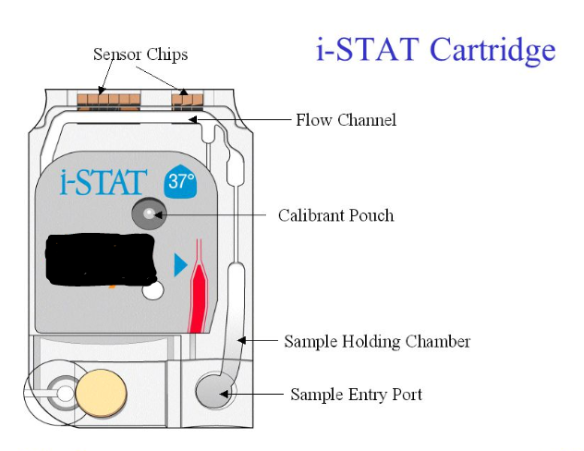
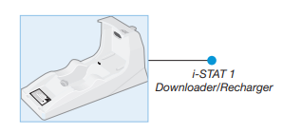

Analyzer and Cartridge Components

Slide 4
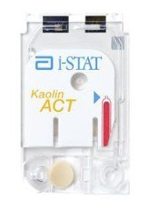
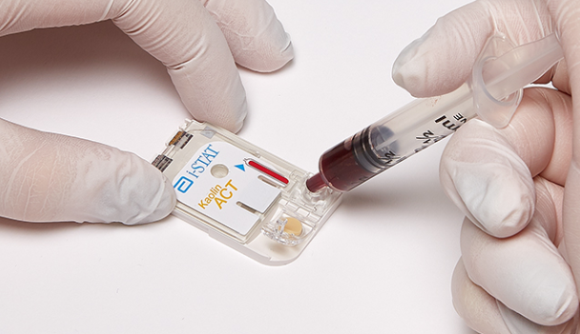
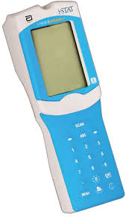
What do I need to run an iSTAT ACTk?
iSTAT Device
iSTAT ACTk Cartridges Plain syringe with whole blood

Slide 5
Cartridge Parts and Handling
Always check expiration date before using a cartridge
Use the cartridge immediately once removed from pouch
Do not put pressure over the center of the cartridge, hold by the long sides only. (There is a calibrant pouch containing fluid in the center of the cartridge that will burst if pressured). Bursting this fluid pouch will require a new cartridge for testing.
Do not touch the sensors on the end of the cartridge
Do not remove a cartridge from the iSTAT device when “Cartridge Locked” is displayed at the bottom of the screen. The cartridge is locked in place and attempted removal will cause irreparable damage to the instrument.
The main supply of cartridges are stored refrigerated between 2-8 °C.
Cartridges may be stored at room temperature for up to 14 days and the new expiration date must be written each individual cartridge.
Cartridges brought to room temperature can not be returned to the refrigerator.
Prior to use, individual cartridges must be brought to room temperature for at least 5 minutes and the full box for 1 hour.

Slide 6
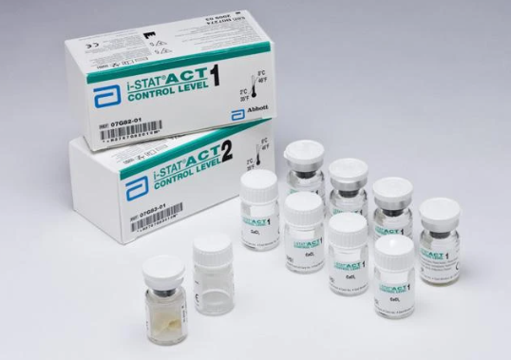
Quality Control – Liquid Controls
Liquid QC is provided in 2 levels; Level 1 and Level 2
Liquid QC is required every 7 days
Each level must be reconstituted from one vial of lyophilized human plasma and one vial of diluent (CaCl₂)
Liquid QC can be used until the expiration on vial
when stored refrigerated
Vials must be left at room temperature for 45 min
prior to reconstitution
Once at room temp, vials must be used within 4 hours

Slide 7
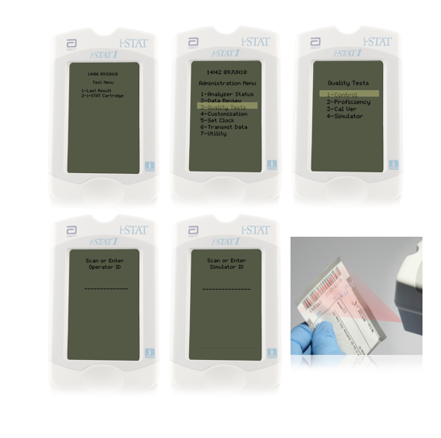
Performing QC using Liquid Controls
Turn on the handheld
Press MENU key
Press 3 – Quality Tests
Press 1 – Control
Scan or manually enter operator ID
Scan Control lot number
Scan Cartridge lot number

Slide 8
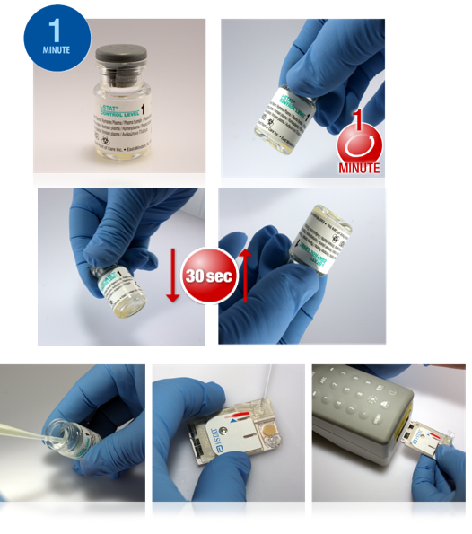
Performing QC using Liquid Controls
Remove the ACTk cartridge from the pouch
Remove cap and stopped from QC vials
Pour entire contents of diluent into lyophilized plasma vial
Replace stopper
Allow vial to sit for 1 minute
Gently swirl vial for 1 minute, then gently invert for 30 seconds
Using a plastic pipette or plain plastic syringe, immediately transfer solution from vial into cartridge
Immediately close cartridge and insert into handheld
Review results. If Pass, ok to use for patient testing. If Fail, action is required.

Slide 9
Specimen Collection and Preparation
The iSTAT ACTk test can be performed using venous or arterial samples (40µL).
The sample for testing should be drawn into a plastic syringe.
The syringe can not contain anticoagulants such as heparin, EDTA, oxalate or citrate.
The sample should be immediately dispensed into the sample well of a cartridge.
If a second measurement is needed, draw a fresh sample.

Slide 10
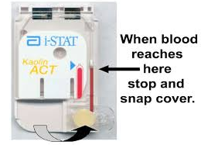
Performing a Patient Test
Turn on the handheld
Press 2 – i-STAT Cartridge
Scan or manually enter your operator ID
Scan or manually enter patient ID
Scan the cartridge lot number on outside of pouch
Prepare the sample by discarding first few drops then fill and seal the cartridge
Push the sealed cartridge into the handheld port until it clicks into place
***The handheld must remain on a level surface with the display facing up during test.

Slide 11

Transmitting Results using a Downloader/Recharger
Note: Wireless communication will be attempted first. If wireless communication fails, wired communication will be attempted →
Place the handheld in the Downloader/Recharger
A “Waiting to Send” or “Communication in Progress” message will appear on the handheld display
Do not move handheld until “Communication in Progress” message disappears, the transmission is successful

Slide 12


Disinfection
To protect from nosocomial infections, decontaminate analyzers periodically and whenever blood is spilled or transferred to an analyzer.
Clean the display screen and the analyzer using a gauze pad moistened with any of the following:
  Alcohol wipes
  Clorox Bleach Wipes (10% bleach)
  PDI Super Sani-Cloth wipes
Rinse the analyzer using another gauze moistened with water and then dry.
The use of any unapproved product to clean the iSTAT system may result in damage to system components.

