Slide 1
Gastroccult Testing
Gastric Occult Blood Testing

Slide 2
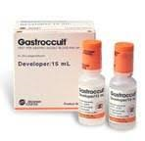
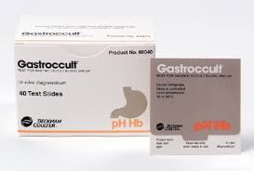
Supplies needed:
Gastroccult Cards
Gastroccult Developer
Syringe or Applicator Stick

Slide 3
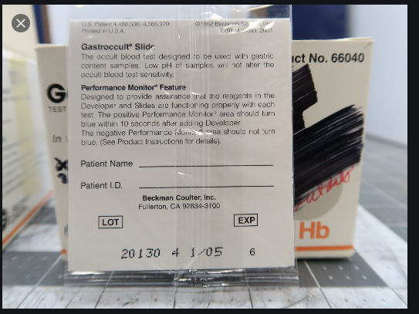
Label each card with patient information

Slide 4
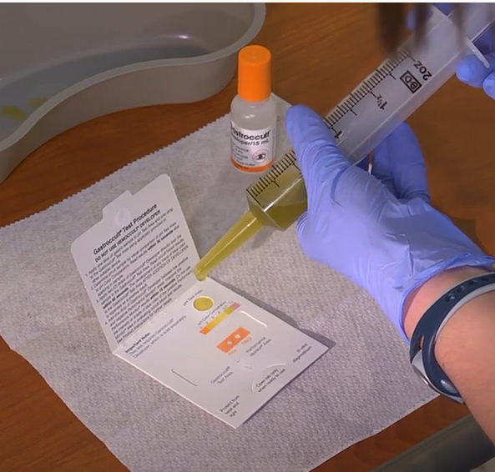
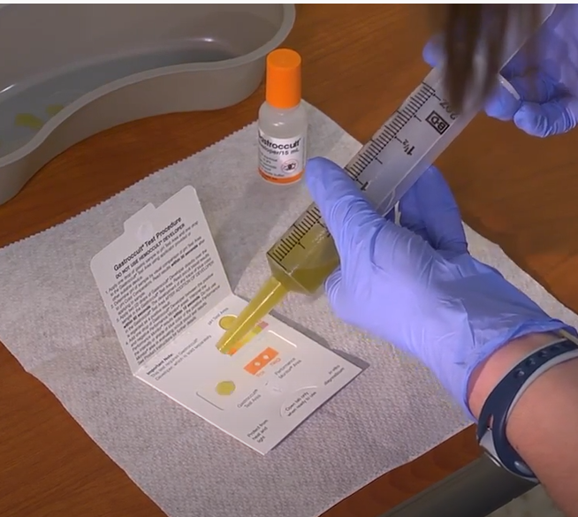
Applying specimen from a syringe:
Open front cover when ready to add specimen
Add one (1) drop of specimen to the pH Test Area
Add one (1) drop of specimen to the Gastroccult Test Area

Slide 5
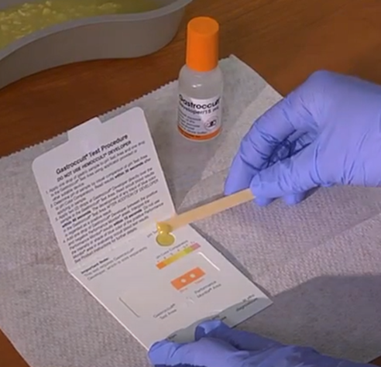
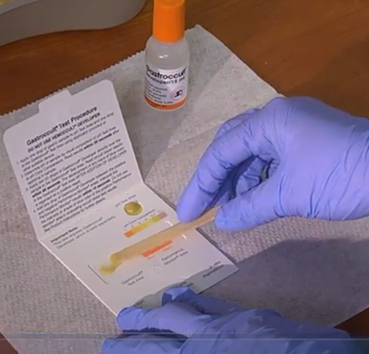
Applying specimen from applicator provided:
Open front cover when ready to add specimen
Apply specimen to the pH Test Area
Apply specimen to the Gastroccult Test Area

Slide 6
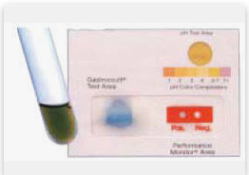

Determine the pH of the sample by visual comparison of pH Test Area to pH Color Comparators.
Read pH results within 30 seconds after applying the sample.
pH Test Area
Compare & read within 30 seconds

Slide 7
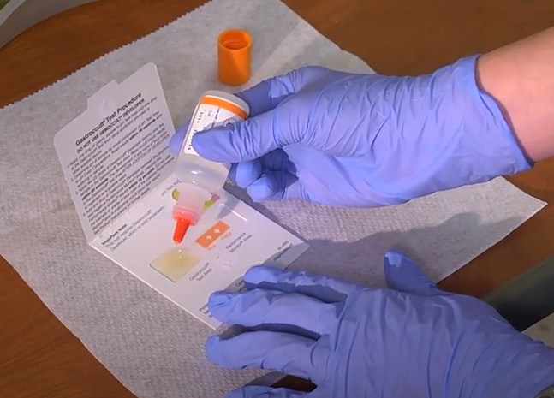
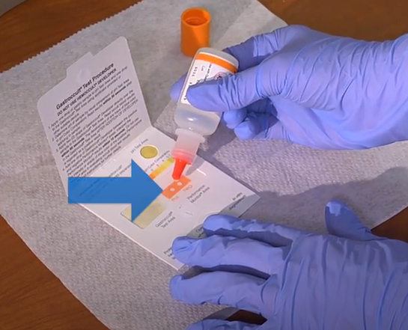
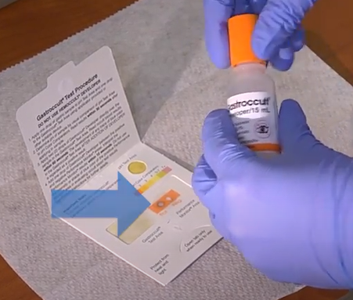
Apply two (2) drops of Gastroccult Developer directly over the sample in the Gastroccult Test Area.
Read Occult blood results within 60 seconds.
Add one (1) drop of Gatroccult Developer between the positive and the negative Performance Monitors areas (internal QC). Interpret the Performance Monitors results within 10 seconds. DO NOT use the intensity or shade of blue color of the positive Performance Monitors area in evaluating occult blood test results. Must have a positive result in order for test to be valid. If not, repeat with a new card, checking expiration dates on both the card and the developer.
Internal QC must be positive (blue) for valid patient results
1 Drop
2 Drops

Slide 8
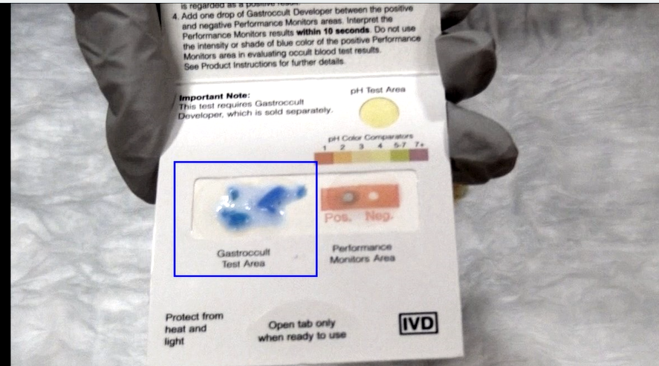
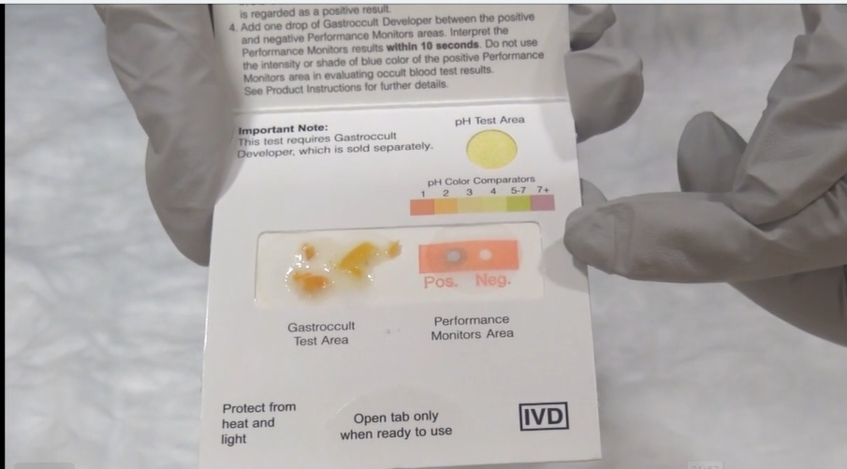
Positive patient results will turn any shade of blue.
Negative patient results will NOT have any shade of blue.
Positive patient result
Negative patient result

Slide 9
ED Supplies for Fecal Occult Blood and Gatric Occult Blood testing
Supplies must be ordered via Logi-D
Or contact Materials Management
POCT/Main Lab doesn’t keep ED supply

