Slide 1
LeadCare® II Capillary Blood Lead Analyzer

Slide 2

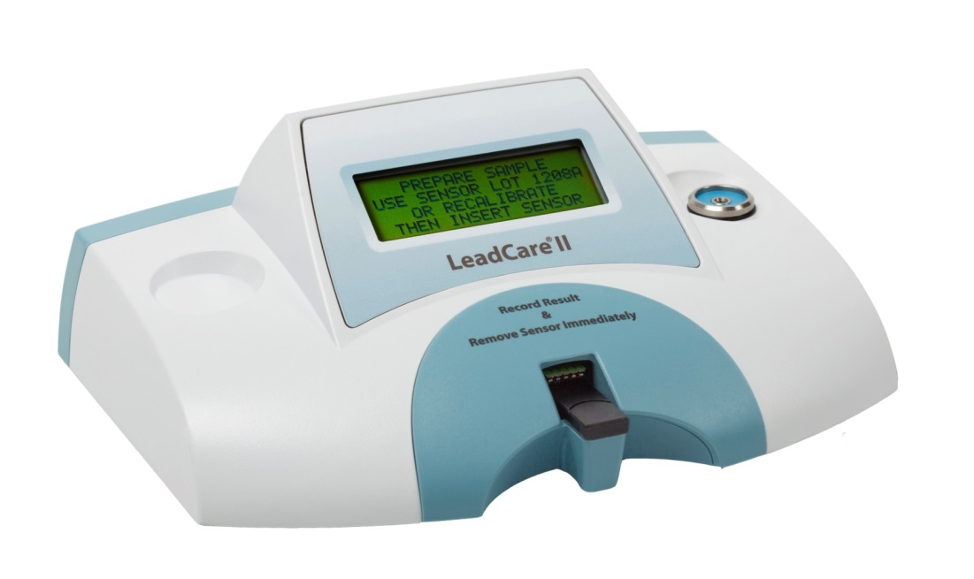

Slide 3
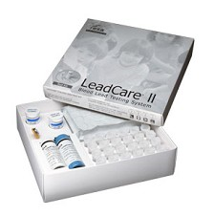
Test Kit
48 Lead Sensors (patient test strips)
48 Lead Treatment reagent tubes
50 Heparinized capillary collection tubes and plungers
50 Droppers
Level 1 control
Level 2 control
Calibration button

Slide 4
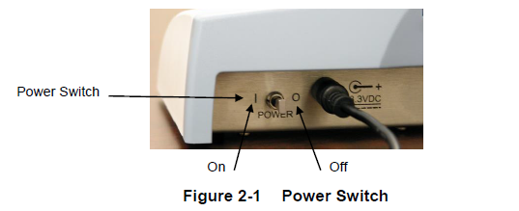
Turn on the Analyzer
The power switch is a toggle switch located at the back of the analyzer

Slide 5
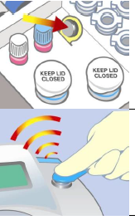
Calibration Button
Each test kit comes with a calibration button.
The calibration button is specific to the test kit lot number.
The calibration button must be read by the analyzer before using a test kit of a new lot number.
Locate the calibration button in the test kit.
Match the lot number on the button with the test strip lot number.
Hold the calibration button to the button reader until you hear a beep.
When calibration is complete, the screen says “calibration successful” and then reads “if new lot test controls.”

Slide 6
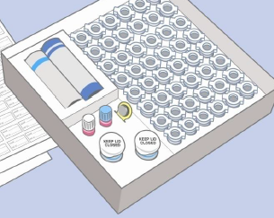
Quality Control (QC)
A level one and a level two control are included with each kit.
QC must be run on each new lot, each new shipment (even if it’s the same lot), by each new operator, when problems are detected, and every 30 days to check storage conditions.
Write date opened, your initials, and QC OK, on top and base of box.
Controls must be run before any patient testing is performed.
Only use kit if BOTH controls are within the target range.
QC target ranges are included with each kit.
Document QC results on QC log sheet.
For problems call Point of Care at ext. 4643 or 4645.

Slide 7

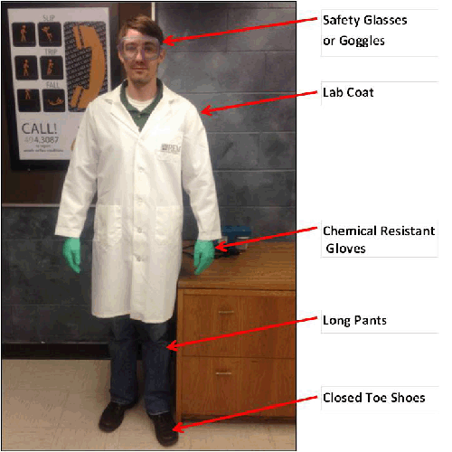
Treatment Reagent
CAUTION: The treatment reagent contains 0.34 M Hydrochloric Acid which may cause eye, skin, and respiratory system irritation. You MUST wear gloves, lab coats, and safety glasses when handling blood and using the Leadcare II test system.

Slide 8
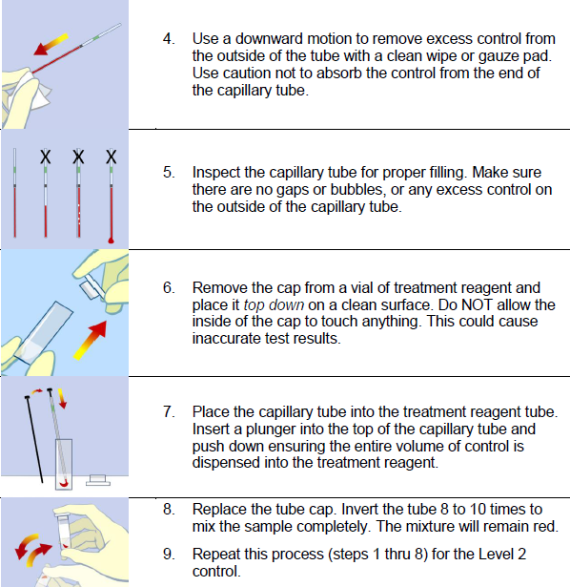
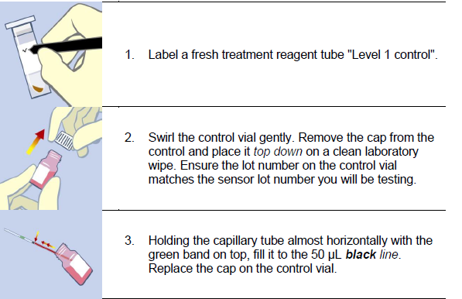
Preparing the QC Sample
QC and patient tests are analyzed the same way.

Slide 9
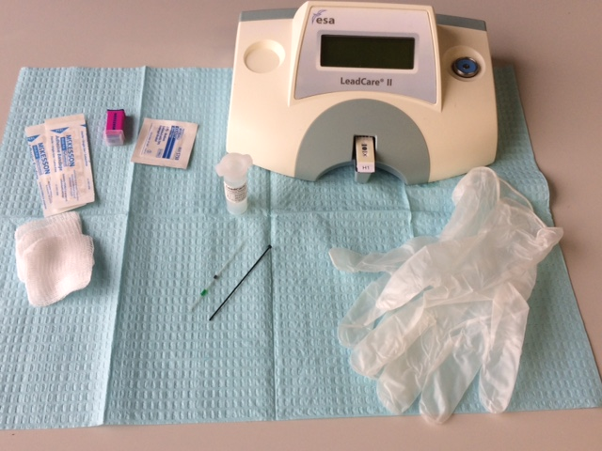
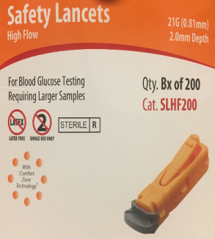
Obtain the supplies needed for the patient test .
Orange high flow lancets are recommended.

Slide 10

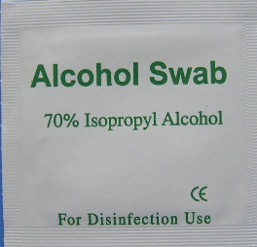
Hand washing is a critical first step. Alcohol swab second.
Alcohol swabs do not remove heavy metals, including lead.
Parents can assist with handwashing to support workflow.
Allow hands to air dry after washing with soap and water. Do not allow clean finger to touch any surfaces including other fingers.

Slide 11
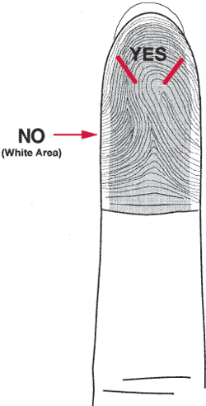
Capillary Collection
Open and arrange equipment.
Wash hands with soap and water. Following washing, the finger to be punctured must not be allowed to touch any surface, including the other fingers.
Scrub the finger (use the middle or ring finger) with an alcohol pad.
Puncture the finger, using a sterile lancet. The puncture should be slightly to the side of the pad of the finger.
Wipe away the first drop of blood. It is often diluted with tissue fluid.
Touch the capillary tip of the blood container to the second blood drop, minimizing direct contact with the skin surface. The container works best if held horizontal or angled downward slightly for proper blood flow.
If necessary, gently massage the base of the finger to improve blood flow. Do not 'milk' the finger as this may dilute the blood with tissue fluids.
Fill the capillary tube to the black line.

Slide 12
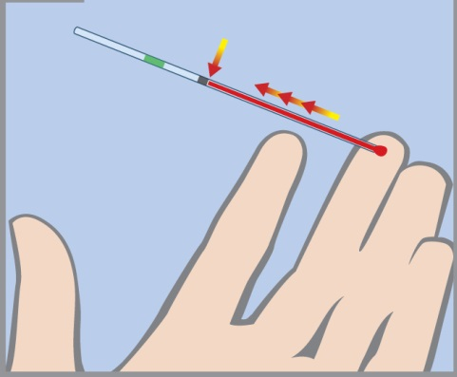
Fill to black line
Keep capillary tube almost horizontal – just slightly raised at 10° angle.

Slide 13
Caution
Do NOT use venous blood with this system! Use of Venous blood could cause inaccurate results!!

Slide 14
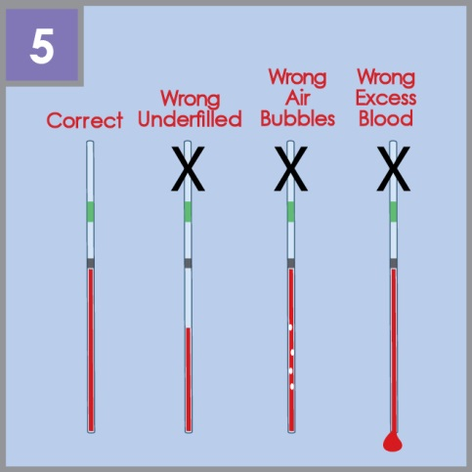

Slide 15
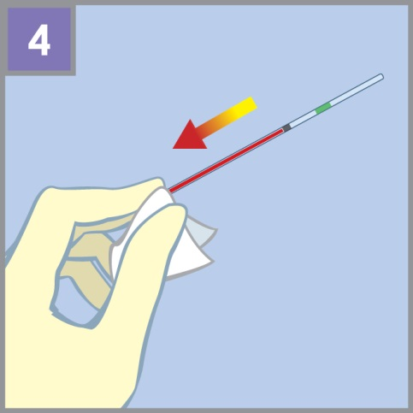
Use a downward motion to remove excess sample from the outside of the tube with a clean gauze pad. Use caution not to absorb the sample from the end of the capillary tube.

Slide 16
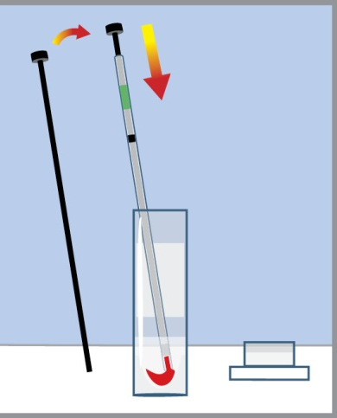
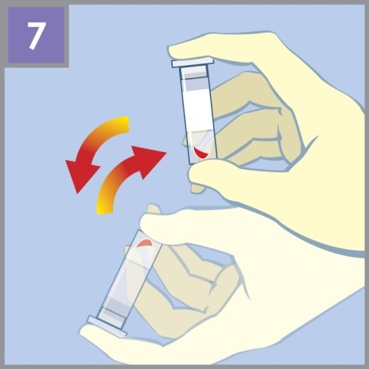
Place the capillary tube into the treatment reagent tube. Insert a plunger into the top of the capillary tube and push down ensuring the entire volume of control is dispensed into the treatment reagent. Replace cap and invert sample 8 to 10 times to mix the sample completely.

Slide 17
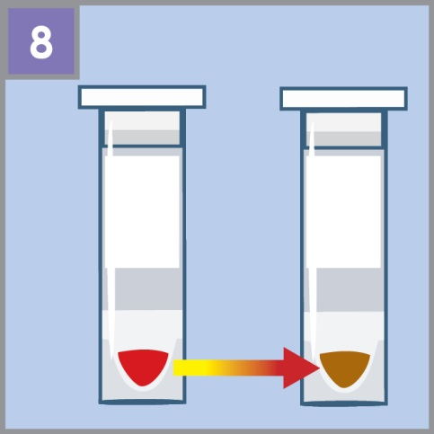
Patient samples will turn brown when cells have been lysed (QC will not change color). The sample is now ready for testing.

Slide 18
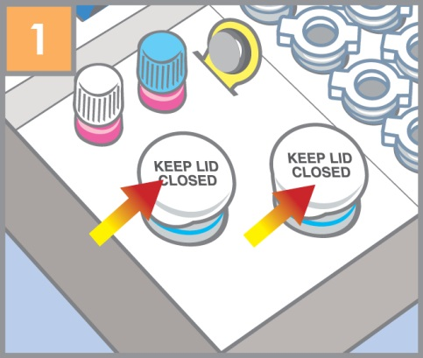
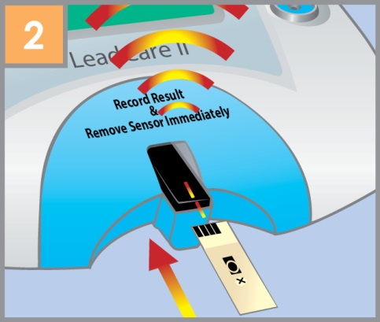
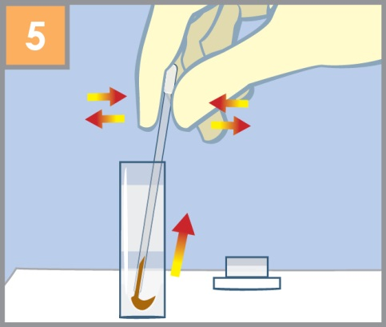
Remove a sensor from the sensor container. Close container tightly.
Insert sensor (with the black bars facing up) under the sensor guides on the sensor deck. Insert completely into the analyzer until you hear a beep.

Slide 19
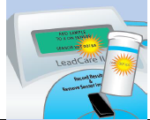
Make sure the sensor lot number matches the display.

Slide 20
Use dropper to pick up sample from treatment reagent tube.

Slide 21
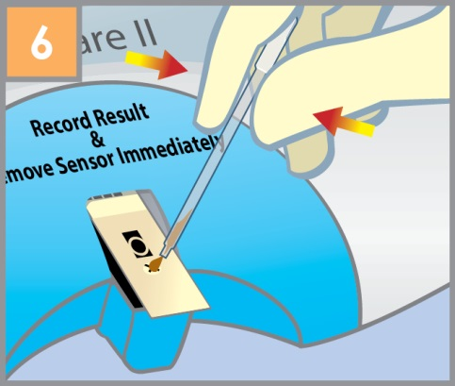
Add sample to the X on the sensor. The analyzer will beep when enough sample has been added and the three minute countdown will begin.

Slide 22
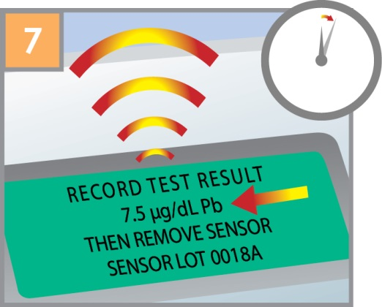
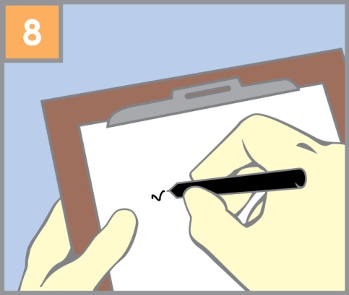
Wait 3 minutes until the test is done. The analyzer will beep and display the lead result.
LOW = < 3.3
Record results on patient log sheet and enter results in computer system.

Slide 23
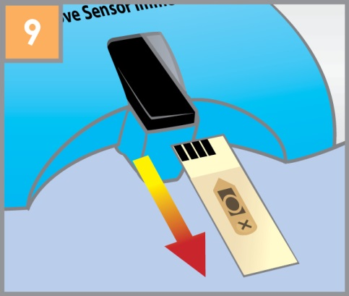
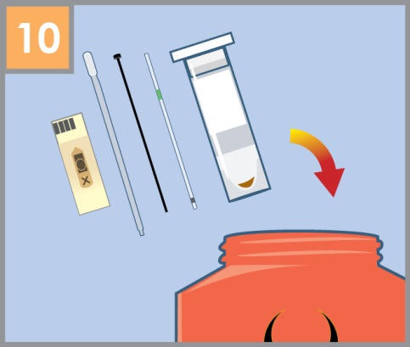
Remove the used sensor and discard material in the appropriate container.

Slide 24
Disposal of Patient & QC Samples
To dispose of the patient and QC test samples, the liquid in the Treatment Reagent tube MUST be treated before being discarded in the biohazard receptacle.
Uncap the treatment reagent tube and set the cap down so it faces down on the covered work surface.
Draw up enough Sodium Bicarbonate to fill the pipet approximately 1/3 to 1/2 of the narrow part of the pipet. Do not fill the bulb.
Dispense 4 drops of the Sodium Bicarbonate 7.5% into the reagent tube.
Securely cap the tube and let is set 15 seconds, then discard in a biohazard container.

Slide 25
Disposal of Patient & QC Samples
If you do not have enough Sodium bicarbonate solution in the pipet for the 4 drops, get a new pipet and draw up more Sodium Bicarbonate. Do not reuse the first pipet to draw up additional solution.
If you have any of the Sodium Bicarbonate solution left in the pipet express it into the sink and discard the pipet. DO NOT put left over Sodium Bicarbonate solution back into it’s bottle.
Sodium Bicarbonate 7.5% Solution –QC not needed. The expiration date on the bottle is used.
When a new bottle is opened please date and initial the bottle. This will give us an idea of how long a bottle of Sodium Bicarbonate will last while in use within the manufacturer’s expiration date.

Slide 26
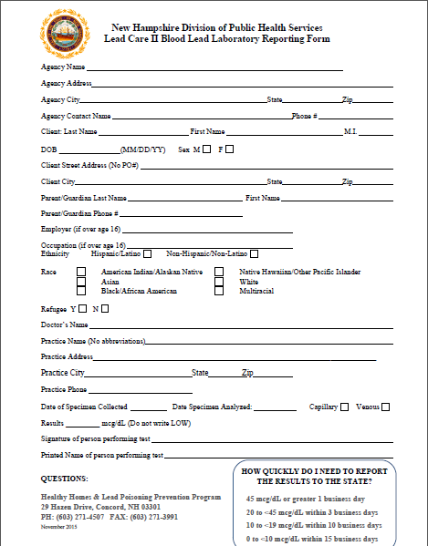
Lead results must also be sent to the state of New Hampshire.
Report Every BLL Test Result
No Post Office Boxes – physical address require.
Test Result – A number value is required. Do not write low.
LOW = < 3.3
Each and every piece of information asked for on these forms – Reported quarterly to the Center for Disease Control

Slide 27
Analyzer Reportable Range
Reportable range is < 3.3 mcg/dL- 45.0 µg/dL.
“Low” in the result display window = < 3.3 mcg/dL.
“High” in the result display window indicates a result > 65.0 mcg/dL.
Even if you see an elevated result greater than 45.0, You MUST report this result as > 45.0 mcg/dL.
Our reportable range has an upper limit 45.0mcg/dL
Our organization’s reportable range goes up to 45.0 mcg/dL. If you see a result over 45.0 mcg/dL, you CANNOT report that number. You MUST report > 45.0 mcg/dL, including results that display as “High.”

Slide 28
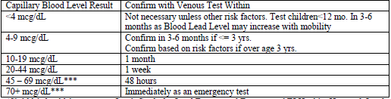
Result Interpretation
A laminated copy of The state of New Hampshire's “Child Medical Management Quick Guide for Lead Testing & Treatment” is available in your office.
The state of New Hampshire guidelines for obtaining a venous sample to confirm capillary lead levels are:

Slide 29
Questionable Results
Make sure the expiration date of the kit has not passed.
Check that the analyzer is properly calibrated. The lot number displayed on the screen should match the lot number printed on the sensor container, the control vials, and test kit.
Check the analyzer and kit contents using proper control material. Acceptable performance is assured if results of the controls are within the proper range.
If the above steps result in unacceptable performance, call Point of Care at 227-7000 ext. 4643 or 4645.

Slide 30
Instrument Maintenance
The LeadCare II System needs very little maintenance. Follow the maintenance procedures listed in Chapter 5 (Troubleshooting and Maintenance) of the User’s Guide.
Cleaning the Analyzer:
  Remove used sensors from the analyzer as soon as the result is recorded.
  Disinfect with dilute (10%) bleach solution after every patient test.
  Do NOT allow liquid of any kind into the sensor connector.
  Do NOT get the metal pins in the sensor connector wet.
  Do NOT wash the inside of the calibration button reader.

Slide 31
Limitations
Dispense the blood from the capillary collection tube into a treatment reagent tube within 10 minutes of collection, and mix well to prevent the blood from clotting inside the reagent treatment tube.
Do NOT use the LeadCare II System in drafts. This could lead to inaccurate results.
Keep the LeadCare II System out of direct sunlight.
Use the sensors, the treatment reagent tubes, capillary tubes and transfer droppers only once. Do NOT reuse. Reuse could lead to erroneous results.
A capillary blood sample that generates an elevated lead level should be confirmed with a venous sample. In cases where the capillary specimen demonstrates an elevated lead level but the confirmation venous sample does not, it is important to recognize that the child may live in a lead-contaminated environment that resulted in contamination of the fingertip. Efforts should be made to identify and eliminate the source of lead in these cases.

Slide 32
Questions?
Contact Point of Care.
You can reach us by phone at ext. 4643 or 4645.
You can email us in GroupWise by typing “Point of Care” into the address line.

