Slide 1
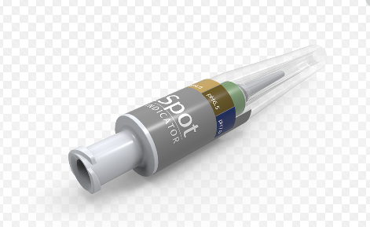
Right Spot pH Indicator

Slide 2
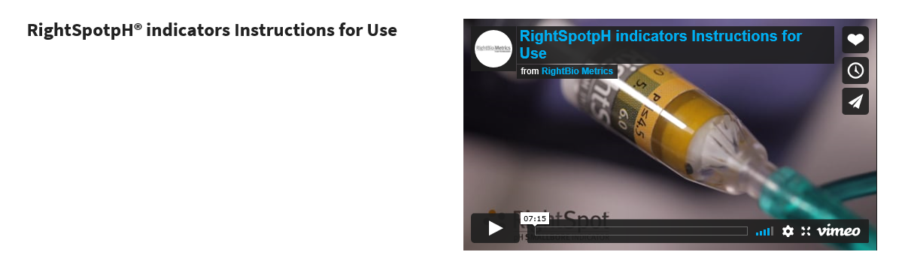
Double click on the blue background text for the link to the video

Slide 3
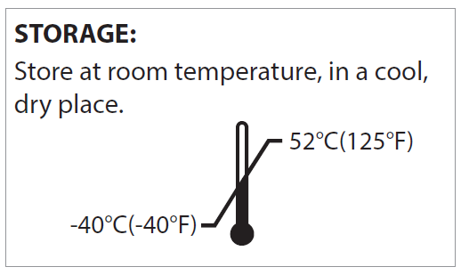
Description & Indications for Use:
The RightSpot™ pH Indicator is an in vitro diagnostic pH test for the evaluation of gastric acidity. It can detect pH from 4.5-7.0.
The RightSpot pH Indicator can be used to assess gastric acidity for tubes intended to end in the stomach. Determination of acceptable gastric pH reading should be done according to your institutions policy. A low pH would indicate gastric acidity.

Slide 4
General Information:
The RightBio Metrics products are the only FDA cleared/CLIA waived pH indicators for confirming gastric acidity for tubes ending in the stomach. pH paper and strips are not FDA cleared or CLIA waived. Additionally, RightBio Metrics devices are fully enclosed systems that protect from gastric acid exposure and do not require calibration.
The pH indicators and the syringe used to withdraw aspirate cannot be reused. Once aspirate is obtained, please remove the pH indicator with the syringe attached and dispose of according to your hospitals policy.
You do NOT need to calibrate or do quality controls on the RightSpotpH® indicators. Unlike pH paper or strips, our pH indicators are protected from light, air and humidity which are the three environmental factors that make un-protected pH strips/paper inaccurate

Slide 5
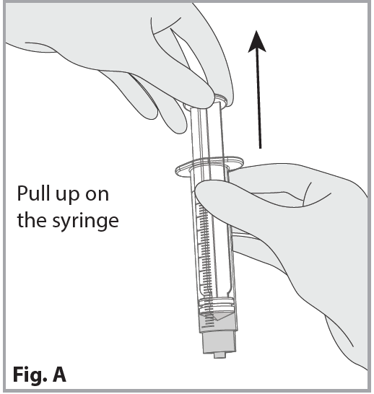
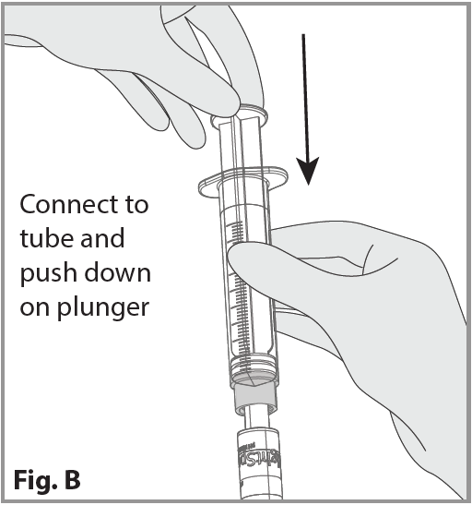
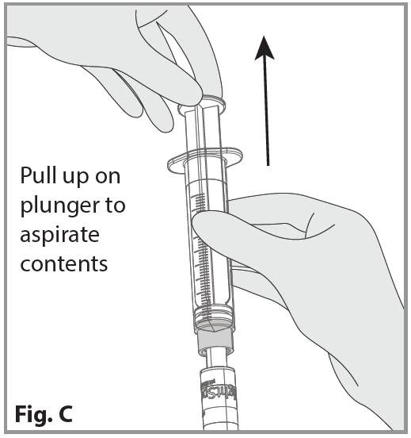
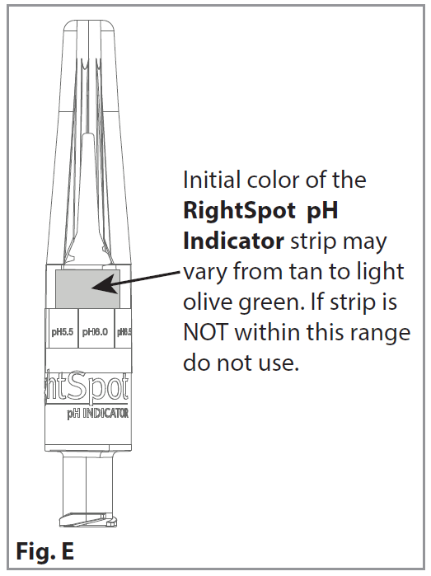
INITIAL PLACEMENT INSTRUCTIONS FOR USE:
1. Use a syringe and pull back .5-20cc depending on patient size and tube type. (Fig. A).
2. Attach the syringe to the RightSpot pH Indicator.
3. Attach the RightSpot pH Indicator to the proximal end of the gastric tube.
4. Insuate the air to remove the tip of tube from stomach wall. (Fig. B).
5. Hold the syringe with it attached to the Indicator. (Fig. C). While OBSERVING the RightSpot pH Indicator strip, begin aspirating contents; slowly aspirate fluid to achieve saturation of the RightSpot pH Indicator strip. Stop aspirating once the Indicator has changed color. (Fig. E) Aspirate needed ~0.022cc - ~0.5cc depending.
KEEP EYE ON INDICATOR. TEST IS ONLY VALID IF YOU SEE THE COLOR CHANGE. (Fig. E)
6. View the color change on the RightSpot pH Indicator strip and compare it to the RightSpot pH reference label on the shaft. Record this pH reading according to your institution’s policy. (Fig. E)
Read within two minutes of the color change.

Slide 6
What if we cannot obtain aspirate?
An important first step to obtaining aspirate is to push a small amount of air into the NG/OG tube prior to attempting to get aspirate. For infants 0.5-2cc, for pediatric patients 5-10cc and for adults 10cc or more. Please use your clinical judgement.
If you are still not able to obtain aspirate, lay the patient on their left side for 10 minutes, push air into the NG/OG tube again as directed and re-attempt. In most cases if the NG/OG tube is in the stomach, aspirate will be obtained. If not, follow hospital protocol for further instruction. For additional information on obtaining aspirate please note the following studies:
  NHS Resource Set Initial Placement for Nasogastric and Orogastric Tubes, July 2016
  The Journal of Neonatology/Perinatology-Neonatal Intensive Care Journal, Fall 2015, p. 64, Dr. Gregory Martin

Slide 7
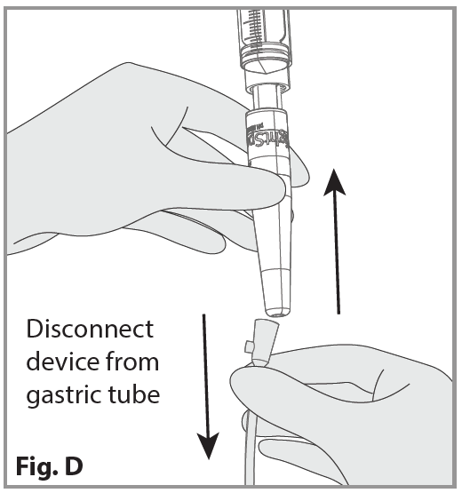
TO REMOVE RightSpot pH Indicator:
1. To reduce exposure to stomach contents, DO NOT disconnect the RightSpot pH Indicator from syringe.
2. Hold the RightSpot pH Indicator above and away from the patient with the syringe tightly connected to the Indicator.
3. Disconnect the RightSpot pH Indicator from the gastric tube. (Fig. D).
4. Discard the RightSpot pH Indicator and syringe according to your institution’s policy.

Slide 8
PRECAUTIONS:
• Drinking water during tube insertion, H2 blockers and PPI may elevate pH reading.
• The test is only valid if saturation of the Indicator is visualized.
• Results should be interpreted in a well-lit area.
• Reading of the RightSpot pH Indicator color change should be done within 2 minutes.
• Contamination with blood may interfere with the reading. Grossly bloody specimens
should not be used. Dried/coagulated blood that looks like coffee grounds will not
affect the reading.
• Once aspirate fluid has changed the pH paper, do not insufflate back through the device.
The aspirate should remain in the device and syringe after use.
• Single-use only

