Slide 1
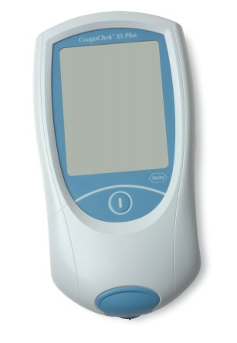
Roche CoaguChek
POC INR Testing

Slide 2
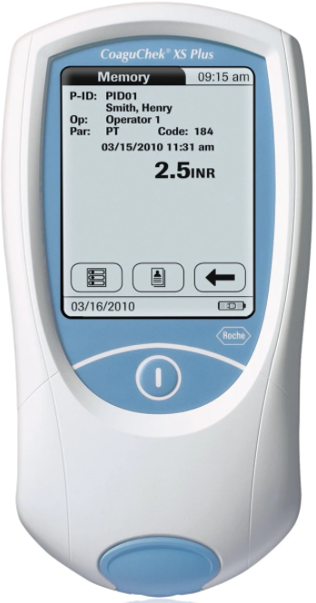
POC INR Testing
The CoaguChek XS system includes a meter, test strips and quality controls.
The handheld meter is battery operated for testing at patient bedside.
The CoaguChek INR is a CLIA Waived test for people taking Coumadin or Warfarin.
Finger stick whole blood (do not wipe away first drop- you want to collect the first drop).
Minimum specimen requirement 8μL whole blood.

Slide 3
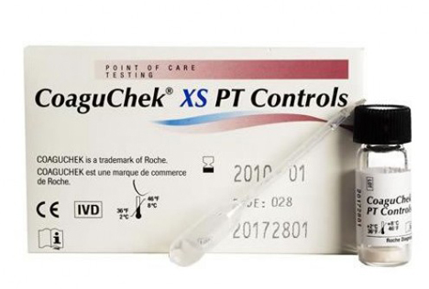
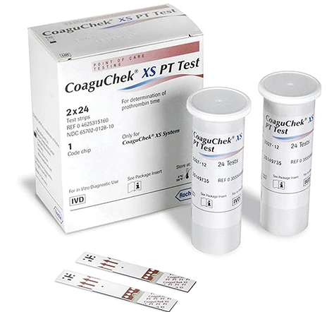
CoaguChek Supplies
Testing Strips
Quality Control

Slide 4
Testing Strips:
  Room Temperature Storage
  Keep container lid tightly closed
  Use test strip within 10 min after removing from container
  Stable until manufacturers expiration date on container
  Each box comes with matching Strip Code Chip- The code chip is how the meter receives lot information. Each code chip belongs to a particular lot of test strips.
Quality Control (Levels 1 and 2)
  Refrigerated Storage
  Run both levels once per week or with new lot/shipment change
  Use within 30 minutes of reconstitution
  Each box comes with pre-measured diluent droppers for reconstitution
  Each box comes with matching QC Code Chip.

Slide 5
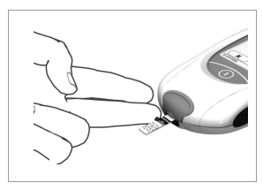
Patient Testing
Perform a finger stick on selected finger. Do NOT wipe away first drop.
Apply the first drop of blood within 15 seconds to test strip.
Hold the blood drop to the test strip until the meter beeps. Do not apply a second drop or disturb the meter while testing.
The INR test result will display in less than a minute.
Clean the meter between patients with purple top super sani cloths.
If retesting is necessary, use a new finger from the opposite hand.

Slide 6
Quality Control Testing
Both levels of QC (1 and 2) must be performed weekly or with new lot/shipment changes.
Ensure correct QC code chip has been inserted if using a new box or lot of controls.
If using new test strips from a new unopened box, you will need to change the test strip code chip.
The meter will display the acceptable control range when each QC test is run.
If QC results are not within range, repeat QC tests. Do not perform patient testing until QC tests are both within range.

Slide 7
Results and Limitations
The CoaguChek XS has been verified and approved for use for INR results from 0.8-6.0
Results above 6.0 should be repeated with a new finger stick or a venous PTINR for testing in the main lab.
If any INR result is accompanied by a “c”, you must consider this result inaccurate and the patient will need a venous blood draw PTINR. This error can be due to decreased or increased hematocrit levels (<25% or >55%).
If the meter displays any error message, repeat testing on a different finger or draw a venous PTINR for testing in the main lab.
Clean the meter as recommended in between patient testing with Purple Top Super Sani Cloth Germicidal Wipes.

