Slide 1
Hemoccult Sensa
Fecal Occult Blood Lab Test

Slide 2
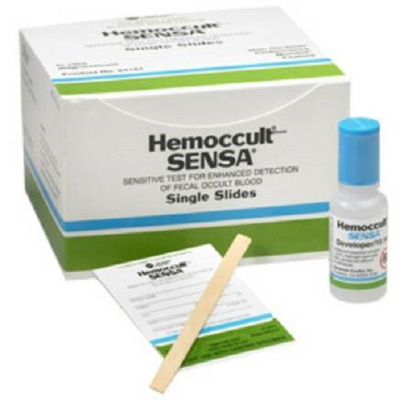
Supplies Needed:
Hemoccult Cards
Hemoccult Developer
Applicator Stick

Slide 3
***Special Note***
All developers must have expiration dates checked before use
All cards must have expiration dates checked before use
All tests performed must be ordered and resulted in patient EMR

Slide 4
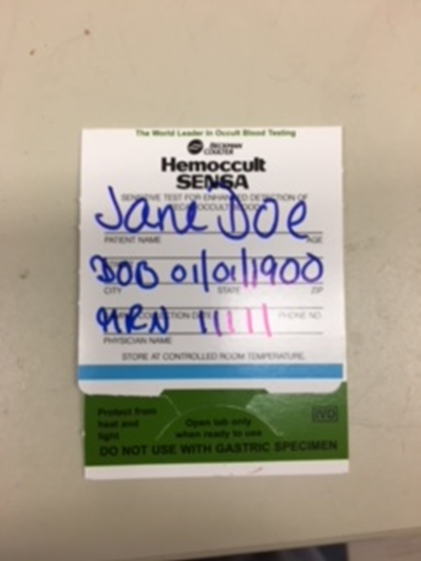
Label each card with patient information

Slide 5
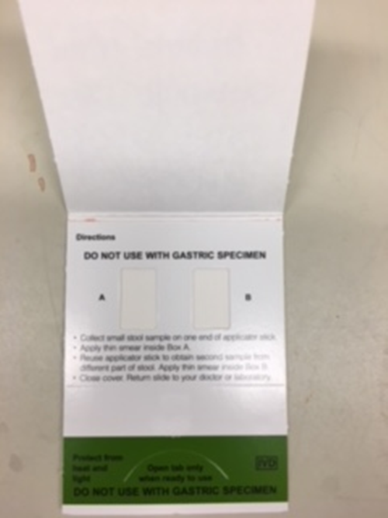
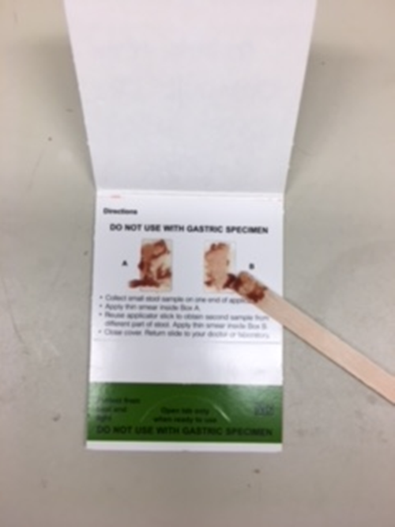
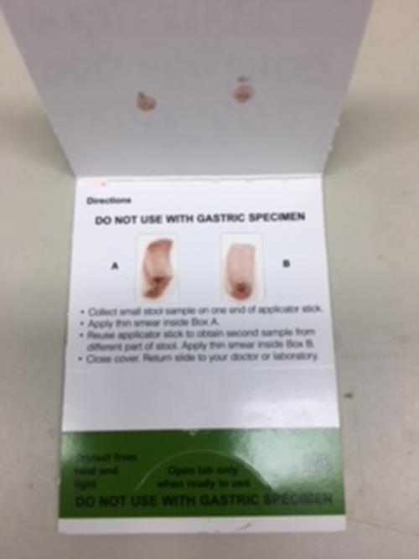
Open front cover where patient information is written. Apply stool specimen to Area A & B. Close card cover.
Wait 3-5 minutes before testing.

Slide 6
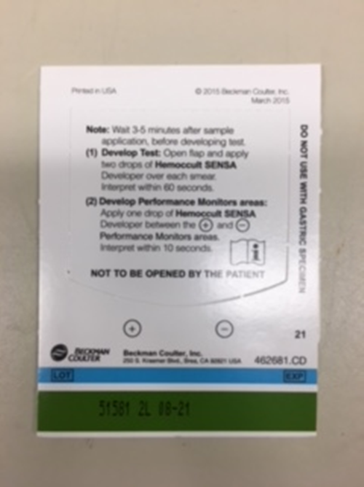
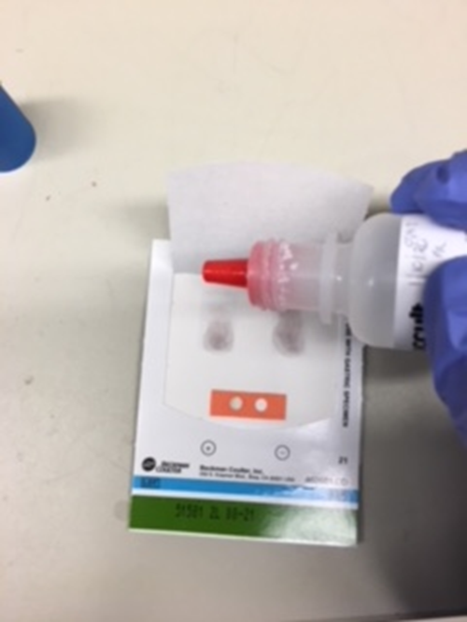
To test, open back cover with instructions. Apply 2 reagent drops on each application area (A&B) on backside of card (not where initial specimen was applied). Add a (1) drop of reagent to the center of internal QC area. Interpret within 60 seconds.
2 drops per application area
1 drop for QC area

Slide 7
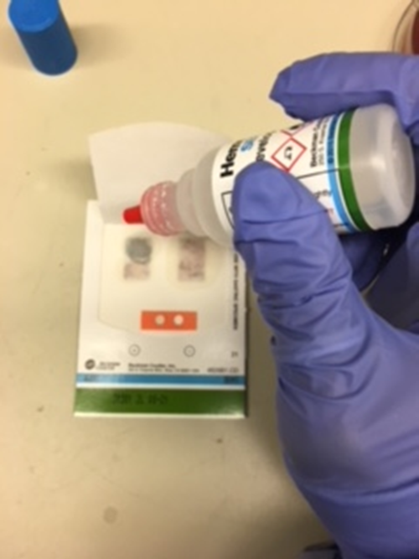
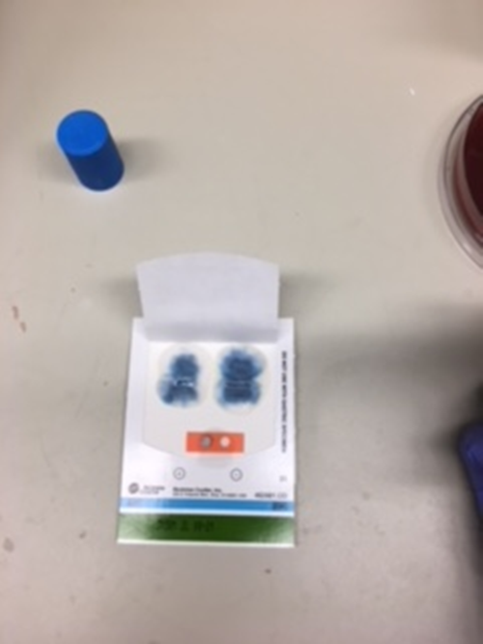
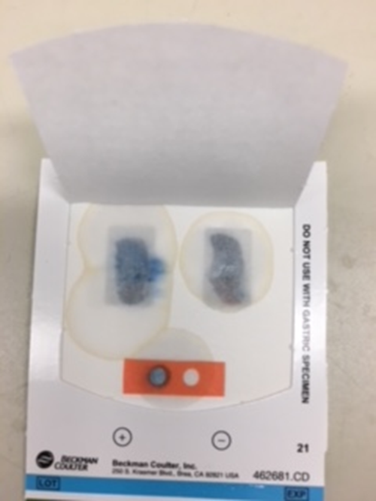
After adding reagent look for a blue color which indicates a positive result, even if only on one side of the card.
One side has blue = Positive
Both sides have blue = positive

Slide 8
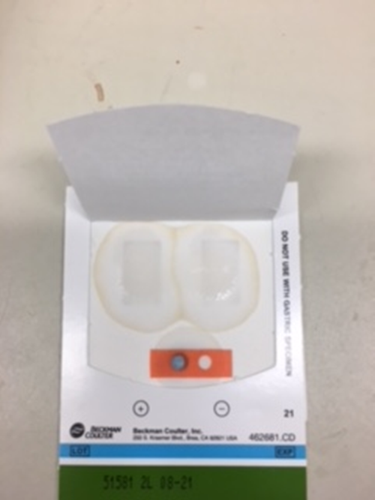
No color indicates a negative patient result.
QC must be positive
QC must be positive

Slide 9
ED Supplies for Fecal Occult Blood and Gatric Occult Blood testing
Supplies must be ordered via Logi-D
Or contact Materials Management
POCT/Main Lab doesn’t keep ED supply

