Slide 1
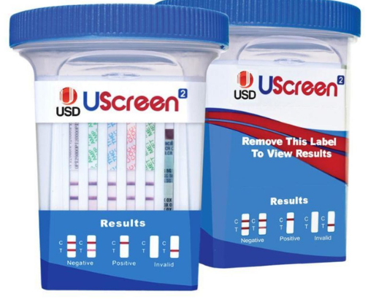
Alere Uscreen
12 Test Drug Cup

Slide 2
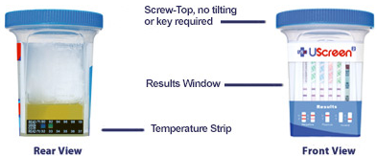
Overview:
CLIA-waived
Integrated urine test cup targets 12 drugs
Simple procedure: collect specimen, tighten lid and read drug results in five minutes
Specimen validity test combinations:
Creatinine (CR), pH (pH), and Specific Gravity (SG)
Each test strip has an Internal QC line
External QC is performed on each new lot, new shipment (same lot number) and for trouble shooting

Slide 3
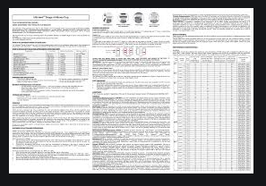
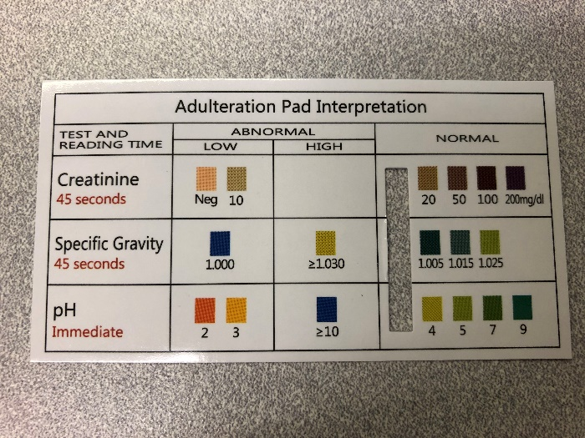
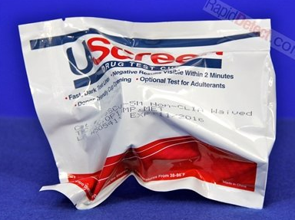
Materials and Storage
Store at room temperature
Keep away from direct sunlight, moisture and heat
DO NOT FREEZE
Do not use if test pouch is punctured or not sealed
Discard cup after first use. The test can not be used more than once
Each box contains 25 test pouches, 1 instruction sheet and 1 adulteration color comparison chart
Each test pouch contains a test cup with integrated test card

Slide 4
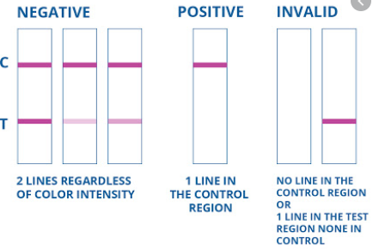
Quality Control - Internal
Alere UScreen 12 Drug Test Cup incorporates an internal quality control. The presence of a color band in the Control (C) region at the top of each drug test strip confirms that sufficient urine specimen volume and adequate membrane wicking exist.
QC Result Interpretation/Reporting:
  The presence of a color band in the control area indicates that the results in the drug test areas are valid.
  The absence of a color band in the control area indicates that the results in the drug test areas are invalid.
  When performing external QC, document the internal QC for each test strip on the QC log sheet.
  When performing a patient test, the internal QC for each test strip is recorded on the Patient Test Log.

Slide 5
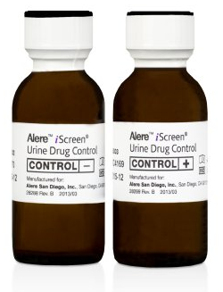
Quality Control - External
External QC = Alere Professional Cup Urine Drug Controls
Each bottle contains stabilized human based urine.
Positive control urines have been spiked with authentic reference drug standards and or appropriate metabolites.
Negative control urines are certified negative by immunoassay screening methods and GC/MS.
External QC is performed on receipt of each shipment and with new lot of Uscreen Drug Test Cups

Slide 6
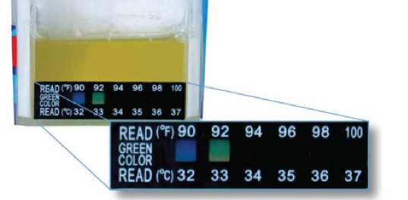
Using the UScreen Cup
Step 1 – Have the patient provide a specimen
Step 2 – Replace and tighten the cap. Verify the temperature is within the range on the temperature strip (90-100°F)
Step 3 – Remove the label to view the results
Step 4 – Place the slot on the adulterant color guide over the adulterant strip on the cup
Step 5 – Read the results when all “Control” lines have appeared. Wait 5 minutes to determine a non-negative result

Slide 7
Test Limitations
This test has been designed for testing urine samples only. No other fluids have been evaluated. Do not use this device to test substances other than urine.
This test is a qualitative screening assay. It is not designed to determine the quantitative concentration of drugs or the level of intoxication.
Adulterated urine samples may produce erroneous results. Strong oxidizing agents such as bleach (hypochlorite) can oxidize drug analytes. If a sample is suspected of being adulterated, obtain a new sample in a different, unused, cup.
This test is single use only.
Do not use the UScreen cup after the printed expiration date on the pouch.
Keep the UScreen cup in its original sealed pouch until ready for use. Do not use the test if the pouch is ripped or torn.

