Slide 1
Avoximeter 1000E
Whole blood oximeter

Slide 4
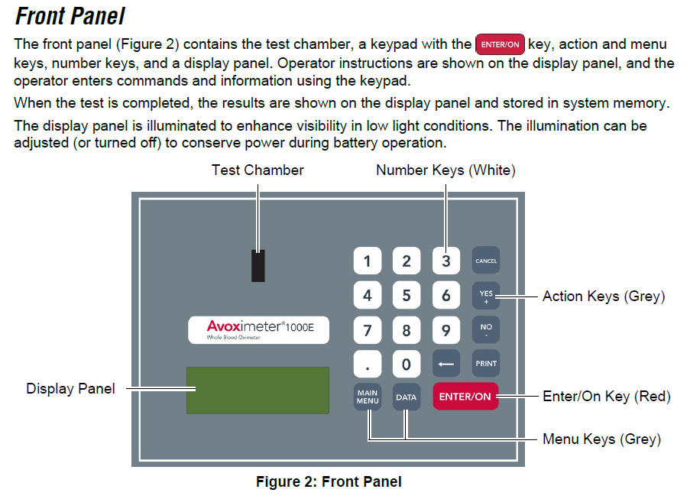

Slide 7
Optical QC is run using the yellow and orange optic filters. Optic filters have the lot number of the instrument printed on them. The optic filters cannot be interchanged between instruments. Each one is calibrated for a specific Avoximeter.

Slide 8
Liquid and Optical QC are documented on the Avoximeter 1000E Quality Control Log Sheets. Each log sheet should have lot numbers, expiration dates and expected ranges noted. Operators must verify that QC is in ranges noted on the QC Log Sheets before running patient samples.
Avoximeter 1000E Quality Control Log Sheet |  |  |  |  |  |  |  | Serial #:____________
Month:_______________________ |  |  | Yellow Filter (Run Optical QC Every 8 hours) |  |  | Orange Filter (Run Optical QC Every 8 hours) |  |  | QC Level 1 (Run once a week) |  |  | QC Level 3 (Run once a week)
Year: ______________ |  |  |  |  |  |  |  |  | Lot # _________________ |  |  | Lot # _________________
 |  |  |  |  |  |  |  |  | Exp date: ______________ |  |  | Exp date: ______________
Cuvette Lot #: ________________ |  |  | %HbO2 Range 93.5-96.5 | THb (g/dL) Range 7.7-8.3 | Passed | %HbO2 Range 37.2-40.8 | THb (g/dL) Range 16.4-17.6 | Passed | %HbO2 | THb (g/dL) | Passed | %HbO2 | THb (g/dL) | Passed
Cuvette Path: ________________ |  |  |  |  | (Y or N) |  |  | (Y or N) | Range | Range | (Y or N) | Range | Range | (Y or N)
Date | Time | Operator |  |  |  |  |  |  | _______ | _______ |  | ________ | _________
1
2
3
4
5
6
7
8
9
10
11
12
13
14
15
16
17
18
19
20
21
22
23
24
25
26
27
28
29
30
31
Comments:

Slide 9
Cuvettes must be stored in the original tightly sealed bag that contains a Humidity Indicator Card. Humidity greatly affects the cuvettes so humidity must be monitored. If circles on the humidity card are blue, the humidity is okay and cuvettes can be used for testing. If circles on card turn pink, humidity levels are too high. The more circles that are pink, the higher the humidity. If circles on humidity card are pink, the cuvettes cannot be used. A new humidity indicator card can be placed in the bag. Seal the bag tightly and let sit for 24 hours. If the humidity indicator card stays blue, the cuvettes are okay to use. If the new humidity card turns pink, contact Point of Care Testing for guidance.

Slide 10
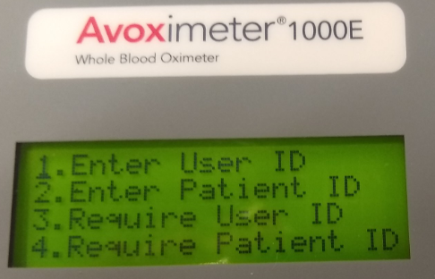
ENTERING A USER ID

Slide 11
ENTERING A SAMPLE ID

Slide 12
A whole blood sample is inserted into a test cuvette by connecting a luer lock syringe or slip syringe containing the whole blood sample to the filling port and then gently pressing the syringe plunger to dispense approximately 50 uL of whole blood into the test cuvette. Air escapes from the vent patch at the end of the test cuvette while the whole blood sample is being inserted. The test cuvette (with the syringe still attached) is then inserted into the test chamber of the instrument. Be sure to handle the cuvette by either the edges or the finger grip to avoid smudges in the light path area.

Slide 13
1) Connect a well-mixed syringe containing the sample to an unused cuvette holding the cuvette by the black finger grip. 2) Firmly holding the cuvette and syringe at a 45 degree angle, fill the cuvette by gently pressing down on the syringe plunger until the sample reaches the black vent patch. DO NOT CAUSE THE VENT PATCH TO BULGE. If the vent patch is bulging, discard the cuvette and charge the sample into a new cuvette. 3) Verify there are no bubbles in the light path area and there is no liquid or debris on the outside of the cuvette. If there are bubbles in cuvette or liquid/debris on outside of the cuvette, discard the cuvette and charge the sample into a new cuvette. **Never insert a cuvette with liquid/debris on the outside of the cuvette or a cuvette with a protruding vent patch into the test chamber. This could disable the instrument by contaminating the optics.**

Slide 14
Never depress the plunger when the syringe is in the test chamber. This will get blood on the optics and disable the instrument.

Slide 15
