Slide 1
DCA Vantage Analyzer for Hemoglobin A1c in Blood

Slide 2
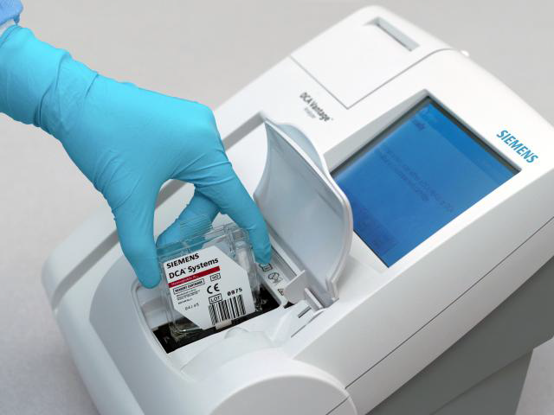
Parts of the DCA System
Analyzer
Reagent cartridge
Capillary holder
Calibration card
Quality control

Slide 3
Analyzer
The DCA Vantage system is a semi-automated, bench top system. It is designed to quantitatively measure the percent Hemoglobin A1c in blood.

Slide 4
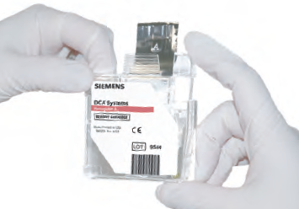
Reagent Cartridge
Reagent cartridges can be stored refrigerated at 2-8 degrees Celsius until the manufacturer’s expiration date or for three months at room temperature.
If storing at room temperature record the 3 month expiration date on the outside of the box.
Cartridges must be brought to room temperature before being used for patient testing.
CAUTION: when handling the reagent cartridge, do not touch or otherwise contaminate the optical window as this may cause error codes during testing.

Slide 5
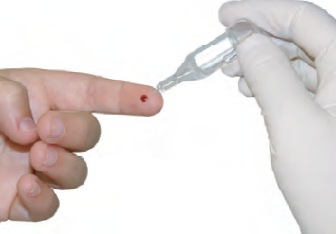
Capillary Holder
Capillary holders are used to collect the patient sample.
Capillary holders may be stored at room temperature or refrigerated.
Unused capillary holders may be saved and used with any lot of Hemoglobin A1c reagent cartridges.

Slide 6
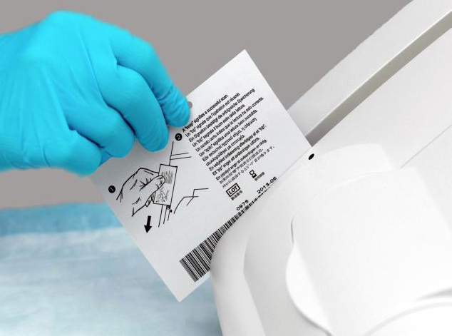
Calibration Card
The DCA Vantage is calibrated each time the calibration card is scanned and a new lot number of reagent is used.
The values for reagent calibration parameters are encoded onto the calibration card provided with each lot of reagent cartridges.
Prior to use of a new lot of reagent cartridges the calibration code must be scanned.
Insert the card above the dot on the analyzer barcode track with the barcode facing to the right.
A beep will sound when the scan is successful.

Slide 7
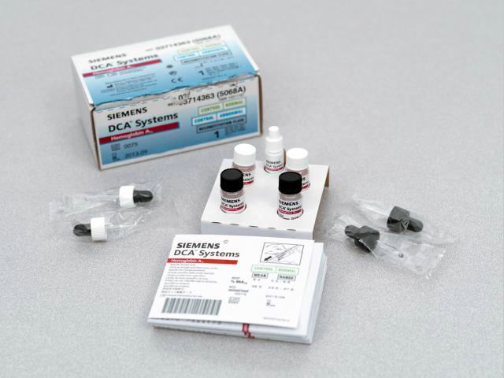
Quality Control
Quality control must be run on receipt of a new shipment, for each new lot number received, monthly for reagents that have been stored for more than 30 days, when patient results are in question and when trouble shooting the analyzer
Results must be acceptable before performing any patient testing.
When opening a new box of controls the controls must be reconstituted before using.
Once reconstituted, control vials are stable for 3 months.
Controls must be labeled with new 3 month expiration date.
Controls must be kept refrigerated (2-8 degrees Celsius) when not in use.
Quality control results must be recorded on the quality control log sheet.

Slide 8
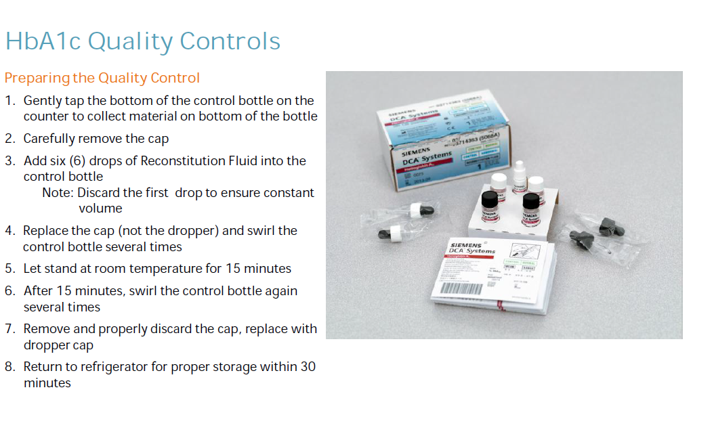

Slide 9
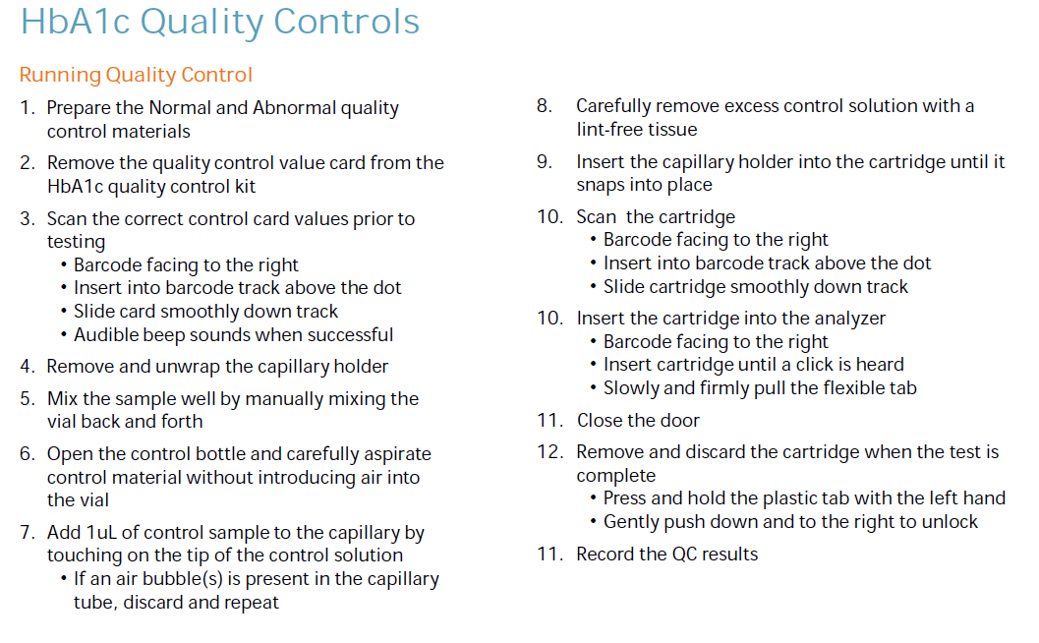

Slide 10
Testing a patient sample
Using two patient identifiers, verify the patient identification, and explain the finger stick procedure to the patient and or family.
Following the Patient Finger Stick Procedure perform a finger stick on the patient.
After performing the finger stick, wipe away the first drop of blood that forms.
Grasping the capillary holder (provided with the DCA Reagent Kit) at an angle, touch only the tip of the capillary holder to the drop of blood on the finger until the capillary is filled.
If blood contacts the plastic part of the capillary holder, discard the capillary holder and start over. Blood touching the plastic of the capillary holder can cause an invalid A1c result or possibly and error message.

Slide 11
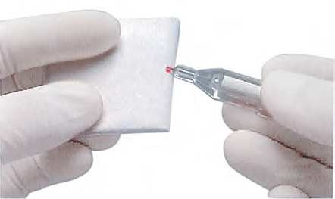
Testing a patient sample
Wipe the side of the capillary tube with a tissue.
Do not allow the issue to touch the open end of the glass capillary. Contact with the open end of the capillary could result in loss of sample. If sample loss is obvious discard the capillary holder. Repeat the procedure using a new capillary holder.
Inspect the glass capillary for the presence of bubbles. If bubbles are obvious, discard the capillary holder and repeat the procedure using a new capillary holder.
Once the capillary is filled with the sample, analysis must begin within 5 minutes.

Slide 12
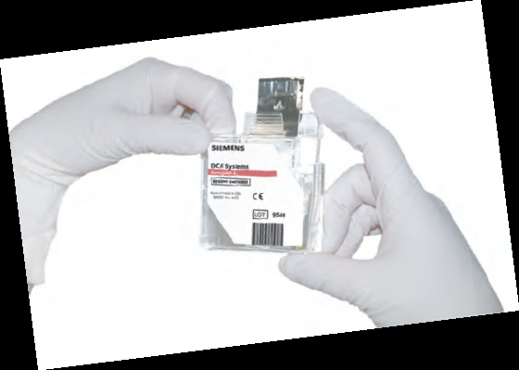
Testing a patient sample
Insert the capillary holder into the cartridge (flat side toward cartridge) until the holder snaps into place.
Do not touch or
otherwise contaminate
The optical window

Slide 13
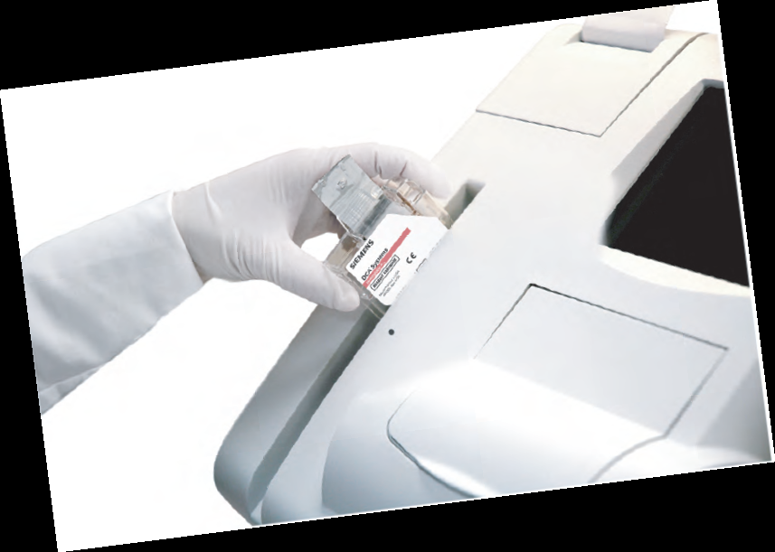
Testing a patient sample
Hold the cartridge so that the barcode faces to the right.
Insert the cartridge into the barcode track above the dot.
Quickly and smoothly, slide the cartridge down. A beep and display change indicate a successful scan; repeat if not successful.

Slide 14
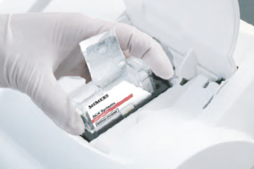
Testing a patient sample
Hold the cartridge so that the barcode faces to the right.
Open the door and insert the cartridge into the compartment until a click is heard.
Slowly and firmly pull to remove the flexible tab.
Close the door to start the test.

Slide 15
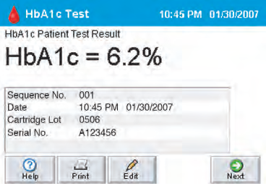
Testing a patient sample
Enter patient name and DOB into the instrument.
Allow 6 minutes for test to complete.
Patient results will automatically print when test is complete.
Record all patient and cartridge information on the patient results log.

Slide 16
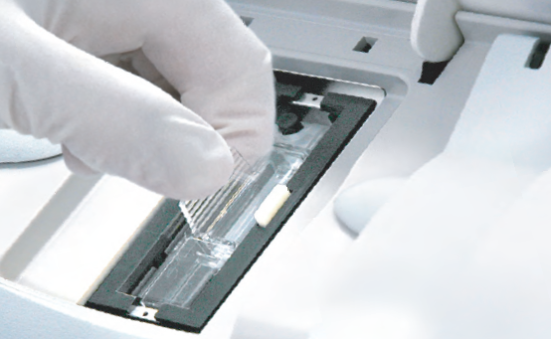
Testing a patient sample
To remove cartridge:
Select next, then open the door.
Push and hold down the button on the right side.
To unlock, gently push the tab on the cartridge to the right.
Pull out the cartridge.
Discard the cartridge.

Slide 17
Maintenance
Weekly:
  Clean exterior bar code window
Quarterly:
  Clean cartridge compartment
  Change air filter
  Run optical test cartridge
As Needed:
  Clean exterior
  Change air filter
  Calibrate touch screen
  Clean cartridge compartment bar code window
  Run optical test

Slide 18
Limitations
The reportable range of the analyzer is 2.5%-14.0%. Results outside this range must be reported as <2.5% or >14.0%.
The DCA HbA1c assay gives accurate and precise results over a range of total hemoglobin of 7 to 24 g/dL. Most patients will have hemoglobin concentrations within these values. However, patients with severe anemias may have hemoglobin concentrations lower than 7 g/dL, and patients with polycythemia may have hemoglobin concentrations above 24 g/dL. Patients known to have these conditions should be assayed by a test employing a different assay principle if their hemoglobin concentrations are outside of the acceptable range.
Glycated hemoglobin F is not measured by the DCA HbA1c assay.
At levels of hemoglobin F less than 10%, the DCA system accurately indicates the patient’s glycemic control. However, at very high levels of hemoglobin F (>10%), the amount of HbA1c is lower than expected because a greater proportion of the glycated hemoglobin is in the form of glycated hemoglobin F. HbA1c results for such patients do not accurately indicate the patient’s glycemic control and should not be compared to published normal or abnormal values.

Slide 19
Limitations continued
Conditions such as hemolytic anemia, polycythemia, homozygous HbS, and HbC, can result in decreased life span of the red blood cells, which causes HbA1c results to be lower than expected, regardless of the method used, and not be related to glycemic control, when using published reference ranges.
Bilirubin, up to a level of 20 mg/dL, does not interfere with this assay.
Triglycerides, up to 1347 mg/dL in fresh whole blood, do not interfere with this assay. Highly lipemic blood samples stored for long periods of time or frozen should not be assayed using this method.
Rheumatoid factor, up to 1:5120 titer, does not interfere with this assay.
Expected serum levels of the following drugs commonly prescribed to persons with diabetes do not interfere with this assay: Diabinese, Orinase, Tolinase, Micronase,Dymelor, glipizide.

