Slide 1
BD Veritor Plus
COVID, Flu A and Flu B Testing

Slide 2
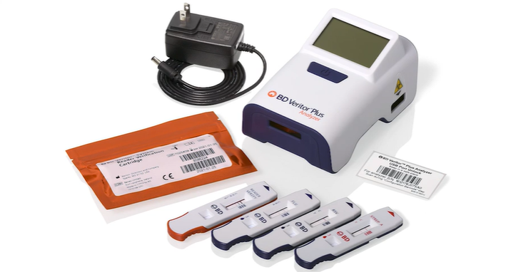
THE BD VERITOR PLUS SYSTEM includes:
▪ BD Veritor Plus analyzer with Reagent Verification Cartridge
▪ Info WiFi module
▪ Printer
▪ Covid/FluA/FluB test kits

Slide 3
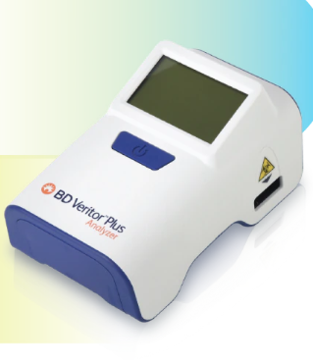
BD VERITOR PLUS ANALYZER
The BD Veritor Plus Analyzer is a digital immunoassay instrument. The Analyzer supports the use of different assays by reading an assay-specific barcode on the test device. The instrument communicates status and results to the operator via a liquid crystal display (LCD). It also can send results to a connected printer.

Slide 4
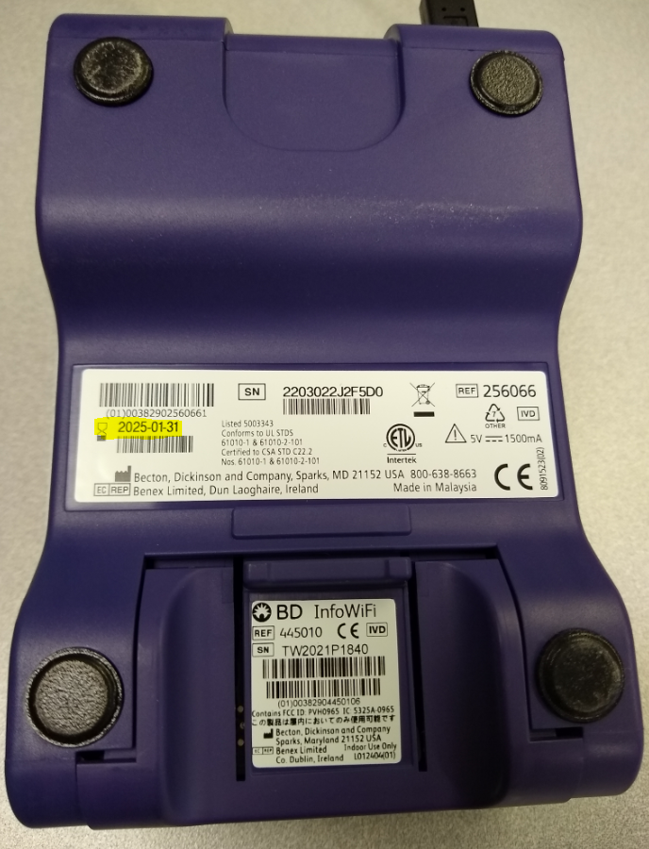
BD VERITOR PLUS EXPIRATON DATE
The BD Veritor Plus analyzer has a manufacturer expiration date printed on the back of it. However, once the analyzer is turned on, there is a 24 month or 3500 tests limit for the analyzer (or the manufacturer expiration date if that is earlier).
The analyzer will keep track and will display an hourglass icon if the in-use expiration is approaching.
Return expired analyzers to Point of Care Testing at the CH Main Laboratory for disposal.

Slide 5
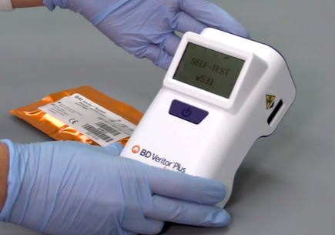
TURNING THE ANALYZER OFF AND ON
The BD Veritor Plus Analyzer has a single blue power button on its front panel.
To power on the analyzer, press the power button once and the analyzer will turn on and go through a self-test.
To power off the Analyzer, depress the power button for at least half a second and release.

Slide 6
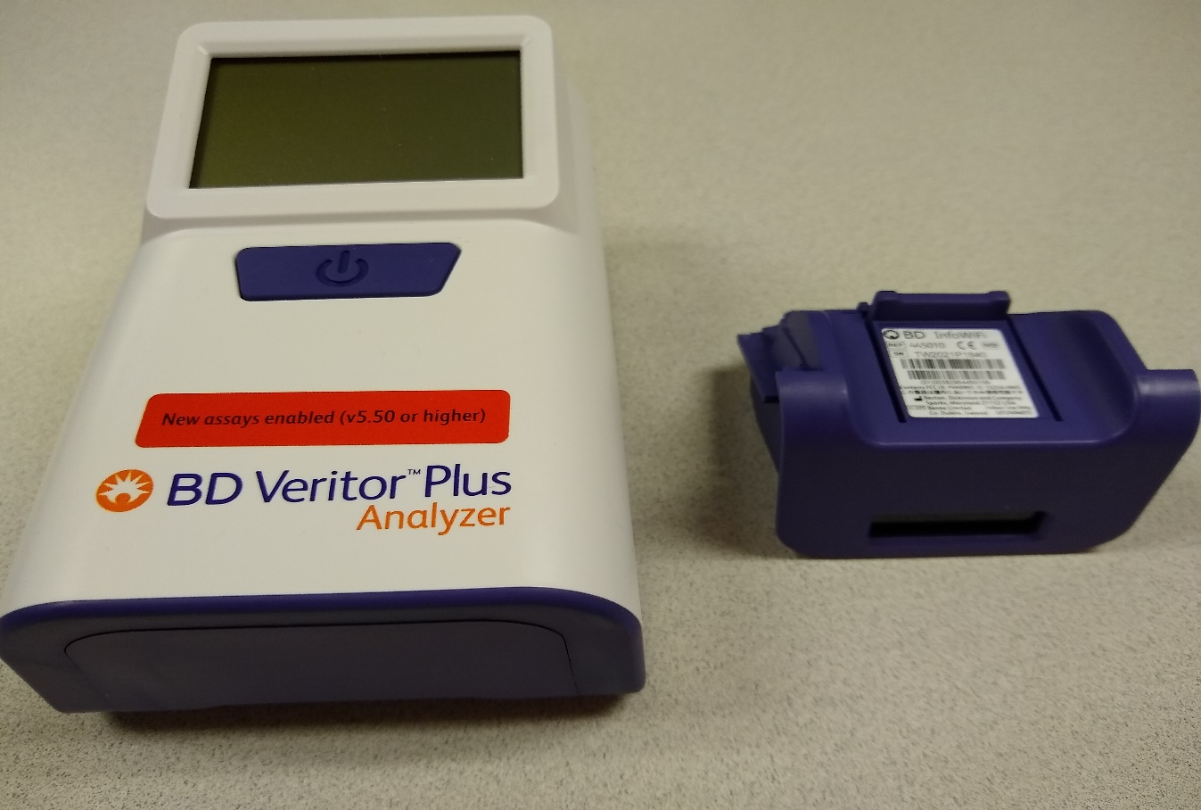
BD VERITOR INFO WIFI MODULE
We will be using the optional BD Veritor InfoWiFi module so that the analyzer can scan barcodes and communicate with a printer.
The InfoWiFi module is reusable and must be removed from the expired analyzer and installed in the new analyzer.

Slide 7
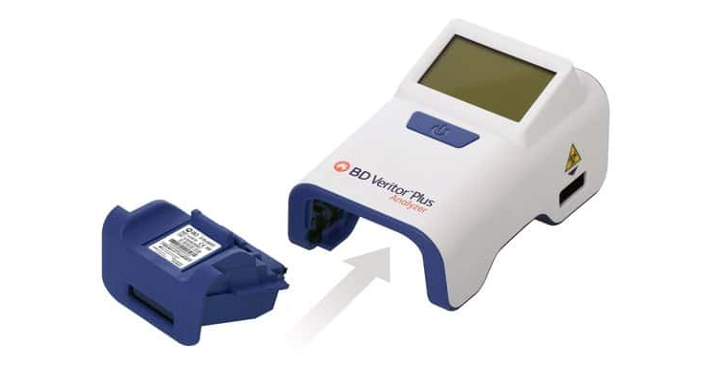
INSTALLING THE INFO WIFI MODULE
Press and hold the blue power button briefly to turn the analyzer off, then turn the analyzer over being careful not to touch the power button.
Ensure that the power button is not accidentally pressed while the analyzer is upside-down. Power to the Analyzer should remain off during module installation.

Slide 8
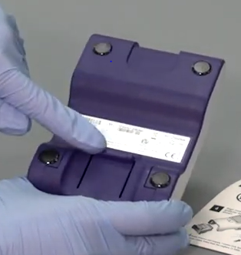
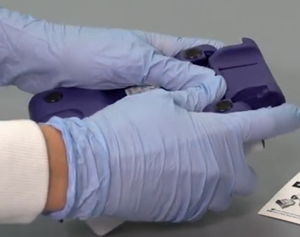
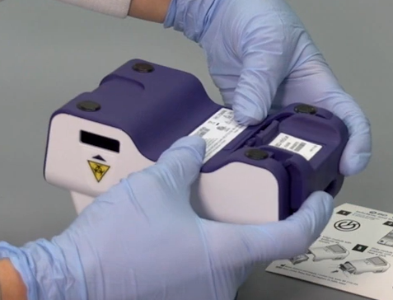
INSTALLING THE INFO WIFI MODULE
The analyzer must be OFF when changing the InfoWiFi module. Make sure you do not press the power button when changing the InfoWiFI module.
Slide the InfoWiFi module into the module bay until an audible click is heard.
Depress the locking tab on the module bay cover.
Slide off the module bay cover plate.

Slide 9
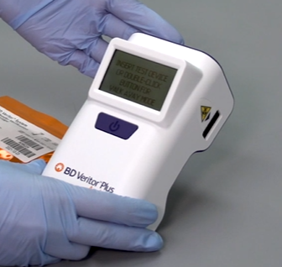
The analyzer will automatically detect the InfoWiFi module when it turns back on.
After the analyzer successfully completes the self-tests, it will be ready for testing when the display reads “INSERT TEST DEVICE OR DOUBLE-CLICK BUTTON FOR WALK AWAY MODE”.

Slide 10
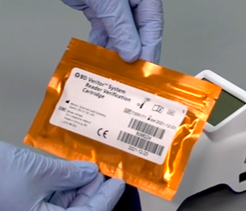
READER VERIFICATION CARTRIDGE
A BD Veritor System Reader Verification Cartridge comes with each analyzer. Before a new analyzer is put into use, the Reader Verification Cartridge must be run to verify that the analyzer is functioning properly. This cartridge should be kept with the analyzer in case it is needed for training or troubleshooting.

Slide 11
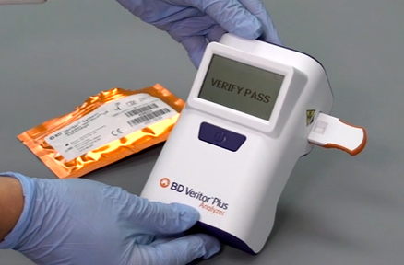
RUNNING THE SYSTEM VERIFICATION CARTRIDGE
Remove the System Verification Cartridge from its pouch and insert it into the slot on the right side of the analyzer with the writing and barcode facing up. You should hear a distinctive “click” when the cartridge is inserted correctly. After approximately 30 seconds, the message VERIFY PASS or VERIFY FAIL will display.
VERIFY PASS must display in order to use the analyzer for controls or test samples.
If VERIFY FAIL is displayed, repeat the test. If it fails for a second time contact PointofCare@crhc.org for further guidance.

Slide 12
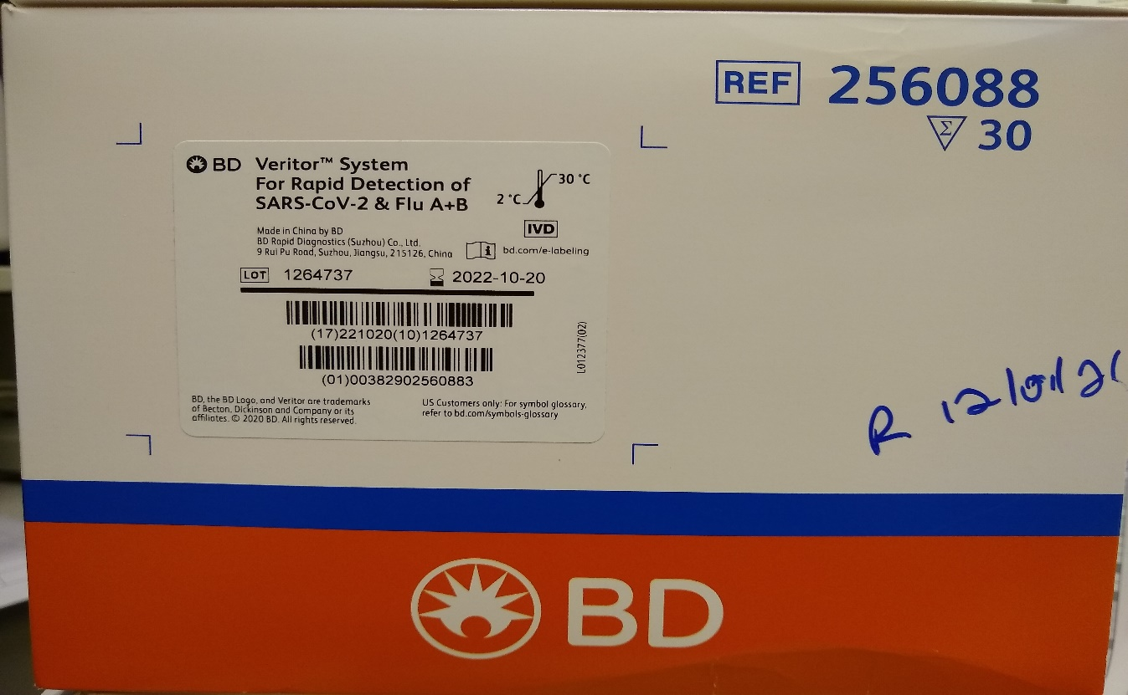
TEST KITS FOR RAPID DETECTION OF SARS-CoV-2 & Flu A+B
Test kits should be stored at 2–30 °C (35.6-86 °F). Do not freeze.
Reagents and devices must be at room temperature (15–30 °C, 59-86 °F) when used for testing.

Slide 13
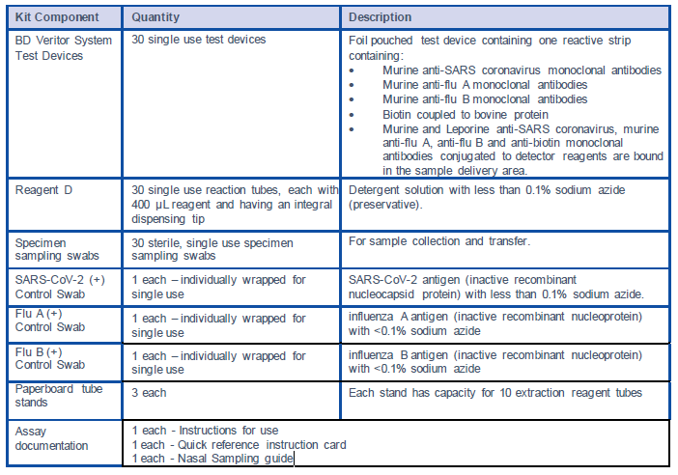
The following components are included in the BD Veritor System for Rapid Detection of SARS-CoV-2 & Flu A+B test kit.
(Extraction tube)

Slide 14
Internal Quality Controls
Each BD Veritor test device contains both positive and negative internal/procedural controls.
The internal positive control line validates the integrity of the device, proper reagent function, and assures correct use of the test device.
The internal negative control line (not marked on device) controls for sample specific non-specific signal.
The membrane area surrounding test lines functions as a background check on the assay device.
The BD Veritor instrument evaluates the positive and negative internal/procedural controls after insertion of each test device. The analyzer prompts the operator if a quality issue occurs during assay analysis.
Failure of the internal/procedural controls will generate an invalid test result.
(See Interpretation of Results for guidance with invalid results.)

Slide 15
External Quality Control Swabs
Positive control swabs are supplied with each kit. These provide additional quality control material to assess that the test reagents and the BD Veritor System Instrument perform as expected.
Each kit comes with a SARS-CoV-2 (+) Control Swab, Flu A (+) Control Swab and Flu B (+) Control Swab.
Prepare and test the positive control swabs using the same procedure as used for patient specimens. Controls swabs, reagents, and devices must be at room temperature (15–30 °C) for testing.
The positive control swabs should be run with:
each new kit lot
each new shipment
each new operator
when having issues with internal quality controls or questionable test results

Slide 16
If the kit controls do not perform as expected, do not report patient results. Contact Point of Care in the Main Laboratory for guidance.
Expected results for positive controls swabs:
The SARS-CoV-2 (+) Control Swab must be positive for CoV2 and negative for Flu A and Flu B.
The Flu A (+) Control Swab must be positive for Flu A and negative for CoV2 and Flu B.
The Flu B (+) Control Swab must be positive for Flu B and negative for CoV2 and Flu A.

Slide 17
There are 3 steps for BD Veritor samples:
1. SAMPLE COLLECTION
2. SAMPLE PROCESSING
3. SAMPLE TESTING

Slide 18
1. SAMPLE COLLECTION
When collecting nasal samples, use only the nasal swabs supplied in the kit.
Collect the anterior nasal swab sample by the dual nares collection method.
It is essential that correct specimen collection and preparation methods be followed. Inadequate specimen collection, improper specimen handling and/or transport may yield a falsely negative result.
This BD Veritor System assay kit is only intended for nasal swab specimens that are collected and tested directly (i.e., swabs that have NOT been placed in transport media).

Slide 19
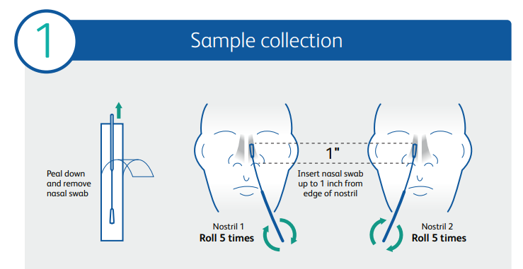
1. SAMPLE COLLECTION
- Insert the swab into one nostril of the patient. The swab tip should be inserted up to 2.5 cm (1 inch) from the edge of the nostril.
- Roll the swab 5 times along the mucosa inside the nostril to ensure that both mucus and cells are collected.
- Take at least 15 seconds to collect the specimen.
- Using the same swab, repeat this process for the other nostril to ensure an adequate sample is collected from both nasal cavities. - Withdraw the swab from the nasal cavity.
- The sample is now ready for processing.
The swab must be processed in the extraction reagent vial within one hour.

Slide 20
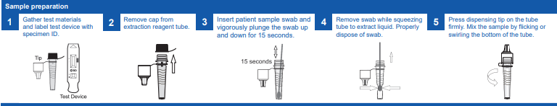
2. SAMPLE PROCESSING
1. Remove one extraction reagent tube and one BD Veritor System test device from its foil pouch immediately before testing.
2. Remove and discard the cap from the extraction reagent tube.
3. Taking care not to splash contents out of the tube, insert the swab into the tube and plunge the swab up and down in the fluid for a minimum of 15 seconds.
4. While firmly squeezing the sides of the tube to extract the specimen from the head of the swab, remove the swab from the extraction reagent. Ensure Swab is above liquid level before squeezing and twist as you remove swab.
5. Press the attached tip firmly onto the extraction reagent tube containing the processed sample (threading or twisting is not required). Mix thoroughly by swirling or flicking the bottom of the tube.
After the swab has been processed in the extraction reagent and the tube has been capped, the sample must be added to the test device within 30 minutes

Slide 21
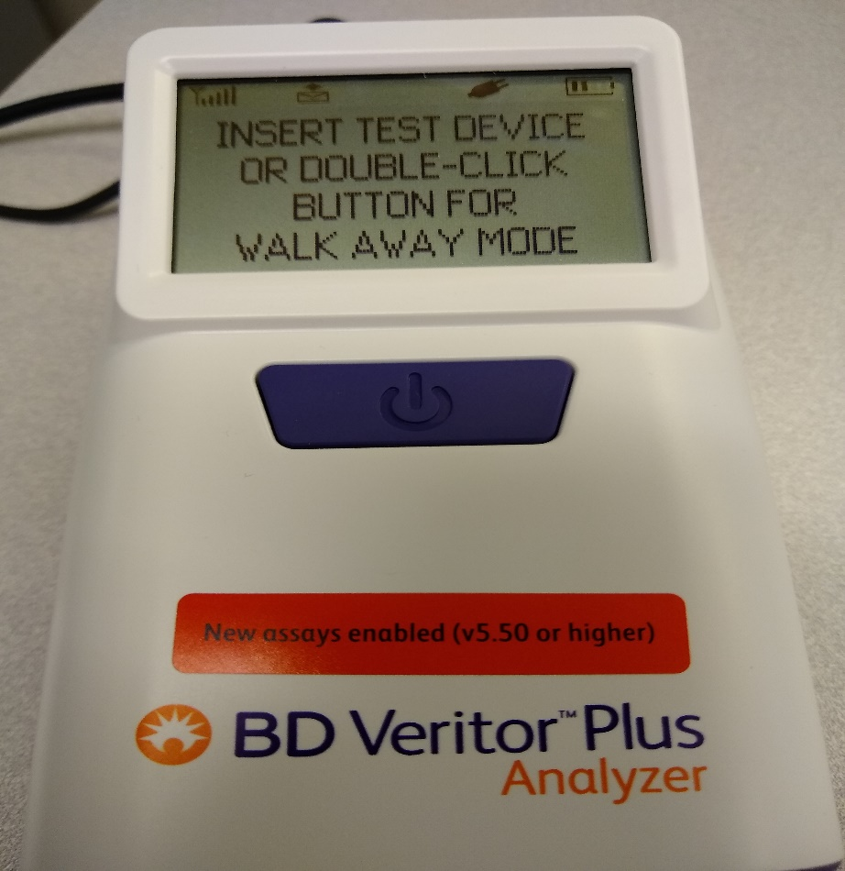
3. SAMPLE TESTING
Make sure that the analyzer displays “INSERT TEST DEVICE OR DOUBLE-CLICK BUTTON FOR WALK AWAY MODE”.
The analyzer does not store sample results, so make sure that the printer is on and ready to print before starting a test.

Slide 22
3. SAMPLE TESTING
There are two modes for testing using the BD Veritor Plus analyzer:
Analyze Now Mode - The sample is added to the test device. After a 15 minute incubation period, the device is loaded into the analyzer and the test is read within a few seconds.
This mode would be useful when there are multiple samples that need to be tested at the same time. Each sample would need a 15 minute timer but the samples can be read consecutively.
Walk Away Mode - The sample is added to the test device and immediately loaded into the analyzer. The analyzer will perform the 15 minute incubation and then read the test results.
When using this mode, only one sample can be tested at a time and the analyzer is unavailable to test any other samples for about 20 minutes.

Slide 23
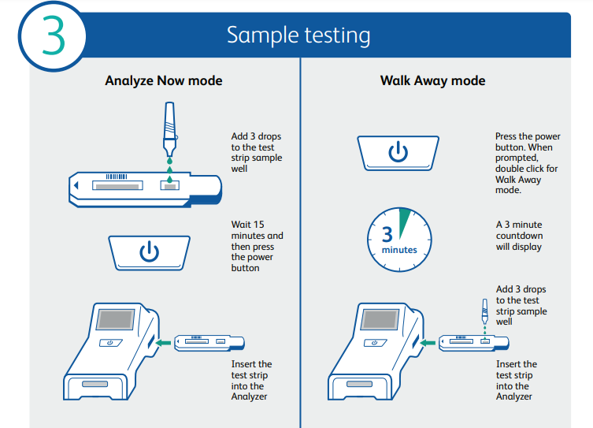
3. SAMPLE TESTING

Slide 24
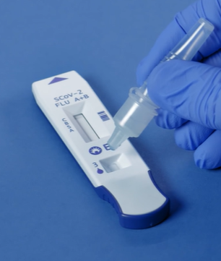
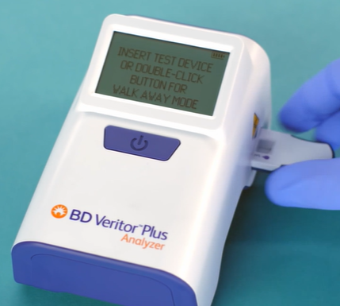
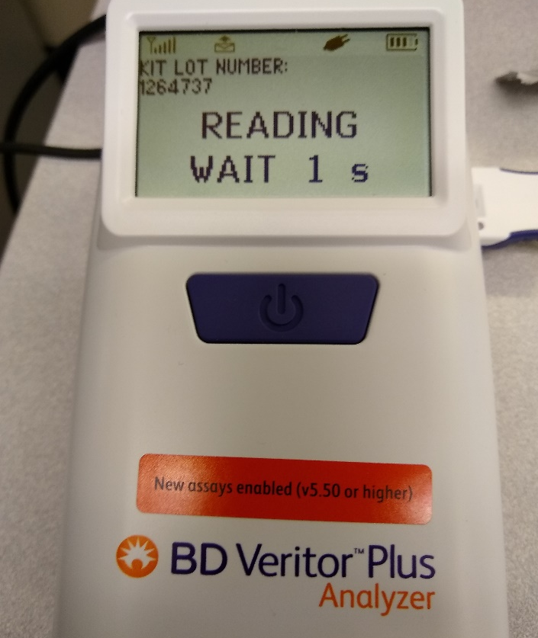
Analyze Now Mode
Insert test device into the slot on the right side of the analyzer.
Follow the prompts to scan user ID, specimen ID and kit lot #.
Add 3 drops of sample to sample well in test device.
Set timer for 15 minutes.
The analyzer will read the device and display results within seconds.

Slide 25
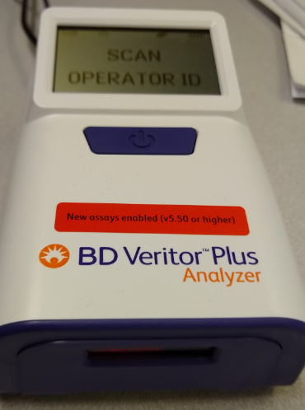
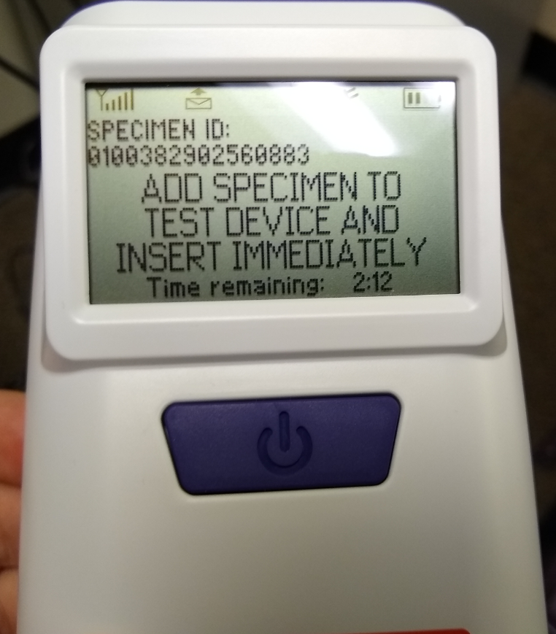
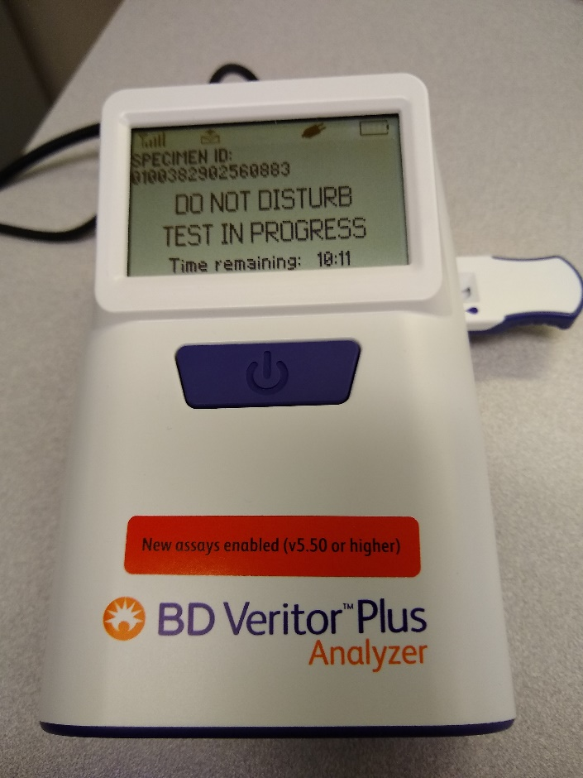
Walk Away Mode
Analyzer must be plugged in to use Walk Away Mode.
The analyzer will display a 15 minute countdown. After the 15 minutes, the device is read and results are displayed.
Do not disturb the device during the incubation or reading time.
Double-click the blue button and follow the prompts to scan operator ID, specimen ID and kit lot number.
The following screen will display. You have 3 minutes to add the sample to the device and insert it into the analyzer.

Slide 26
BARCODE SCANNING
When performing tests using the BD Veritor analyzer, follow the prompts on the display screen to complete barcode scans of:
– OPERATOR ID
– KIT LOT NUMBER (scan the top barcode on the kit)
Move barcodes slowly toward the window until a confirmation tone sounds. Do not touch the analyzer or remove the test device during this process. Doing so will abort the test.

Slide 27
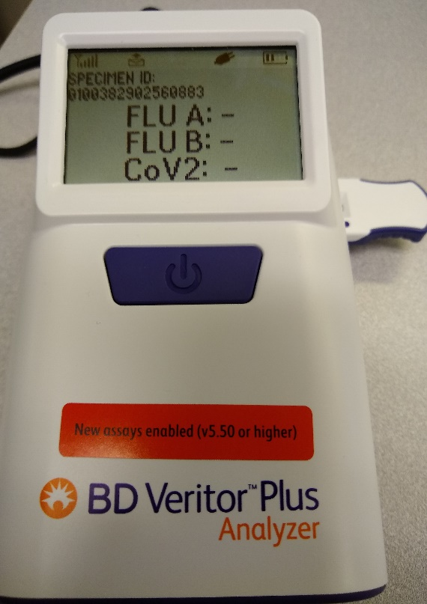
PRINTING RESULTS
When analysis is complete a result appears in the display window and the result will automatically print on the attached printer.
The analyzer does not store test results, so it is very important to verify that the printer is on and ready to print prior to starting a test. Results cannot be reprinted.
Results will disappear from the display screen as soon as the device is removed from the analyzer.

Slide 28
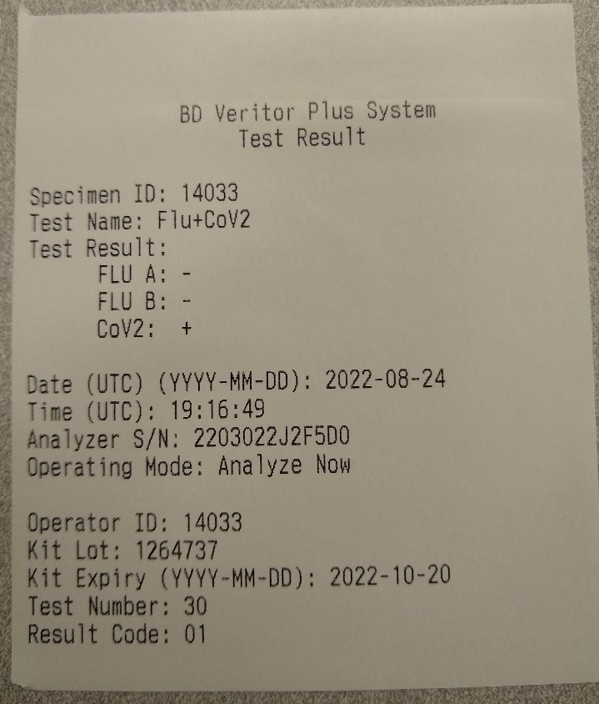
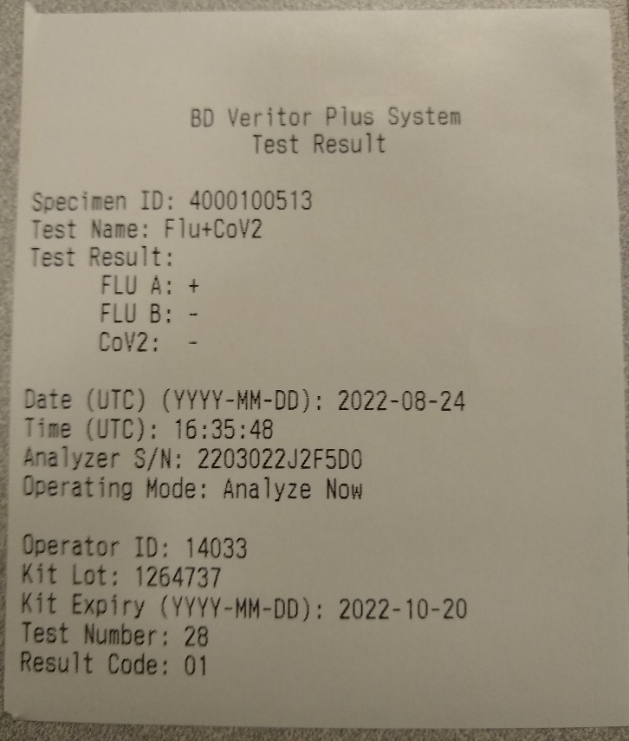
EXAMPLES OF TEST PRINTOUTS
Please note: Time is displayed in UTC (Universal Time Coordinated) which is 5 hours ahead of Eastern Standard Time (4 hours ahead during Daylight Savings Time). This is pre-programmed into the BD Veritor and cannot be changed.
Positive COVID test
Positive Flu A test

Slide 29
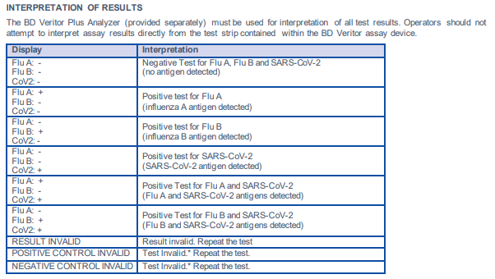
INTERPRETATION OF RESULTS
Test results must NOT be read visually. The BD Veritor Plus analyzer must be used for interpretation of all test results.
The following chart shows the possible test results displayed by the BD Veritor and the interpretation for each one:

Slide 30
INTERPRETATION OF RESULTS
POSITIVE TESTS - Positive results indicate the presence of SARS-CoV-2 or influenza viral antigens.
NEGATIVE TESTS - Negative results should be treated as presumptive. Negative test results do not preclude infection and should not be used as the sole basis for treatment or other patient management decisions, particularly in the presence of clinical signs and symptoms consistent with disease. It is recommended that these results be confirmed by a molecular testing method, if necessary.
RESULT INVALID - The instrument will display RESULT INVALID if both the Flu A and Flu B are positive, whether or not the SARS-CoV-2 result is also positive. Specimens generating RESULT INVALID should be retested. Upon retesting of the same specimen, if the specimen produces RESULT INVALID again, the user should retest using other methods (e.g., molecular testing) to determine whether the sample is positive or negative for SARS-CoV-2 or influenza virus. In this instance, the instrument is questioning interference in the test.
TEST INVALID - If the test is invalid, the Instrument will display “POSITIVE CONTROL INVALID” or “NEGATIVE CONTROL INVALID” and the patient specimen or control swab assay must be repeated. Do not report results. Repeat the test. It may be necessary to collect a fresh patient specimen, if more than one hour has passed since specimen collection, or more than 30 minutes since the specimen was placed into extraction buffer. If the “CONTROL INVALID” reading recurs, contact Point of Care in the Main Laboratory for guidance.

Slide 31
LIMITATIONS
Test results are not meant to be visually determined. All test results must be determined using the BD Veritor Plus Analyzer.
When collecting anterior nasal swab sample, use only the nasal swab supplied in the kit.
Users should test specimens as quickly as possible after specimen collection and always process the swab within one hour of specimen collection and within 30 minutes of placing the swab into the extraction reagent.
Do not analyze test devices before 15 minutes as this could result in a false negative or invalid result.
Do not analyze devices after 20 minutes as false positive or invalid results may occur.
The amount of antigen in a sample may decrease as the duration of illness increases. Specimens collected after day 6 of illness are more likely to be negative when compared to an RT-PCR assay.
A false-negative test result may occur if the level of viral antigen in a sample is below the detection limit of the test or if the sample was collected or transported improperly; therefore, a negative test result does not eliminate the possibility of infection.

Slide 32
MAINTENANCE
The outer case and display may be wiped with a clean towel lightly moistened with 70% isopropyl alcohol or a 10% bleach solution.
Do not introduce the cleaning solution or any other liquids directly into the unit. Do not use a saturated towel which may introduce liquid into the case or display seams. Ensure that the BD Veritor Plus Analyzer is dry and the surface is free of any residual cleaning solution prior to returning to use.
Do not clean the barcode scanner window with any cleaning agent. Use a clean, soft towel lightly moistened with plain water to clean the window gently. Scratching the window may reduce the scanner’s performance.
There are no user serviceable components in the unit. For issues with the analyzer, contact Point of Care Testing in the Main Laboratory.

