Slide 1
BD Veritor Plus
RESPIRATORY Syncytial virus (RSV) Testing

Slide 2
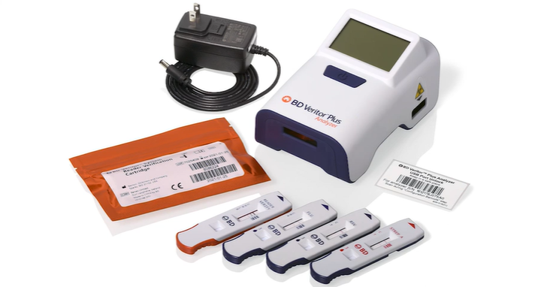
THE BD VERITOR PLUS SYSTEM includes:
▪ BD Veritor Plus analyzer with Reagent Verification Cartridge
▪ Info WiFi module
▪ Printer
▪ Respiratory Syncytial Virus (RSV) test kits

Slide 3
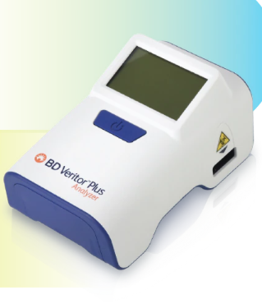
BD VERITOR PLUS ANALYZER
The BD Veritor Plus Analyzer is a digital immunoassay instrument. The Analyzer supports the use of different assays by reading an assay-specific barcode on the test device. The instrument communicates status and results to the operator via a liquid crystal display (LCD). It also can send results to a connected printer.

Slide 4
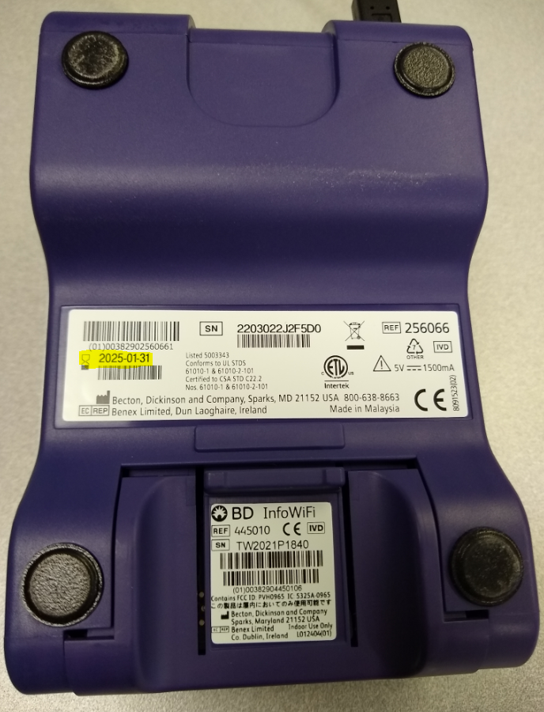
BD VERITOR PLUS EXPIRATON DATE
The BD Veritor Plus analyzer has a manufacturer expiration date printed on the back of it. However, once the analyzer is turned on, there is a 24 month or 3500 tests limit for the analyzer (or the manufacturer expiration date if that is earlier).
The analyzer will keep track and will display an hourglass icon if the in-use expiration is approaching.
Return expired analyzers to Point of Care Testing at the CH Main Laboratory for disposal.

Slide 5
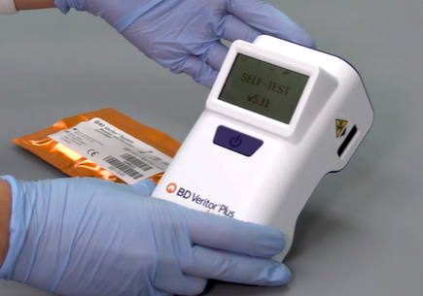
TURNING THE ANALYZER OFF AND ON
The BD Veritor Plus Analyzer has a single blue power button on its front panel.
To power on the analyzer, press the power button once and the analyzer will turn on and go through a self-test.
To power off the Analyzer, depress the power button for at least half a second and release.

Slide 6
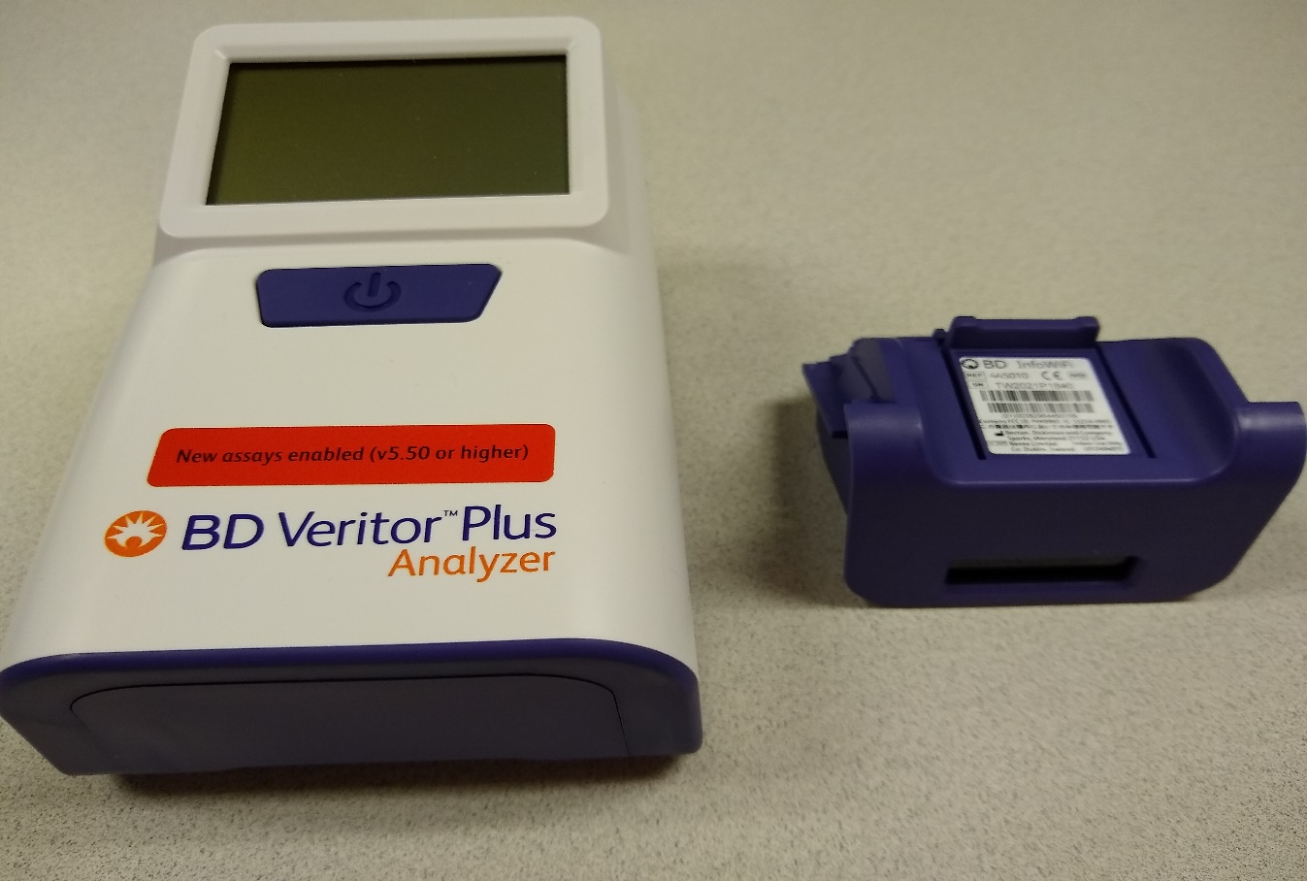
BD VERITOR INFO WIFI MODULE
We will be using the optional BD Veritor InfoWiFi module so that the analyzer can scan barcodes and communicate with a printer.
The InfoWiFi module is reusable and must be removed from the expired analyzer and installed in the new analyzer.

Slide 7
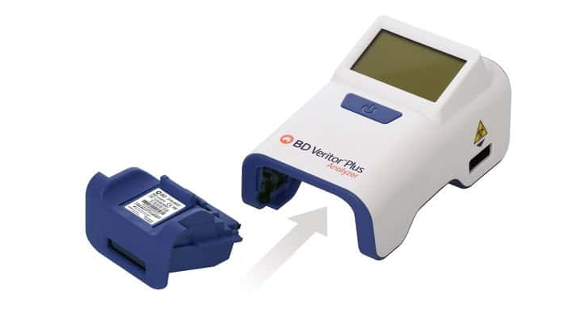
INSTALLING THE INFO WIFI MODULE
Press and hold the blue power button briefly to turn the analyzer off, then turn the analyzer over being careful not to touch the power button.
Ensure that the power button is not accidentally pressed while the analyzer is upside-down. Power to the Analyzer should remain off during module installation.

Slide 8
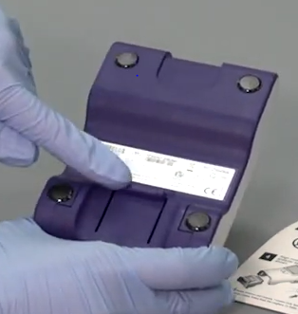
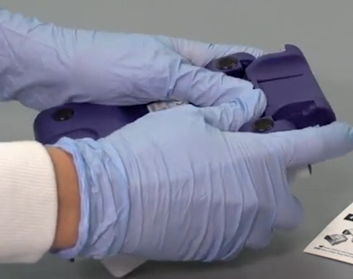
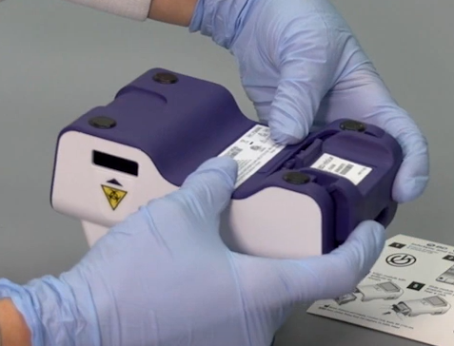
INSTALLING THE INFO WIFI MODULE
The analyzer must be OFF when changing the InfoWiFi module. Make sure you do not press the power button when changing the InfoWiFI module.
Slide the InfoWiFi module into the module bay until an audible click is heard.
Depress the locking tab on the module bay cover.
Slide off the module bay cover plate.

Slide 9
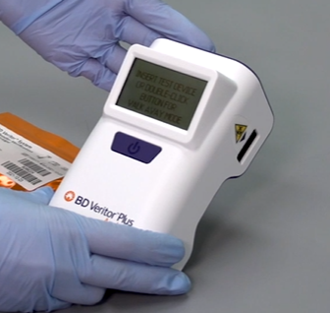
The analyzer will automatically detect the InfoWiFi module when it turns back on.
After the analyzer successfully completes the self-tests, it will be ready for testing when the display reads “INSERT TEST DEVICE OR DOUBLE-CLICK BUTTON FOR WALK AWAY MODE”.

Slide 10
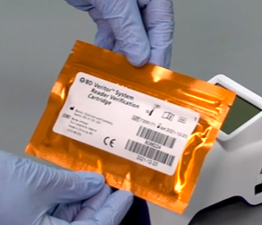
READER VERIFICATION CARTRIDGE
A BD Veritor System Reader Verification Cartridge comes with each analyzer. Before a new analyzer is put into use, the Reader Verification Cartridge must be run to verify that the analyzer is functioning properly. This cartridge should be kept with the analyzer in case it is needed for training or troubleshooting.

Slide 11
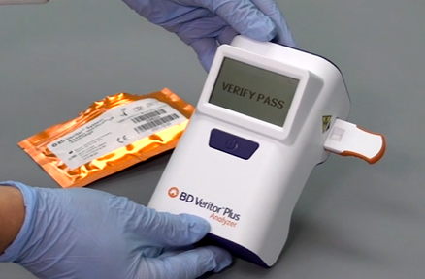
RUNNING THE SYSTEM VERIFICATION CARTRIDGE
Remove the System Verification Cartridge from its pouch and insert it into the slot on the right side of the analyzer with the writing and barcode facing up. You should hear a distinctive “click” when the cartridge is inserted correctly. After approximately 30 seconds, the message VERIFY PASS or VERIFY FAIL will display.
VERIFY PASS must display in order to use the analyzer for controls or test samples.
If VERIFY FAIL is displayed, repeat the test. If it fails for a second time contact PointofCare@crhc.org for further guidance.

Slide 12
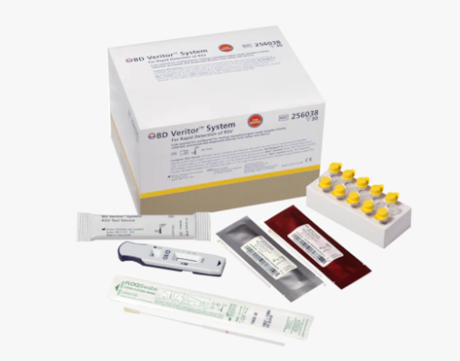
TEST KITS FOR RAPID DETECTION OF RSV
Test kits should be stored at 2–30 °C (35.6-86 °F). Do not freeze.
Reagents and devices must be at room temperature (15–30 °C, 59-86 °F) when used for testing.

Slide 13
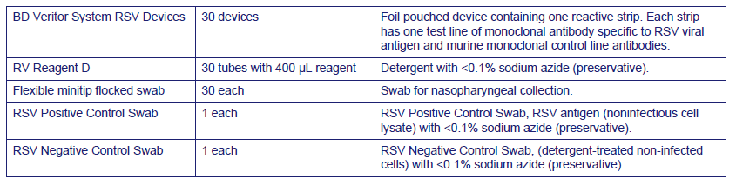
The following components are included in the BD Veritor System for Rapid Detection of RSV test kit:
(Extraction tube)

Slide 14
Internal Quality Controls
Each BD Veritor RSV test device contains both positive and negative internal/procedural controls.
The internal positive control validates the immunological integrity of the device, proper reagent function, and assures correct test procedure.
The membrane area surrounding test lines functions as a background check on the assay device.
The BD Veritor instrument evaluates the positive and negative internal/procedural controls after insertion of each test device. The analyzer prompts the operator if a quality issue occurs during assay analysis.
Failure of the internal/procedural controls will generate an invalid test result.
(See Interpretation of Results for guidance with invalid results.)

Slide 15
External Quality Control Swabs
RSV + and RSV - control swabs are supplied with each kit. These controls provide additional quality control material to assess that the test reagents and the BD Veritor System Instrument perform as expected.
Process the control swabs as follows:
1. Remove and discard the cap from the RV Reagent D tube corresponding to the sample to be tested.
2. Insert the control swab into the tube and vigorously plunge the swab up and down in the fluid for a minimum of 15 seconds.
3. Remove the swab while squeezing the sides of the tube to extract the liquid from the swab.
Test the control swabs using the same procedure as used for patient specimens.
(Controls swabs, reagents, and devices must be at room temperature (15–30 °C) for testing.)
The positive control swabs should be run with:
each new kit lot
each new shipment
each new operator (when running QC on new lots/shipments show the new operators how to do it)
when having issues with internal quality controls or questionable test results

Slide 16
If the kit controls do not perform as expected, do not report patient results. Contact Point of Care in the Main Laboratory for guidance.
Expected results for RSV controls swabs:
The RSV + Control Swab must be positive for RSV.
The RSV - Control Swab must be negative for RSV.

Slide 17
There are 3 steps for BD Veritor samples:
1. SAMPLE COLLECTION
2. SAMPLE PROCESSING
3. SAMPLE TESTING

Slide 18
SAMPLE COLLECTION
The CLIA-waived BD Veritor System for Rapid detection of RSV kit is only intended for nasopharyngeal swab specimens that are collected and tested directly. This kit is NOT INTENDED for testing liquid samples such as wash or aspirate samples or swabs in transport media as results can be compromised by over dilution.
This test is intended for use to aid in the diagnosis of RSV infections in infants and pediatric patients under the age of 6 years. Only children <6 years old can be tested with this RSV kit.
Collect nasopharyngeal samples, using the flexible minitip flocked swabs supplied in the kit.
Specimens obtained early in the course of the illness will contain the highest viral titers.
It is essential that correct specimen collection and preparation methods be followed. Inadequate specimen collection, improper specimen handling and/or transport may yield a falsely negative result.

Slide 19
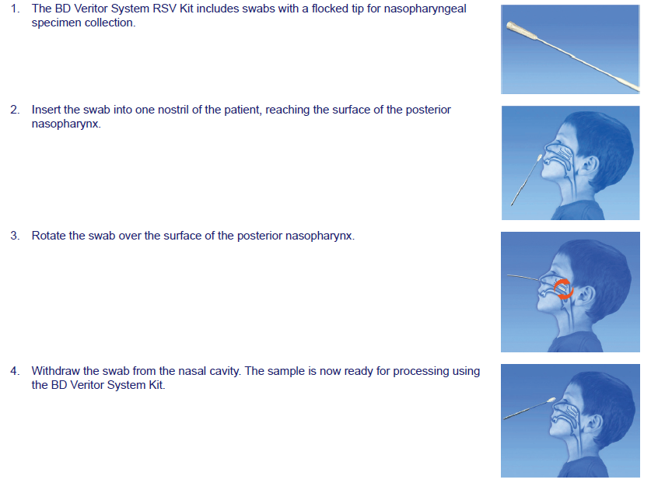
1. SAMPLE COLLECTION
The swab must be processed within one hour of sample collection.

Slide 20
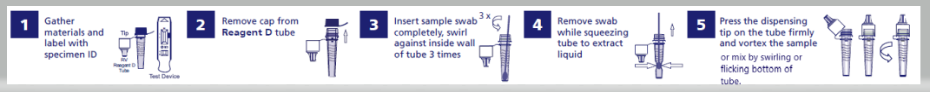
2. SAMPLE PROCESSING
1. Remove one RV Reagent D tube and one BD Veritor System RSV test device from its foil pouch immediately before testing.
2. Remove and discard the cap from the reagent tube.
3. Insert the patient swab all the way into the Reagent D tube and swirl it against the inside wall three times.
4. Remove the swab while squeezing the sides of the tube to extract the liquid from the swab and properly dispose of the swab.
5. Press the attached tip firmly onto the reagent tube containing the processed sample.
6. Mix thoroughly by swirling or flicking the bottom of the tube.

Slide 21
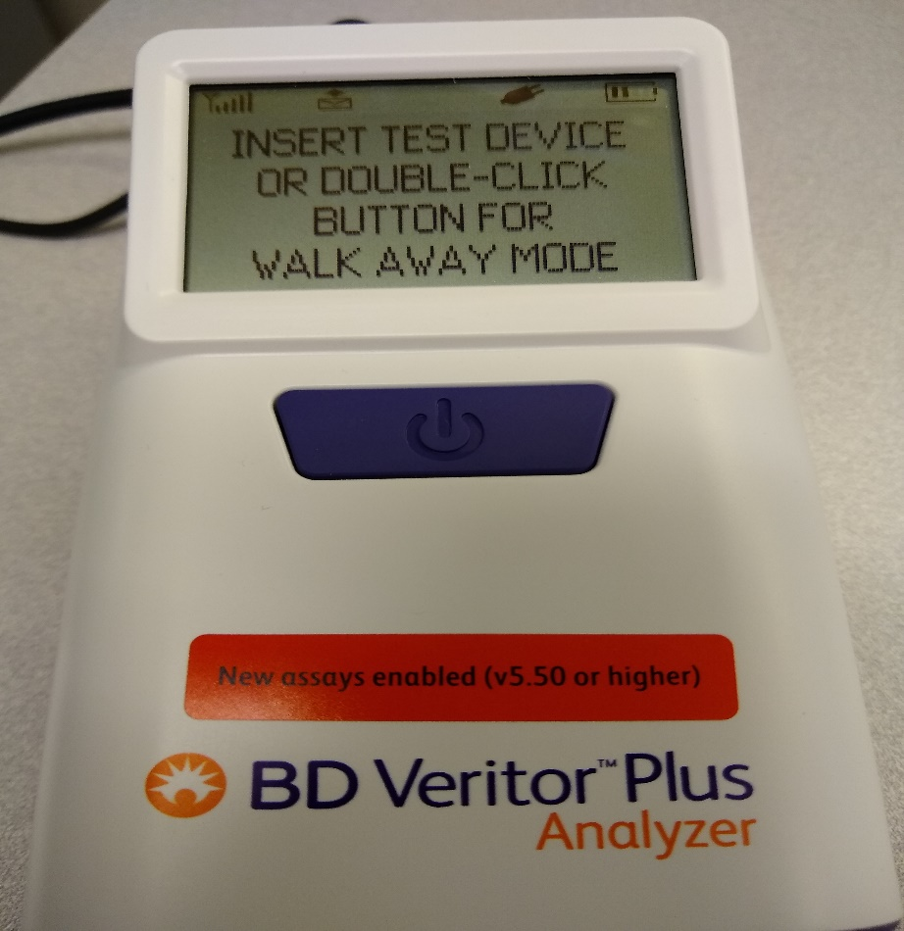
3. SAMPLE TESTING
Make sure that the analyzer displays “INSERT TEST DEVICE OR DOUBLE-CLICK BUTTON FOR WALK AWAY MODE”.
The analyzer does not store sample results, so make sure that the printer is on and ready to print before starting a test.

Slide 22
3. SAMPLE TESTING
There are two modes for testing using the BD Veritor Plus analyzer:
Analyze Now Mode - The sample is added to the test device. After a 10 minute incubation period, the device is loaded into the analyzer and the test is read within a few seconds.
This mode would be useful when there are multiple samples that need to be tested at the same time. Each sample would need a 15 minute timer but the samples can be read consecutively.
Walk Away Mode - The sample is added to the test device and immediately loaded into the analyzer. The analyzer will perform the 10 minute incubation and then read the test results.
When using this mode, only one sample can be tested at a time and the analyzer is unavailable to test any other samples for about 15 minutes.

Slide 23
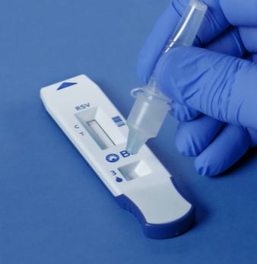
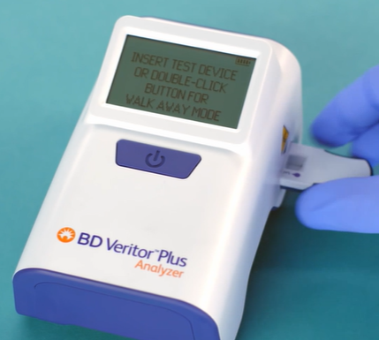
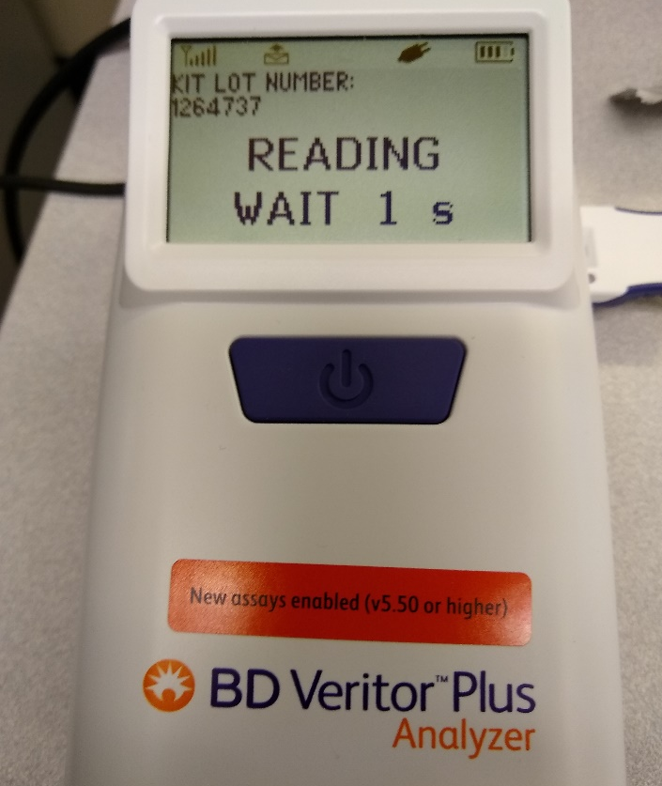
Analyze Now Mode
Insert test device into the slot on the right side of the analyzer after the 10 minute incubation.
Follow the prompts to scan user ID and and kit lot #.
Add 3 drops of sample to sample well in test device.
Set timer for 10 minutes.
The analyzer will read the device and display results within seconds.

Slide 24
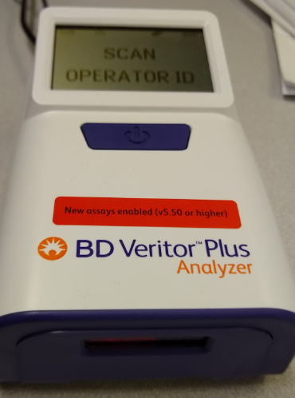
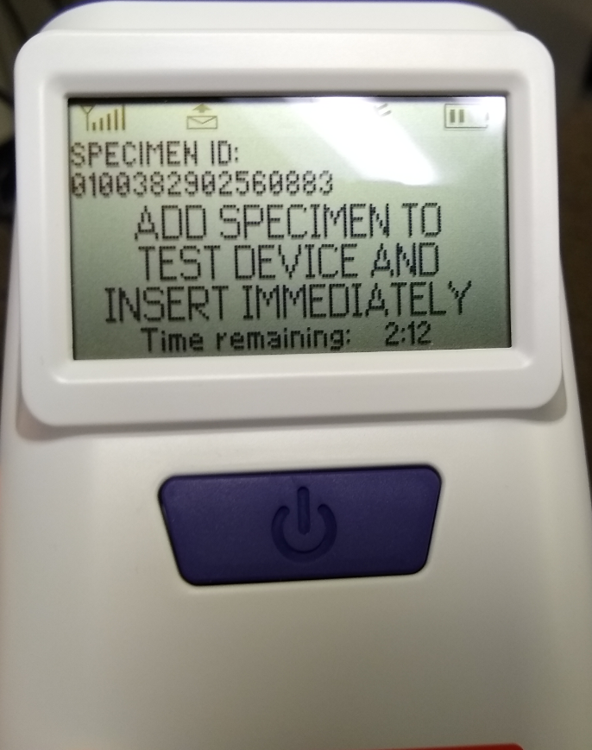
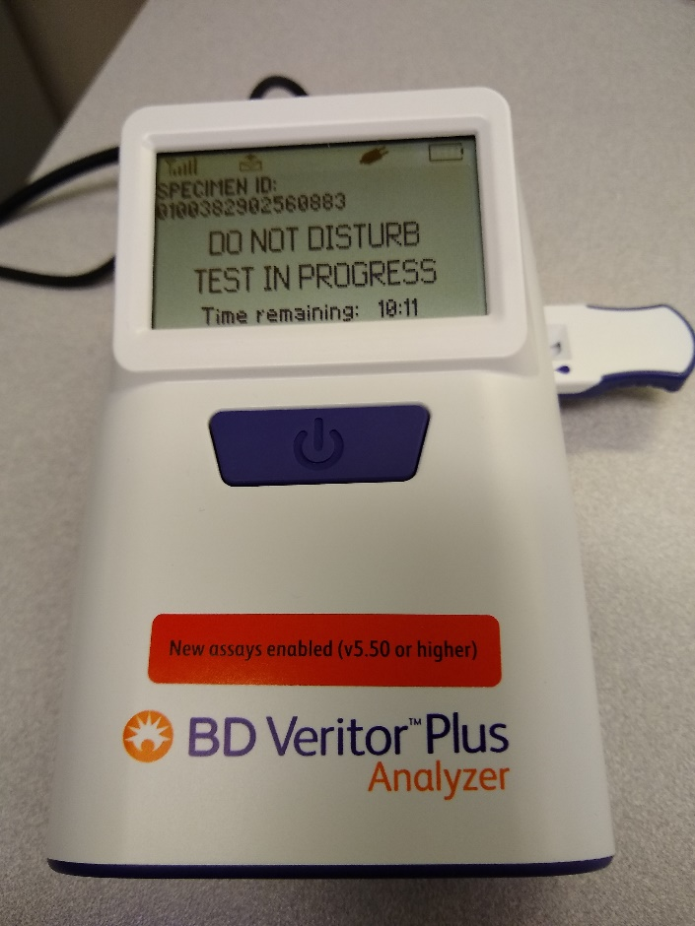
Walk Away Mode
Analyzer must be plugged in to use Walk Away Mode.
The analyzer will display a 10 minute countdown. After the 10 minutes, the device is read and results are displayed.
Do not disturb the device during the incubation or reading time.
Double-click the blue button and follow the prompts to scan operator ID and kit lot number.
The following screen will display. You have 3 minutes to add 3 drops of the sample onto the device and insert it into the analyzer.

Slide 25
BARCODE SCANNING
When performing tests using the BD Veritor analyzer, follow the prompts on the display screen to complete barcode scans of:
– OPERATOR ID
– KIT LOT NUMBER (scan the barcode on the side of the test kit box)
Move barcodes slowly toward the window until a confirmation tone sounds. Do not touch the analyzer or remove the test device during this process. Doing so will abort the test.

Slide 26
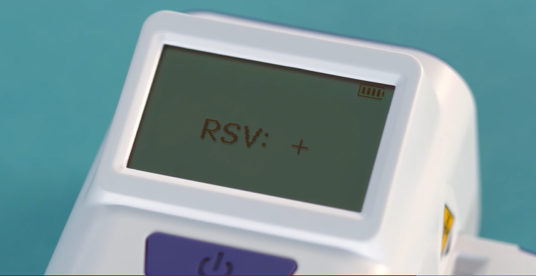
PRINTING RESULTS
When analysis is complete a result appears in the display window and the result will automatically print on the attached printer.
The analyzer does not store test results, so it is very important to verify that the printer is on and ready to print prior to starting a test. Results cannot be reprinted.
Results will disappear from the display screen as soon as the device is removed from the analyzer.

Slide 27
TEST PRINTOUTS
Please note: On test printouts the time is displayed in UTC (Universal Time Coordinated) which is 5 hours ahead of Eastern Standard Time (4 hours ahead during Daylight Savings Time). This is pre-programmed into the BD Veritor and cannot be changed.

Slide 28

INTERPRETATION OF RESULTS
Test results must NOT be read visually. The BD Veritor Plus analyzer must be used for interpretation of all test results.
The following chart shows the possible test results displayed by the BD Veritor and the interpretation for each one:

Slide 29
INTERPRETATION OF RESULTS
POSITIVE TESTS - Positive for the presence of RSV antigen. A positive result may occur in the absence of viable virus.
NEGATIVE TESTS - Negative for the presence of RSV antigen. Infection due to RSV cannot be ruled out because the antigen present in the sample may be below the detection limit of the test. In the U.S., a negative test is presumptive and it is recommended that these results be confirmed by viral cell culture or an FDA-cleared RSV molecular assay if clinically indicated.
CONTROL INVALID - Do not report results. Repeat the test. If the test is invalid, the BD Veritor System Instrument will display “CONTROL INVALID” and the test or control must then be repeated. If the “CONTROL INVALID” reading recurs, contact Point of Care.

Slide 30
LIMITATIONS
The contents of this kit are to be used for the qualitative detection of RSV antigens from nasopharyngeal swabs.
The BD Veritor System for Rapid Detection of RSV is capable of detecting both viable and non-viable RSV particles.
The BD Veritor System for Rapid Detection of RSV performance depends on antigen load and may not correlate with other diagnostic methods performed on the same specimen.
Results from the BD Veritor System for Rapid Detection of RSV test should be correlated with the clinical history, epidemiological data and other data available to the clinician evaluating the patient.
A false-negative test result may occur if the level of viral antigen in a sample is below the detection limit of the test or if the sample was collected or transported improperly; therefore, a negative test result does not eliminate the possibility of RSV infection, and should be confirmed by viral cell culture or in the U.S., an FDA-cleared RSV molecular assay, if clinically indicated.
Positive test results do not rule out co-infections with other pathogens.
Negative test results are not intended to rule in other non-RSV viral or bacterial infections.
Monoclonal antibodies may fail to detect, or detect with less sensitivity, RSV viruses that have undergone minor amino acid changes in the target epitope region.
The performance of this test has not been evaluated for use in patients without signs and symptoms of respiratory infection.
The validity of the BD Veritor System for Rapid Detection of RSV test has not been proven for identification/confirmation of tissue culture isolates and should not be used in this capacity.
Therapeutic anti-RSV monoclonal antibodies may interfere with the BD Veritor System for Rapid Detection of RSV.
Performance characteristics have not been established for use with patients older than 5 years of age or for immunocompromised patients.

Slide 31
MAINTENANCE
The outer case and display may be wiped with a clean towel lightly moistened with 70% isopropyl alcohol or a 10% bleach solution.
Do not introduce the cleaning solution or any other liquids directly into the unit. Do not use a saturated towel which may introduce liquid into the case or display seams. Ensure that the BD Veritor Plus Analyzer is dry and the surface is free of any residual cleaning solution prior to returning to use.
Do not clean the barcode scanner window with any cleaning agent. Use a clean, soft towel lightly moistened with plain water to clean the window gently. Scratching the window may reduce the scanner’s performance.
There are no user serviceable components in the unit. For issues with the analyzer, contact Point of Care Testing in the Main Laboratory.

