Slide 1
NOVA Biomedical Stat Strip Glucose Hospital Meter System

Slide 2
CLIA and IFU
CLIA WAIVED
CLIA Complexity: This StatStrip Glucose Hospital Meter System is WAIVED under the Clinical Laboratory Improvements Amendments of 1988 (CLIA) and all applicable state and local laws must be met.
Facilities performing this test must have a Certificate of Waiver and must follow the manufacturer’s instructions for performing the test.
If a laboratory modifies the test instructions, the test will no longer be considered waived.
Intended Use
The StatStrip Glucose Hospital Meter System is also intended for point-of-care, in vitro diagnostic, multiple-patient use for the quantitative determination of glucose in capillary finger stick, venous whole blood, arterial whole blood, neonate arterial whole blood, and neonate heel stick specimens throughout all hospital and all professional healthcare settings, including patients receiving intensive medical intervention/therapy.
The system should only be used with single-use, auto-disabling lancing devices when performing a capillary finger stick or neonate heel stick.
It is not intended for use with neonate cord blood specimens.
It is not intended for the screening or diagnosis of diabetes mellitus but is indicated for use in determining dysglycemia.

Slide 3
Capillary Precautions
• Caution should be exercised when testing capillary whole blood due to potential pre-analytical variability in capillary specimen collection.
• A capillary whole blood specimen relies upon an adequate, non-compromised capillary blood flow. The healthcare provider must be aware that a capillary whole blood specimen glucose result may not always be the same as an arterial or a venous whole blood glucose result, especially when the patient's condition is rapidly changing.
• If a capillary whole blood glucose result is not consistent with a patient’s clinical signs and symptoms, glucose testing should be repeated on the StatStrip Glucose Hospital Meter System. If the repeated test does not match patient’s clinical presentation, consult provider about ordering a whole blood glucose STAT.
• When performing a capillary heel stick glucose test on a neonate, caution should be exercised to ensure adequate blood flow to the heel. Healthcare facilities should consider unswaddling the neonate, massaging and/or warming the heel prior to specimen collection.

Slide 4
Limitations
• The system has not been evaluated for use with neonate venous blood.
• Blood source - Use only whole blood. Do not use serum or plasma.
• Temperature and humidity extremes - Test results may be inaccurate when test strips are stored outside of the storage and handling conditions.
• Altitudes above 15,000 feet (4500 meters) above sea level have not been evaluated.
• Specimens - Only fresh whole blood or whole blood collected in lithium heparin collection devices should be used for arterial and venous specimens.
• Fluoride, EDTA, Sodium, and Ammonium blood collection devices should not be used for arterial and venous specimens.

Slide 5
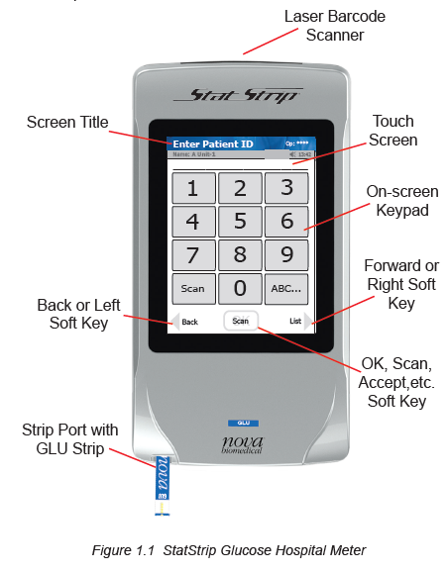
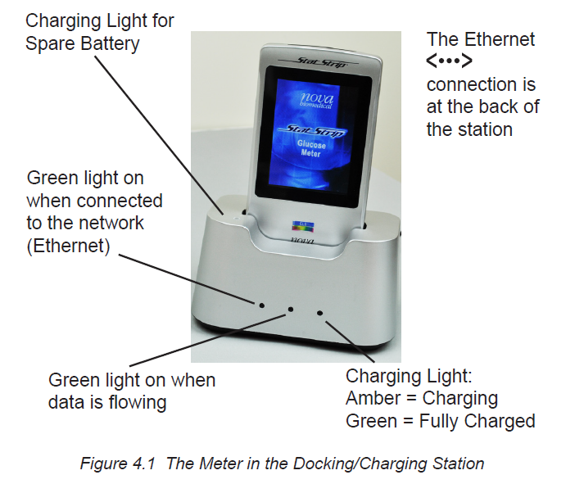
The StatStrip Glucose Hospital Meter System

Slide 6
Barcode Scanning
A built-in barcode scanner provides automated data entry. Patient ID's and lot numbers may be scanned into the meter.
To scan a barcode, hold the barcode label parallel to and approximately 2 to 6 inches from the scanner. Press the scan button on the touch screen. If the information appears on the screen at the top (Screen Title), the barcode has been successfully scanned. Press the Accept button.
WARNING: Do Not stare into the laser light or point the light towards anyone's eyes while scanning a barcode.

Slide 7
Meter Sleep/Wake Up
The meter’s LCD display turns off to conserve battery power (sleep mode) after a period of no activity.
Touch the screen to Wake Up the meter
The meter will display the last screen that was displayed before it went to sleep.

Slide 8
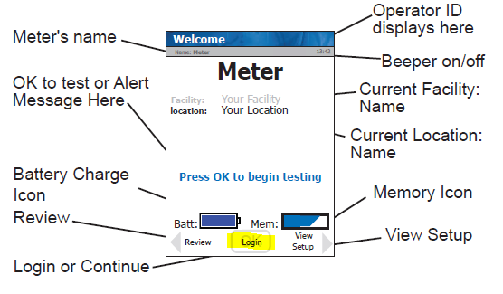
Welcome Screen
The Welcome screen displays information about the meter, such as the meter name, facility and location assigned to the meter, battery charge and memory storage.
If no one is currently logged into the meter, there is a Login button at the bottom of the screen.

Slide 9
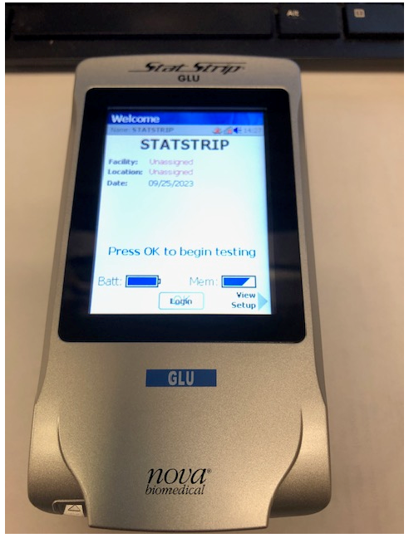
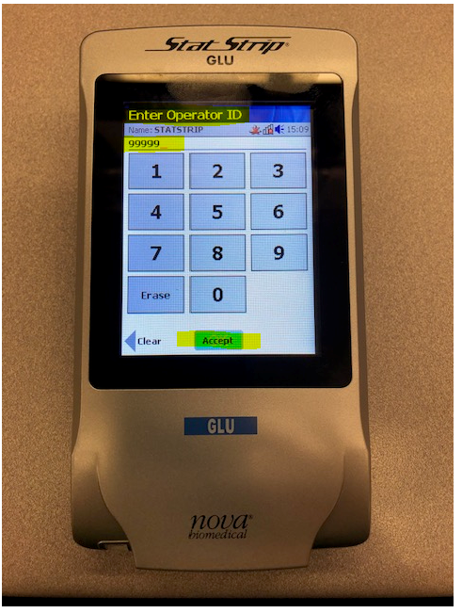
Logging Into The Meter
Every staff member should sign into the glucometer with their assigned operator ID number prior to performing any testing.
On the Welcome Screen- touch the Login Soft key.
Enter or scan your Operator ID
Select the Accept Soft key

Slide 10
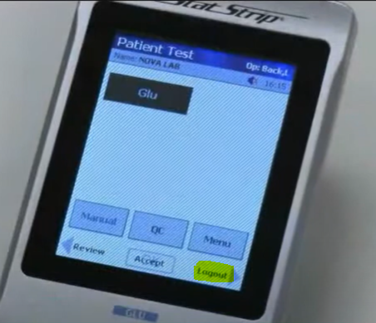
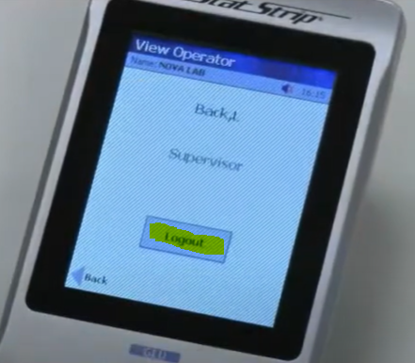
Logging Out Of The Meter
After testing patients, every operator needs to log out of the glucometer.
If you do not log out, the glucometer will keep your user ID on its screen and other staff could run patient testing under your user ID.
Select the Logout soft key on the bottom right of the display.
The View Operator screen displays.
Select Logout to confirm logging out of the glucometer.

Slide 11
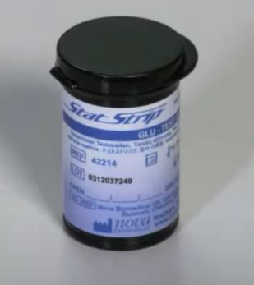
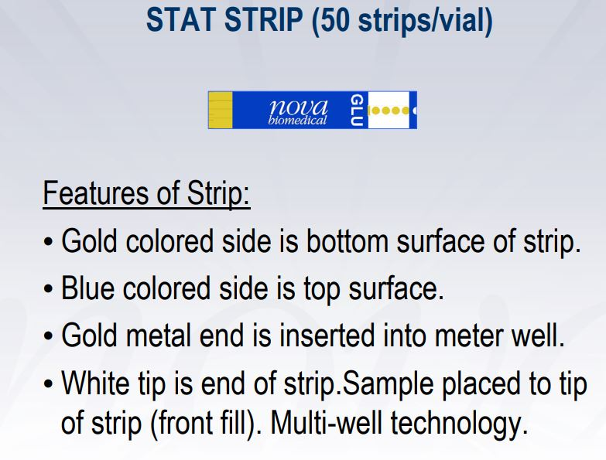
StatStrip Glucose Test Strips
Storage and Handling:
Test strips should only be stored in their original vial.
Keep the test strip vial tightly closed when not in use.
Test strips should be stored between 34-86°F (1-30°C). Do not freeze the test strips.
Test strips should be stored between 10-90% relative humidity (non-condensing).
Expiration:
The manufacturer’s expiration date is printed on the vial of test strips.
Once opened, the test strips are stable for 6 months or until manufacturer’s expiration date, whichever comes first.

Slide 12
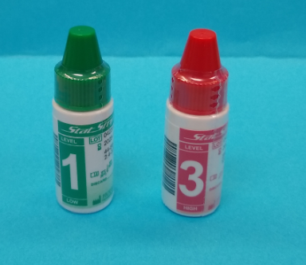
Quality Control (QC) Solutions
There are two levels of Nova StatStrip Glucose Control Solutions:
Level 1 (Low) - green capped bottle
Level 3 (High) - red capped bottle
The expected value range for the control is listed on each control vial.
Expiration:
The manufacturer’s expiration date is printed on the control vials.
Once opened, controls are stable for 3 months or until the manufacturer’s date, whichever comes first.
Both levels of control solutions must be run at least every 24 hours, and they must have acceptable results.
If the QC is not run within 24 hours or the QC failed, the meter will be locked and will not allow patient testing.

Slide 13
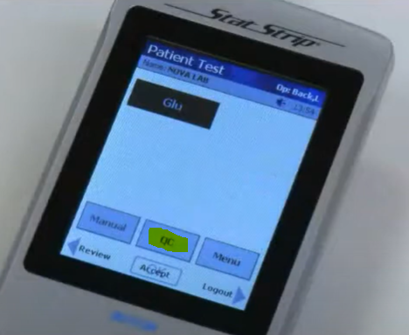
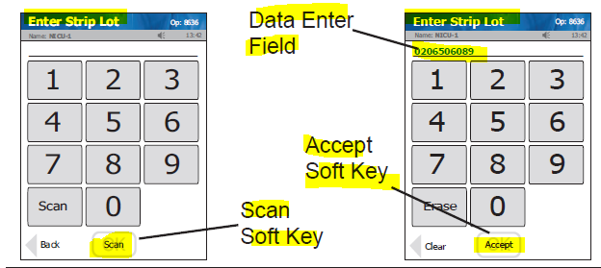
Running Quality Controls
From the Patient Test screen, press the QC soft key.
The Enter Strip Lot screen displays. Enter the Strip Lot Number by pressing the Scan soft key and scanning the barcode.
NOTE: If the Strip Lot Number is invalid, the screen displays the invalid number with “Is not a valid Strip Lot - Try again."
Press the Accept soft key if the lot number is correct.

Slide 14
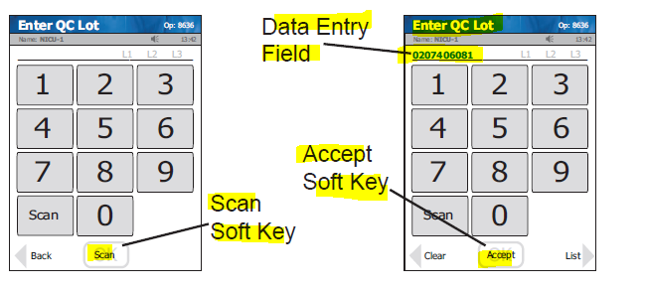
Running Quality Controls
The Enter QC Lot screen displays. Enter the QC lot number, by pressing the Scan soft key and scanning the barcode.
NOTE: If the QC Lot Number is invalid, the screen displays the invalid number with "is not a valid QC Lot # Try again.“
Press the Accept soft key if the lot number is correct.

Slide 15
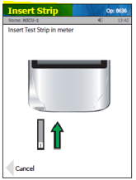
Running Quality Controls
The Insert Strip screen displays. Insert the gold end of the test strip into the strip port with the blue side facing up.
With the test strip correctly inserted, the Apply Sample screen displays.
Gently mix the StatStrip Glucose Control Solution before each use.

Slide 16
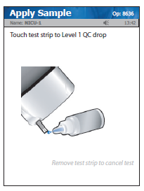
Running Quality Controls
Place a drop of control solution from the bottle to the end of the test strip until the solution is drawn into the well of the test strip. When enough sample has been drawn into the strip, an audible beep is sounded by the meter.
Recap the control solution. The Testing Sample screen displays. The screen shows a clock with seconds remaining below the clock.
When the meter completes the test, the QC Result screen will display PASS or FAIL.

Slide 17
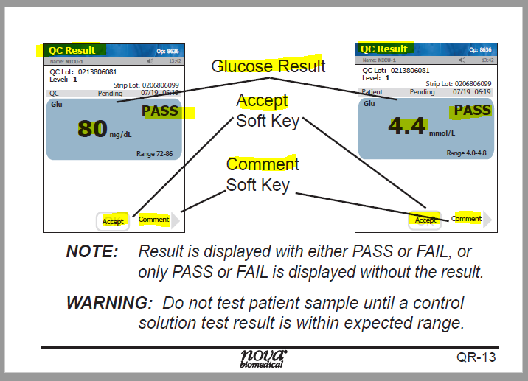
Running Quality Controls
Remove the strip manually or use the ejector button on the back of the meter to eject the strip directly into a biohazard container.
To add a comment to the result, press the Comment soft key.
To accept the results, press the Accept soft button.
Both levels of QC must PASS in order to perform patient testing.

Slide 18
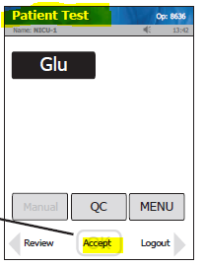

Running a Patient Sample
1. From the Patient Test screen, press the Accept soft key.
2. The Enter Strip Lot screen displays. Scan the strip lot number.
3. Once the Lot Number has been added, press the Accept soft key.

Slide 19
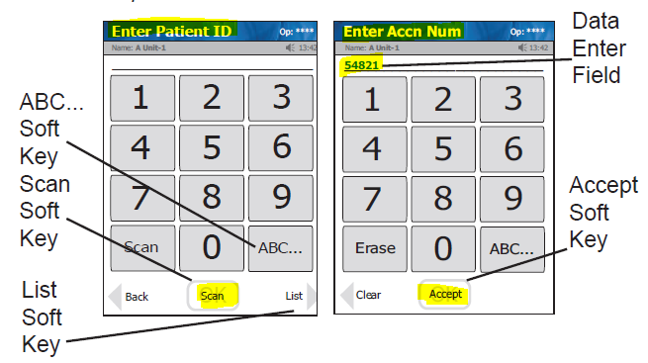
Running a Patient Sample
4. The Enter Patient ID screen is displayed:
  Hospital inpatients- scan the QR code on the patient’s wristband. Verify the FIN and patient demographic information that is displayed on the screen.
  CVOR , Main OR, Wound Health, Cath Lab- scan the chart label. Verify the FIN and patient demographic information that is displayed on the screen.
  Physician offices will manually enter the patient’s Medical Record Number.
5. After entering the patient ID, press the Accept soft key.

Slide 20
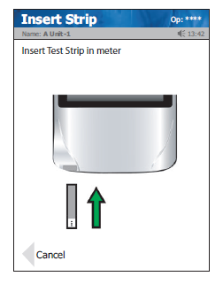
Running a Patient Sample
6. The screen will display Insert Strip. Insert the gold end of the test strip into the strip port with the blue side facing up.
7. The meter will display Apply Sample.
8. Perform the finger stick.

Slide 21
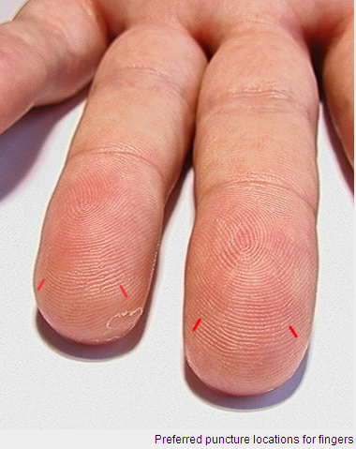
Performing the Fingerstick
Select a site on the pad of the fingertip, preferably on the middle or ring finger. (These fingers are less sensitive to pain than the index finger. Using the thumb or little finger presents a greater probability of injuring the bone. The area should be free of cuts, scars, and bruises.)
Warm the site if necessary.
Hold the patient’s selected finger so that the intended puncture site is facing upward.
Cleanse the selected site with alcohol and either allow to air dry or wipe with a clean, dry gauze.
Firmly position the lancet at the incision site on the finger (at 10 o’clock or 2 o’clock, perpendicular to the finger print lines).
Depress the firing pad on the side of the lancet to activate the incision device.
Remove the lancet from the finger. The incising blade will have already retracted into the body of the lancet.
Wipe away the first drop of blood with clean, dry gauze.
Apply gentle pressure again to form a second drop of blood.

Slide 22

Cleaning the Finger
If visibly soiled, the patient’s hands should first be washed with soap and water.
Clean the chosen finger with an alcohol swab.
Ensure the alcohol dries!
You can let the alcohol air dry or you may wipe it with a clean gauze.
Sugar residue on the fingers = False high glucose
Sugar residues from sweets and fruit can cause false high glucose results on a glucometer.
Be sure both your hands and the patient’s hands are clean and free of sugary residue.

Slide 23
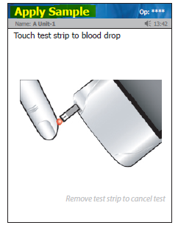
Running a Patient Sample
9. Touch the end of the test strip to the second drop of blood until the test strip fills. A quick beep sounds when sufficient sample has been added to the test strip.
10. The meter will count down for 6 seconds.
11. A long beep will sound when the results are ready, and the result will display on the Patient Result screen.

Slide 24
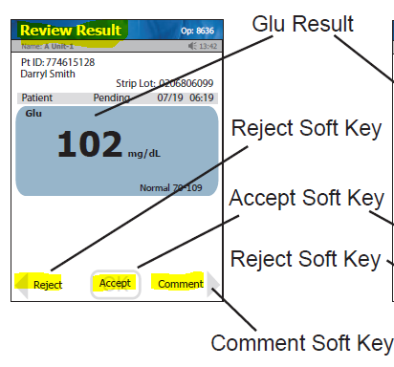
Running a Patient Sample
12. There are three options at the bottom of the Patient Result screen.
  ACCEPT - To accept the result, press the Accept soft key.
  REJECT - To reject the result, press the Reject soft key.
If a test result is in question, the test result should be Rejected and the test repeated with a new test strip.
Rejecting a test requires a comment. Press Reject and select a comment, then press OK. The selected comment is
now displayed on the Patient Result screen. Press Accept to process the result.
  COMMENT - To add a comment, press the Comment soft key.
Select one of the comments from the comments list, and then press the Accept soft key to place the comment onto the result. A critical result requires a comment-“Will Repeat Test”, “Notifying RN/MD”
All test results must be either Accepted or Rejected.

Slide 25
Running a Patient Sample
13. Remove the strip manually or use the ejector button on the back of the meter to eject the strip directly into a biohazard container. All used test strips are to be disposed of in proper waste receptacles.
14. Clean and disinfect the meter between patients.
15. Place the meter in the docking station when not in use.

Slide 26
Result Interpretation
Results that are within the normal reference range will display in blue.
Results outside the normal reference range will display in red with one or two arrows.
One arrow up ↑ or down ↓ is a high or low result.
Two arrows up ↑↑ or down ↓ ↓ is a Critical high or Critical low result.
A critical result requires a comment-“Will Repeat Test”, “Notifying RN/MD”.
Results displayed as LO or HI are outside the reportable range and are considered critical.

Slide 27
Reporting Results
Hospital Patients and Walk-In Urgent Care Result Reporting - Once a glucose result has been accepted in the glucometer, the result will cross to the electronic record via wireless or network connectivity.
Physician offices - Results for patient testing performed at the physician offices will be manually recorded into the HIS.
Reportable range (linearity): 18-500 mg/dL
Normal range: Refer to reference ranges in LIS
Critical Values:
0-7days: <30 or >200 mg/dL
7days–18yrs: <40 or >200 mg/dL
18+ yrs: <40 or >500 mg/dL

Slide 28
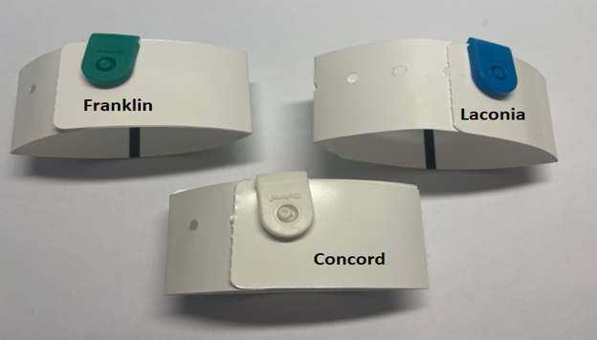
Invalid Patient ID
If Invalid Patient ID is displayed when entering the patient ID number, the meter cannot find patient information to match that ID number.
Verify that the correct ID number (patient FIN) is displayed on the screen.
Verify that the patient wristband has the correct color tab for your facility.
(If the patient wristband belongs to a different facility, this will prevent the glucose result
from crossing over to the patient’s chart.)

Slide 29
Invalid Patient ID
If the patient ID is correct on the display and the wristband belongs to the correct facility, press Downtime Override to continue with the test.
A patient that has just transferred to a floor may arrive on the unit before the transfer information has crossed in the computer system. By selecting Downtime Override, you can continue with the test and the glucose result should cross over to the patient’s chart.
If the patient ID number displayed on the screen is incorrect, scan the wristband again.
- Make sure that you are scanning the QR code on the wristband.
- Check the wristband to see if there is something wrong with the barcode.

Slide 30
Cleaning And Disinfecting The Meters
The meter is to be cleaned and disinfected after each patient test. Cleaning is not the same as disinfecting. To ensure proper disinfection, it is important to clean the meter prior to disinfecting the meter.
Clorox bleach wipes should be used to clean and disinfect the meters.
1. Clean the Meter
  Remove a fresh bleach wipe from the canister.
  Wipe the external surface of the meter thoroughly with the wipe.
  Discard the wipe into an appropriate biohazard container.
2. Disinfect the Meter
  Using a fresh bleach wipe, thoroughly wipe all surfaces of the meter a minimum of 3 times avoiding the barcode scanner and electrical connector. (Make sure that no fluid enters the test port.)
  Ensure the meter surface stays wet for 1 minute and then allow to air dry for 1 minute.
  Dispose of used wipe in a biohazard container.

Slide 31
Meter Maintenance
Keep the meter dry and avoid exposure to extremes in temperature.
Do not allow liquid to enter the strip port connector or allow pooling of liquid on the touch screen.
Do not spray the meter directly with solutions as this could cause the solution to enter the case and damage the electronic components.
Do not take the meter apart.
If the meter is dropped, inspect for obvious damage. Perform QC to ensure meter is functioning properly. QC results must be acceptable prior to performing patient testing.

Slide 32
Battery Maintenance
The meter needs to have the battery charged in the Charging Station when meter is not in use.
Each battery has an expiration date printed it. The battery will function beyond that date, but with lower maximum charge. Replace the battery when battery life in no longer acceptable for clinical use.
Replace the battery with Nova Biomedical batteries only. Using another battery may present a risk of fire or explosion.
Lithium batteries should not be thrown away in regular trash. Batteries should be given to Safety department for proper disposal.
Contact Point of Care Testing at ext 4643 or 4645 for battery issues or battery disposal.

Slide 33
Rebooting The Meter
If the meter appears to be frozen or will not wake up, the meter needs to be rebooted:
Remove the battery cover from the back of the meter by pulling back on the cover latch.
Grasp the sides of the battery near the top and remove the battery by pulling upwards.
Leave the battery out for approximately 10-20 seconds.
Reinsert the battery by inserting the bottom first, then push in the top of the battery.
(Make sure that the label on the battery is facing outward. You should be able to read the label when the battery is inserted correctly.)
Replace the battery cover.
Dock the meter in a downloader charging station if the date and time need to be reset.

Slide 34
Loaner Glucometers
If you experience any issues with your glucometer, loaner glucometers are available at all times by going to the drop-off window of the main laboratory.
There will be a form that you need to fill out describing the issues with your glucometer. A loaner glucometer will be given to you while Point of Care Testing troubleshoots the broken glucometer.
Contact Point of Care Testing in the Main Laboratory (ext 4643 and 4645) with glucometer issues.

